Slide 1
CS 3313 Foundations of Computing: Lab 9 – Asymptotic Notation

Slide 2
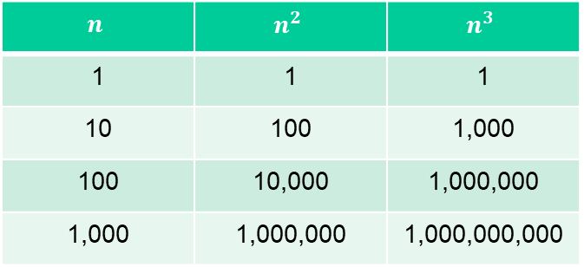
Time Complexity Background
In programming, we want to minimize the time it takes for our algorithms to run
By reducing the number of operations we need to compute, we see dramatic decreases in run-time
This is essential! We want things ASAP!
For example, consider the following:
$$n$$ | $$n^{2}$$ | $$n^{3}$$
1 | 1 | 1
10 | 100 | 1,000
100 | 10,000 | 1,000,000
1,000 | 1,000,000 | 1,000,000,000

Slide 3
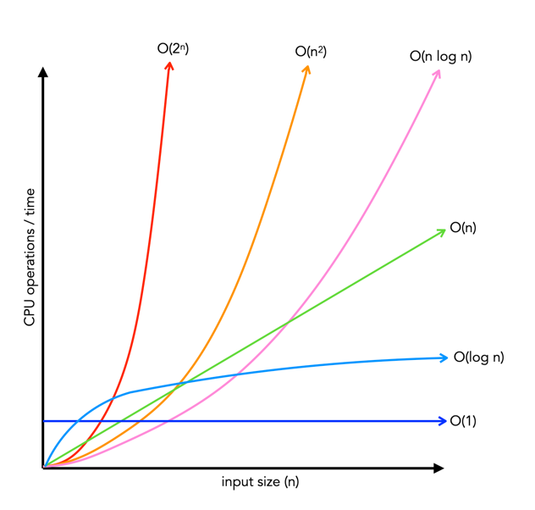
Asymptotic Notation
When we compare programs, we look at them asymptotically
This is because we are concerned with the growth in time of our functions as our value n (the number of elements we have) increases
We saw an example of this on the previous slide, where a higher power resulted in a higher growth rate
We can demonstrate this visually as well

Slide 4
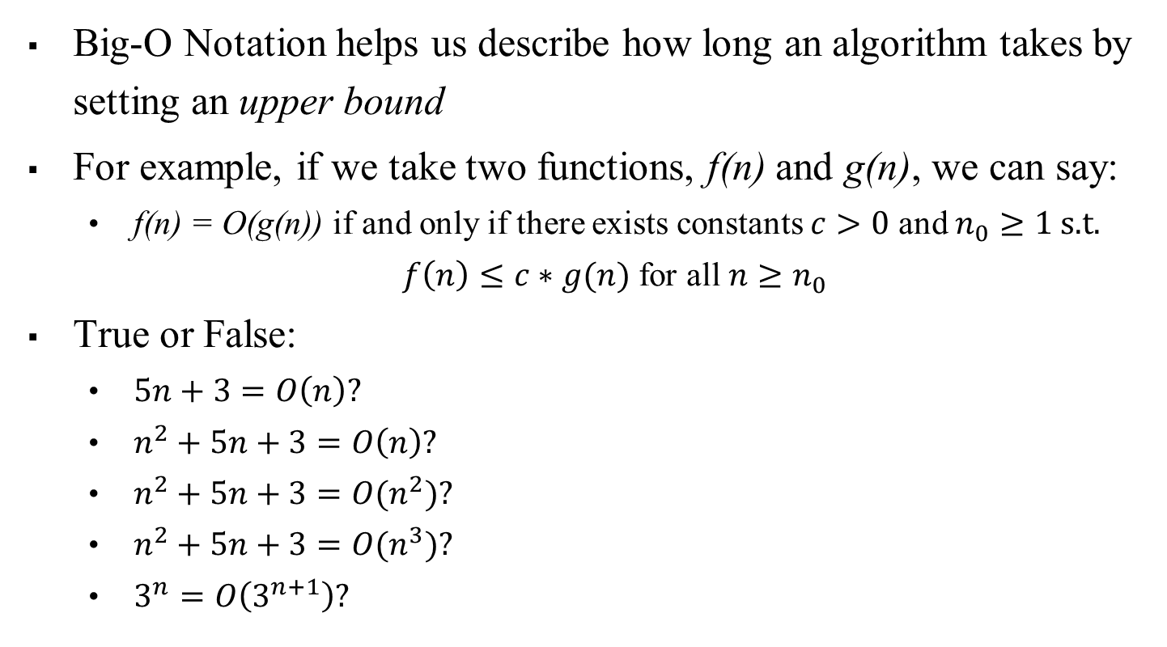
Big-O Notation
Big-O Notation helps us describe how long an algorithm takes by setting an upper bound
For example, if we take two functions, f(n) and g(n), we can say:
f(n) = O(g(n)) if and only if there exists constants $c>0$ and $n_{0}≥1$ s.t.
$f\left(n\right)≤c∗g(n)$ for all $n≥n_{0}$
True or False:
$5n+3=O\left(n\right)?$
$n^{2}+5n+3=O\left(n\right)?$
$n^{2}+5n+3=O(n^{2})?$
$n^{2}+5n+3=O(n^{3})?$
$3^{n}=O\left(3^{n+1}\right)?$
Notes:
Click 1
When we talk about problems, we use the term “decidable.” it means that there is an algorithm to answer its question – that is, a Turing machine that accepts the encoded instances of the problem for which the answer is “yes,” and halts without accepting the other instances.
So a decidable problem is really the same thing as a recursive language, if we think of the language as encoding a problem.
Click 2
The opposite of decidable is undecidable.

Slide 5
Big-O Notation
Now that we have defined what Big-O means, how can we show that this holds true as n increases?
The trick to this is through the induction proof technique
Notes:
Click 1
When we talk about problems, we use the term “decidable.” it means that there is an algorithm to answer its question – that is, a Turing machine that accepts the encoded instances of the problem for which the answer is “yes,” and halts without accepting the other instances.
So a decidable problem is really the same thing as a recursive language, if we think of the language as encoding a problem.
Click 2
The opposite of decidable is undecidable.

Slide 6
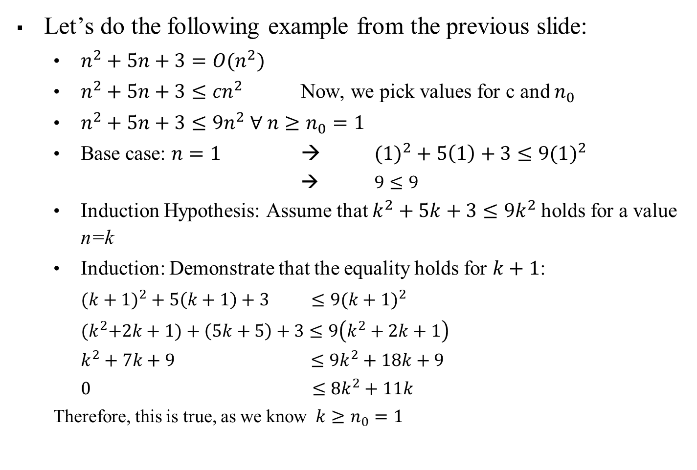
Big-O Notation: Induction Proof
Let’s do the following example from the previous slide:
$n^{2}+5n+3=O(n^{2})$
$n^{2}+5n+3≤{cn}^{2}$ Now, we pick values for c and $n_{0}$
$n^{2}+5n+3≤{9n}^{2} ∀ n≥n_{0}=1$
Base case: $n=1$ → $(1)^{2}+5\left(1\right)+3≤9(1)^{2}$
→ $9≤9$
Induction Hypothesis: Assume that $k^{2}+5k+3≤{9k}^{2}$holds for a value n=k
Induction: Demonstrate that the equality holds for $k+1$:
$(k+1)^{2}+5\left(k+1\right)+3 ≤9(k+1)^{2}$
${(k}^{2}+2k+1)+\left(5k+5\right)+3≤9\left(k^{2}+2k+1\right)$
$k^{2}+7k+9 ≤9k^{2}+18k+9$
$0 ≤8k^{2}+11k$
Therefore, this is true, as we know $k≥n_{0}=1$
Notes:
Click 1
When we talk about problems, we use the term “decidable.” it means that there is an algorithm to answer its question – that is, a Turing machine that accepts the encoded instances of the problem for which the answer is “yes,” and halts without accepting the other instances.
So a decidable problem is really the same thing as a recursive language, if we think of the language as encoding a problem.
Click 2
The opposite of decidable is undecidable.

Slide 7

Exercise 1:
$L_{1}=\left\{ww^{r} \right| w∈\left\{a,b\}^{∗}\right\}$
Give a 1-tape TM solution to solve this problem in $O(n^{2})$ time
Can we improve the time by having a 2-tape TM? If so, give a 2-tape TM solution and describe its time complexity
Notes:
Click 1
When we talk about problems, we use the term “decidable.” it means that there is an algorithm to answer its question – that is, a Turing machine that accepts the encoded instances of the problem for which the answer is “yes,” and halts without accepting the other instances.
So a decidable problem is really the same thing as a recursive language, if we think of the language as encoding a problem.
Click 2
The opposite of decidable is undecidable.

Slide 8
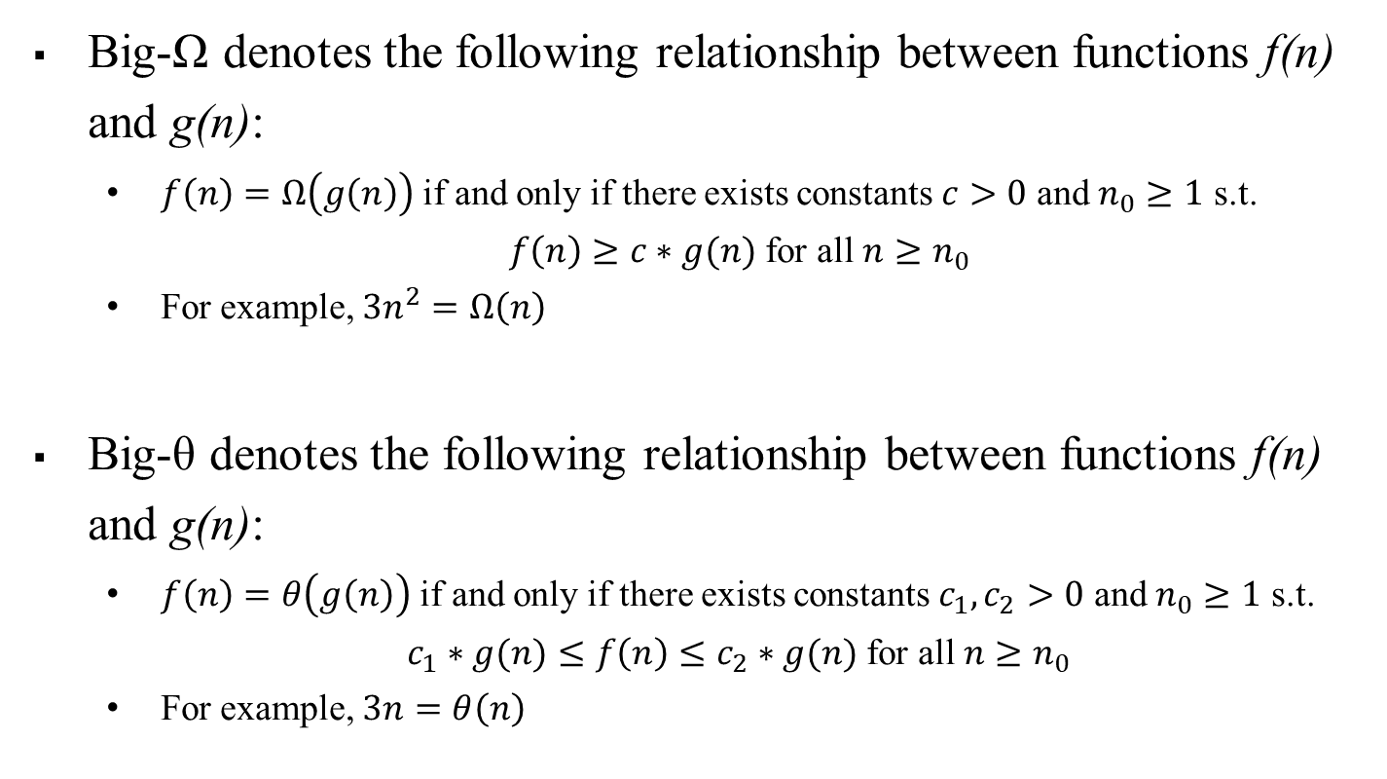
Big-Omega and Big-Theta (Big-Ω and Big-θ)
Big-Ω denotes the following relationship between functions f(n) and g(n):
$f\left(n\right)=Ω\left(g\left(n\right)\right)$ if and only if there exists constants $c>0$ and $n_{0}≥1$ s.t.
$f\left(n\right)≥c∗g(n)$ for all $n≥n_{0}$
For example, $3n^{2}=Ω\left(n\right)$
Big-θ denotes the following relationship between functions f(n) and g(n):
$f\left(n\right)=θ\left(g\left(n\right)\right)$ if and only if there exists constants $c_{1},c_{2}>0$ and $n_{0}≥1$ s.t.
$c_{1}∗g(n)≤f\left(n\right)≤c_{2}∗g(n)$ for all $n≥n_{0}$
For example, $3n=θ\left(n\right)$
Notes:
Click 1
When we talk about problems, we use the term “decidable.” it means that there is an algorithm to answer its question – that is, a Turing machine that accepts the encoded instances of the problem for which the answer is “yes,” and halts without accepting the other instances.
So a decidable problem is really the same thing as a recursive language, if we think of the language as encoding a problem.
Click 2
The opposite of decidable is undecidable.

Slide 9
Transformations Between Notations
Here, we see that these relationships are connected
For example, if f(n) = O(g(n)), then g(n) = Ω(f(n))
Why is this?
Additionally, if f(n) = O(g(n)) and simultaneously f(n) = Ω(g(n)), then f(n) = θ(g(n))
Why is this?
Notes:
Click 1
When we talk about problems, we use the term “decidable.” it means that there is an algorithm to answer its question – that is, a Turing machine that accepts the encoded instances of the problem for which the answer is “yes,” and halts without accepting the other instances.
So a decidable problem is really the same thing as a recursive language, if we think of the language as encoding a problem.
Click 2
The opposite of decidable is undecidable.

Slide 10

Exercise 2:
Prove or disprove the following:
$\frac{n\left(n+1\right)}{2}=Ω(n^{2})$
$\frac{n\left(n+1\right)}{2}=θ(n^{2})$
$2^{2n}=O(2^{n})$
Notes:
Click 1
When we talk about problems, we use the term “decidable.” it means that there is an algorithm to answer its question – that is, a Turing machine that accepts the encoded instances of the problem for which the answer is “yes,” and halts without accepting the other instances.
So a decidable problem is really the same thing as a recursive language, if we think of the language as encoding a problem.
Click 2
The opposite of decidable is undecidable.

