Slide 1


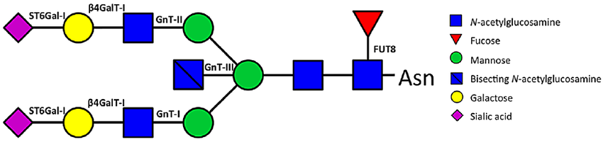
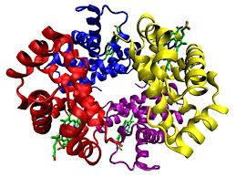
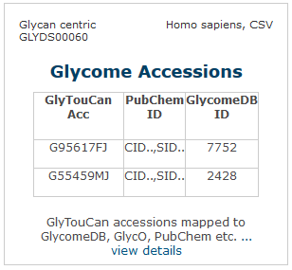


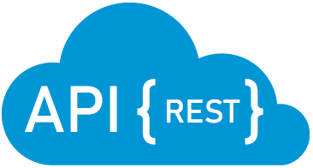

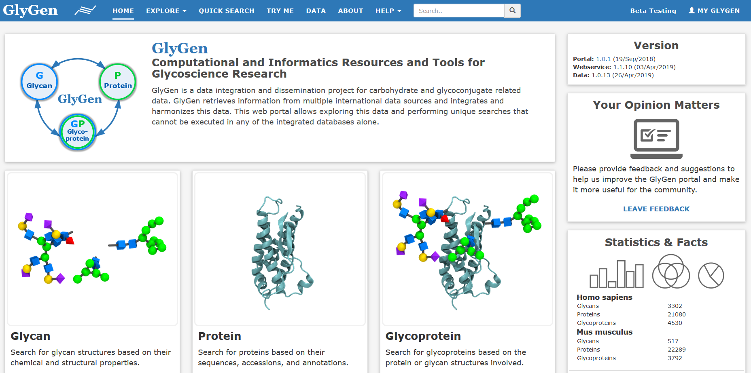



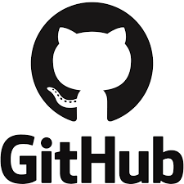
Computational and Informatics Resources for Glycoscience
PI: Raja Mazumder
The George Washington University
Search - Explore
PI: William York
CCRC, University of Georgia
Glycan Search
Protein Search
Glycoprotein Search
Data Collection
Data Access
Searches by glycan/protein/glycoprotein
Data can be accessed via data page (data.glygen.org), APIs (api.glygen.org) and SPARQL endpoint (sparql.glygen.org)
Data collection from multiple international resources with metadata
Quick Search
License and Repository
Data License
Source Code License
GitHub Repository
Quick search to answer user specific questions in glycan, protein, glycoprotein and disease domain
https://github.com/glygener
Open license for data and source code
Funded by: NIH Common Funds Glycoscience Program Grant U01 GM125267-01

