Slide 1
Data Structures
http://lxr.free-electrons.com/source/include/linux/list.h

Slide 2
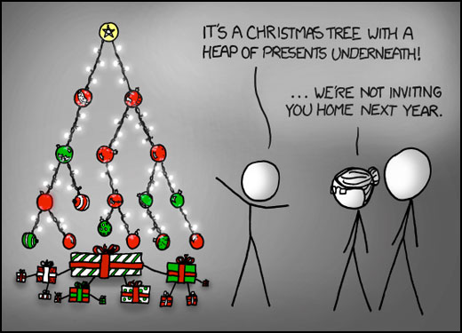

Slide 3
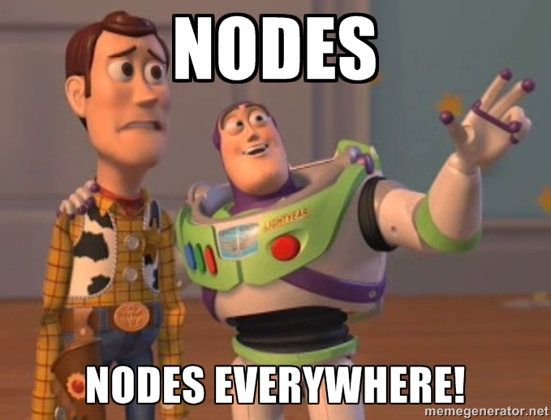
Data Structures Covered
Arrays
Linked List
Queues
Stacks
Radix Tree
Hash Maps

Slide 4
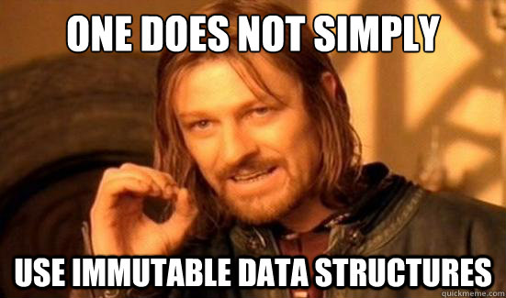
Why Data Structures?
Storage
Searching
Sorting

Slide 5
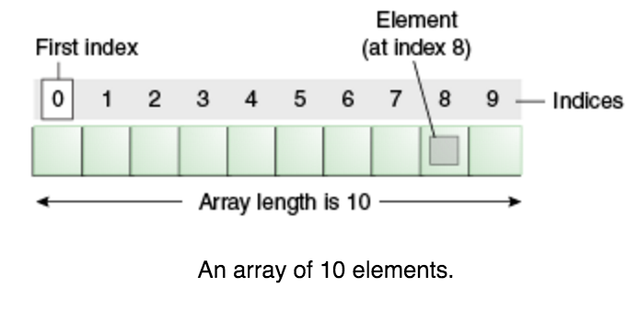
Arrays
An array is a container object that holds a fixed number of values of a single type. The length of an array is established when the array is created. After creation, its length is fixed.
https://docs.oracle.com/javase/tutorial/java/nutsandbolts/arrays.html

Slide 6
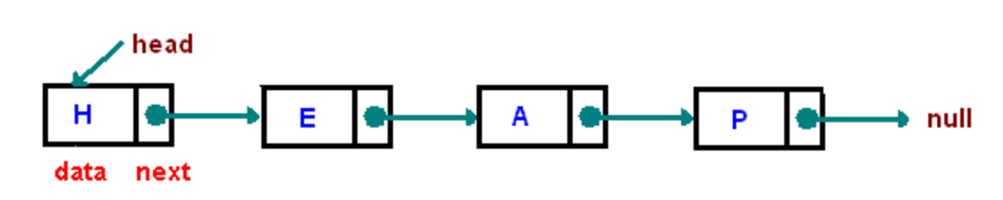
Linked List
A linked list is a linear data structure where each element is a separate object.
https://www.cs.cmu.edu/~adamchik/15-121/lectures/Linked%20Lists/linked%20lists.html

Slide 7
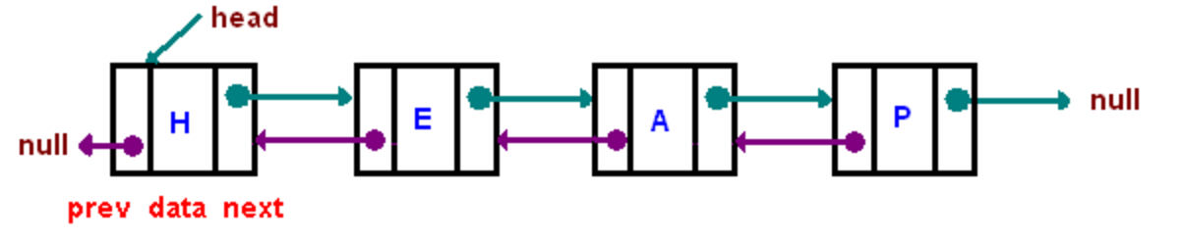
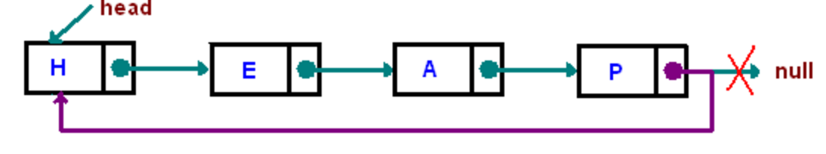

Types of Linked Lists
Singly linked list
Doubly linked list
Singly Circular Linked List
Doubly Circular Linked List
https://www.cs.cmu.edu/~adamchik/15-121/lectures/Linked%20Lists/linked%20lists.html

Slide 8
Lists and Arrays
Lists and Arrays are two of the most fundamental data structures in Computer Science used to implement many other abstract structures such as stacks, queues, and trees.
No Meme ☹

Slide 9
Arrays vs. Linked List Big O
Average Time Complexity
 | Arrays | Linked List
Access | O(1) | O(n)
Search | O(n) | O(n)
Insertion | O(n) | O(1)
Deletion | O(n) | O(1)

Slide 10
Queues
A queue is a particular kind of abstract data type or collection in which the entities in the collection are kept n order and the principal operations on the collection are the addition of entities to the rear terminal position, known as enqueue, and removal of enetities from the from on the terminal position known as dequeue.
A queue is First-In-First-Out (FIFO) data structure
https://en.wikipedia.org/wiki/Queue_(abstract_data_type)

Slide 11
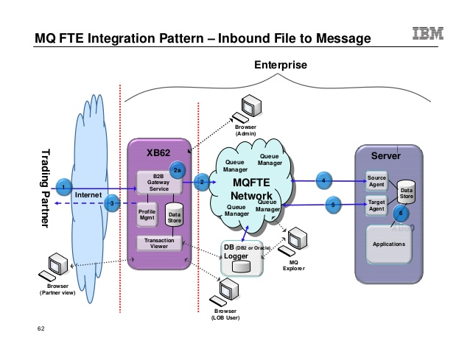
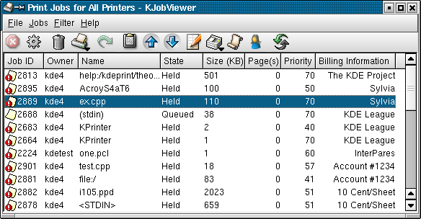
Common Uses of Queues

Slide 12
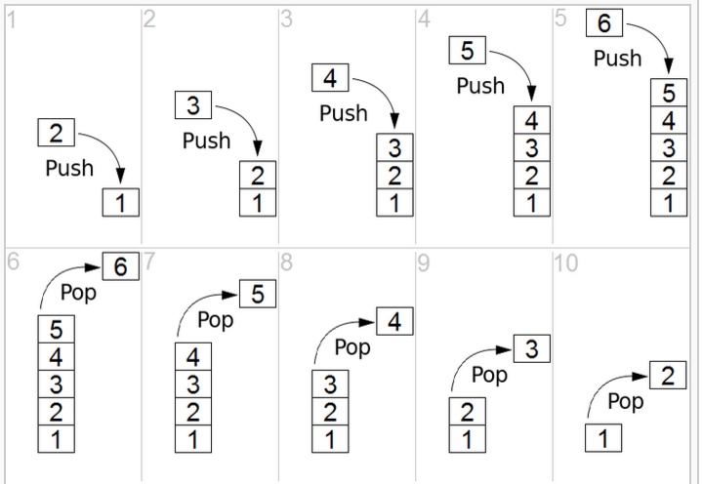
Stack
A stack is an abstract data type that serves as a collection of elements, with two principal operations push, which adds an element to the collection, and pop, which removes the last element that was added.
A stack is a
Last-In-Fist-Out (LIFO)
Data structure
https://en.wikipedia.org/wiki/Stack_(abstract_data_type)

Slide 13
Queues vs. Stacks Big O
Average Time Complexity
 | Queue | Stack
Access | O(n) | O(n)
Search | O(n) | O(n)
Insertion | O(1) | O(1)
Deletion | O(1) | O(1)

Slide 14
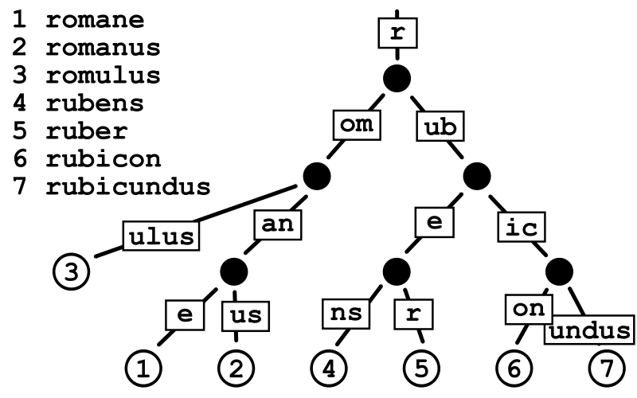
Radix Trees
A radix tree is a data structure that represents a space-optimized trie (pronounced tree) in which each node that is the only child is merged with its parent. The result is that the number of children of every internal node is at least the radix r of the radix trie, where r is a positive integer and a power of x of 2 having x>= 1.
https://en.wikipedia.org/wiki/Radix_tree

Slide 15
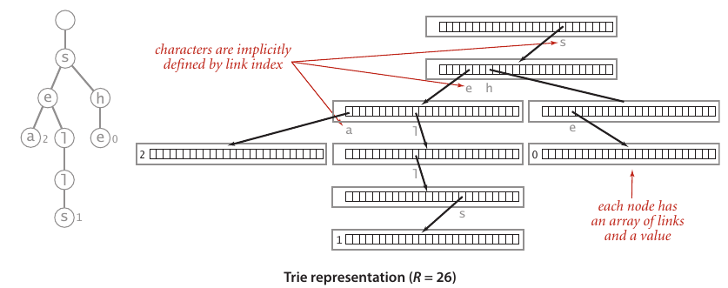
Where Are Radix Tries Used?

Slide 16

Composite OS http://composite.seas.gwu.edu

Slide 17
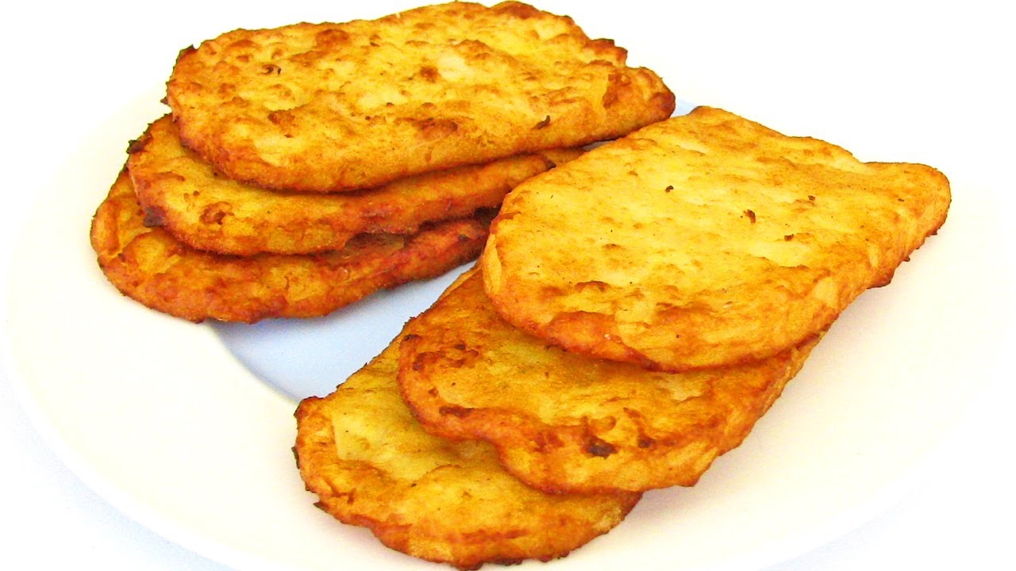
Hash Maps
I want hash browns instead.

Slide 18
Hash Maps
A hash map or hash table is a data structure used to implement an associative array, a structure that can map keys to values. A hash table uses a hash function to compute an index into an array of buckets or slots, from which the desired value can be found.
Ideally the hash function will assign each key to a unique bucket, but it is possible that two keys will generate an identical hash causing both keys to point to the same bucket.
https://en.wikipedia.org/wiki/Hash_table

Slide 19
Hash Table Big O
 | Average Case | Worst Case
Search | O(1) | O(n)
Insertion | O(1) | O(n)
Deletion | O(1) | O(n)

