Slide 1
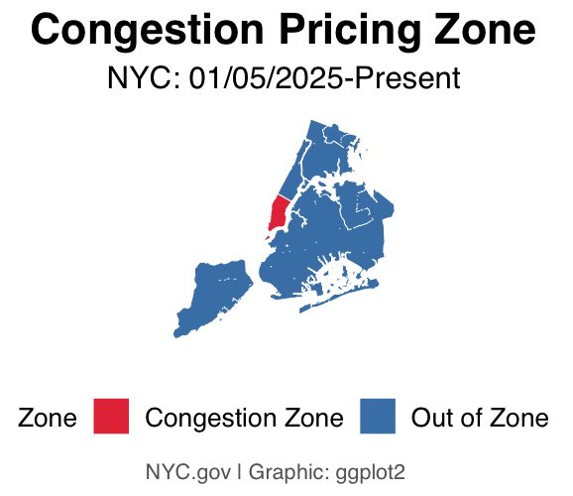
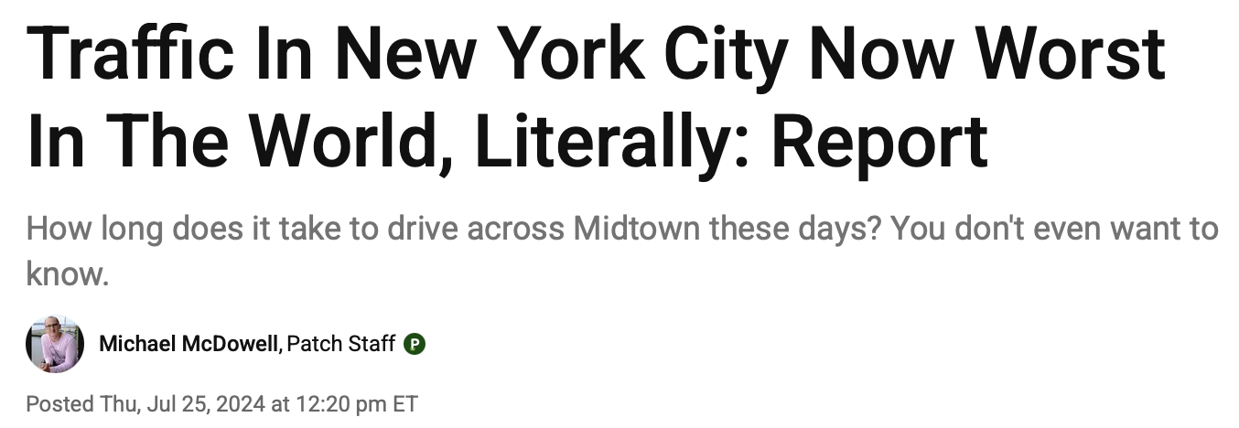
Credit: Patch News 2024
Did NYC’s Congestion Pricing Policy Reduce Traffic Accidents and Injuries?

Slide 2
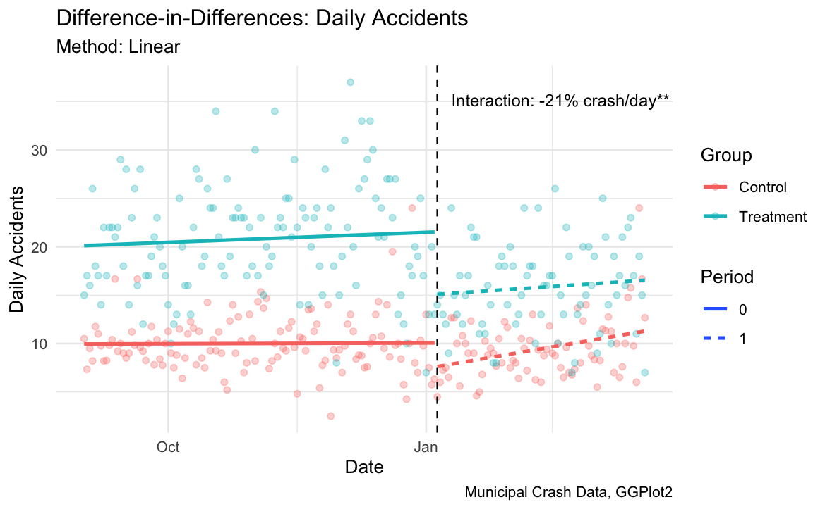
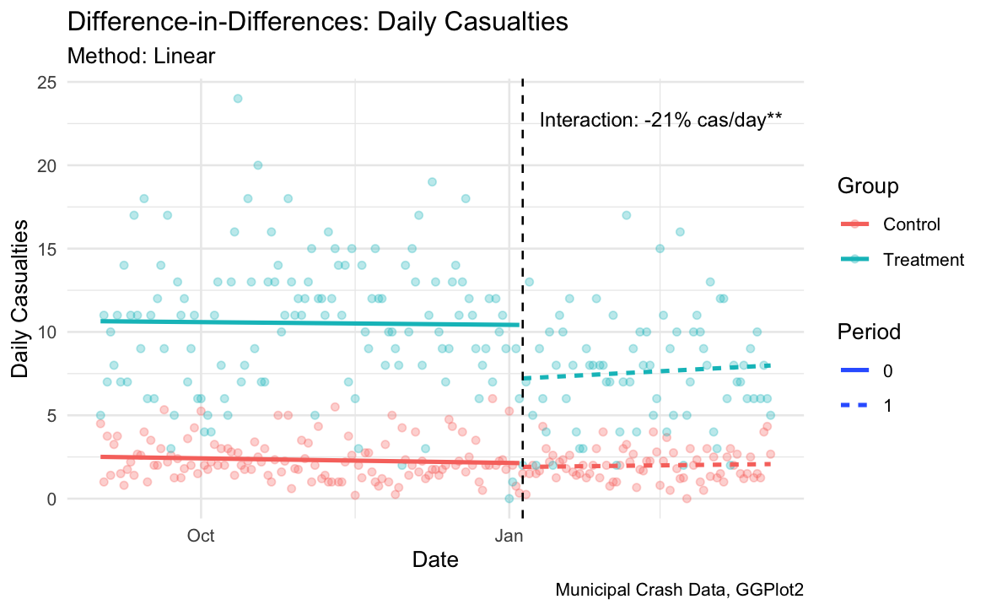
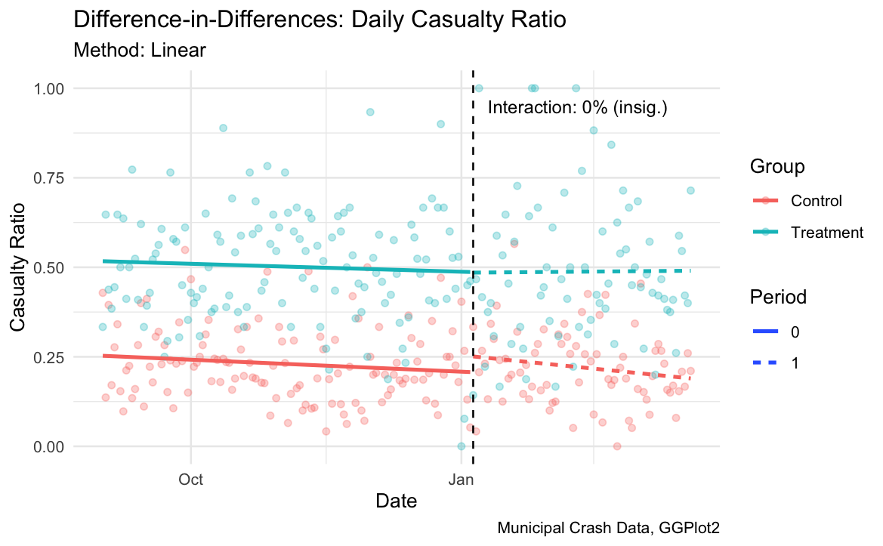
Method: Difference in Differences
Treatment: NYC Congestion Zone
Policy Date: 01/05/2025
Control: Boston, Chicago, San Diego, Seattle, DC

Slide 3
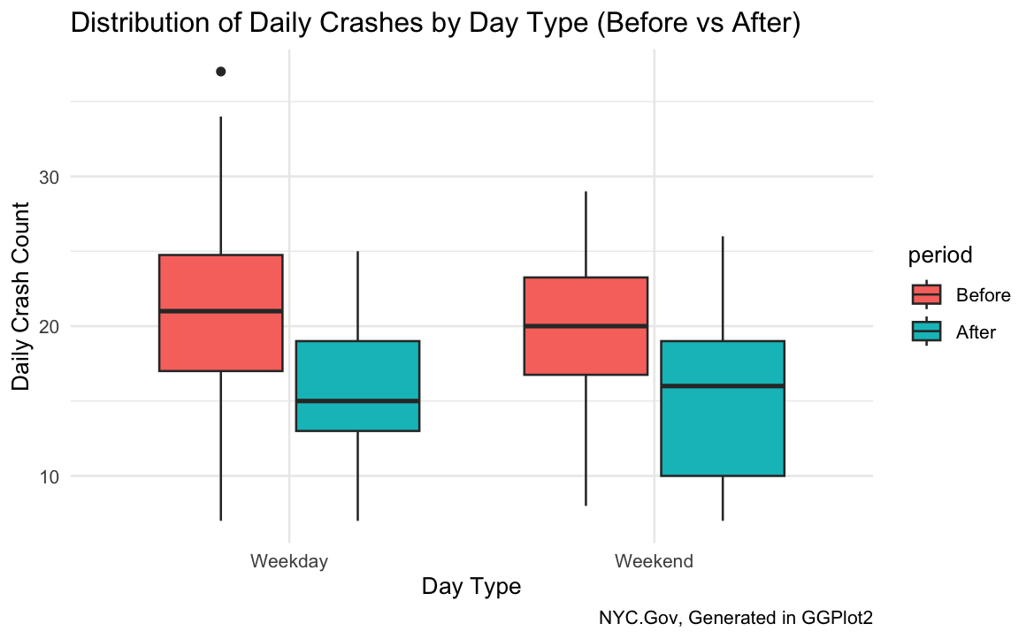
At this rate the zone will see:
1140 fewer crashes (21%, underestimate)
675 fewer casualties (21%)
$152 million averted damages
(Weekdays, annualized)
Credit: US DOT

