Slide 1
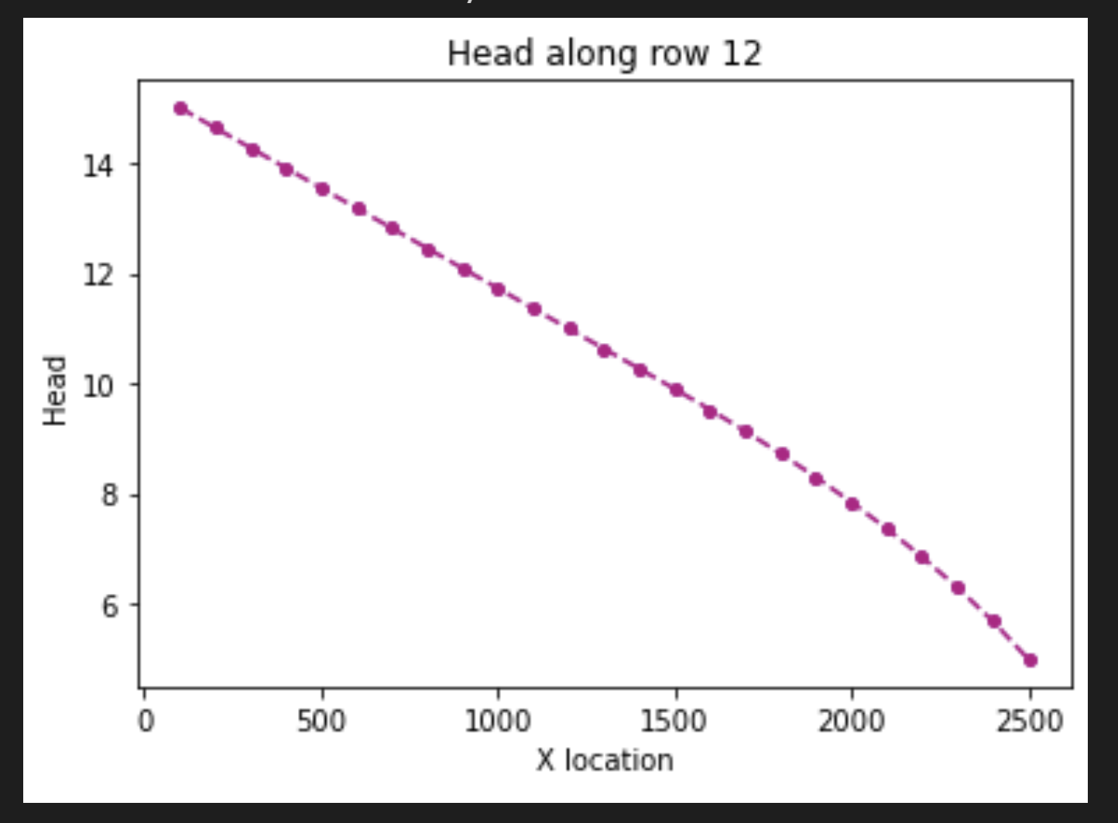
.
Aquifer thickness = 10
Confined
Unconfined

Slide 2
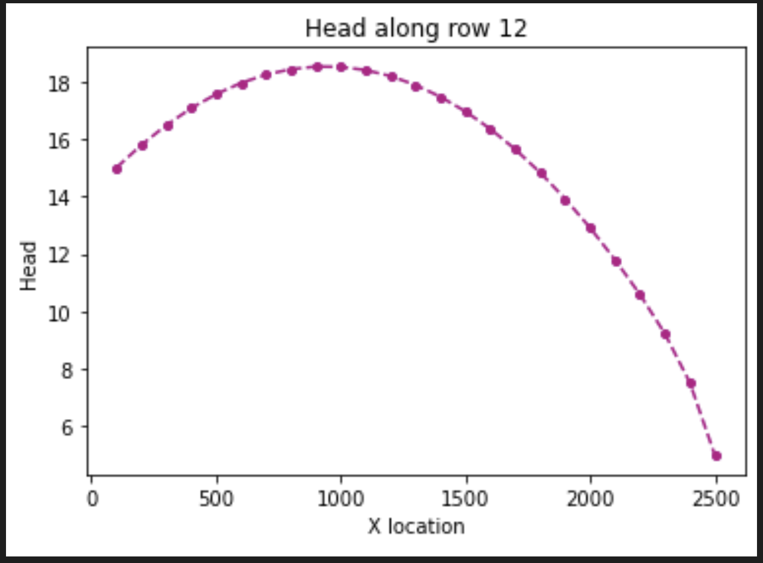
Flow to left
Flow to right
Curved: because needs to convey the extra water
Aquifer thickness = 10
Confined
Unconfined
Steep gradient: Harder to flow through this section (Desaturated, plus needs to convey extra water)

