Slide 1



Box Model – flopy Exercise
By: Danielle Rehwoldt & Matthew Ford

Slide 2
The Set-Up - Models
The model is first set up for a heterogeneous medium - a homogeneous medium with a centered, square low K inclusion.
Overall, we want to:
modify the K value of the inclusion and discuss the impacts on the head and boundary flux distributions.
assess how the domain-scale equivalent K depends on the background and inclusion K values.

Slide 3
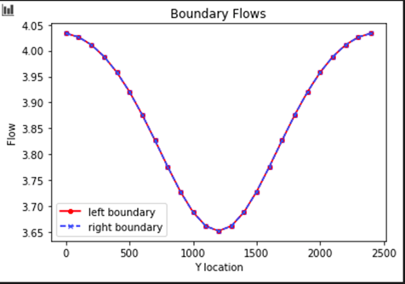
Model Results (Pt.1)
“For the initial values of background and inclusion K, plot the flow into the left and out of the right boundary.”

Slide 4
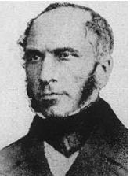
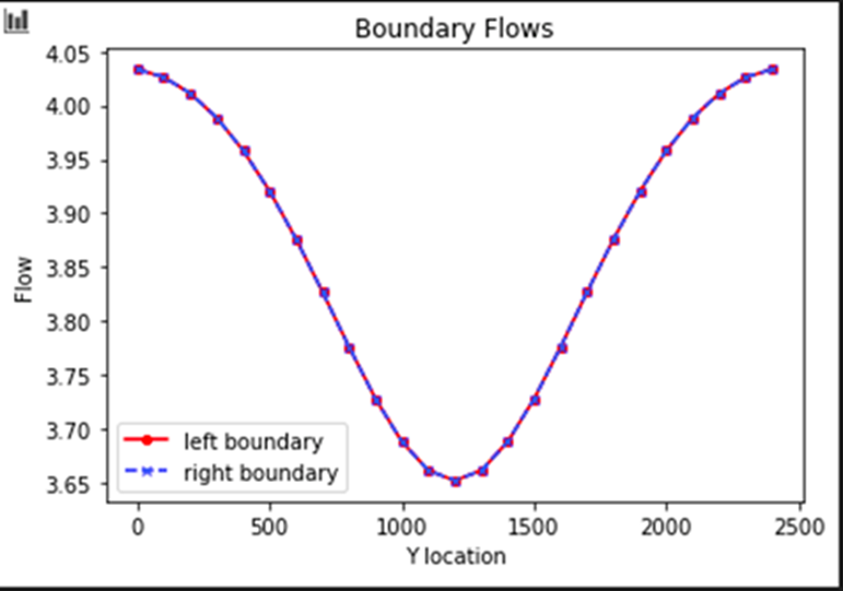
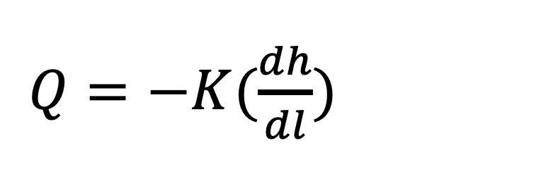
Model Results (Pt. 1 contd.)
$Q=−K(\frac{dh}{dl})$
“Explain why the values are not constant along the boundary”
Could you only model the top half of the system and still figure this out?
Notes:
This means at the boundaries of the domain, we see a constant head value on the left and righthand sides.
This is because flow must change as k changes and the system must maintain the input head value by making sure the rate of fluid going into and out of the system maintains the input head value.
POINTS TO FACILITATE DISCUSSION
Type 1 boundaries = Specified head values.
With an inclusion zone, K changes and lowers the flow as you approach the middle of the domain.
We could reduce the

Slide 5
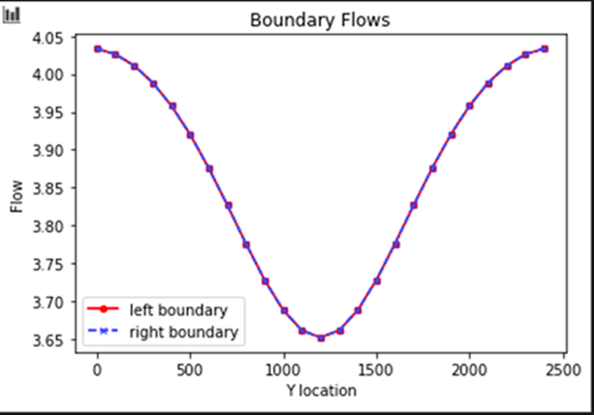
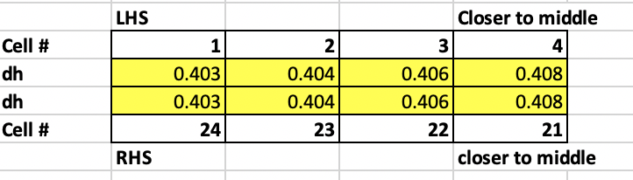
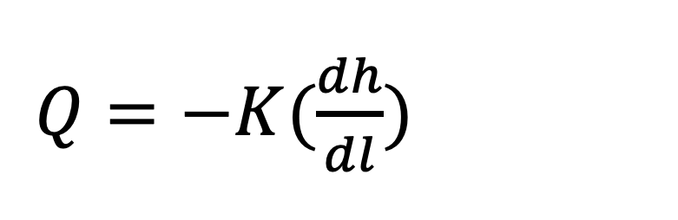
Model Results (Pt. 1 contd.)
HINT: Symmetry
“Explain why the flow distributions are the same for the left and right boundaries.”
$Q=−K(\frac{dh}{dl})$
What is this chart showing us?
Notes:
You maybe wondering if the dh is really the same at both end of the column. We can see in the excel figure that the dh at the LHS & RHS is equal. The change in length between cells is easy to understand and the K is easy to understand because is changes proportionally to distance because the is a symmetric flow area with a K inclusion zone.
Flow (Q) is equal at both boundaries because it has to satisfy darcy law
In this example: -K,dh,dl are all the same at both the left & right boundary because of the symmetric nature of this domain.

Slide 6
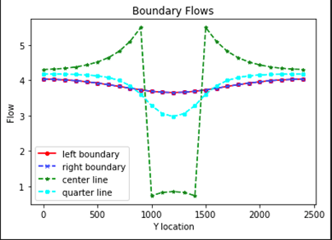
Model Results (Pt. 2)
“Add a plot of the left-to-right flow along a line that passes through the center of the inclusion. What can you learn from comparing this distribution to that seen on the boundaries?”

Slide 7

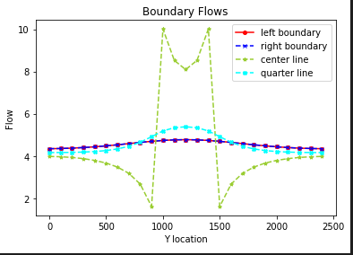
Model Results (Pt. 2 contd.)
“Add a plot of the left-to-right flow along a line that passes through the center of the inclusion. What can you learn from comparing this distribution to that seen on the boundaries?”
Which chart has the the K inclusion higher than the K background and why?
What does the ‘hump’ in the middle of the low K layer show us?
Why is the flow so HIGH right next to the K inclusion zone?
Notes:
With the center line going through the middle of the inclusion, we see a jump down in flow values. This is because with a smaller inclusion K value, the flow will decrease as the medium is more restrictive and allows less flow paths to meet.
With a starting inclusion k value of 0.1, we get this chart on top. K inclusion is smaller than our background K of one.
We expect inverse graphs if we were to make our K inclusion value greater than our background K. (shown on left)

Slide 8
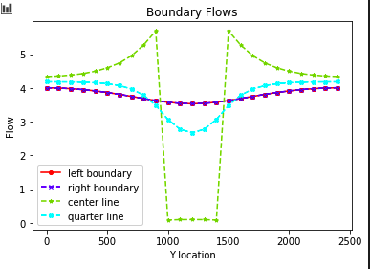
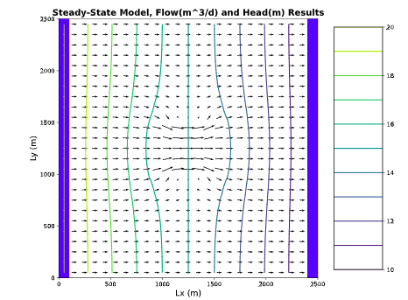
Do These Figures Match?
Why or Why Not?

Slide 9
K inclusion = 0.01
K inclusion = 100
If you got it correct. How did you figure it out? If you got it incorrect what did you miss?

Slide 10
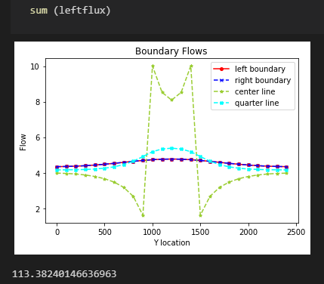

Model Results (Pt. 3)
We can see this in our code here for the 100 K inclusion value:
“Calculate the total flow into (and out of) the domain.”
How did you do this?
Notes:
By summing all the flows along a flowline, we found these flow values for each K inclusion value.

Slide 11
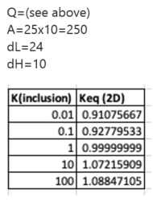


Model Results (Pt. 3 contd.)
“Use this to calculate the Keq of the heterogeneous system with the K values as given in the starter code. Repeat this calculation for the following K values for the inclusion (keeping the background K as it is given): 0.01, 0.1, 1, 10, 100.”
Given in previous slide
Notes:
Really explain how to do this calculate Keq with the model

Slide 12
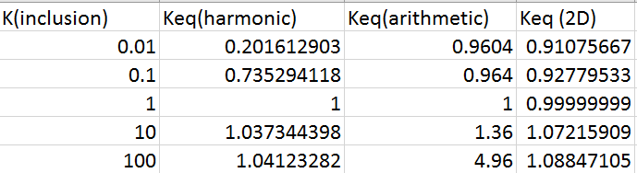
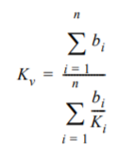
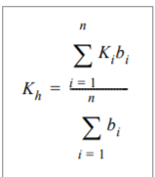
Model Results (Pt. 3 contd.)
“Compare the Keq to the harmonic and arithmetic mean K values based on the area occupied by each medium (rather than the length for a 1D system). Can you draw any general conclusions about the impact of high or low K heterogeneities on the equivalent K for the flow system examined?”

Slide 13
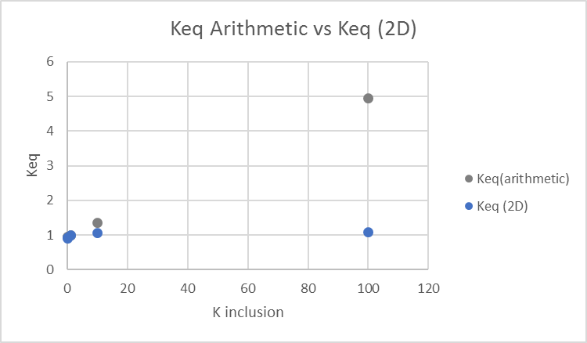
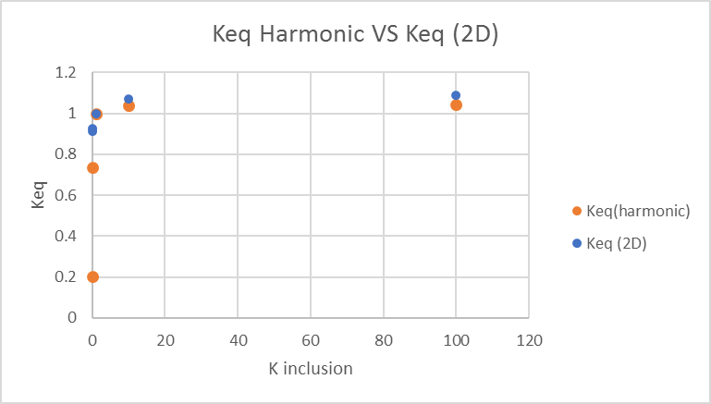

Model Results (Pt. 3 contd.)
What can we learn from these Keq plots?
(Look at the harmonic mean graph)
What does this tell us about the influence of high vs. low K inclusion zones?
Notes:
It seems like when you have extremely high or low values the actual Keq values can vary significantly from their calculated values. The for low K inclusion the Keq isn’t greatly affected by this small area. This makes sense because of preferential flow the flow lines will bypass this area in which it is hard to travel.
If K inclusion < 10, there is a stronger relationship between Keq and K inclusion in the area weighted arithmetic mean graph.
If K inclusion > 0.1, we see a strong correlation with the area weighted harmonic mean.

Slide 14
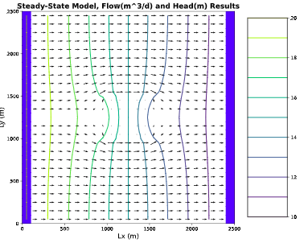
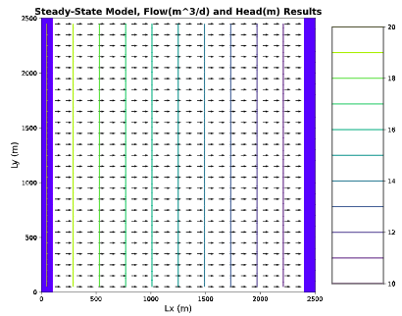
Model Results (Pt. 4)
“Does the equipotential distribution depend on the absolute or relative K values for the background and the inclusion? How would you use the model to test your answer?”
Could you show this using the Keq harmonic mean equation?
Would it matter if we changed the constant head value at 1 or both boundaries?
Notes:
How the head changes depends on the K of different areas of the medium and how the K values compare to other K values within the medium. Using a background K value of 10000 and K inclusion value of 0.0001, we see the clear distinction around the limiting K layer where the model squeezes. This is for the figure to the left. For the figure to the right, evenly spaced equipotential lines are shown as we have a homogeneous medium with the K inclusion values equaling the K background values. This shows that absolute K doesn’t necessarily show differences in equipotential values, but relative K does.
Equipotential distribution depends on the relative K values rather than the absolute values
The equipotential distribution shows the gradient of how the head changes.
K value is relative to the K of its “neighbors”

Slide 15
Questions?

Slide 16
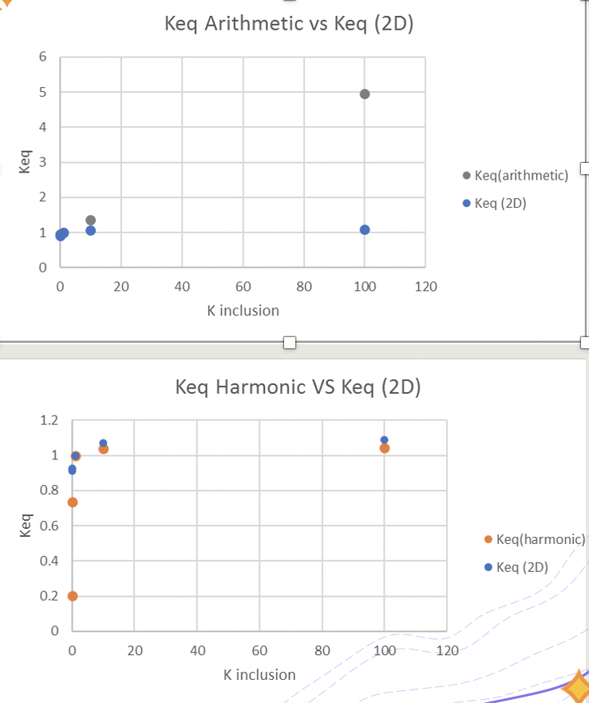
Breakouts
1. Explain why the Q values are NOT constant along the boundary & explain why flow distributions are the same LHS & RHS
2. What does the hump in the middle of the K inclusion show us? Why is Q so high right next to k inclusion?
3. What can we learn from Keq plots? Why does this tell us about influence of high vs. low K inclusion zones?

