Slide 1
Some notes on Vertical Layering in Modflow

Slide 2
You need multiple layers to simulate vertical flow
If you only have one layer in a model then flow is always parallel to the layer and there is NO potential for vertical flow no matter how you stress the model.
If you have only two layers you can calculate either an upward or a downward gradient of one magnitude (i.e. you can’t calculate a stronger gradient at one level vs another). You can’t calculate convergent flow.
If you want to calculate convergent flow you need at least 3 layers
Source: from Eileen Poeter (https://inside.mines.edu/~epoeter/583/07/discussion/grid_guide_vertical.htm)

Slide 3
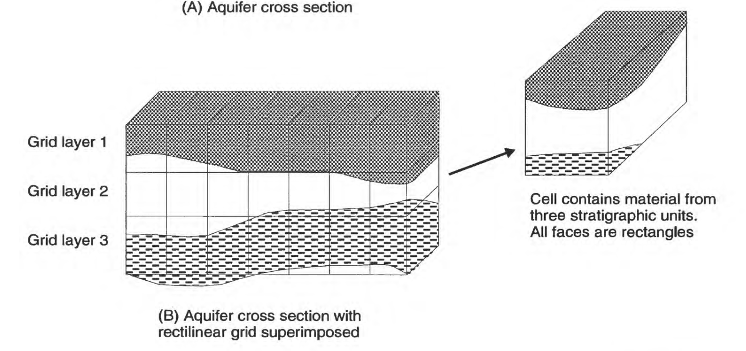
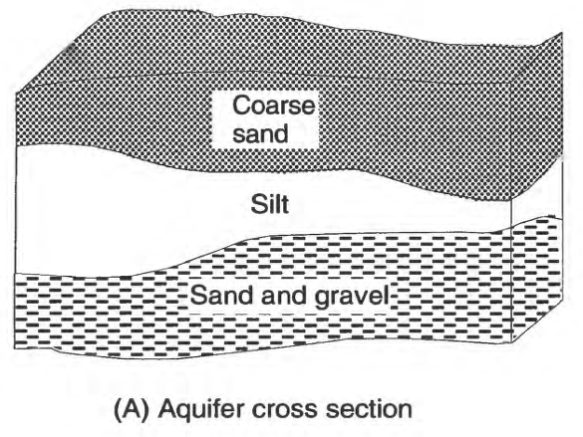
There are multiple approaches to vertical discretization
Rectilinear Grid
Source: USGS Open-File Report 94-343 (Harte, 1994)
https://pubs.usgs.gov/of/1994/0343/report.pdf

Slide 4
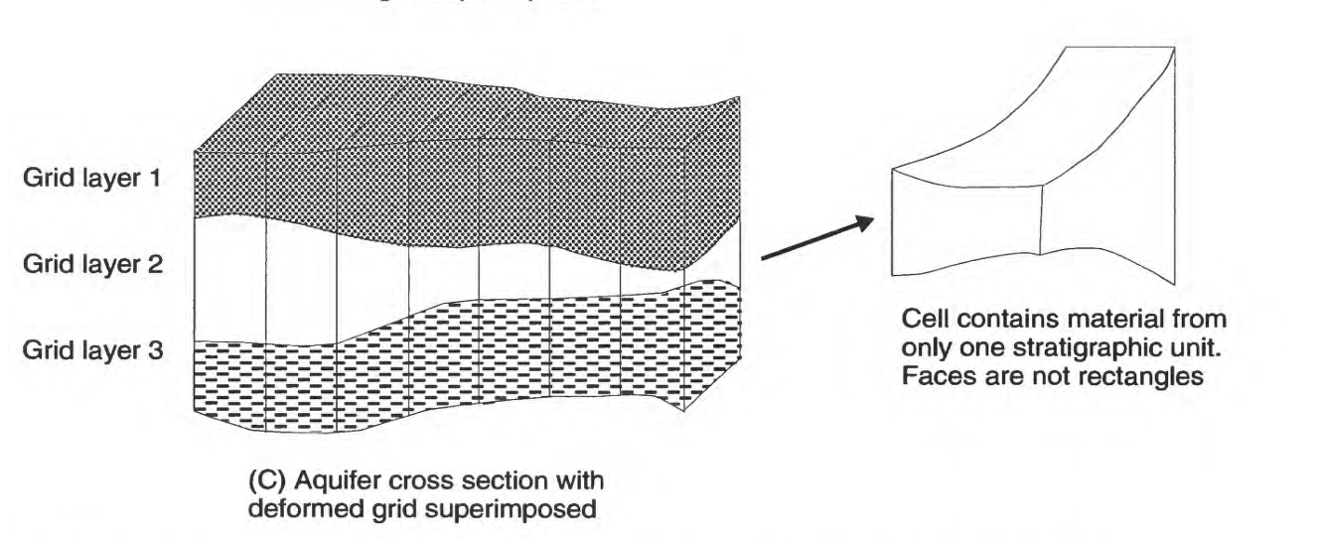
There are multiple approaches to vertical discretization
Deformed Grid
Source: USGS Open-File Report 94-343 (Harte, 1994)
https://pubs.usgs.gov/of/1994/0343/report.pdf

Slide 5
Some additional examples of grid types
https://www.waterloohydrogeologic.com/wp-content/uploads/PDFs/VisualMODFLOWFlex/VMOD_Flex_WhitePaper_Grid_Types.pdf
https://hatarilabs.com/ih-en/regional-groundwater-modeling-with-modflow-and-flopy-tutorial

