Slide 1
Homework 5: Recharge ME
HWRS 582
David E. Morales

Slide 2
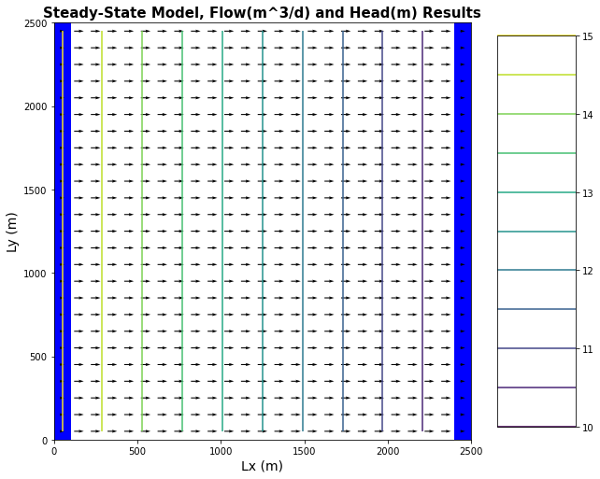
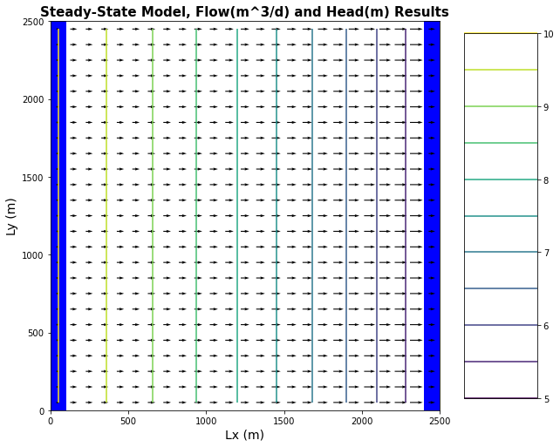
Challenge question 1:
1a. Confined: 15m-10m
1b. Unconfined: 15m-10m

Slide 3
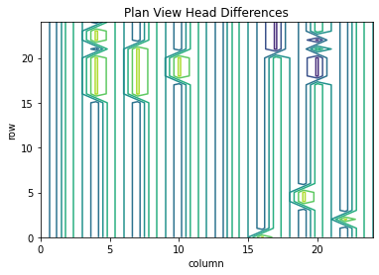
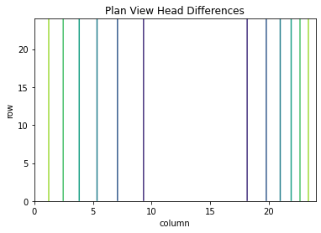
Challenge question 1:
1c. Confined: 15m-10m
1d. Unconfined: 15m-10m

Slide 4
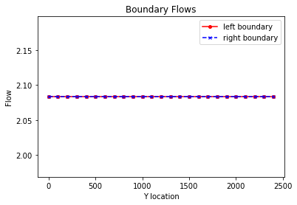
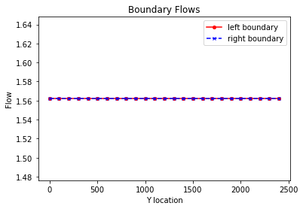
Challenge question 2:
2a. Confined: 15m-10m
2b. Unconfined: 15m-10m

Slide 5
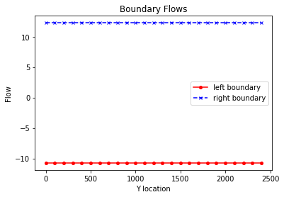
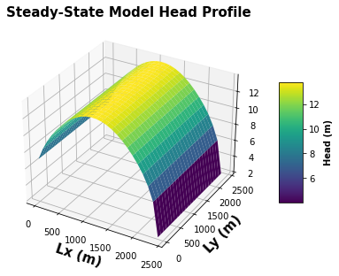
Challenge question 3:
3a. Outflow observed at both boundaries
3b. Complete area infiltration

Slide 6
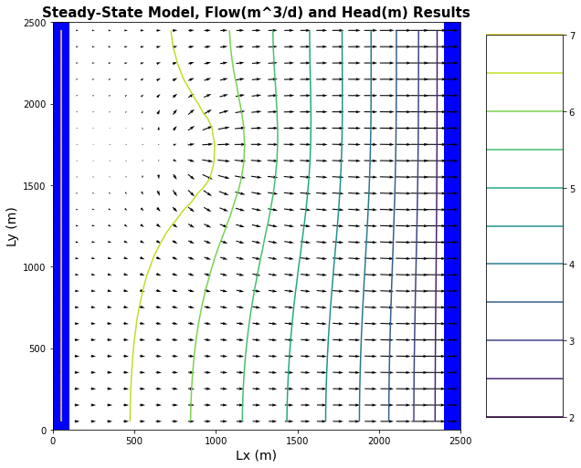


Challenge question 4:
4. Irrigation infiltration in NW corner

Slide 7
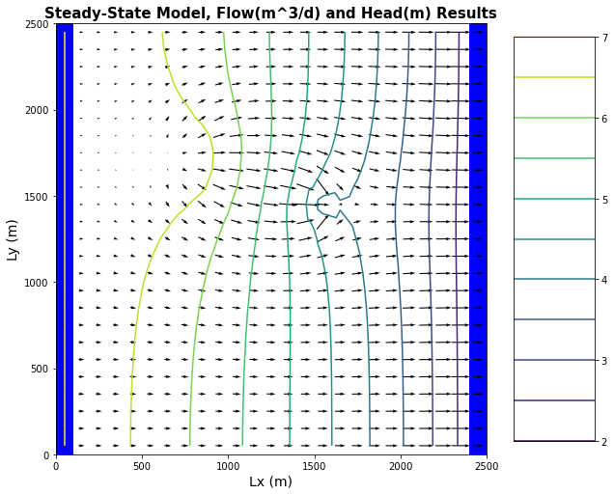




Challenge question 5:
5. Irrigation infiltration in NW corner + pumping well

