Slide 1
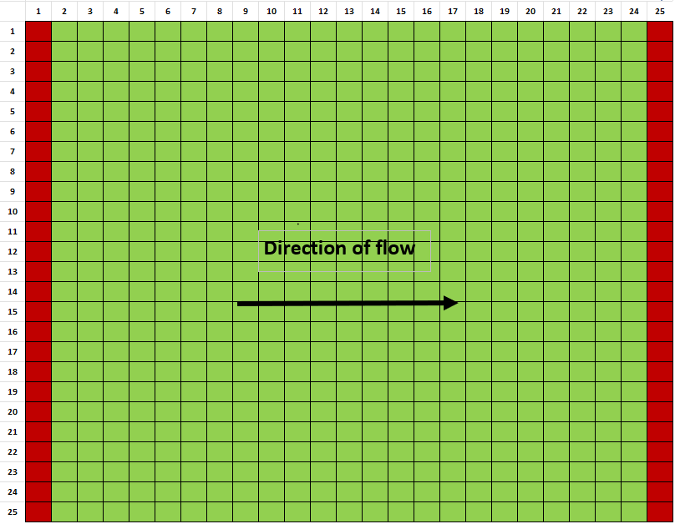
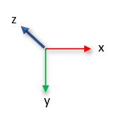
nx = 25 grid cells
dz = 10
dy = 100
ny = 25
grid
cells
Length Units = meters
Time units = days
y = 1400m
K = 1 m/d
y = 2000m
z = 10m
nz = 1 grid cell
z = 0m
dx = 100
Constant head boundary 15m
Constant head boundary 10m
X = 500m
X = 2000m

Slide 2
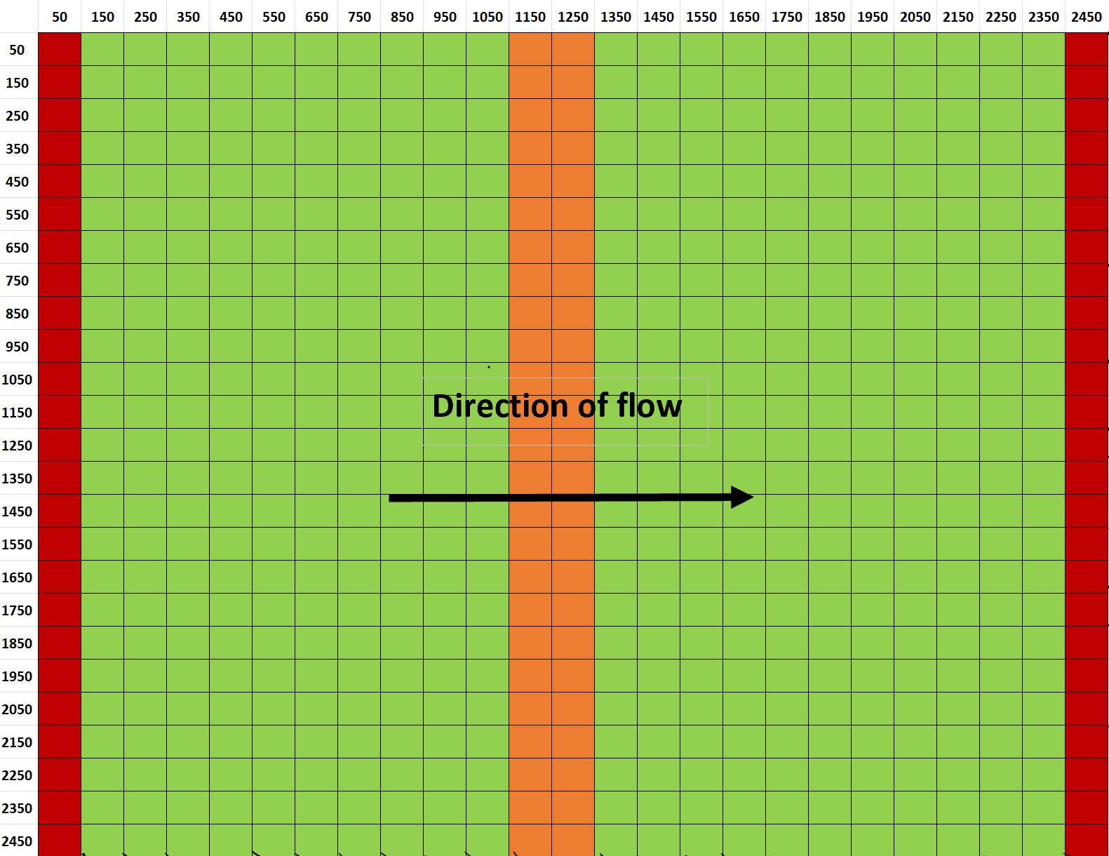
height (thickness)
K = 1 m/d
K = 0.1 m/d
K = 1 m/d
width
Length Units = meters
Time units = days
K = 1 m/d
10 m
length
Constant head boundary 15m
Constant head boundary 10m

Slide 3
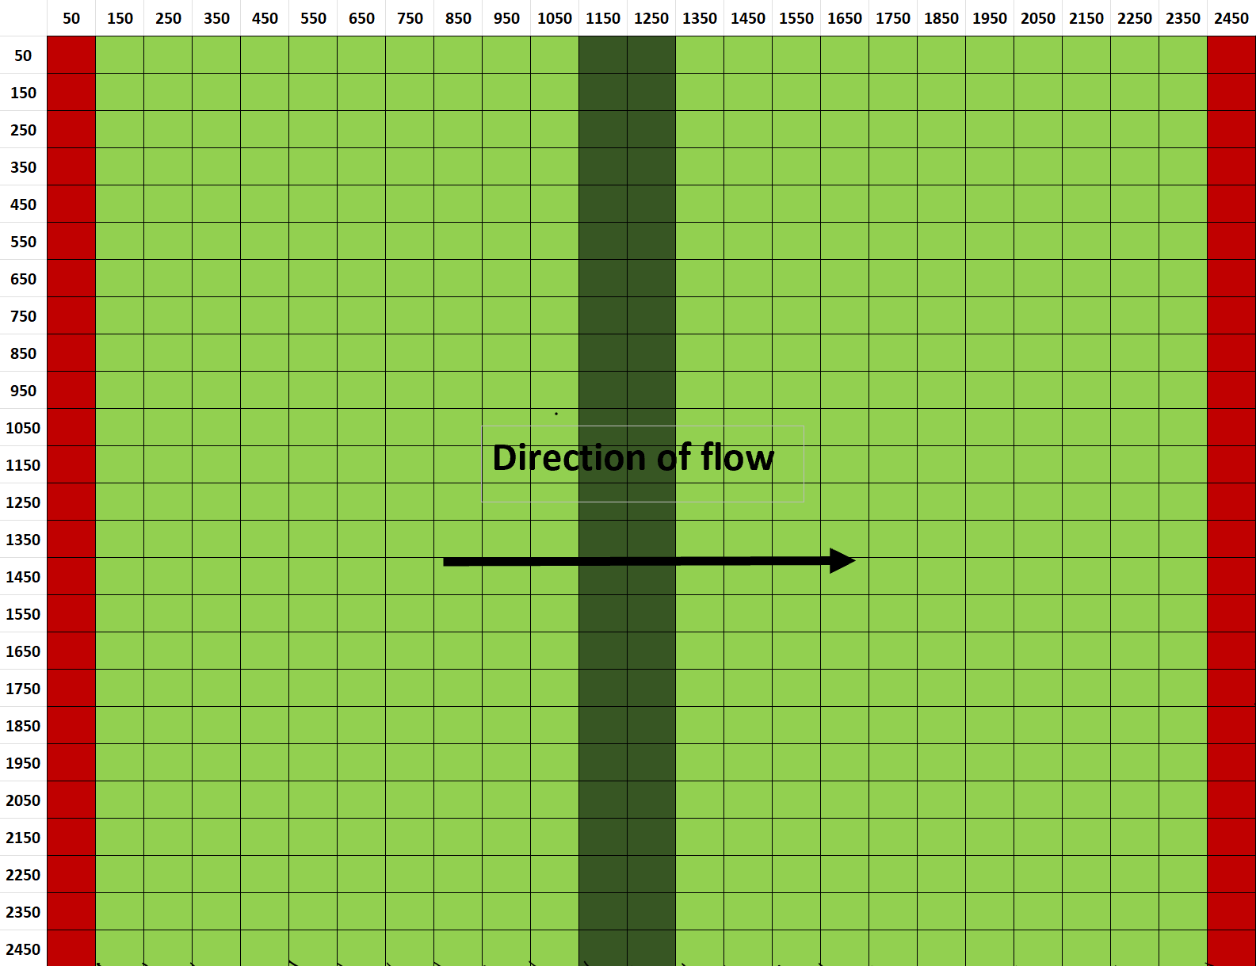
height (thickness)
K = 1 m/d
K = 10 m/d
K = 1 m/d
width
Length Units = meters
Time units = days
K = 1 m/d
10 m
length
Constant head boundary 15m
Constant head boundary 10m

Slide 4
height (thickness)
K = 1 m/d
K = 0.5 m/d
width
Length Units = meters
Time units = days
10 m
length
Constant head boundary 15m
Constant head boundary 10m

