Slide 1
Transpired
Diana, Justin, David
3/3/22

Slide 2
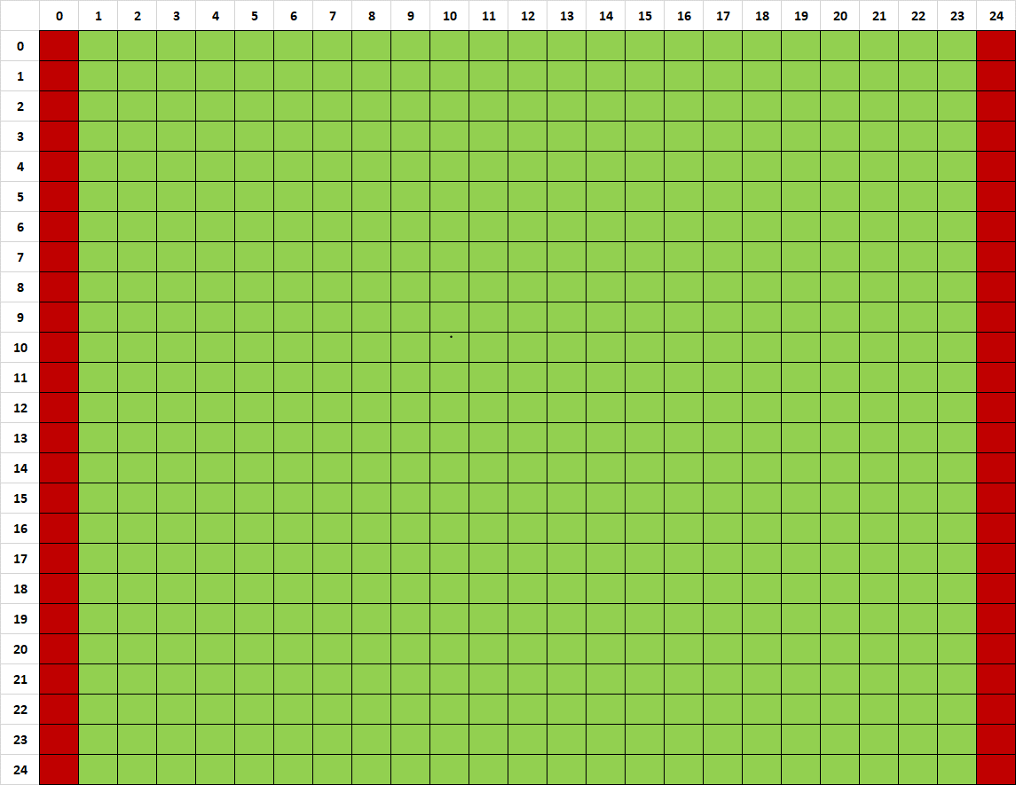
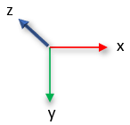
Overview
25 x 25 cell grid
dx and dy = 100 m. One vertical layer with dz = 15 m
Constand head boundaries & steady state
Left head 15 m, right head 5 m
Water table elevation less than aquifer thickness→ unconfined aquifer
Local area of recharge at [6:10,6:10]
Rate: 5*10⁻⁴ m / day / cell * 10,000 m² per cell * 16 cells = 80 m³ / day recharge
ET potentially across entire domain, if water table depth (WTD) < extinction depth in that cell
WTD = Vertical Layer Thickness (15 m) minus Head
Rate 5*10⁻⁵ m / day / cell
Pumping well at [10,15]
When turned on, pumps at 20 m³ / day
Recharge
Well
K = 1 m/d
dz = 15m
Constant head boundary 15m
Constant head boundary 5m

Slide 3
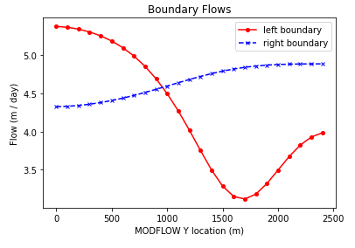
Challenge 1
For the initial boundary head values (15 and 5) and recharge (5e-4) and ET rates (5e-5):
We see the left boundary flow dip about halfway between the recharge area and the bottom boundary. The high flow above the dip is the system’s response to balance spreading recharge and maintain the specified head of 15.
In the next slide, we see that the introduced recharge affects the gradient, diverting much of the inflow away from the recharge zone and down near the bottom of domain, increasing the flow of the bottom boundary.

Slide 4
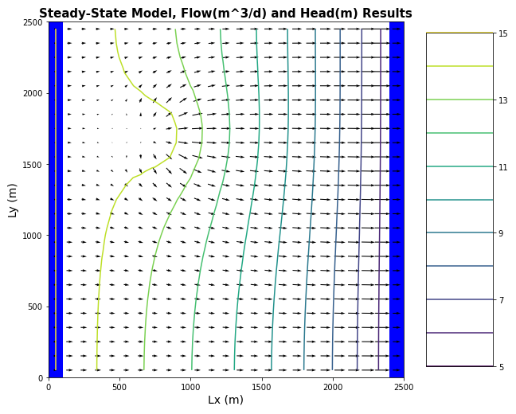
The recharge reaches much of the down-gradient domain. We can see that water from the upper left boundary is diverted from its left-to-right path and incorporates downward movement. This can help explain the higher flow rate near the bottom of the right boundary from the previous question.
Challenge 1

Slide 5
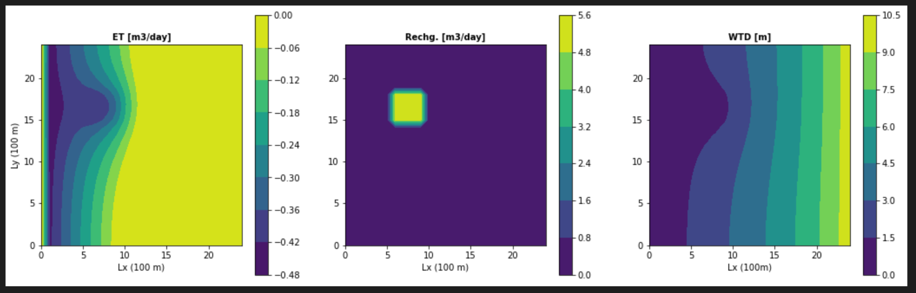
Challenge 1
Plot ET,Recharge and Water Table depth and explain why we see the patterns we do.

Slide 6

Challenge 2
Calculate the water balance for the model
Report all of the inflows and outflows with units and show that mass is being balanced.
dS/dt = output - input
0 = Q_out + ET - Q_in - R
Q_out + ET = Q_in + R
116 m³/d + 70 m³/d = 106 m³/d + 80 m³/d
186 m³/d = 186 m³/d
Inflows (input) | Outflows (output)
Flux in (Q_in) Recharge (R) | Flux out (Q_out) Evapotranspiration (ET)

Slide 7
Challenge 2
Explain what controls each term in your water balance
Terms | Controls
Flux in (Q_in) | Boundary conditions, head gradient, K, area
Recharge (R) | Input Values, Area
Flux Out (Q_out) | Boundary conditions, head gradient, K, area
Evapotranspiration (ET) | Input Value, Extinction Depth, Area

Slide 8
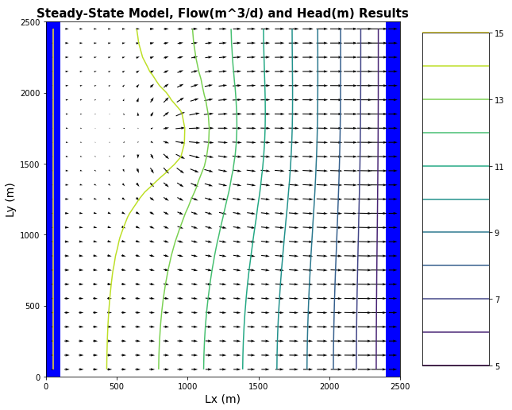

Challenge 3, part I
Changing extinction depth from 3m to 1m:
dS/dt = input - output
0 = Q_{in} + R - Q_{out} - ET
Q_{out} + ET = Q_{in} + R
125 m³/d + 34 m³/d = 79 m³/d + 80 m³/d
159 m³/d = 159 m³/d
Evapotranspiration removes less water from the system because its extinction depth is shallower than 3m. With lower ET and a constant recharge, less water is needed to cross the left boundary for its specified head, but more water must flow out the right boundary.

Slide 9
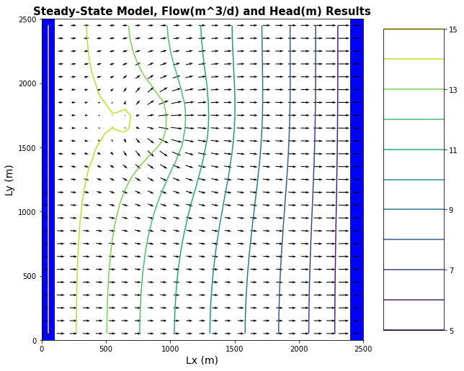

Challenge 3, part II
Changing extinction depth from 3m to 8m:
dS/dt = input - output
0 = Q_{in} + R - Q_{out} - ET
Q_{out} + ET = Q_{in} + R
88 m³/d + 132 m³/d = 140 m³/d + 80 m³/d
220 m³/d = 220 m³/d
Evapotranspiration removes more water from the system because its extinction depth is deeper than previously. With higher ET and a constant recharge, more water is needed to cross the left boundary for its specified head, but less water must flow out the right boundary.

Slide 10
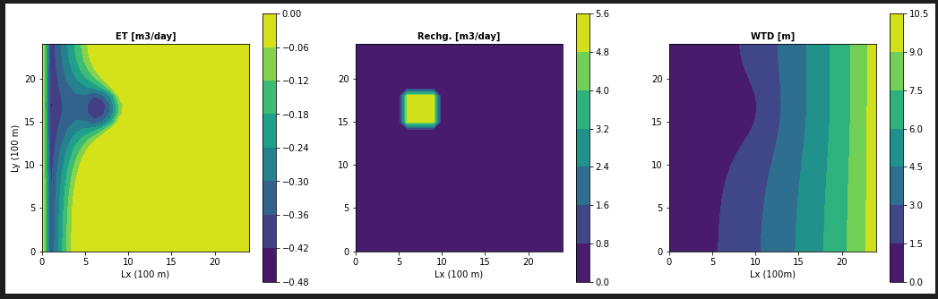
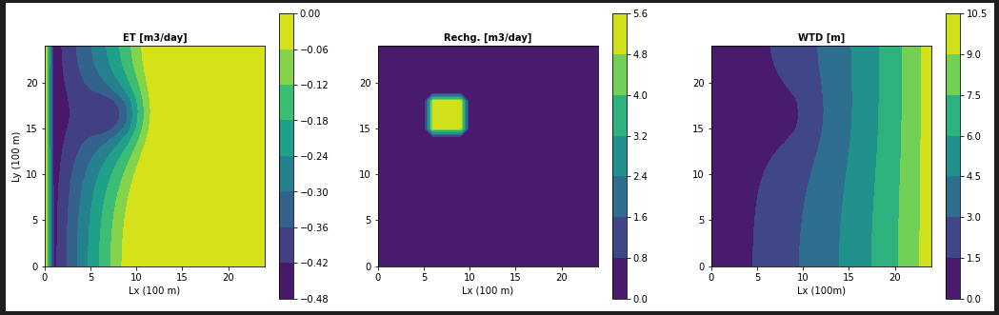
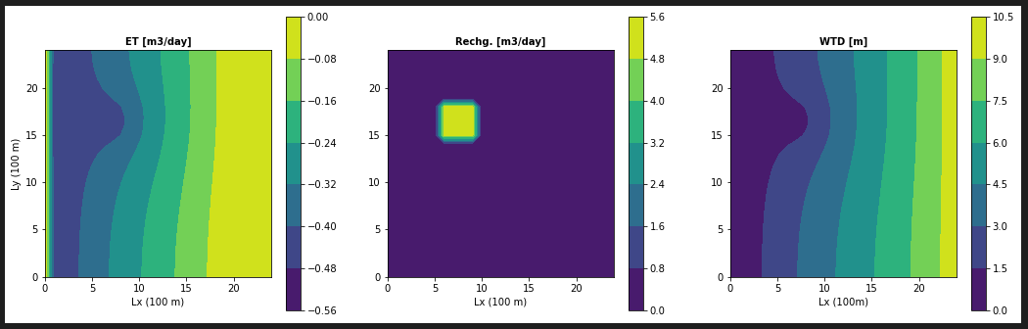
Extinction Depth 1
(No pumping)
Extinction Depth 3
(No pumping)
Extinction Depth 8
(No pumping)

Slide 11
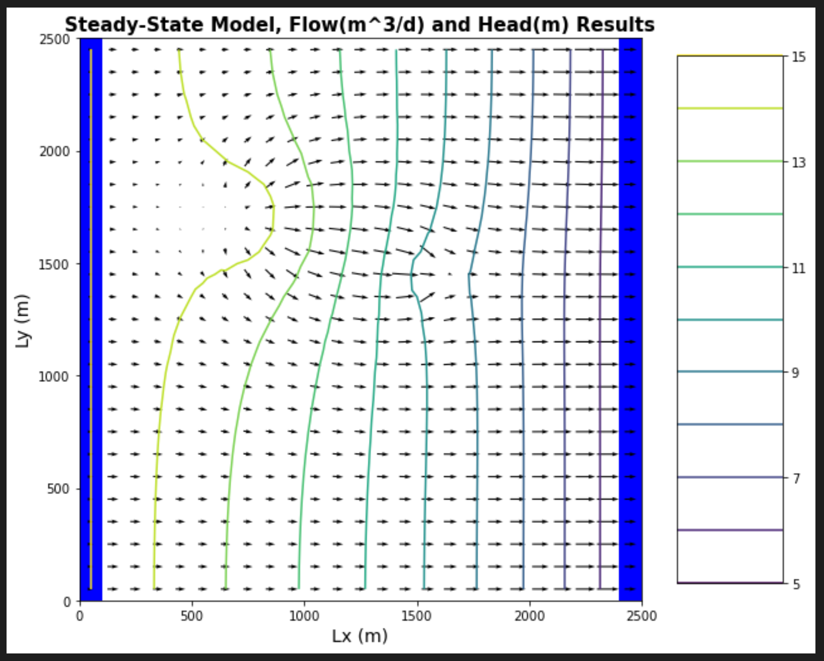
Challenge 4
Well begins pumping: extracting 20 m³/day.
How does the well change the zone that is affected by the recharge area
How does it affect the ET map?
See next slides for further discussion

Slide 12
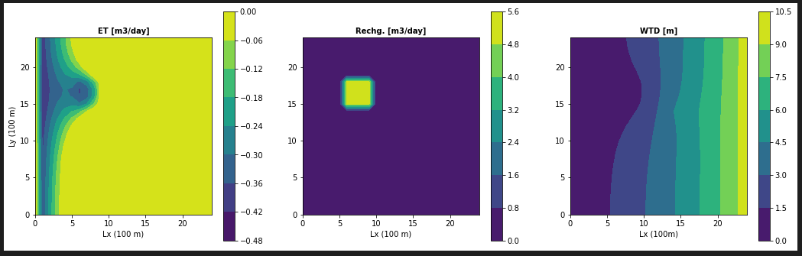
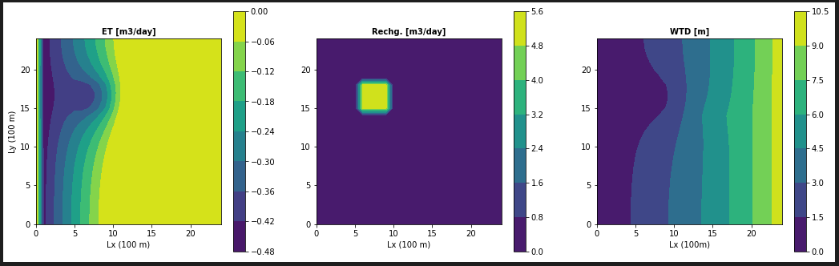
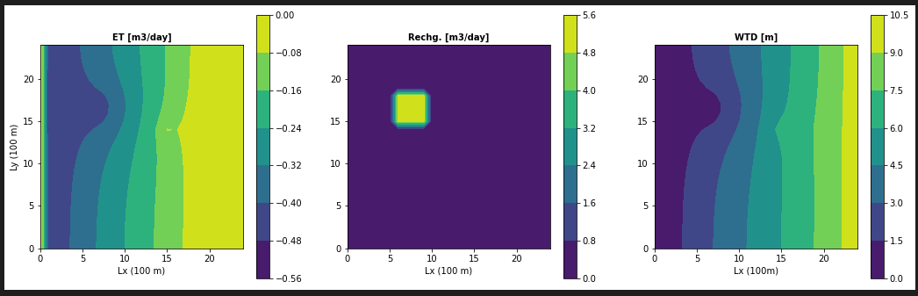
No Pumping
Pumping
Extinc. Depth 1
Extinc. Depth 3
Extinc. Depth 8
Notes:
Explain why we see the ET, RCH, and WTD patterns.
How does the well change the zone that is affected by the rch area?
It minimizes its impact. You can see in each scenario comparison, the WTD bulge that benefits from recharge is narrowed once well pumping begins.
How does it affect the ET map?
It reduces the amount of ET that occurs in all scenarios but with to a higher degree in ET maps that represent deeper extinction depths.

Slide 13
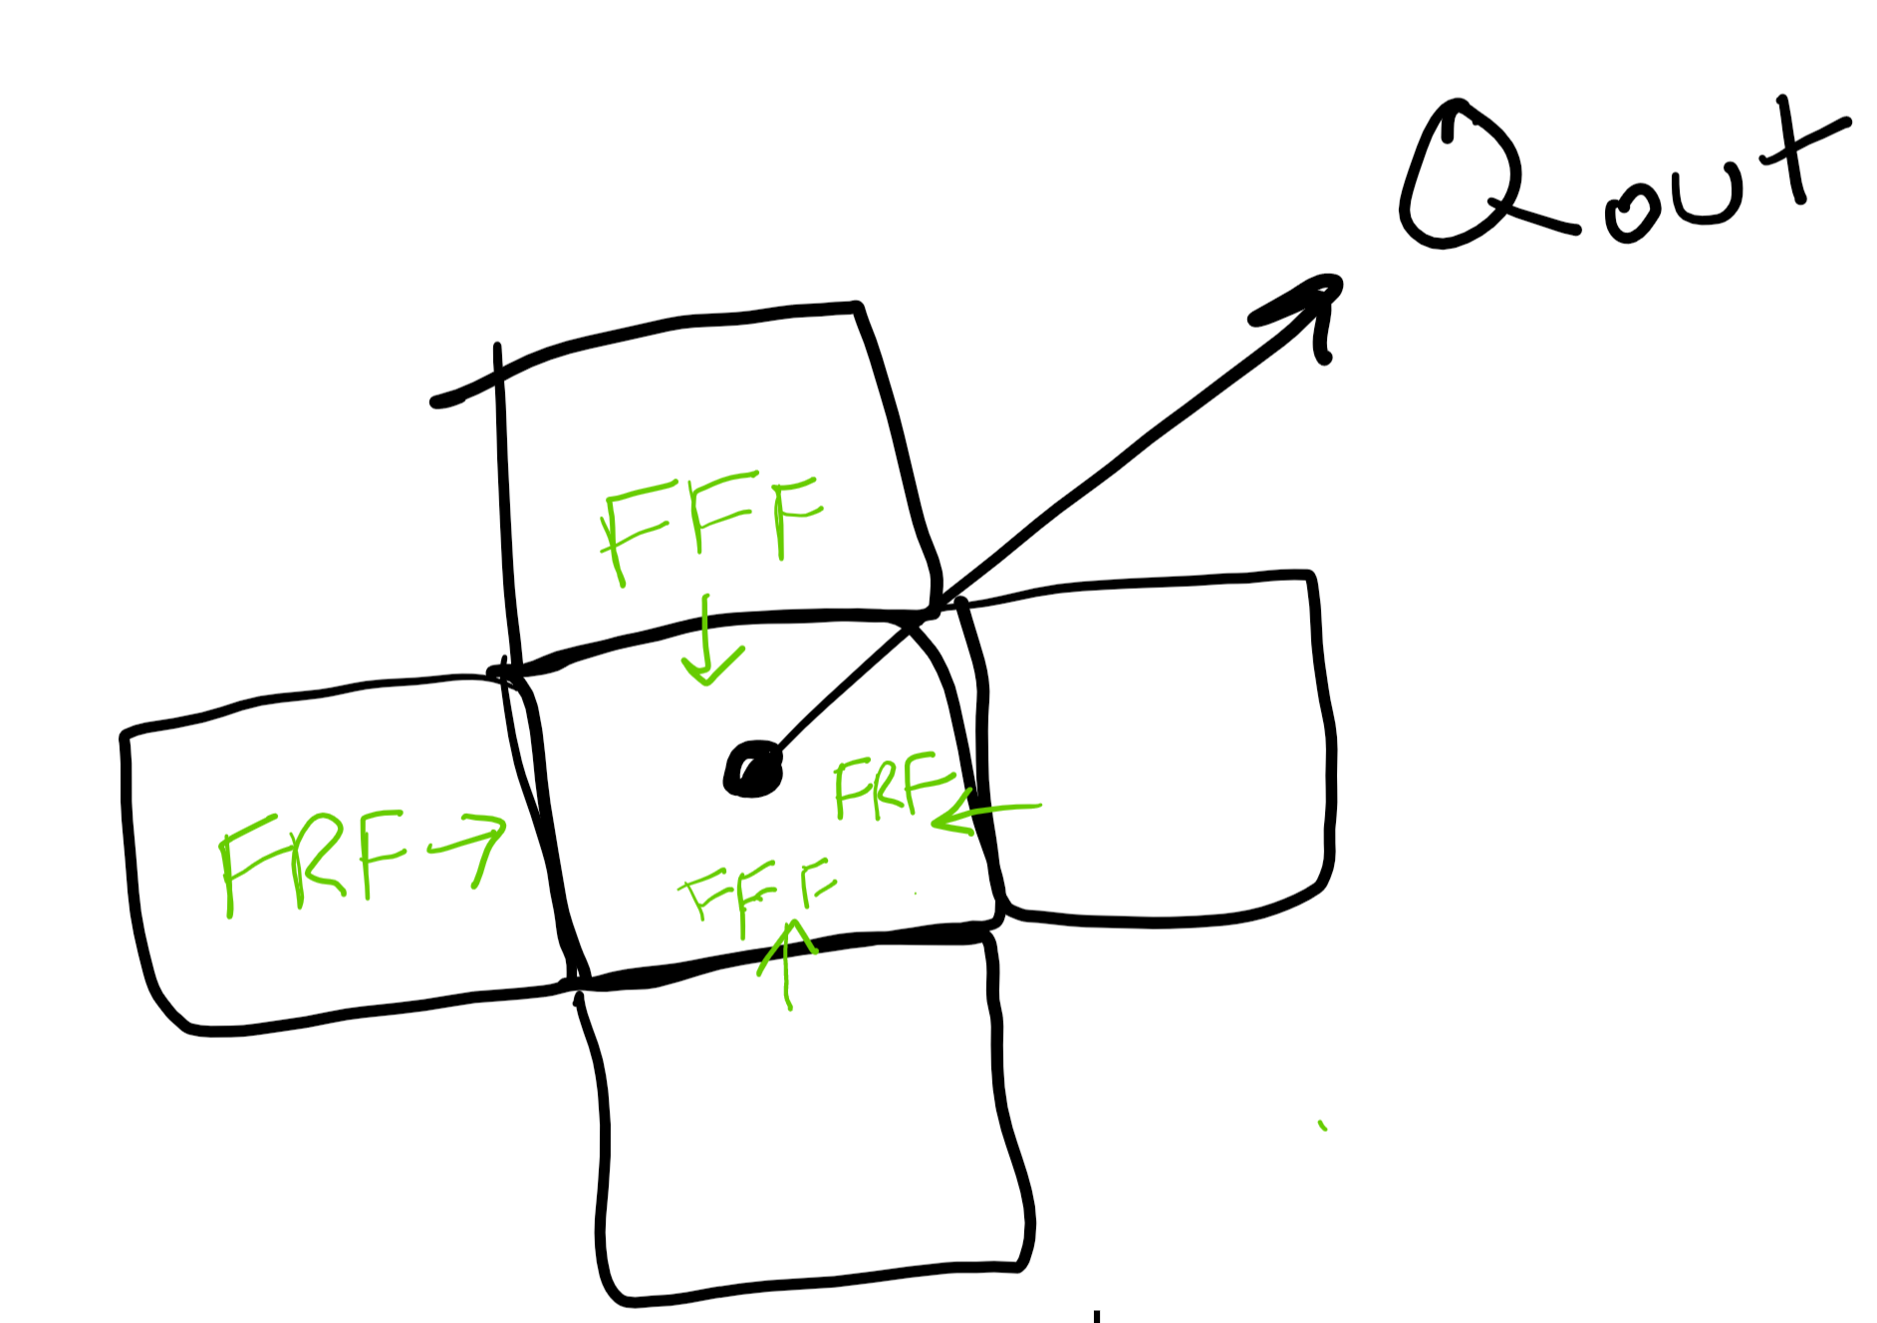
Challenge 5
Write a mass balance for the well:
dS/dt = input - output
0 = Q_{in} - W
Q_{in} = W
10.03 m³/d + .08 m³/d + 5.41 m³/d + 4.49 m³/d = 20 m³/d
20 m³/d = 20 m³/d
Inflows (input) | Outflows (output)
[10,14] Flux Right Face [10,15] Flux Right Face [9,15] Flux Front Face [10,15] Flux Front Face | Well Pumping (W) ET? No, because depth to WT > extinction depth

Slide 14
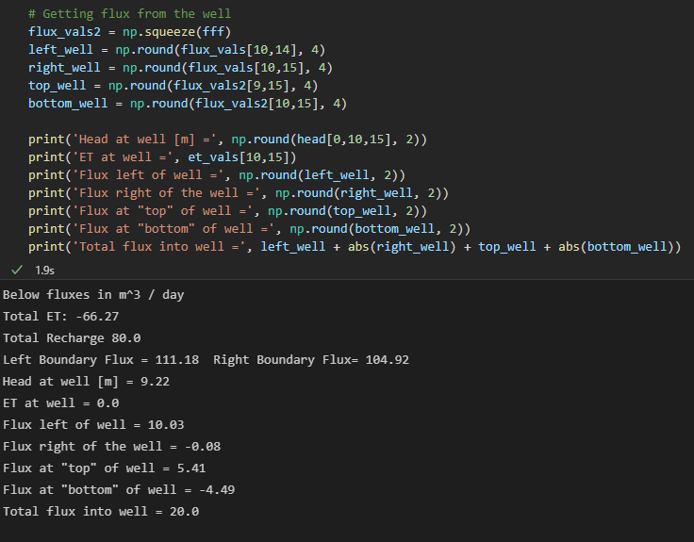
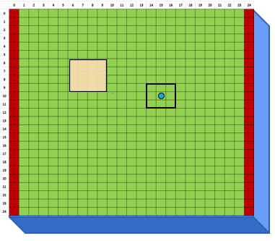
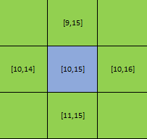
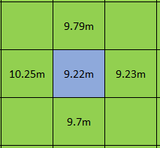
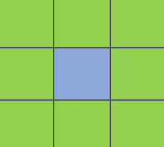
Python Coordinates
K = 1 m/d
Q_{out} = - 20
Head
Flux (m³ / day)
5.41
10.03
0.08
4.49

Slide 15

[9,15]
FFF
FRF
[10,15]
FRF
[10,14]
FFF
This diagram shows the cells that flux for the well is calculated at.
Note: there are only 3 cells that determine our flux at the well!
The FFF of the cell above ([9,15]) the well
The FFF of the well cell ([10,15])
The FRF of the cell to the left ([10,14]) of the cell
The FRF of the well cell ([10,15])

Slide 16
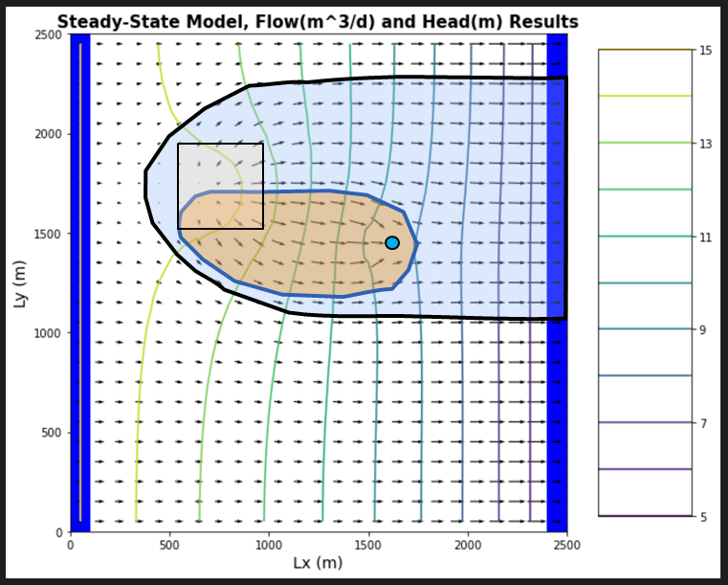
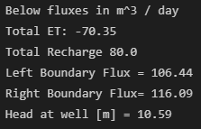
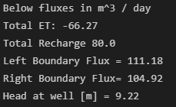
Challenge 5
How much water captured by the well is coming from a boundary?
Based off flow lines, almost none
How much is originating as recharge?
Based off flow lines, almost all of it
80 m³ / day of recharge, well captures ~20 m³ / day of it
How do you account for ET?
ET at and around well is zero for extinction depth of 3m, because WTD in that area is ~5-6 m.
At steady state, what are the effects of 'capture' by the well?
For entire domain, total ET reduced from 70.35 m³ / day to 66.27 m³ / day
Flow leaving right boundary is less than flow entering left boundary (opposite is true if well is turned off).
No Pumping
Pumping

Slide 17
Questions?

