Slide 1
How the SFR Package Works
The SFR (Streamflow Routing) module is an improvement upon the STR (Stream) module, which itself is an improvement upon the RIV (River) module.
SFR includes more complex hydraulic parameters of the stream into the simulation. This is needed to correctly simulate something such as an irregularly-shaped streambed. However, when modeling simplified idealized aquifers, the differences between SFR and STR are negligible, and use of either package would be appropriate.

Slide 2

How SFR Differs from STR
More options for computing stream depth and width: better for irregular geometry.
In SFR, stream depth is computed at midpoint of reach, instead of beginning of reach (STR).
Allows for runoff, ET, or precipitation inputs/outputs to be calculated within each reach.
In SFR, stream depth can be computed in multiple different ways, such as a specified value, Manning’s equation, a power equation, or a table of values that relate flow depth to width.
STR only uses Manning’s Equation
In SFR, streambed conductance is now calculated internally, as the channel’s hydraulic radius changes from reach to reach.
Manning’s Equation
Q = Discharge
n = Manning’s roughness coefficient
A = streambed cross-sectional area
R = streambed hydraulic radius (a function of area and stream depth)
S = streambed slope

Slide 3
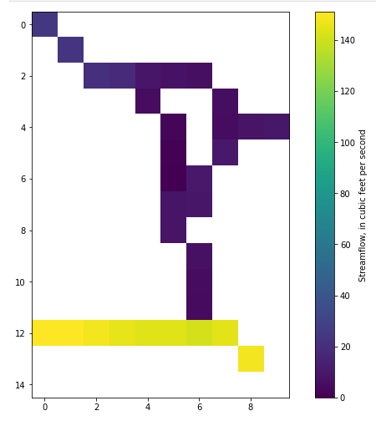
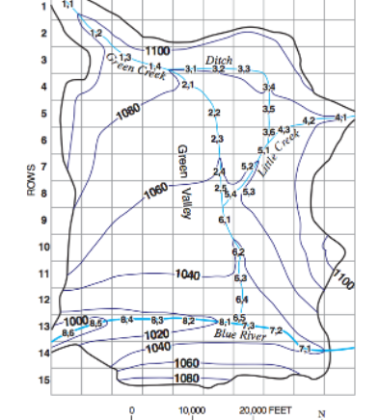
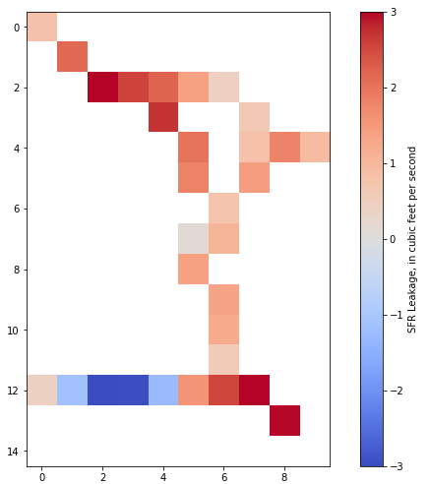
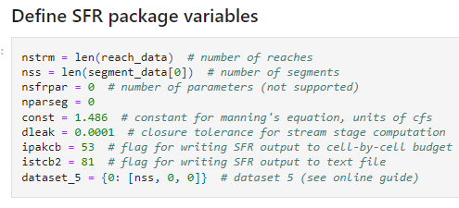
How to Implement in Python
Segments and reaches must be loaded into numpy and then checked for continuity. In the example, segment 8, in the bottom of the domain, is the segment that the other stream segments ultimately flow into.
Variables within the SFR package must be defined and then the package is instantiated.

