Slide 1
Transpired
Diana, Justin, David

Slide 2
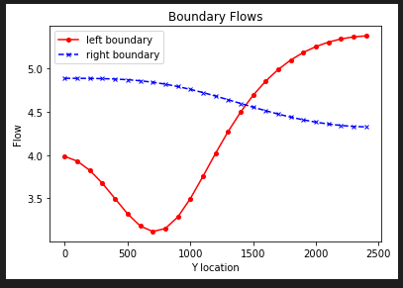
Challenge 1
This image got updated, use next slides image (keeping it incase we need it again for discussion)
For the initial boundary head values (15 and 5) and recharge (5e-4) and ET rates (5e-5):
We see the left boundary flow dip about halfway between the recharge area and the bottom boundary. The high flow above the dip is the system’s response to balance spreading recharge and maintain the specified head of 15.
In the next slide, we see that the introduced recharge affects the gradient, diverting much of the inflow away from the recharge zone and down near the bottom of domain, increasing the flow of the bottom boundary.

Slide 3
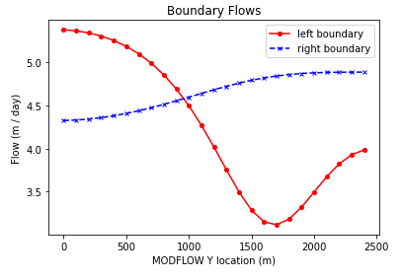
Challenge 1
For the initial boundary head values (15 and 5) and recharge (5e-4) and ET rates (5e-5):
We see the left boundary flow dip about halfway between the recharge area and the bottom boundary. The high flow above the dip is the system’s response to balance spreading recharge and maintain the specified head of 15.
In the next slide, we see that the introduced recharge affects the gradient, diverting much of the inflow away from the recharge zone and down near the bottom of domain, increasing the flow of the bottom boundary.

Slide 4
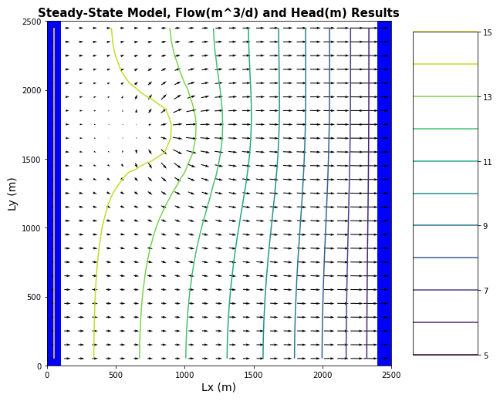
The recharge reaches much of the down-gradient domain. We can see that water from the upper left boundary is diverted from its left-to-right path and incorporates downward movement. This can help explain the higher flow rate near the bottom of the right boundary from the previous question.
Challenge 1

Slide 5
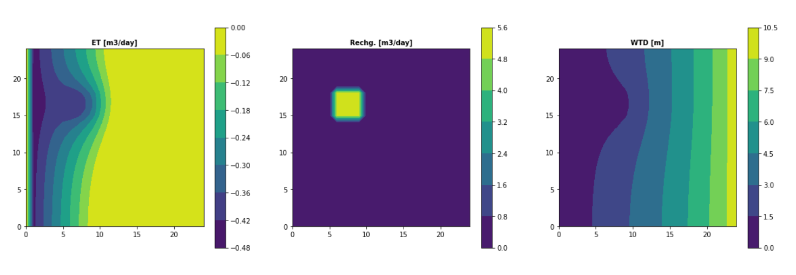
Challenge 1
Plot ET,Recharge and Water Table depth and explain why we see the patterns we do. This was the old version before laura updated the code

Slide 6
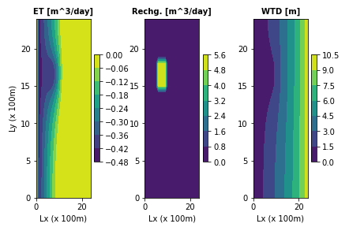
Challenge 1
Plot ET,Recharge and Water Table depth and explain why we see the patterns we do.

Slide 7

Challenge 2
Calculate the water balance for the model
Report all of the inflows and outflows with units and show that mass is being balanced.
dS/dt = input - output
0 = Q_in + R - Q_out - ET
Q_out + ET = Q_in + R
116 m³/d + 70 m³/d = 106 m³/d + 80 m³/d
186 m³/d = 186 m³/d
Inflows (input) | Outflows (output)
Flux in (Q_in) Recharge (R) | Flux out (Q_out) Evapotranspiration (ET)

Slide 8
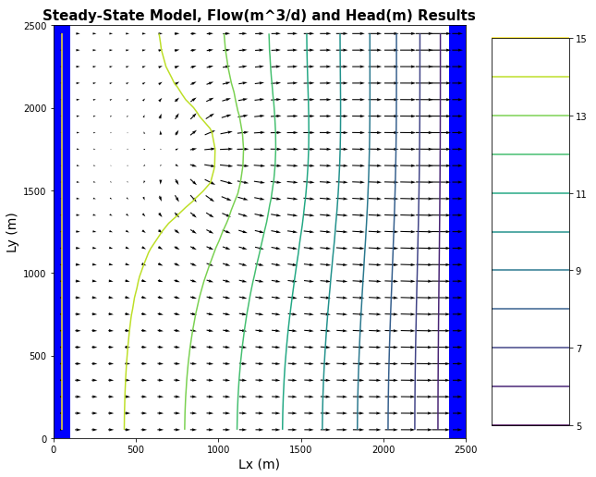

Challenge 3
Change the extinction depth in your model. (I changed it from 3→ 1) Justin
Report the new water balance numbers
Provide a plot of the new head contours and fluxes
dS/dt = input - output
0 = Q_in + R - Q_out - ET
Q_out + ET = Q_in + R
125 m³/d + 34 m³/d = 79 m³/d + 80 m³/d
159 m³/d = 159 m³/d

Slide 9
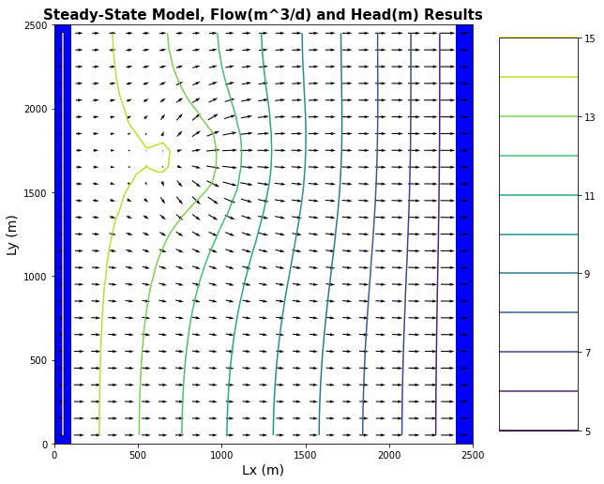

Challenge 3
Change the extinction depth in your model. (I changed it from 3→ 8) - Justin
Report the new water balance numbers
Provide a plot of the new head contours and fluxes
dS/dt = input - output
0 = Q_in + R - Q_out - ET
Q_out + ET = Q_in + R
88 m³/d + 132 m³/d = 140 m³/d + 80 m³/d
220 m³/d = 220 m³/d

Slide 10
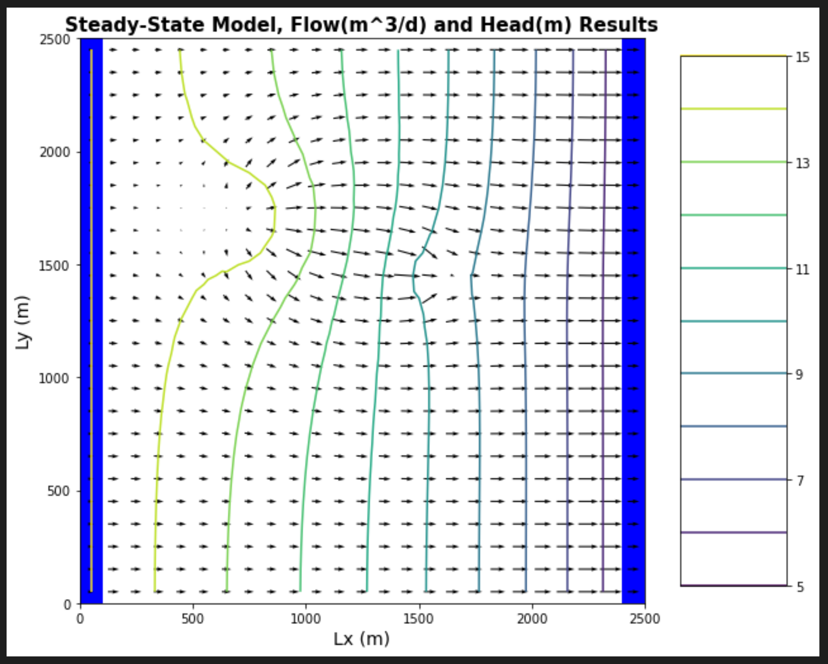
Challenge 4
Now start the well pumping, extracting 20 m³/day. Question: What extinction level? I did 3, show well capture (well at [0,10,15]
Plot the equipotentials and flow vectors in plan view and outline (hand draw) the area that would be affected by recharge (i.e. if it were contaminated).

Slide 11
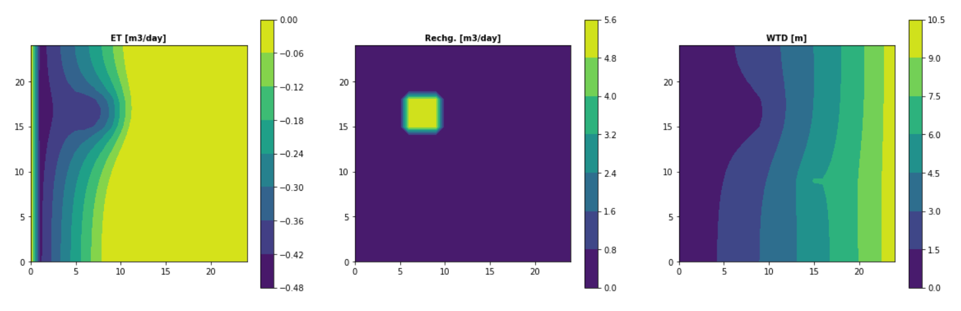
Challenge 4
Plot ET,Recharge and Water Table depth and explain why we see the patterns we do.
This is at a well of 0,15,15, before laura changed the markdown file
Only keeping slide incase useful for discussions.

Slide 12

Challenge 4
Plot ET,Recharge and Water Table depth and explain why we see the patterns we do.
This has been updated to show a well at [0,10,15]

Slide 13
How does the well change the zone that is affected by the recharge area?
How does it affect the ET map?

Slide 14
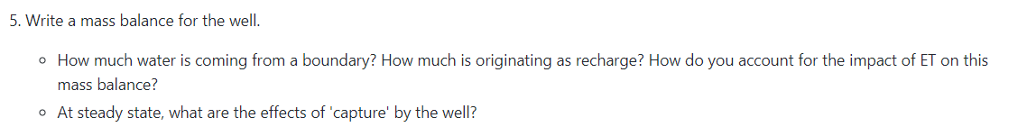
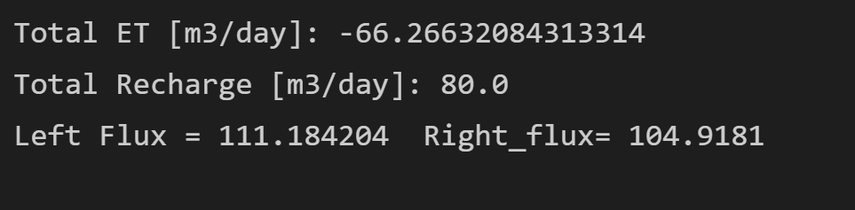
Challenge 5
Inflows (input) | Outflows (output)
Flux in (Q_in) Recharge (R) | Flux out (Q_out) Evapotranspiration (ET) Well Pumping (W)
This shows that the system is balancing
dS/dt = input - output
0 = Q_in + R - Q_out - ET - W
Q_out + ET + W = Q_in + R
105 m³/d + 66 m³/d + 20 = 111 m³/d + 80 m³/d
191 m³/d = 195 m³/d

Slide 15
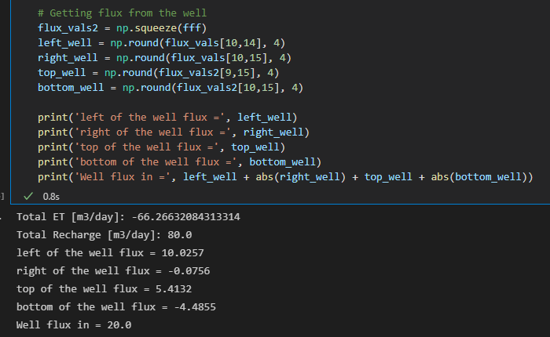
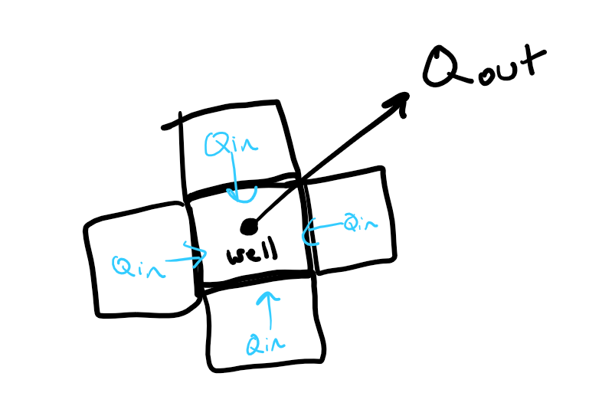
Challenge 5
Inflows (input) | Outflows (output)
Flux in (Q_in) | Well Pumping (W)

Slide 16
Extinction Depth 1m
Extinction Depth 8m
Can anyone see a difference in flow lines? I’m having a really hard time telling a difference.

