Slide 1
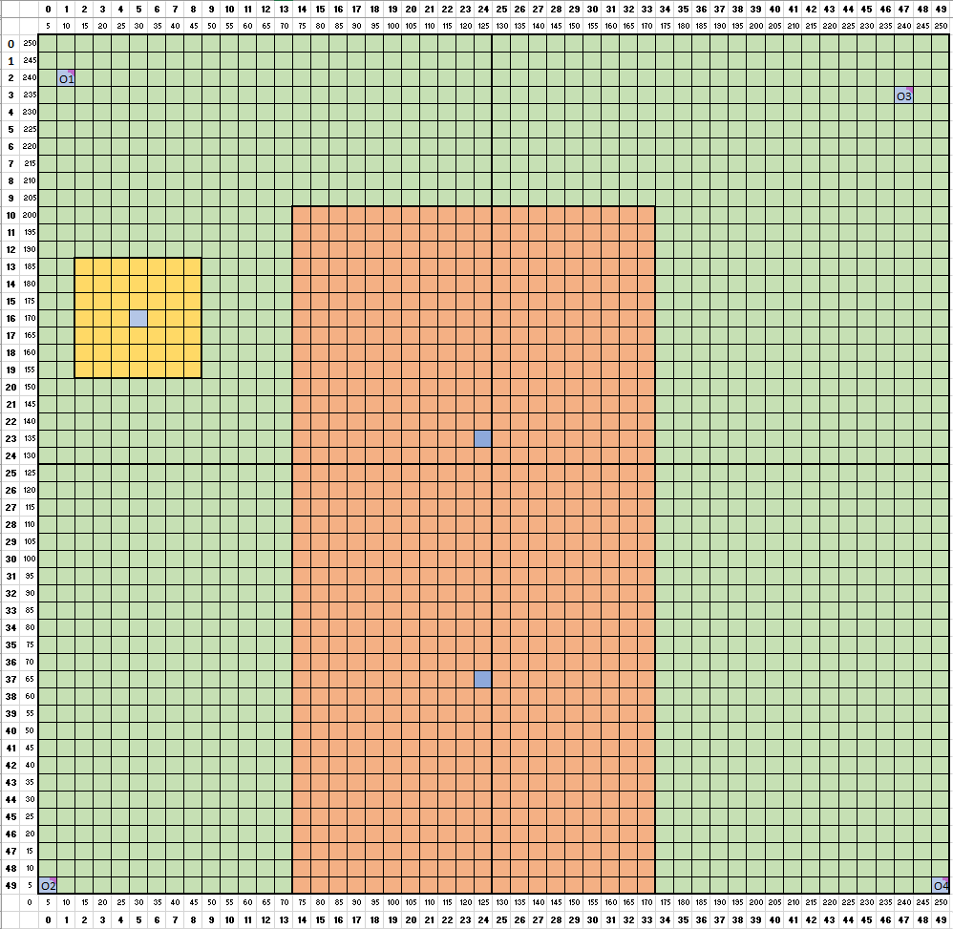
Conceptual Figure
50 cells, each cell has dx and dy of 50m.
Overall dimensions of domain 2500x2500m.
One 900m vertical layer
Constant west and east head boundaries
West: 895 m
East: 749 m
Arithmetic average of north & south observation well heads in respective domain half.
Amber 7x7 square (350m x 350m) is Wildcat Farm, with a pumping well in the middle of it [16,5]
Pink 40x20 (2000m x 1000m) rectangle is ACME Farm, with two pumping wells
Scenario 1:
K of domain is divided into four quadrants of equal area, based on K of the quadrant’s respective observation well.
K = 1.5 m / day
K = 1 m / day
K = 13 m / day
K = 8.4 m / day

