Slide 1
Overview of the MODFLOW stream package
References:
MODFLOW Guide: https://water.usgs.gov/nrp/gwsoftware/modflow2000/MFDOC/str.html
FLOPY Documentation: https://flopy.readthedocs.io/en/3.3.5/source/flopy.modflow.mfstr.html
Reference report on the package: https://pubs.er.usgs.gov/publication/ofr88729
Update for MODFLOW2005: https://water.usgs.gov/nrp/gwsoftware/modflow2000/MFDOC/str.html#:~:text=%E2%80%A2-,STR7.pdf,-Related%20Packages

Slide 2
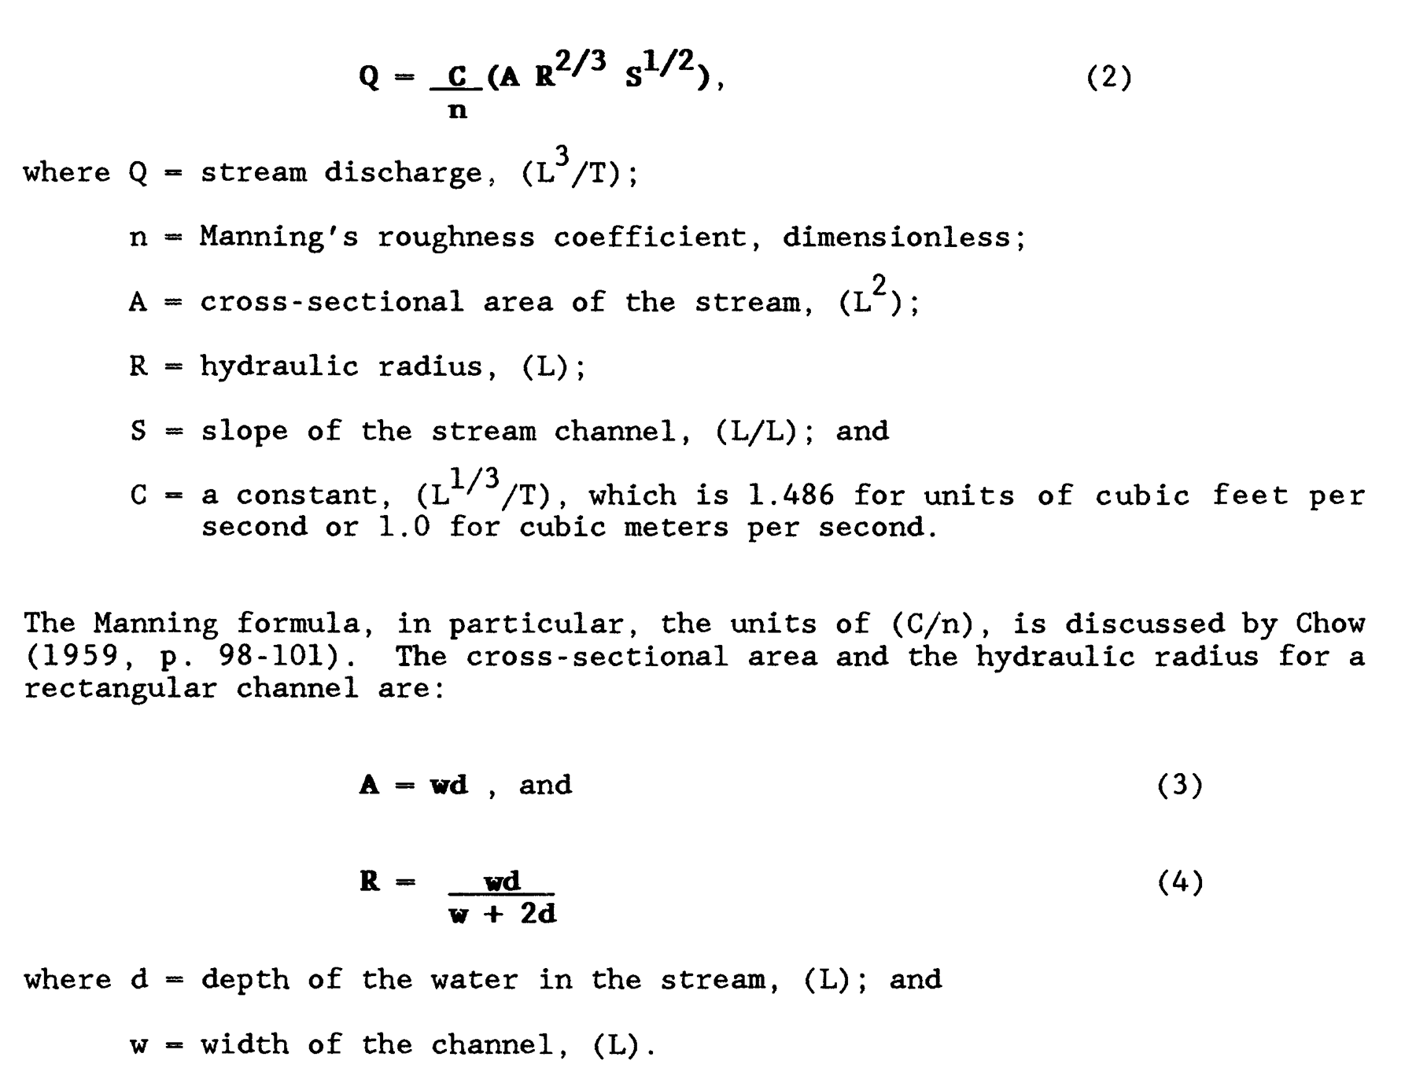
Str calculations
Leakage from aquifer to streambed. = Streambed conductance *(Head in stream – head in aquifer)
If the icalc variable is >0 then stream stage in each reach will be computed using an inversion of Mannings equation where to solve for stream depth.
Stream stage is calculated prior to calculating leakage
For the first iteration its calculated using the inflow into a segment. If there is no inflow its set to the top of the streambed
Leakage terms are calculated based on stream stage and then heads are calculated
In subsequent iterations leakage from previous iteration is subtracted from the streamflow prior to calculating the new stream stage

Slide 3
MODFLOW implementation

Slide 4
General inputs:
mxacts (int) – Maximum number of stream reaches that will be in use during any stress period. (default is 0)
nss (int) – Number of stream segments. (default is 0)
ntrib (int) – The number of stream tributaries that can connect to one segment. The program is currently dimensioned so that NTRIB cannot exceed 10. (default is 0)
ndiv (int) – A flag, which when positive, specifies that diversions from segments are to be simulated. (default is 0)
icalc (int) – A flag, which when positive, specifies that stream stages in reaches are to be calculated. (default is 0)
const (float) – Constant value used in calculating stream stage in reaches whenever ICALC is greater than 0. (1.486 for flow units of cfs and 1.0 for units of cms). The constant must be multiplied by 86,400 when using time units of days in the simulation. If ICALC is 0, const can be any real value. (default is 86400.)

Slide 5
Variables that control printing and saving:
ipakcb (int) – A flag that is used to determine if cell-by-cell budget data should be saved. If ipakcb is non-zero cell-by-cell budget data will be saved. (default is 0).
istcb2 (int) – A flag that is used flag and a unit number for the option to store streamflow out of each reach in an unformatted (binary) file. If istcb2 is greater than zero streamflow data will be saved. (default is None)
irdflg (integer or dictionary) – is a integer or dictionary containing a integer flag, when positive suppresses printing of the stream input data for a stress period. If an integer is passed, all stress periods will use the same value. If a dictionary is passed, stress periods not in the dictionary will assigned a value of 1. Default is None which will assign a value of 1 to all stress periods.
iptflg (integer or dictionary) – is a integer or dictionary containing a integer flag, when positive suppresses printing of stream results for a stress period. If an integer is passed, all stress periods will use the same value. If a dictionary is passed, stress periods not in the dictionary will assigned a value of 1. Default is None which will assign a value of 1 to all stress periods.

Slide 6
Stress period data:
A dictionary of values where each entry is a stress period
Each stress period has a list of data that is detailed below (or you can pass it a -1 if you want it to repeat values from previous stress period or 0 to indicate no stream reaches in the stress period)
There should be one row for each reach containing the following:
Layer
Row
Column
Segment #
Sequential reach # (number upstream to downstream)
Flow entering segment
Stream stage
Streambed hydraulic conductance
Streambed Bottom elevation
Streambed top elevation
Stream width
Stream slope
Roughness coefficient

Slide 7
Option for calculating stream states (icalc):
If icalc>0 the stream stages will be calculated
Default value is 0
Stream width, stream slope, and roughness coefficients are only used if icalc is greater than 0 (if its equal to 0 they can have any values as they are not used)

Slide 8
Segment Data:
A dictionary of values where each entry is a stress period
Each stress period has a list of segment data
There should be one row for each segment containing the following:
Itrib data for up to 10 tributaries (i.e. 10 values specifying if a giv
Iupseg
If ntrib = 0 this indicates that no stream segments have tributaries and the itrib values can be anything because they are ignored.
If ntrib>0 then you should list the tributaries for each segment in columns 0:ntrib (note that the maximum number of tributaries is 10)
If ndiv =0 then the iupseg values are not used. If ndiv >- then iupseg should be listed in the last column.

Slide 9
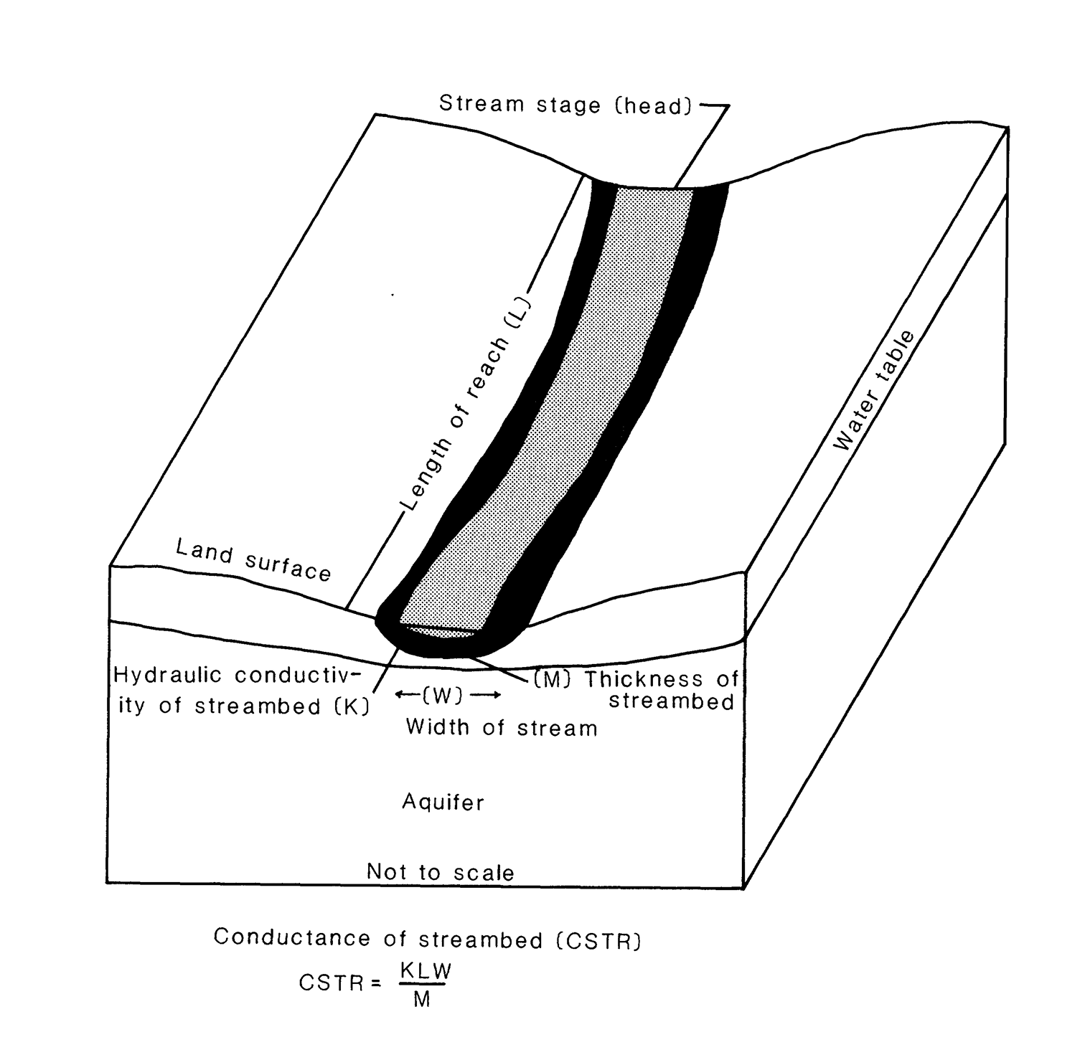
Streambed conductance

Slide 10
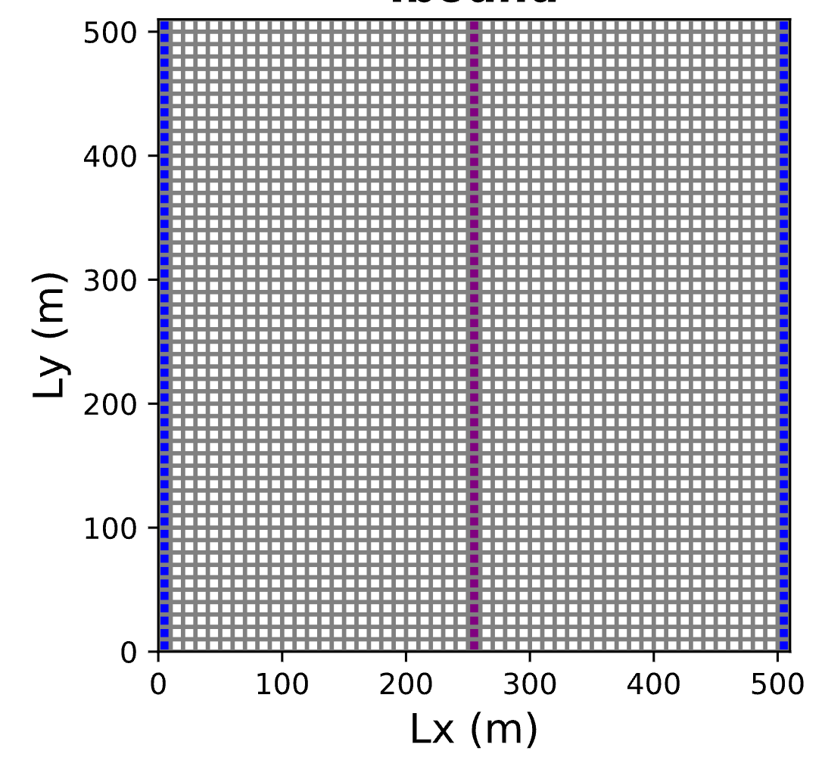
Example implementation for a single segment:
50 reaches ordered from north to south and a single segment

Slide 11
Example implementation for a single segment:
4. Setup the stress period dictionary
strd = {}
strspd = []
for y in range(nrow):
add = [0, y, ncol/2, 1, y+1, Flow_into_the_1st_reach, str_stage, cond_vals[x], str_bott, str_top, width, slope, rough]
strspd.append(add)
strd[0]=strspd
5. Setup the segment dictionary
seg_info = [0, 0, 0, 0, 0, 0, 0, 0, 0, 0, 0] #create segment info array - all zeros since only one segment
str_segd = {0: seg_info} #create dict of segment info keyed to stress periods
6. Setup the package call strm = flopy.modflow.mfstr.ModflowStr(m, mxacts=75, nss=1, ntrib=0, ndiv=0,icalc= set_icalc, const=const, ipakcb=53, istcb2=53, dtype=None,
stress_period_data=strd, segment_data=str_segd, extension='str')
1. Setup the stream characteristics
slope = 0.0001 #slope of streambed (m/m)
rough = 0.02377 #roughness of streambed
width = 20. #x-sectional width of channel (m)
Flow_into_the_1st_reach = 0 # m^3/day
set_icalc = 1 # the stage is to be calculated based on flow
const = 86400.0 #multiplication constant for m3/day
2. Calculate the streambed conductance
k_strbott = 1 #river bottom hydraulic conductivity in l/t
sed_thick = 1 #thickness of riverbed sediment
cond = k_strbott*(width)*(dy)/(sed_thick)
cond_vals = np.ones(nrow) *cond
3. Setup river elevations and stages
str_bott = 7 #Elevation of the river bottom str_top = str_bott+sed_thick. # Elevation of streambed top
str_stage = 9 #doesn’t matter what we se this to if icalc is >0

Slide 12
Implementation for multiple segments

Slide 13
Example implementation for a multiple reaches:
1. Setup the stream characteristics
The maximum tributes you can have is 10
nseg = 3
ntrib = 2
Stage = 0.5
slope = 0.001 #slope of streambed (m/m)
rough = 0.04 #roughness of streambed
width = 1. #x-sectional width of channel (m)
Flow_into_the_1st_reach = 0 # m^3/day
set_icalc = 1 # the stage is to be calculated based on flow
const = 86400.0 #multiplication constant for m3/day
2. Calculate the streambed conductance
k_strbott = 1.36*K_horiz #river bottom hydraulic conductivity in l/t
sed_thick = 1 #thickness of riverbed sediment
cond = k_strbott*(width)*(dy)/(sed_thick)

Slide 14
Example implementation for a multiple reaches:
3. Setup the reach locations stream segment numbers and reach numbers
(Note we are taking a slightly more complicated approach here setting the streambed relative to the elevation of the land surface)
#Setup the reach locations – here the row value will be 25 for each reach and the column values will go from 0-49
nreach = 50 # river extending the width of the domain
str_rows = 25*np.ones((nreach),dtype=np.int32) # integer array of row #s for each reach
str_cols = np.arange(0,nreach) # integer array of col #s for each reach
#Setup the inflows for the reaches
Qreturn =50 # return flow from the town
reach_flow = np.zeros((nreach),dtype=np.int32) # initially set all inflows to zero for all reaches
reach_flow[return_loc] = Qreturn # inflow to seg2 = return from town.
reach_flow[return_loc+1] = -1 # inflow to seg3 = sum of all previous segs
#setup segment numbers – this is a list of segment values that goes with each reach
return_loc = 25 #specifying the column where the town return flows come in
segments = np.ones((nreach),dtype=np.int32) # make a segment array that is nreach long and initialize all the values to 1
segments[return_loc] = 2 #Change the segment number to ‘2’ where the town recharge comes in
segments[return_loc+1:nreach] = 3 # Change the segment number to ‘3’ everywhere downstream of the the town well
#Segment[25+1]=3
#setup reach numbers – this will be the numbering of the reaches within each segment.
# Recall that numbering starts and one and increases moving downstream
reaches = np.arange(1,nreach+1) # create an array of reach #s counting from 1-50
reaches[return_loc] = 1 # reassign the reach number to be 1 for segment 2
reaches[return_loc+1:nreach] = np.arange(1,nreach-(return_loc+1)+1) # reassign the reach numbers for segment 3 to start counting at 1

Slide 15
Example implementation for a multiple reaches:
4. Setup the elevation of the streams
(In this case we will be setting it relative to surface elevation which is an array called ‘ztop’)
ztop = np.genfromtxt('BASE_top_elev.csv', delimiter=',') # top elevation of top layer (import from csv file) (dim: nrow, ncol)
surf_elev = np.zeros((nreach)) # create array of zeros the length of the stream
# loop over the stream reaches and pull the land surface elevation for the location of each stream cell
for i in np.arange(nreach):
surf_elev[i] = ztop[str_rows[i],str_cols[i]] Stop = surf_elev - 1. # elevation of the top of the streambed (1 m below land surface) (m)
Sbot = Stop - thickness # elevation of the bottom of the streambed (m)
stage_elev = Stop + stage # elevation of the water surface in the stream (m)

Slide 16
Example implementation for a multiple reaches:
5. Setup the stress period dictionary
str_info = np.zeros((nreach,13)) # create array of zeros for reaches, each reach requires 13 input values
# Loop over the reaches and setup the data
for r in np.arange(nreach):
str_info[r,:] = [0, str_rows[r], str_cols[r], segments[r], reaches[r], reach_flow[r], stage_elev[r], Kstream, Sbot[r], Stop[r], width, slope, rough] #this order can not be modified inside the dictionary because that is how flopy uses them
str_spd = {0: str_info} # save the stream info in a stress period dictionary
5. Setup the segments dictionary
#for each segment, need an array of 10 zeros, for last segment, first two values are seg #s of upstream segments
seg_info = np.zeros((10,nseg))
seg_info = [[0, 0, 0, 0, 0, 0, 0, 0, 0, 0, 0], [0, 0, 0, 0, 0, 0, 0, 0, 0, 0, 0], [1, 2, 0, 0, 0, 0, 0, 0, 0, 0, 1]]
str_segd = {0: seg_info} #save the stream info in a segment dictionary
6. Setup the mudflow package call
strm = flopy.modflow.mfstr.ModflowStr(mf, mxacts=nreach, nss=nseg, ntrib=ntrib, ndiv=0,icalc=icalc, const=const, ipakcb=53, istcb2=53, dtype=None, stress_period_data=str_spd, segment_data=str_segd, extension='str')

