Slide 1

Choreography with Code
Notes:
Say about girls who code

Slide 2
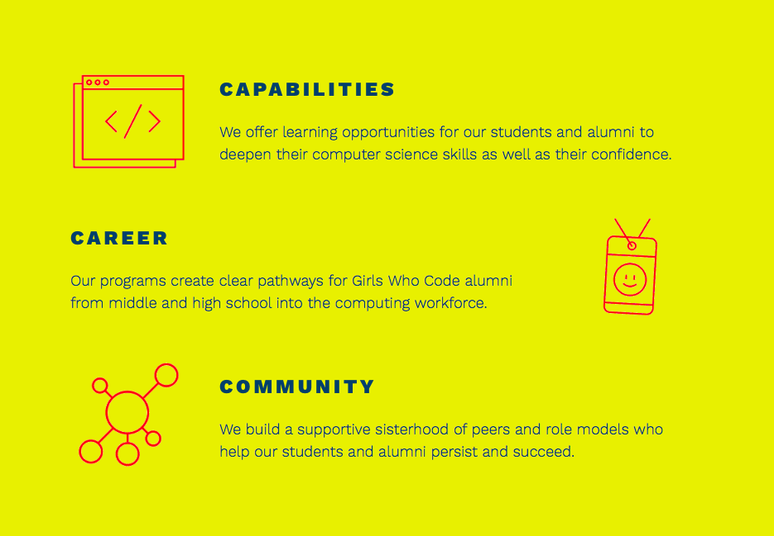
Notes:
Explain what Girls Who Code is
Introduce ourselves

Slide 3
What is coding?

Slide 4


Boolean: binary value with two possible values
TRUE
FALSE
Notes:
Yes or No
One or Zero

Slide 5
If you like the color pink:
Put your thumb up
Else:
Put your thumb down
Notes:
Now stand up and move around

Slide 6
If you have brown hair:
Go to left side of classroom
Else:
Go to right side of classroom

Slide 7
If you like chocolate:
Go to left side of classroom
Else:
Go to right side of classroom

Slide 8
If you were born in Michigan:
Go to left side of classroom
Else:
Go to right side of classroom

Slide 9
If you like dogs:
Go to left side of classroom
Else if you like cats:
Go to right side of classroom
Else:
Go to front of classroom
Notes:
If you like dogs AND cats you have to go to the left side of the room because liking dogs comes first--ORDER MATTERS

Slide 10
If you like math:
Go to left side of classroom
Else if you like science:
Go to right side of classroom
Else:
Go to front of classroom

Slide 11
If you like to read:
Go to left side of classroom
Else if you like to watch tv:
Go to right side of classroom
Else:
Go to front of classroom
Notes:
Notice the language I used when introducing your options

Slide 12
Conditional statement
If something is TRUE:
Then do something
Else if something is TRUE:
Then do something
Else:
Do something

Slide 13
Boolean operators
OR
NOT
AND

Slide 14
Boolean operators
Dancer
Dancer
Dancer
Soccer player
Soccer player
Soccer player
OR
NOT
AND
Notes:
o Look at the clothing the students are wearing and choose articles of clothing or other appropriate features that distinguish the students best in your room.
o Example: Tell all of the students wearing a t-shirt to stand up. Count the number of students standing. Now ask the students who are wearing a t-shirt and jeans to remain standing. Count the number of students standing and explain how this exercise has shown how AND is used on the internet in order to narrow a search just like and narrowed our group of students standing. Now tell the students wearing a t-shirt or jeans to stand. Count the number of students standing and explain how this exercise has shown how OR is used on the internet in order to broaden a search. Now ask the students wearing t-shirts but not sneakers to stand. Count the number of students standing and explain how this exercise has shown how NOT is used on the internet in order to narrow a search.

Slide 15
If you like to dance and play soccer:
Raise both hands
Dancer
Soccer player
Notes:
Notice the language I used when introducing your options

Slide 16
If you like to dance and play soccer:
Raise both hands
Else if you like to dance:
Raise your right hand
Dancer
Soccer player

Slide 17
If you like to dance and play soccer:
Raise both hands
Else if you like to dance:
Raise right hand
Dancer
Else if you like to play soccer:
Raise left hand
Soccer player

Slide 18
If you like to dance and play soccer:
Raise both hands
Else if you like to dance:
Raise right hand
Dancer
Else if you like to play soccer:
Raise left hand
Soccer player
Else:
Keep both hands down

Slide 19
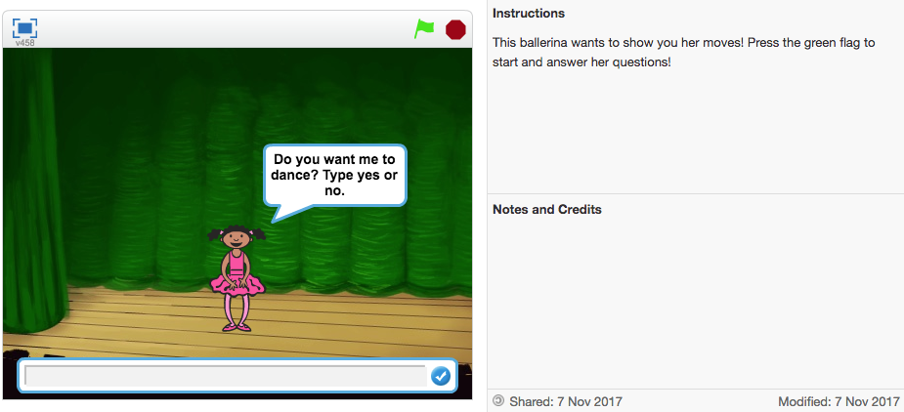
Choreography with Code
Notes:
Scratch is a free visual programming language
Developed by MIT Media Lab
Follow the notes and see what the ballerina can do

Slide 20
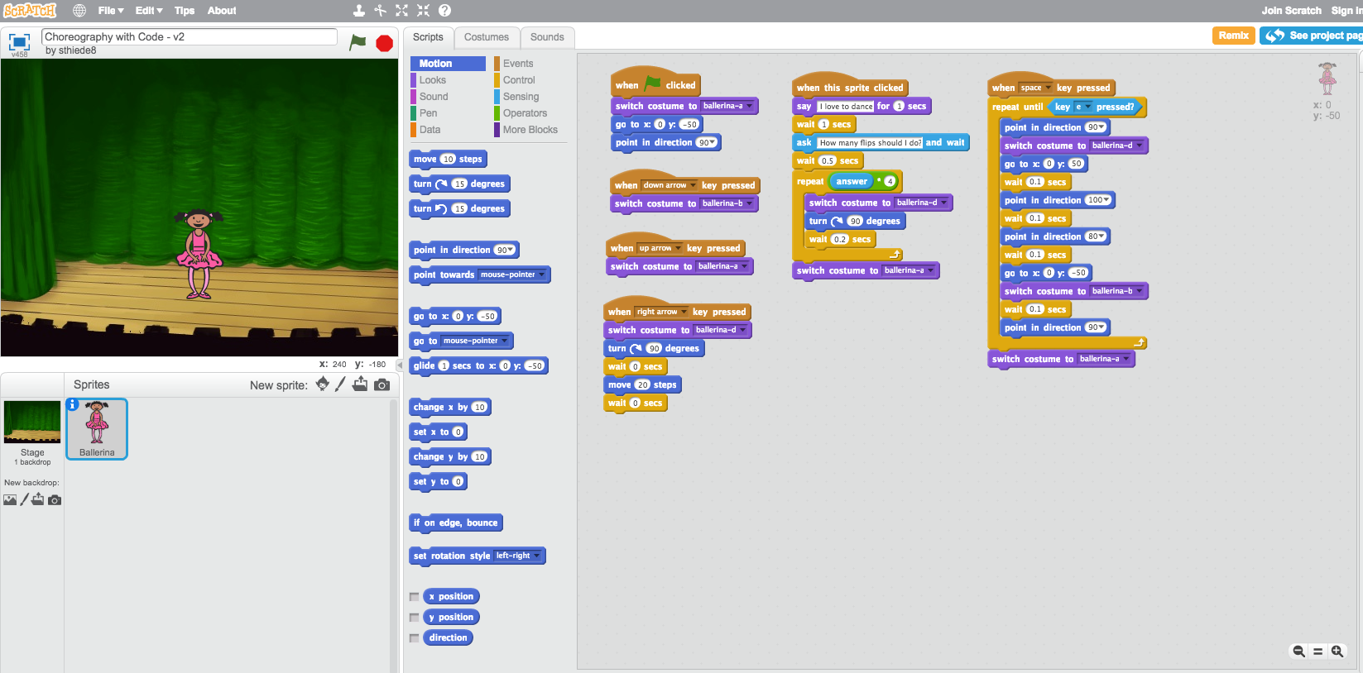
Choreography with Code
Notes:
See inside
Doing choreography that is being defined due to code
Now we want to do something more automated and generalizable
How you can tell it what to do

Slide 21
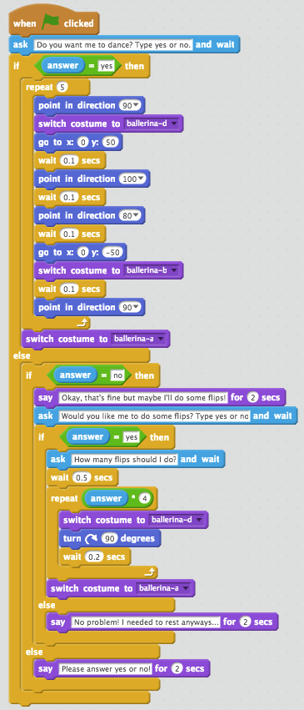
Choreography with Code
If answer to question “Do you want me to dance?” is yes:
Ballerina dances
Else:
If answer to question “Do you want me to dance” is no:
Ask “Would you like me to do some flips?”
If answer to question “Would you like me to do some flips?” is yes:
Ask “How many flips should I do?” and do flips
Else:
Say “No problem! I needed to rest anyways...”
Else:
Ask user to please answer yes/no
Notes:
Walk through if statement example and explain details of scratch
Each language has its own words, this language has some you might not know
Where to find operators and interact with scratch
Hand out for definitions
Bold is the do something

Slide 22

Choreography with Code
Make your own if statement following instructions on the handout.

Slide 23
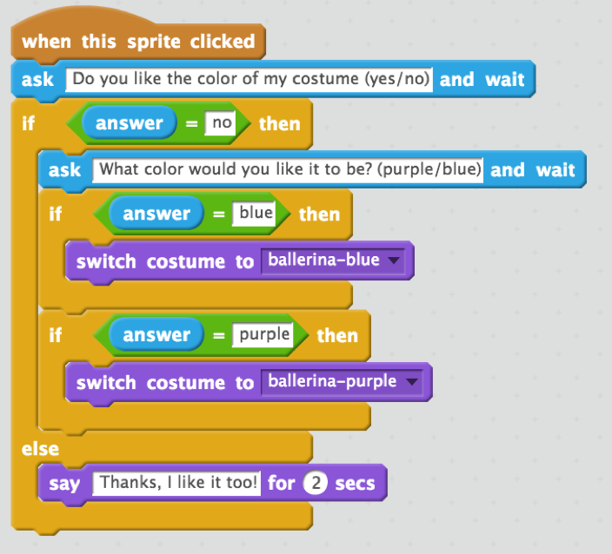
Choreography with Code
Notes:
Answer

Slide 24
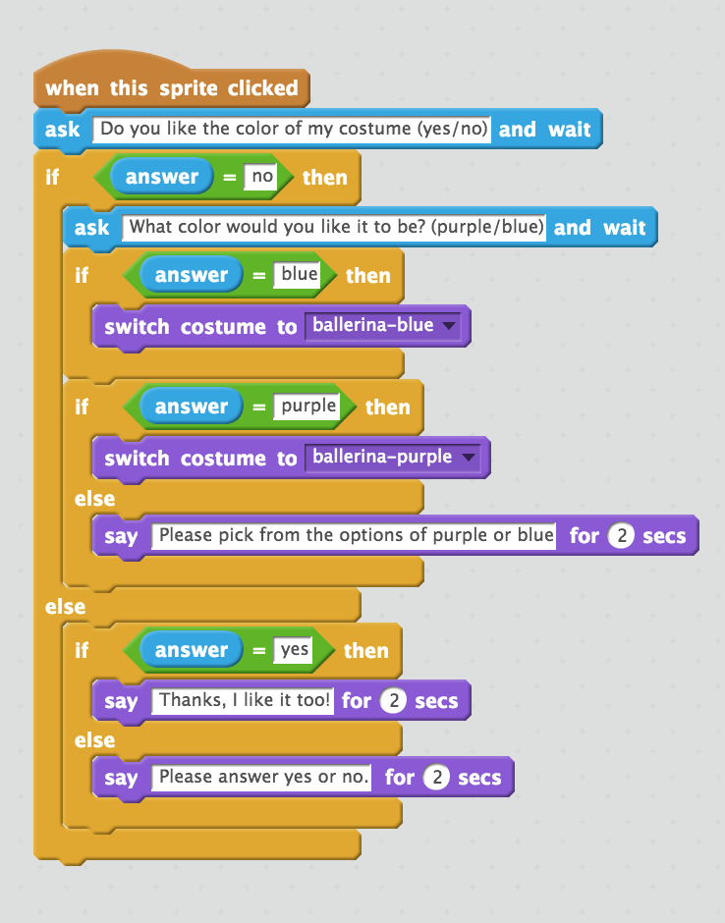
Choreography with Code

