Slide 1

Choreography with Code
Notes:
Say about girls who code

Slide 2
What is coding?

Slide 3


Boolean: binary variable with two possible values
TRUE
FALSE
Notes:
Yes or No
One or Zero

Slide 4
If you like the color pink:
Put your thumb up
Else:
Put your thumb down
Notes:
Now stand up and move around

Slide 5
If you have brown hair:
Go to left side of classroom
Else:
Go to right side of classroom

Slide 6
If you like chocolate:
Go to left side of classroom
Else:
Go to right side of classroom

Slide 7
If you were born in Michigan:
Go to left side of classroom
Else:
Go to right side of classroom

Slide 8
If you like dogs:
Go to left side of classroom
Else if you like cats:
Go to right side of classroom
Else:
Go to front of classroom
Notes:
If you like dogs AND cats you have to go to the left side of the room because liking dogs comes first--ORDER MATTERS

Slide 9
If you like math:
Go to left side of classroom
Else if you like science:
Go to right side of classroom
Else:
Go to front of classroom

Slide 10
If you like to read:
Go to left side of classroom
Else if you like to watch tv:
Go to right side of classroom
Else:
Go to front of classroom
Notes:
Notice the language I used when introducing your options

Slide 11
Conditional statement
If something is TRUE:
Then do something
Else if something is TRUE:
Then do something
Else:
Do something

Slide 12
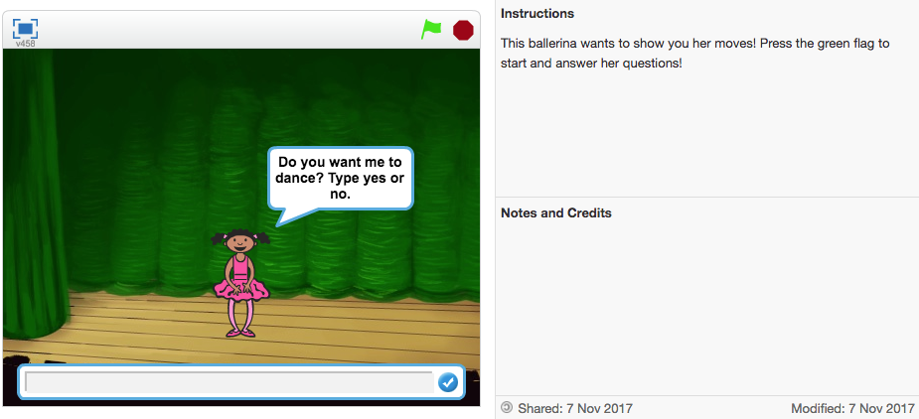
Choreography with Code
Notes:
Scratch is a free visual programming language
Developed by MIT Media Lab
Follow the notes and see what the ballerina can do

Slide 13
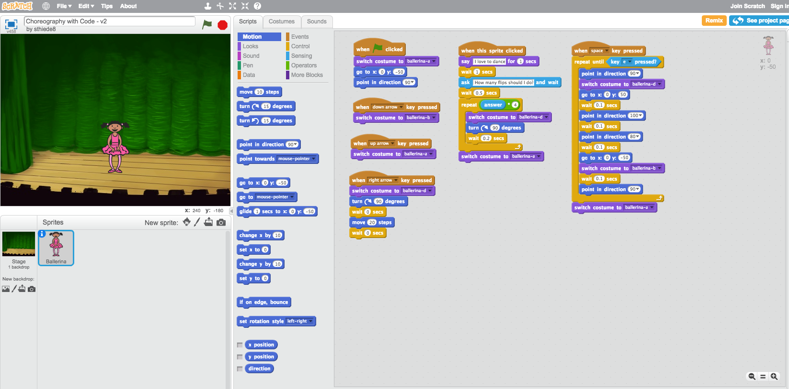
Choreography with Code
Notes:
See inside
Doing choreography that is being defined due to code
Now we want to do something more automated and generalizable
How you can tell it what to do

Slide 14
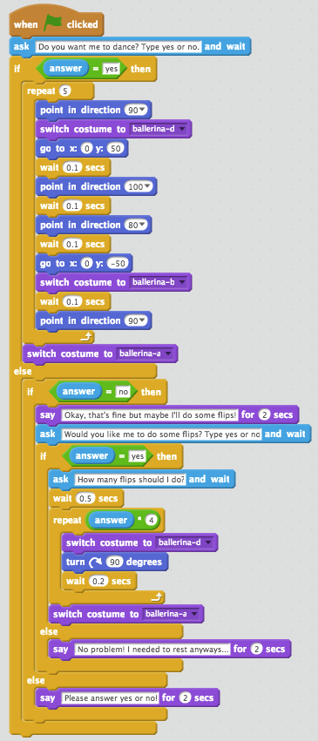
Choreography with Code
If answer to question “Do you want me to dance?” is yes:
Ballerina dances
Else:
If answer to question “Do you want me to dance” is no:
Ask “Would you like me to do some flips?”
If answer to question “Would you like me to do some flips?” is yes:
Ask “How many flips should I do?” and do flips
Else:
Say “No problem! I needed to rest anyways...”
Else:
Ask user to please answer yes/no
Notes:
Walk through if statement example and explain details of scratch
Each language has its own words, this language has some you might not know
Where to find operators and interact with scratch
Hand out for definitions
Bold is the do something

Slide 15

Choreography with Code
Make your own conditional statement following instructions on the handout.

Slide 16
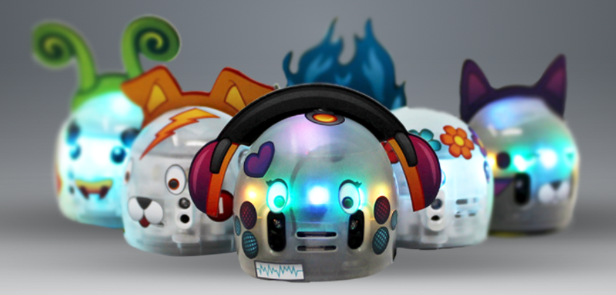
Ozobot

Slide 17

If sensor reads :
Spin around like a tornado
Else:
Continue moving forward on path

Slide 18
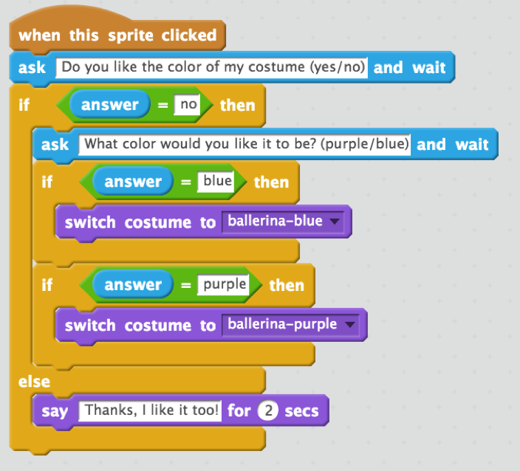
Scratch Solution
Notes:
Answer

Slide 19
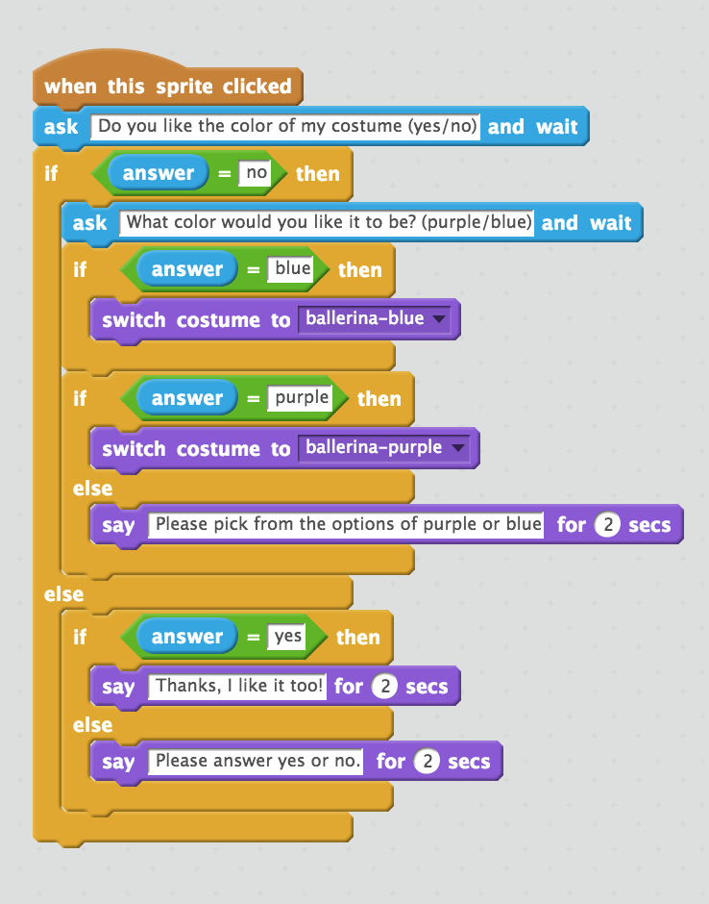
Scratch bonus: How to make your code robust

Slide 20
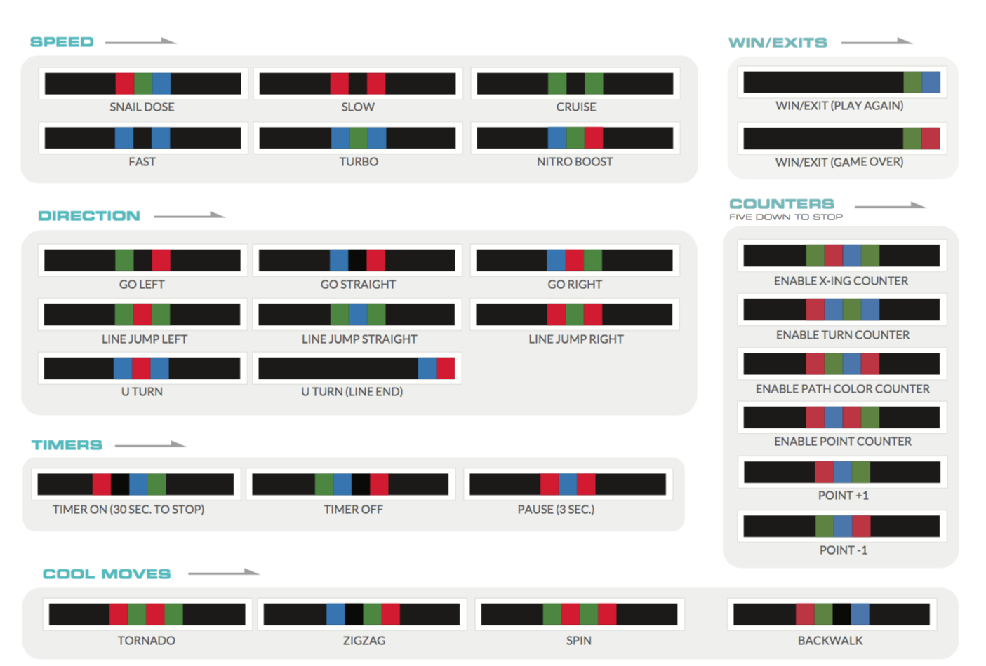
Ozocodes

