Slide 1
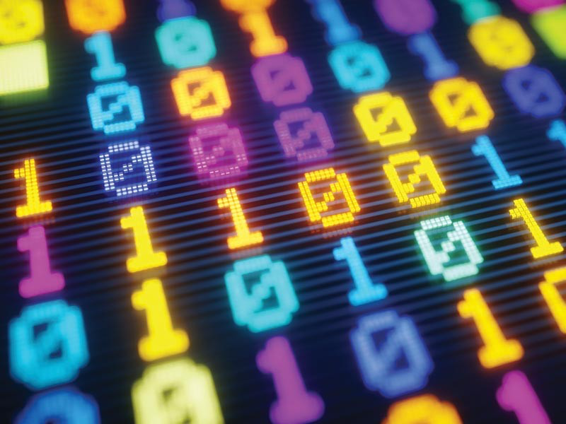
Computer Code

Slide 2
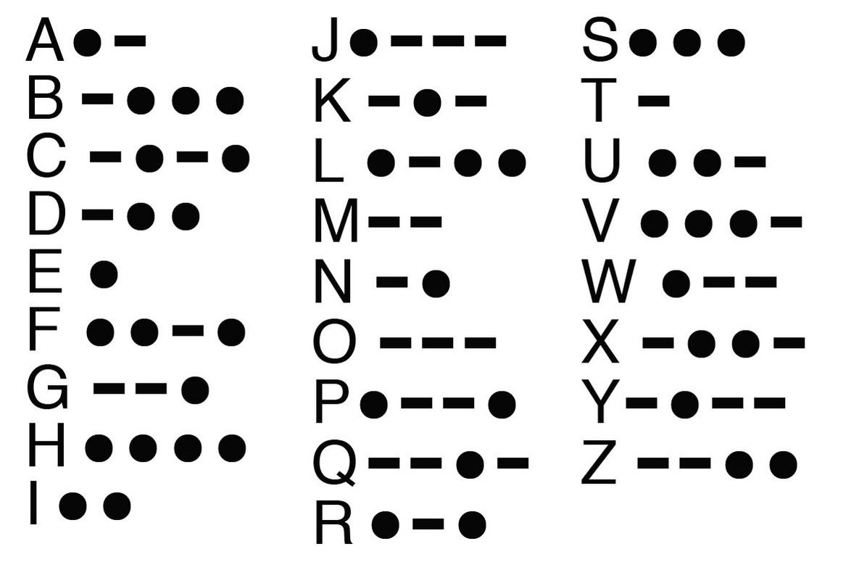
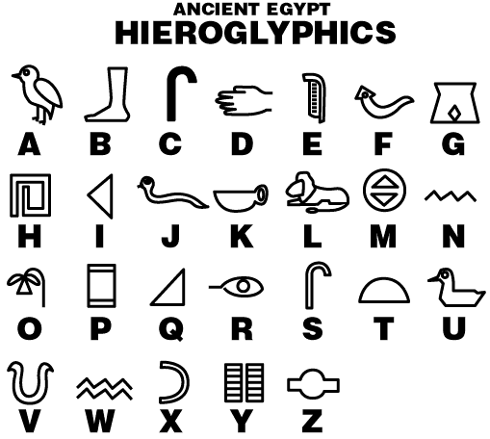
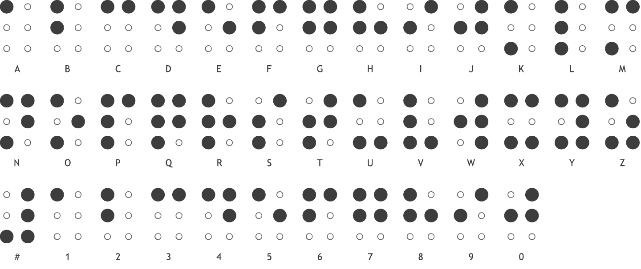
Use of Codes

Slide 3
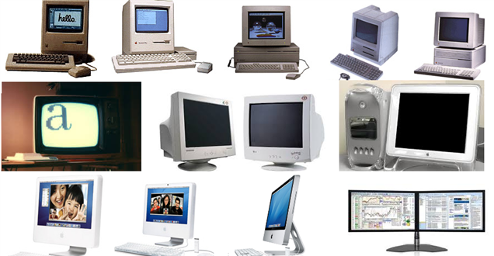
What types of code do computers use?
https://commons.wikimedia.org/wiki/File:Evolution_of_computers.png

Slide 4
Source code is written using a human-readable programming language
Python
C++
R
Java
HTML
Perl
Ruby
Scratch
Ozoblockly

Slide 5
Just like English can be translated to Spanish…
Hi! How are you?
¡Hola! ¿Como estás?
Translation

Slide 6
…Source code is translated to machine code
If variable equals five:
Then print(“Hello World”)
0 1 1 0 1 0 1
1 0 1 1 0 0 1
0 0 0 1 1 1 0
Translation
Source code
Machine code
https://medium.com/basecs/a-deeper-inspection-into-compilation-and-interpretation-d98952ebc842

Slide 7
Machine code is also called binary code
A language made entirely of 0 and 1
Run by the central processing unit (CPU)
Binary is a system of numerical notation using only 0 and 1
Binary arithmetic uses base 2, we usually use base 10
0 1 1 0 1 0 1
1 0 1 1 0 0 1
0 0 0 1 1 1 0
Machine code

Slide 8
Counting in binary!
Notes:
27 sticky notes in a line (count together)
How would you write this number? (have them write on board)
Number 27 is written in pace value - places are powers of 10
Rearrange sticky notes into tens and ones - base 10
Can use other place values, like base 5 (based on powers of 5)
Compute powers of five
Rearrange sticky notes into twenty-fives, fives, and ones
Write numeral for base 5 below sticky notes (102 - pronounced twenty-seven or 1-0-2 base 5)
Another example of place value is base two, or binary (based on powers of 2)
Compute powers of two
Rearrange sticky notes into sixteens, eights, fours, twos, and ones
Write numeral for base 2 under each label (11011)
Base 10 has 10 digits, base 5 has 5 digits, base 2 has 2 digits (ex. in base 10 can’t have a 10 in any place because that is the same as a 1 in the next higher place, in base 2 a 2 in a place would equal the next higher power of two, which is the same as a 1 in the next higher place)
Can use any base (ex. base 16 - uses letters A to F for values 10 to 15)
Students as binary numbers - 5 students at front of room - standing is a 1 (both ways - examples: 11011=27, 100=4,10011=19,9=1001,1=1,11=3)

Slide 9
27

Slide 10
Base 10
2
7
10¹
10⁰
10
1
10x2 + 1x7 = 27

Slide 11
Base 5
1
0
2
5²
5¹
5⁰
25
5
1
25x1 + 5x0 + 1x2 = 27

Slide 12
Base 2
1 1 0 1 1
2⁴
2³
2²
2¹
2⁰
16
8
4
2
1
16x1 + 8x1 + 4x0 + 2x1 + 1x1 = 27

Slide 13
How to count in binary (base 2)
Notes:
27 sticky notes in a line (count together)
How would you write this number? (have them write on board)
Number 27 is written in pace value - places are powers of 10
Rearrange sticky notes into tens and ones - base 10
Can use other place values, like base 5 (based on powers of 5)
Compute powers of five
Rearrange sticky notes into twenty-fives, fives, and ones
Write numeral for base 5 below sticky notes (102 - pronounced twenty-seven or 1-0-2 base 5)
Another example of place value is base two, or binary (based on powers of 2)
Compute powers of two
Rearrange sticky notes into sixteens, eights, fours, twos, and ones
Write numeral for base 2 under each label (11011)
Base 10 has 10 digits, base 5 has 5 digits, base 2 has 2 digits (ex. in base 10 can’t have a 10 in any place because that is the same as a 1 in the next higher place, in base 2 a 2 in a place would equal the next higher power of two, which is the same as a 1 in the next higher place)
Can use any base (ex. base 16 - uses letters A to F for values 10 to 15)
Students as binary numbers - 5 students at front of room - standing is a 1 (both ways - examples: 11011=27, 100=4,10011=19,9=1001,1=1,11=3)

Slide 14

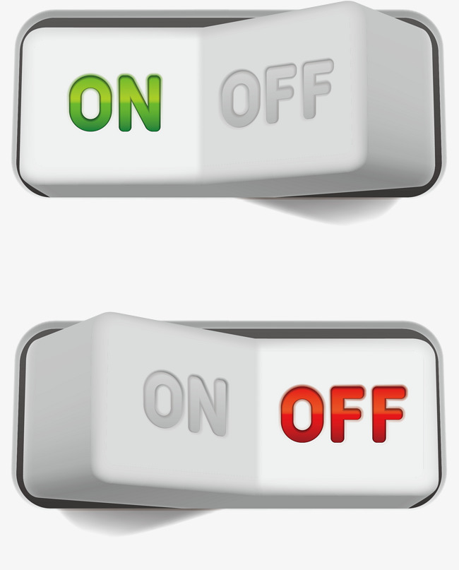

Boolean: binary variable with two possible values
1
TRUE
0
FALSE
Notes:
Computers read binary code because the 0 and 1 represnts on and off
A bit takes one of two values 0 or 1
Literally an electrical switch being turned on or off on the computer’s mother board
We can also think of it as true or false

Slide 15
Statement | Binary notation | Boolean notation
The sky is blue
The Earth is flat
1
TRUE
0
FALSE

Slide 16
If you like the color pink:
Put your thumb up
Else:
Put your thumb down
Notes:
Think about the binary and boolean notation in these cases

Slide 17
If you like chocolate:
Put your thumb up
Else:
Put your thumb down

Slide 18
If you were born in Michigan:
Put your thumb up
Else:
Put your thumb down

Slide 19
If you like dogs:
Raise your right hand
Else if you like cats:
Raise your left hand
Else:
Keep your hands down
Notes:
If you like dogs AND cats you have to go to the left side of the room because liking dogs comes first--ORDER MATTERS

Slide 20
If you like to read:
Raise your right hand
Else if you like to watch tv:
Raise your left hand
Else:
Keep your hands down
Notes:
Notice the language I used when introducing your options

Slide 21
Conditional statement
If something is TRUE:
Then do something
Else if something is TRUE:
Then do something
Else:
Do something

Slide 22
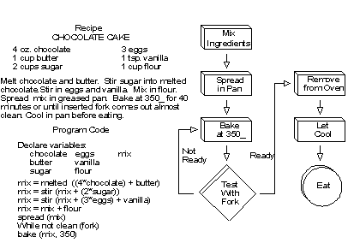
We write algorithms with source code
to make the computer do what we want
An algorithm is like a recipe
A process or set of instructions for the CPU to follow
https://www.webopedia.com/TERM/A/algorithm.html
Notes:
Give me an algorithm for doing a jumping jack

Slide 23
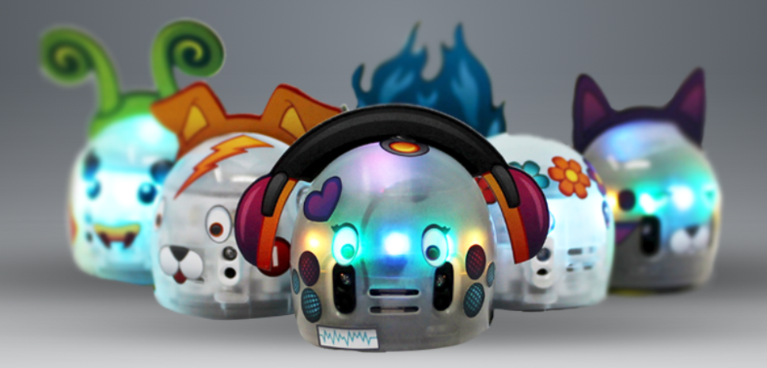
We are going to write source code
that uses an algorithm to convert
base10 to base2 numbers!

Slide 24
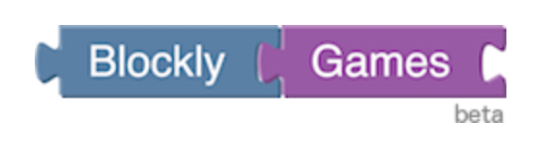

Let’s get coding!

Slide 25
We are going to write source code
that uses an algorithm to convert
base10 to base2 numbers!

Slide 26
Goal: Turn your Ozobot into a decimal to binary number converter with booleans and conditional statements! Use source code to: 1. Make the Ozobot follow the correct path
2. Check your answers to decimal-binary number conversions

Slide 27

Visit https://girlswhocode.com/locations/
For high schoolers with transportation to University of Michigan:
Email gwc.bioinfo-requests@umich.edu for information about our Application for 2018-2019 Girls Who Code Club

