Slide 1
Sample paths through facility:
Input material (=facility prep)
user prep
RNA QC1
Prep
QC1
QC2
sequencing
DNA QC1
Prep
QC1
QC2
sequencing
Libraries (=made of DNA too)
QC1
QC2
sequencing

Slide 2
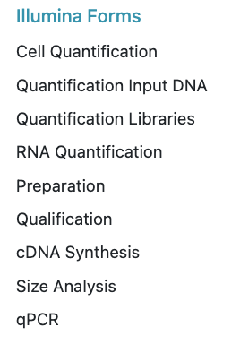
QC 1 – Qubit & FA
QC -> data accessibility problem we use our individual “lab-journal excel file” to record -all measurements -all calculations for dilutions
Fsk upload: currently available forms → forms used in QC upload data via or file
csv
csv
FA
FA
FA
csv
FA

Slide 3
QC 1 – Qubit & FA: processing workflow & important values
RNA Qubit (Fsk: concentration, vol) FA (Fsk: profile, RIN, DV200)
DNA Qubit (Fsk: concentration, vol) FA (Fsk: profile, %in smear) prepare input plate (Fsk: ng input, vol)
Libraries Qubit (Fsk: concentration, dilution) FA (Fsk: profile, size, molarity)
(next: qPCR in QC2)
csv
csv
csv
FA
FA
FA
+Library QC (after prep)
+Library QC (after prep)

Slide 4
QC 1 – forms to be created
Fsk upload: currently available forms: forms used in QC
proposed forms: Illumina Forms
Cell Quantification RNA Qubit RNA FA DNA input Qubit DNA input FA Preparation cDNA Synthesis Library Qubit Library FA qPCR
csv
csv
FA
csv
csv
FA
FA
FA
csv
FA
FA

Slide 5

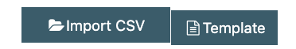
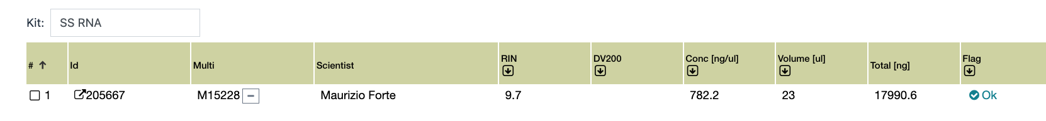
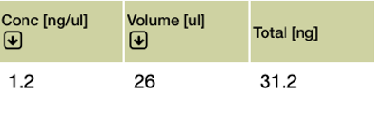
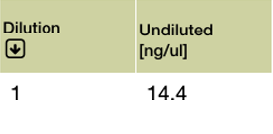
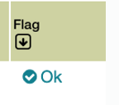
QC 1 – RNA Qubit
c12: tickbox
c13: text
c11
RNA Qubit: import from → grab from import file: sample ID and conc, rest of the form empty or grabbed from database → flag “dilute” to be set automatically IF tab5 >200 → form does not exist yet, can be derived from “DNA input Qubit”
→ To store Qubit conc & volume and prepare sample for FA
csv
c7: Auto-calc:
(=c5*c6)
c8: Filled by us, default=1
c3: Automatic from database
c4:Automatic from database
c6: Filled by us
c9: Auto-calc:
(=c5/c8)
c10: dropdown
BR RNA Qubit
c5: From csv
BR RNA Qubit
Qubit
c2: From csv
Conc of diluted sample
factor
10
0.12
Flag dropdown:
-unknown
-ok
-warning
-Not enough material
-dilute

Slide 6
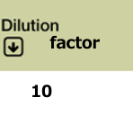
QC 1 – RNA FA
c14: tickbox
c15: text
c13
RNA FA: import from → RIN, DV200 and FA conc imported from FA-csv-file → dilution factor & Volume grabbed from Qubit form but dilution factor with option to change & fill manually? → DV200 does not work every time (bug) → to store quality measures from FA run and evaluate sample
FA
c8: grab from RNA Qubit form c8
c10: grab from RNA Qubit form c6
c3: Automatic from database
c4: Automatic from database
c5: From FA file
c6: From FA file
c7: From FA file
c12: dropdown
FA
c2: From FA file
Preparation type
Original conc
c4a: Automatic from database
c9: Auto-calc:
(=c7*c8)
c11: Auto-calc:
(=c9*c10)
Flag dropdown:
-unknown
-ok
-warning
-Not enough material
-RIN
-DV200
-pattern mismatch
-DNA Contamination
-degradation

Slide 7

QC 1 – DNA input Qubit
c13
c14: tickbox
c15: text
DNA input Qubit: import from -> from import file: sample ID and Qubit conc, rest of the form empty or filled from database -> targeted FA conc to be filled by me, can be pre-filled with 2.5, but editable -> sample vol: we want to waste as little material as possible for dilution for FA, ideally only 1ul, but editable in case it needs to be 2ul -> To store Qubit conc & volume and prepare sample for FA
csv
c10: auto-calc: (=(c5/c8)-c9)
c11: auto-calc:
(=c5/c8)
c7: Auto-calc:
(=c5*c6)
c8: filled by us, default=empty
c9: filled by us, default=1
c4: Automatic from database
c5: From csv
c6: Filled
by us
c12: dropdown
c2: From csv file
Qubit
Preparation type
Water to add
resultingdilution factor
c4a: Automatic from database
Flag dropdown:
-unknown
-ok
-warning
-Not enough material
2.5
1
1
c3: Automatic from database

Slide 8

QC 1 – DNA input FA
c13: tickbox
c14: text
c12
c8: grab from DNA Qubit form c11
DNA input FA: import from -> from import file: sample ID, FA conc, range ratio%, smear (x-y bp) -> then grab dilution factor used from Qubit file → to store quality measures from FA run and evaluate sample
FA
c6: From
FA file
c7: From
FA file
c9: auto-calc:
(=c5*c8)
c10: auto-calc:
(=c9*c6/100)
c2: From FA file
c3: Automatic from database
c4: Automatic from database
c5: From
FA file
c11: dropdown
Preparation type
FA conc
Smear (bp)
dilution factor used
FA conc original
c4a: Automatic from database
1000-180000
5
8.5
=8.5*93.4/100
Flag dropdown:
-unknown
-ok
-warning
-Not enough material
-size mismatch genomic
-size mismatch ligation
-size mismatch ChIP-Seq

Slide 9
QC 1 – Library Qubit
c16: text
c15: tickbox
c14
c8: Auto-matic from data- base, but editable
c9: Auto-matic from data-base
c7: filled by us, default=empty
c10: Auto-calc: (=c6/(c7*c8) editable
Library Qubit: import from -> from import file: sample ID and conc -> -> targeted FA conc to be filled by me (default empty, but editable!) -> targeted sample vol should be prefilled with vol according to readmode, but editable -> readmode grabbed from fsk (always grab parent request!!, or list all of them if more?) -> sample vol and buffer vol field calculated by Fsk but editable in case we physically dilute differently (for documentation reasons)!!!! -> undiluted? for traceability, is it undiluted? With tickbox if tickbox is ticked= c10 and c11 should be wiped/empty
→ To store Qubit conc and prepare sample for FA
csv
c6: From csv
c11: Auto-calc: (=c8-c10)
c2: From csv file
c12: tickbox
c4: Automatic from database
c5: Automatic from database
Qubit
c13: dropdown
Experiment type
Targeted Sample
vol (ul)
Undiluted?
amplicon
30
Flag dropdown:
-unknown
-ok
-warning
-Not enough material
c3: Automatic from database

Slide 10
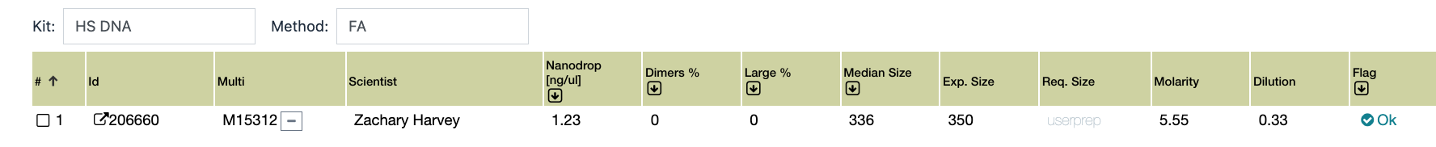
QC 1 – Library FA – pt1
Library FA: import from
-> median size, exp size, req. size, molarity calculated → to store average size from FA run and evaluate sample
FA
c10: autocalc from c6 & c7
c6: From
FA file
c7: From
FA file
c4: Automatic from database
c5: Automatic from database
c8: From
database
c9: From
database
c2: From FA file
Experiment type
…see next slide
amplicon
c3: Automatic from database

Slide 11
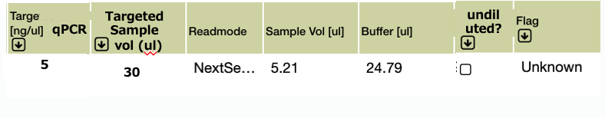
QC 1 – Library FA – pt2
Library FA: import from
-> targeted qPCR conc (11) to be filled by me (can be prefilled with 6, but editable!) -> targeted sample vol (12) to be filled by me (can be prefilled with vol according to readmode) -> readmode grabbed from fsk (always grab parent request if there is, or list all of them if more?) -> sample vol and buffer vol field calculated by Fsk with (6), (11), (12) but editable in case we physically dilute differently (for documentation reasons) -> undiluted? for traceability, is it undiluted? Tickbox! -> pooling strategy (either FA or qPCR)
FA
Flag dropdown:
-unknown
-ok
-warning
-Not enough material
-pattern mismatch
-adapter dimers
-multiple peaks
->30% over 1000bp
c12: Automatic from database
c13: Automatic from database
c17: Auto-matic from data-base
c11: Autofill to 6, but editable
c14: Auto-calc: (=c6/(c11*c12)
c15: Auto-calc: (=c12-c14)
c16: tickbox
c18: dropdown
c15: tickbox
c14
c16: text
…
Targeted for qPCR [nM]
Pooling strategy
qPCR

Slide 12
Other forms:
cDNA & preparation form update: show qubit and FA concentrations alongside for comparison input vol is calculated using which one??

Slide 13
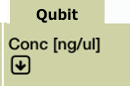

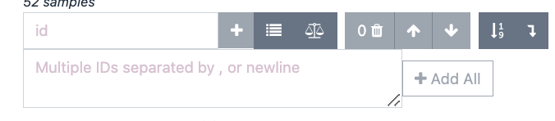
cDNA Synthesis
c11a: from DB
Flag dropdown:
As it is now
Request ID (for Wells coordinates)
c5-Automatic from database
Well position submission plate
c12: dropdown
FA
c6: Automatic RNA Qubit form c5
B10
c2: loads after typing into box below
c3: Automatic from database
c4: Automatic from database
c7: Automatic RNA FA form c7
c8: automatic from RNA Qubit c6, with deduction (minus value c9)
c9: calculated using c10 & c7
c10: calculated using c9 & c7
c11b: automatic from database
c14: tickbox
c15: text
c13
cDNA form update: show qubit and FA concentrations alongside for comparison input vol is calculated using FA conc (if possible: deduct from volume IF there were cDNA forms created before) well position from submission plate?

Slide 14
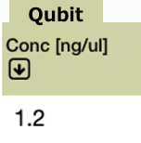

Preparation form
Flag dropdown:
As it is now
c14: text
c15: dropdown
c14
c17: tickbox
c18: text
Preparation form for DNA update: show qubit and FA + effective conc & effective concentration alongside for comparison input vol is calculated using Qubit value
c5: dropdown
c6: dropdown
c7: dropdown
c8: Automatic from DNA input Qubit form c5
c9: Auto-matic from DNA input FA form c9
c10: Automatic from DNA input FA form c10
c11: calculated using c8 & c12
c12: calculated using c8 & c11
c13
c2: loads after typing into box below
c3: Automatic from database
c4: Automatic from database

Slide 15
QC 1 – automatic emails
Make them a 2nd step package – but lay the groundwork for it to work (like form-specific flags?)
Questions: - when to trigger the email? (upon status change?) - is it worth to keep the written PDF own risk sheet format? Or should we switch to an online version? Like a application that allows the PI to open a window that shows all the open cases for own risk in the group & PI can give confirmation by click from own profile?
Ideas: - On multiplex status → On Hold → triggers email with accumulated list of samples with problems and problem description - Automatic email for status change can stay

Slide 16
Connectivity of Forms:
Always latest values from the database if various versions are saved/available
Possibility of being overwritten manually by admin
Refresh button to make sure the latest values are loaded
Plate-Well-Information:
- Save information of well coordinates in sample/request combination at plate generation step in database
- this is necessary if plates are partially re-submitted and old ones partially re-used

Slide 17
Legend
c<number> = column number
c<number> in calculations: values in this columns should be used for calculations
Green border = new or changed column
Red border = column exists this way in this or in another form

