Slide 1
Medical Insurance Coverage
Graphical Analysis of the Expansion of Coverage (2010-2015) versus Medicare Cost Per Beneficiary et al.

Slide 2
The PPACA, Expansion of Coverage and Healthcare Costs
The two main focuses of the PPACA as reported to us in 2010 was to:
Expand Coverage
Contain Costs
Well the expansion of coverage is evident in the following Data Sets, but what about the containment of cost?
What else is significant about these analyses?

Slide 3
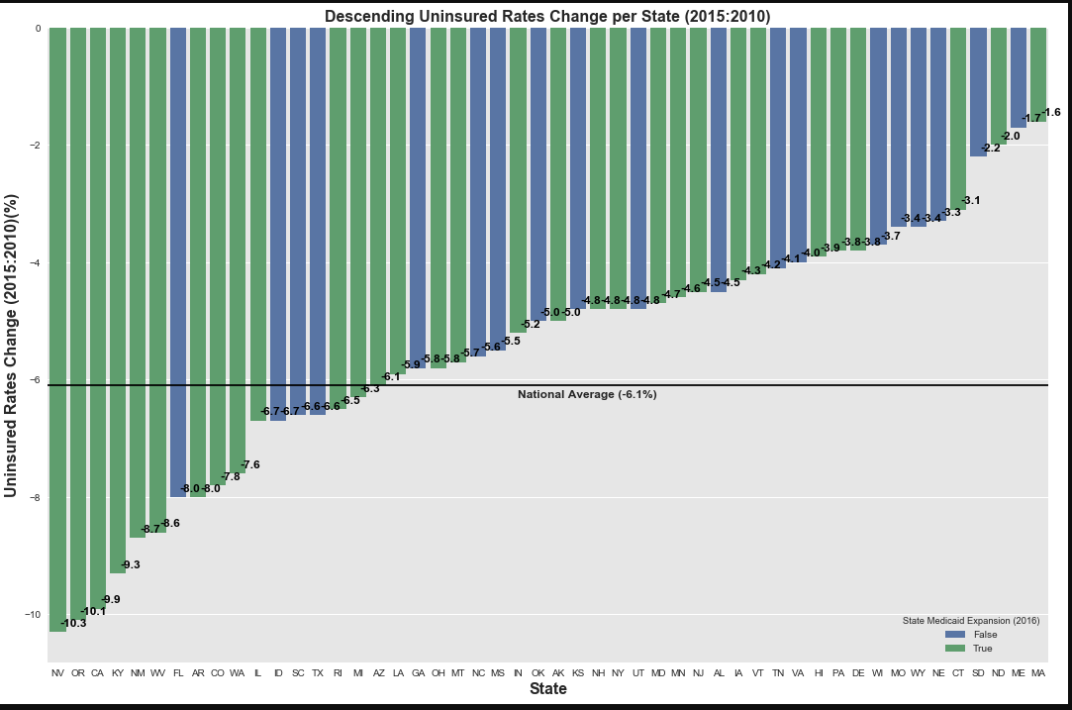
Following the implementation of the PPACA:
All States experienced an increase in medical coverage for their respective populations
The National Population of Uninsured citizens decrease by an Average of 6.1 %

Slide 4
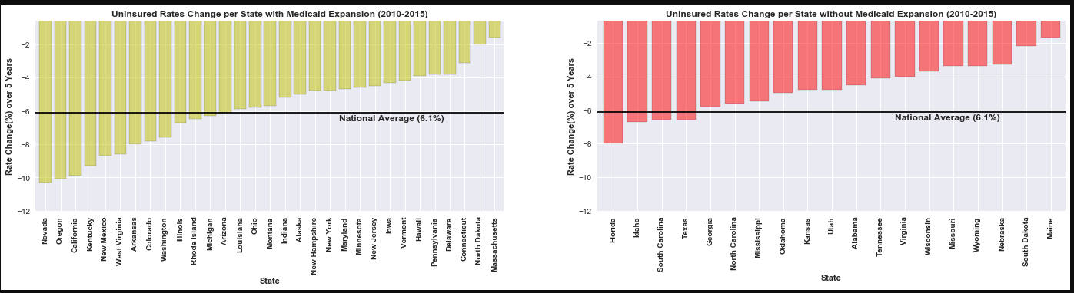
Side by side comparison demonstrating that states that expanded Medicaid had higher drops in Uninsured population Rates. Did the geographic location of the states have an impact on these factors?

Slide 5
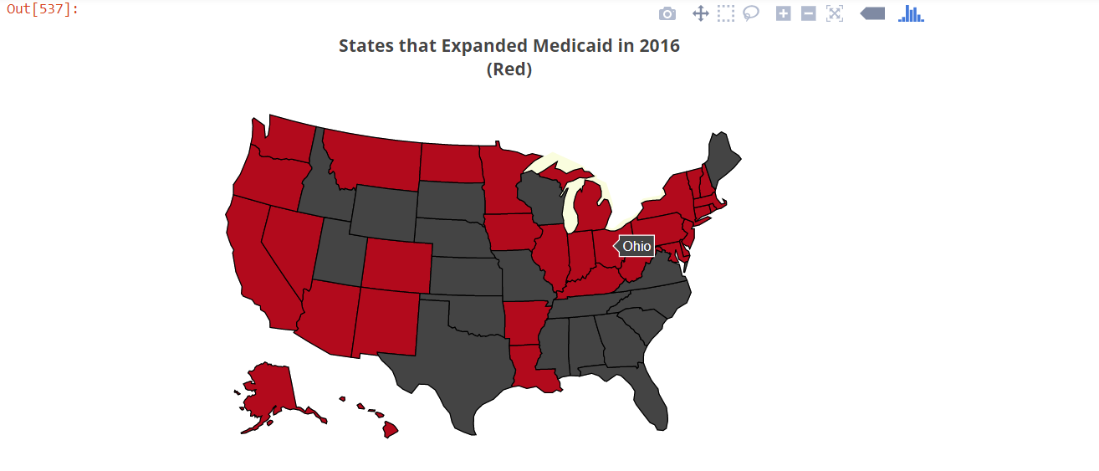
A map visualization of the previous two slides helps to identify where to investigate further correlations:
How would this compare to various voter/political maps
How would this compare to census maps
How would this compare to financial maps with GDP, avg. income, etc

Slide 6
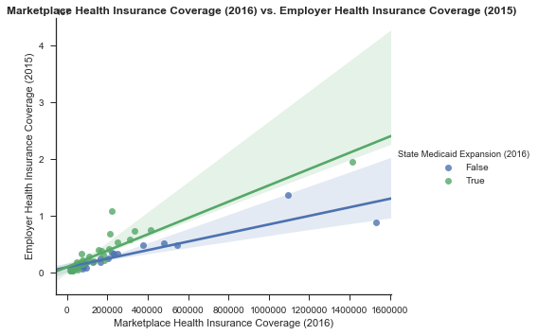
We began to Analyze things in the perspective of Medicaid Expansion versus No Medicaid Expansion:
EmployerHealth Insurance Coverage versus Marketplace Health Insurance Coverage rates were higher in most states that took the Medicaid Expansion.
Should the expansion be considered a stop-gap and not permanent moving forward?

Slide 7
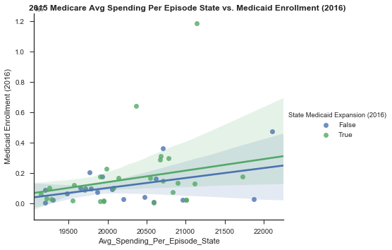
Directly the Average Spending Per State versus Medicare Enrollment had a positive correlation:
Though they were outliers two states that did not expand Medicaid were of the highest in average cost per episode
Another state that did expand Medicaid Coverage and had a significant enrollment in Medicaid did not seem to lower costs as was expected in 2010
Did this state have a reason for this result (underserved populations, sicker populace)?

Slide 8
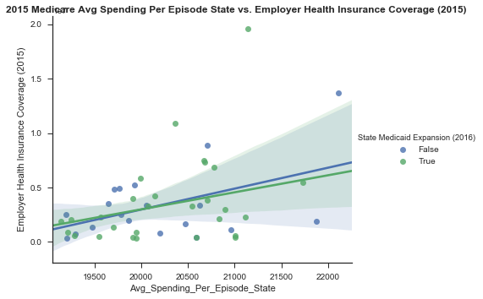
Positive Correlation between a rise in Employee Health Coverage and Average Spending per State:
Was this indicative of anything or was it just congruent with the other side of expanding coverage?

Slide 9
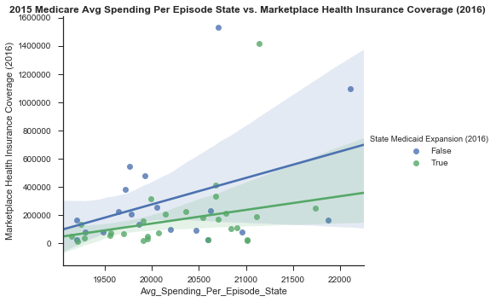
Positive Correlation -

Slide 10
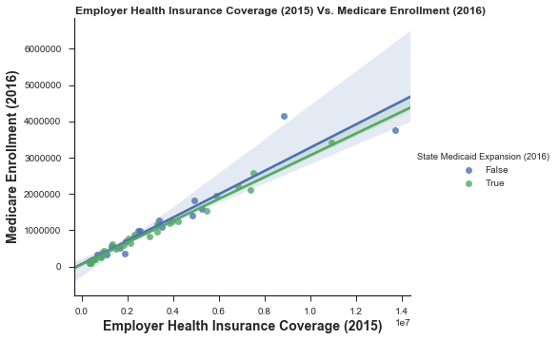
Positive Correlation showing two likely unrelated events.

Slide 11
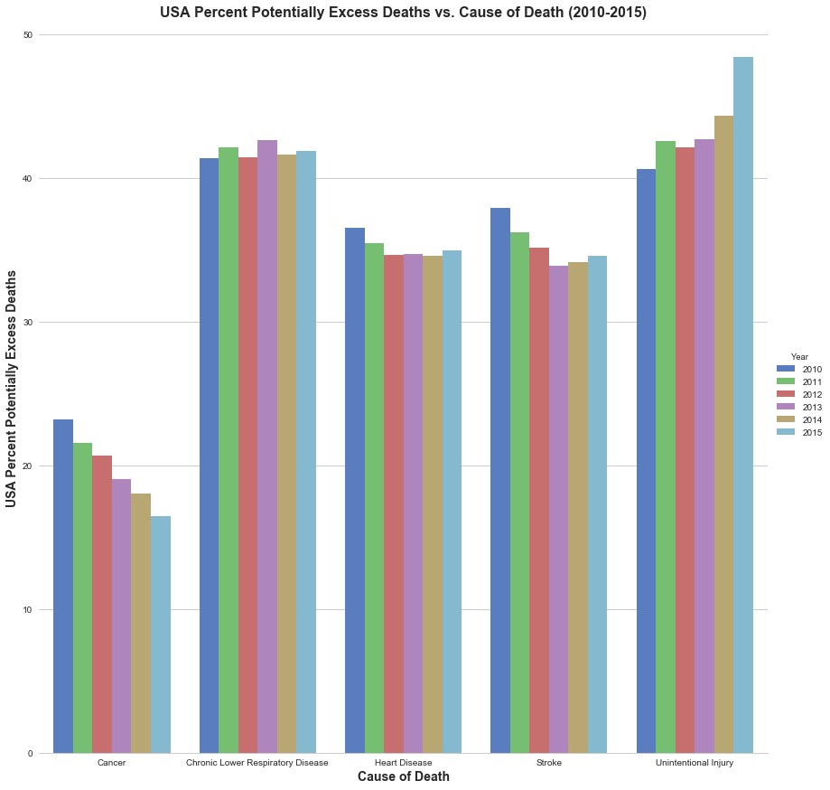
We then Included another Data Set for Analysis. This depicting the death rates from the major killers over the last 5 years. (Cataclysmic events like death are the major cost affecting factors)
Cause of Death Trends
Two Interesting Trends Stand Out:
Cancer Death Rates:
Decreased as health care coverage expanded
What further explanations should be investigated?
Unintentional Injury Deaths (Unintentional Poisonings, i.e. overdoses):
Increased as health care coverage expanded
What further explanations should be investigated?

Slide 12
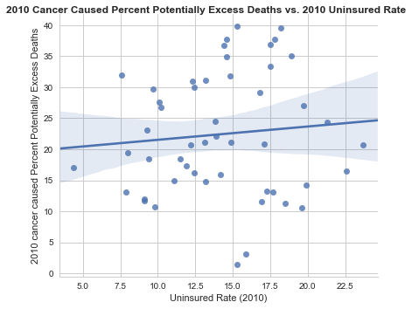
Positive Correlation (slightly)-
There was a slightly positive demonstrable correlation between the states Uninsured Rates in 2010 and the recorded Excess Deaths from Cancer of that year. Though the spread provides a significant amount of outliers

Slide 13
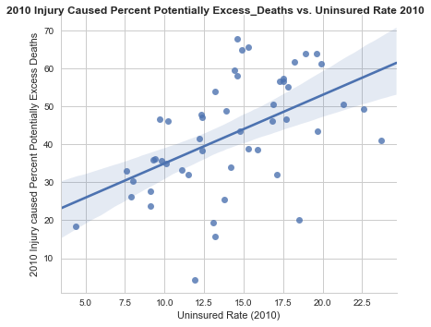
Positive Correlation (more definitive)-
Though there was a more definitive correlation between Injury Caused Excess Deaths versus Uninsured Rates in 2010

Slide 14
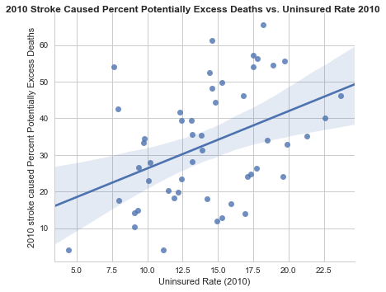
Positive Correlation-
There was also a more significant positive correlation between Excess Deaths via Stroke versus Uninsured Rates in 2010 also

Slide 15
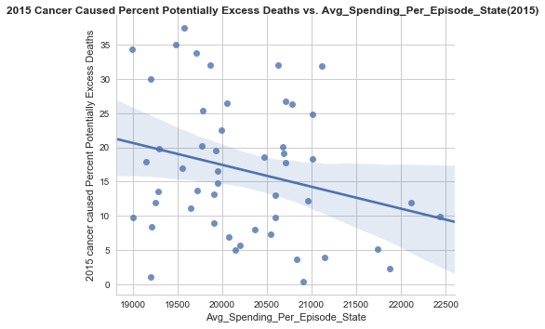
Negative Correlation -
Average Spending Per State had a negative correlation with the recorded Potentially Excess Deaths from Cancer (2015)

Slide 16
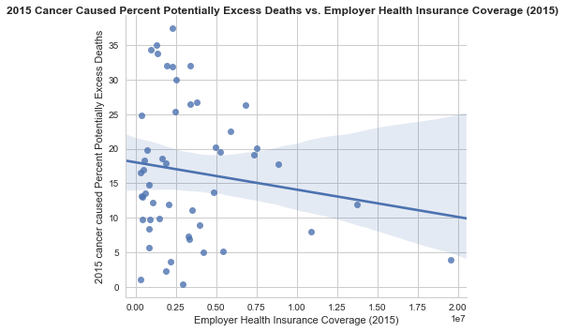
Negative Correlation-
In 2015 the datasets we used showed a slightly negative correlation between Excessive Deaths from Cancer and Employer Health Coverage
Is the coverage provided by employers of lower quality than it was before the PPACA (ie High Deductible Plans)
Is work bad?

Slide 17
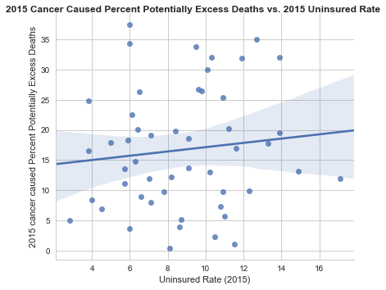
Not a significant correlation between these two variables:

Slide 18
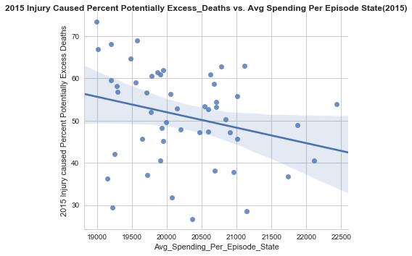
Negative Correlation-

Slide 19
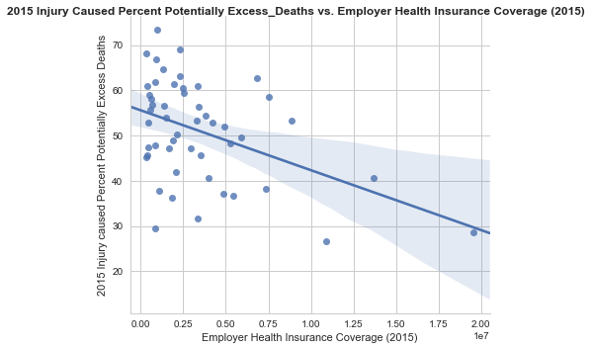
Negative Correlation – As Employer Health Insurance Coverage went up Excess Deaths from Injury went down. This would be expected.

Slide 20
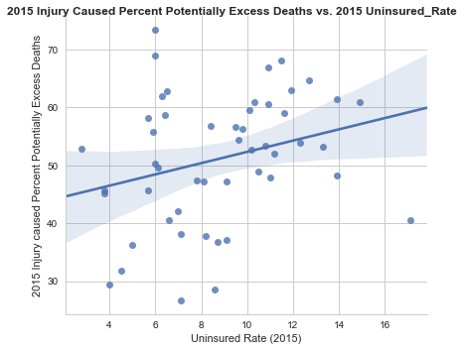
Positive Correlation-

Slide 21
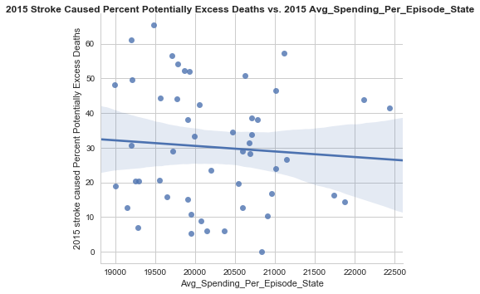
No identifiable correlation between contrasting these two variables

Slide 22
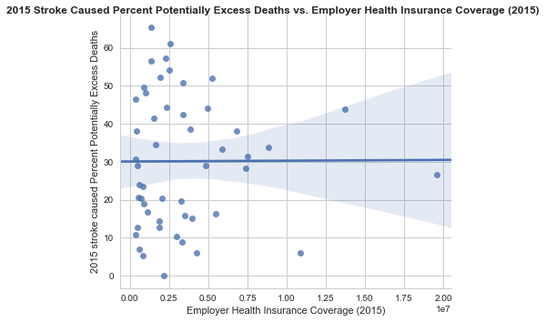
Nor these-

Slide 23
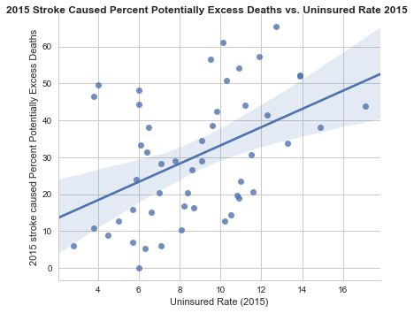
Positive Correlation-

Slide 24
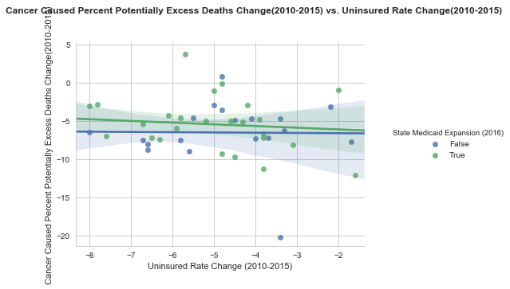
No Obvious Correlation-
Could we change the equation by dividing by another factor?

Slide 25
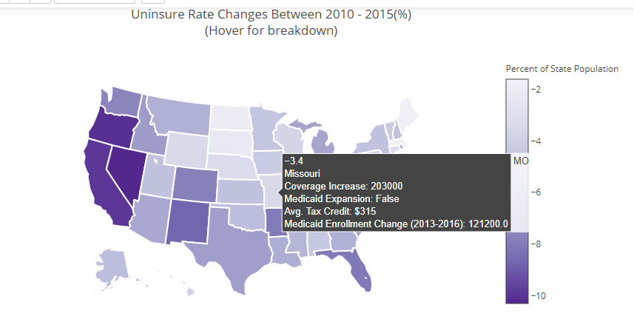
Coverage map depicting Health Insurance Coverage Data Set:
I

