Slide 1
Chapter 2
Instructions: Language of the Computer

Slide 2
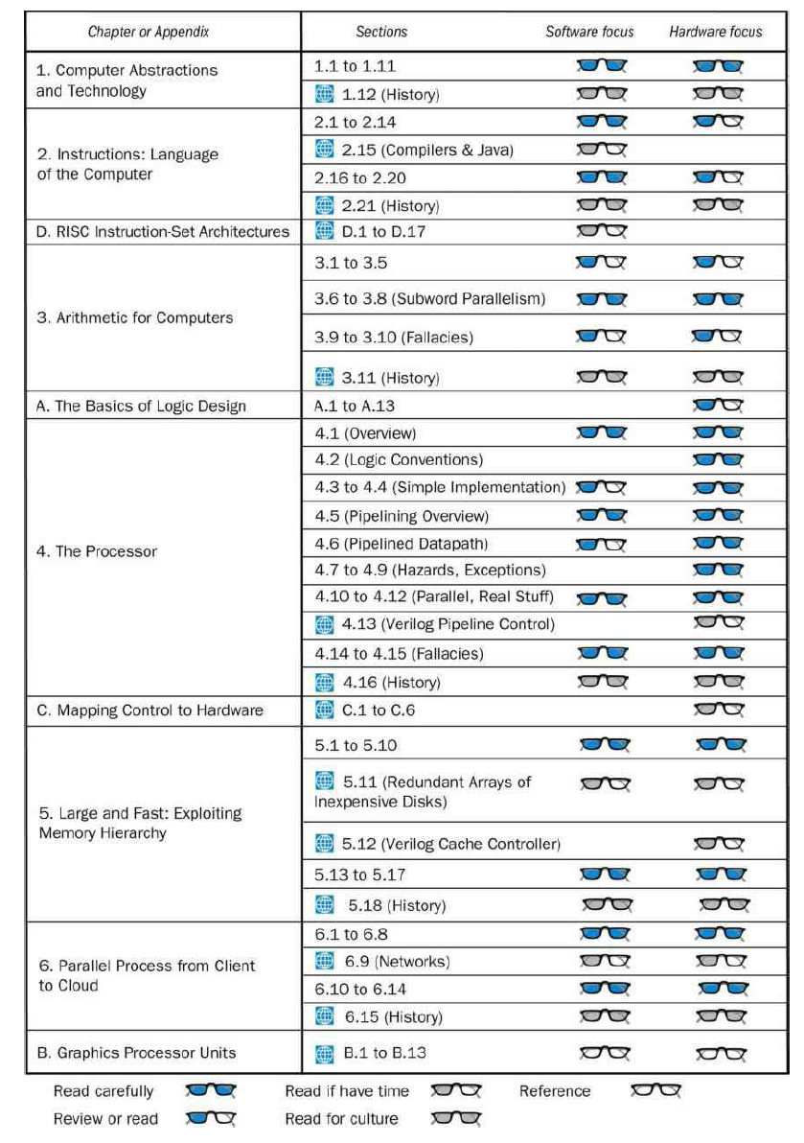

Slide 3
Instruction Set
§2.1 Introduction
The repertoire of instructions of a computer
Different computers have different instruction sets
But with many aspects in common
Early computers had very simple instruction sets
Simplified implementation
Many modern computers also have simple instruction sets

Slide 4
The MIPS Instruction Set
Used as the example throughout the book
Stanford MIPS commercialized by MIPS Technologies (www.mips.com)
Large share of embedded core market
Applications in consumer electronics, network/storage equipment, cameras, printers, …
Typical of many modern ISAs
See MIPS Reference Data tear-out card, and Appendixes B and E

Slide 5
The RISC-V Instruction Set
Used as the example throughout the book
Developed at UC Berkeley as open ISA
Now managed by the RISC-V Foundation (riscv.org)
Typical of many modern ISAs
See RISC-V Reference Data tear-out card
Similar ISAs have a large share of embedded core market
Applications in consumer electronics, network/storage equipment, cameras, printers, …

Slide 6
ISA
MIPS Green Card:
https://inst.eecs.berkeley.edu/~cs61c/resources/MIPS_Green_Sheet.pdf
RISC-V Greed Card:
https://www.cl.cam.ac.uk/teaching/1617/ECAD+Arch/files/docs/RISCVGreenCardv8-20151013.pdf

Slide 7
Arithmetic Operations
Add and subtract, three operands
Two sources and one destination
add a, b, c // a gets b + c
All arithmetic operations have this form
Design Principle 1: Simplicity favours regularity
Regularity makes implementation simpler
Simplicity enables higher performance at lower cost
§2.2 Operations of the Computer Hardware

Slide 8
Arithmetic Example
C code:
f = (g + h) - (i + j);
Compiled RISC-V code:
add t0, g, h // temp t0 = g + h add t1, i, j // temp t1 = i + j add f, t0, t1 // f = t0 - t1

Slide 9
Register Operands (RISC-V)
Arithmetic instructions use register operands
RISC-V has a 32 × 64-bit register file
Use for frequently accessed data
64-bit data is called a “doubleword”
32 x 64-bit general purpose registers x0 to x30
32-bit data is called a “word”
Design Principle 2: Smaller is faster
c.f. main memory: millions of locations

Slide 10
Register Operands (MIPS)
Arithmetic instructions use register operands
MIPS has a 32 × 32-bit register file
Use for frequently accessed data
Numbered 0 to 31
32-bit data called a “word”
Assembler names
$t0, $t1, …, $t9 for temporary values
$s0, $s1, …, $s7 for saved variables
Design Principle 2: Smaller is faster
c.f. main memory: millions of locations
§2.3 Operands of the Computer Hardware

Slide 11
RISC-V Registers
x0: the constant value 0
x1: return address
x2: stack pointer
x3: global pointer
x4: thread pointer
x5 – x7, x28 – x31: temporaries
x8: frame pointer
x9, x18 – x27: saved registers
x10 – x11: function arguments/results
x12 – x17: function arguments

Slide 12
Register Operand Example
C code:
f = (g + h) - (i + j);
f, …, j in x19, x20, …, x23
Compiled RISC-V code:
add x5, x20, x21 add x6, x22, x23 sub x19, x5, x6

Slide 13
Memory Operands
Main memory used for composite data
Arrays, structures, dynamic data
To apply arithmetic operations
Load values from memory into registers
Store result from register to memory
Memory is byte addressed
Each address identifies an 8-bit byte
RISC-V is Little Endian
Least-significant byte at least address of a word
c.f. Big Endian: most-significant byte at least address
RISC-V does not require words to be aligned in memory
Unlike some other ISAs

Slide 14
Memory Operands (MIPS)
Main memory used for composite data
Arrays, structures, dynamic data
To apply arithmetic operations
Load values from memory into registers
Store result from register to memory
Memory is byte addressed
Each address identifies an 8-bit byte
MIPS is Big Endian
Most-significant byte at least address of a word
c.f. Little Endian: least-significant byte at least address
Words are aligned in memory
Address must be a multiple of 4

Slide 15
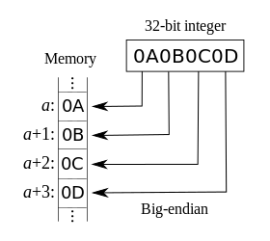
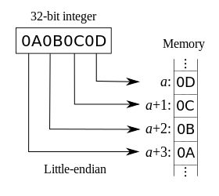
Big-Endian vs Little-Endian
https://en.wikipedia.org/wiki/Endianness

Slide 16
Memory Operand Example
C code:
A[12] = h + A[8];
h in x21, base address of A in x22
Compiled RISC-V code:
Index 8 requires offset of 64
8 bytes per doubleword
ld x9, 64(x22) add x9, x21, x9 sd x9, 96(x22)

Slide 17
Memory Operand (MIPS)
C code:
A[12] = h + A[8];
h in $s2, base address of A in $s3
Compiled MIPS code:
Index 8 requires offset of 32
lw $t0, 32($s3) # load word add $t0, $s2, $t0 sw $t0, 48($s3) # store word

Slide 18
Registers vs. Memory
Registers are faster to access than memory
Operating on memory data requires loads and stores
More instructions to be executed
Compiler must use registers for variables as much as possible
Only spill to memory for less frequently used variables
Register optimization is important!

Slide 19
Immediate Operands
Constant data specified in an instruction
addi x22, x22, 4
Make the common case fast
Small constants are common
Immediate operand avoids a load instruction

Slide 20
The Constant Zero
MIPS register 0 ($zero) is the constant 0
Cannot be overwritten
Useful for common operations
E.g., move between registers
add $t2, $s1, $zero
RISC-V register 0 (x0) is the constant 0

Slide 21
Unsigned Binary Integers
Given an n-bit number
§2.4 Signed and Unsigned Numbers
Range: 0 to +2^{n} – 1
Example
0000 0000 … 0000 1011₂ = 0 + … + 1×2³ + 0×2² +1×2¹ +1×2⁰ = 0 + … + 8 + 0 + 2 + 1 = 11₁₀
Using 64 bits: 0 to +18,446,774,073,709,551,615

Slide 22
2s-Complement Signed Integers
Given an n-bit number
Range: –2^{n – 1} to +2^{n – 1} – 1
Example
1111 1111 … 1111 1100₂ = –1×2³¹ + 1×2³⁰ + … + 1×2² +0×2¹ +0×2⁰ = –2,147,483,648 + 2,147,483,644 = –4₁₀
Using 64 bits: −9,223,372,036,854,775,808 to 9,223,372,036,854,775,807

Slide 23
2s-Complement Signed Integers
Bit 63 is sign bit
1 for negative numbers
0 for non-negative numbers
–(–2^{n – 1}) can’t be represented
Non-negative numbers have the same unsigned and 2s-complement representation
Some specific numbers
0: 0000 0000 … 0000
–1: 1111 1111 … 1111
Most-negative: 1000 0000 … 0000
Most-positive: 0111 1111 … 1111

Slide 24
Signed Negation
Complement and add 1
Complement means 1 → 0, 0 → 1
Example: negate +2
+2 = 0000 0000 … 0010_{two}
–2 = 1111 1111 … 1101_{two} + 1 = 1111 1111 … 1110_{two}

Slide 25
Sign Extension
Representing a number using more bits
Preserve the numeric value
Replicate the sign bit to the left
c.f. unsigned values: extend with 0s
Examples: 8-bit to 16-bit
+2: 0000 0010 => 0000 0000 0000 0010
–2: 1111 1110 => 1111 1111 1111 1110
In RISC-V instruction set
lb: sign-extend loaded byte
lbu: zero-extend loaded byte

Slide 26
Representing Instructions
Instructions are encoded in binary
Called machine code
RISC-V/MIPS instructions
Encoded as 32-bit instruction words
Small number of formats encoding operation code (opcode), register numbers, …
Regularity!
§2.5 Representing Instructions in the Computer

Slide 27
Hexadecimal
Base 16
Compact representation of bit strings
4 bits per hex digit
0 | 0000 | 4 | 0100 | 8 | 1000 | c | 1100
1 | 0001 | 5 | 0101 | 9 | 1001 | d | 1101
2 | 0010 | 6 | 0110 | a | 1010 | e | 1110
3 | 0011 | 7 | 0111 | b | 1011 | f | 1111
Example: eca8 6420
1110 1100 1010 1000 0110 0100 0010 0000

Slide 28
RISC-V R-format Instructions
funct7
rs2
rs1
funct3
rd
opcode
7 bits
5 bits
5 bits
3 bits
5 bits
7 bits
Instruction fields
opcode: operation code
rd: destination register number
funct3: 3-bit function code (additional opcode)
rs1: the first source register number
rs2: the second source register number
funct7: 7-bit function code (additional opcode)

Slide 29
MIPS R-format Instructions
op
rs
rt
rd
shamt
funct
6 bits
5 bits
5 bits
5 bits
5 bits
6 bits
Instruction fields
op: operation code (opcode)
rs: first source register number
rt: second source register number
rd: destination register number
shamt: shift amount (00000 for now)
funct: function code (extends opcode)

Slide 30
R-format Example
funct7
rs2
rs1
funct3
rd
opcode
7 bits
5 bits
5 bits
3 bits
5 bits
7 bits
add x9,x20,x21
0
21
20
0
9
51
0000000
10101
10100
000
01001
0110011
0000 0001 0101 1010 0000 0100 1011 0011_{two} =
015A04B3₁₆

Slide 31
RISC-V I-format Instructions
immediate
rs1
funct3
rd
opcode
12 bits
5 bits
3 bits
5 bits
7 bits
Immediate arithmetic and load instructions
rs1: source or base address register number
immediate: constant operand, or offset added to base address
2s-complement, sign extended
Design Principle 3: Good design demands good compromises
Different formats complicate decoding, but allow 32-bit instructions uniformly
Keep formats as similar as possible

Slide 32
RISC-V S-format Instructions
imm[11:5]
rs2
rs1
funct3
imm[4:0]
opcode
7 bits
5 bits
5 bits
3 bits
5 bits
7 bits
Different immediate format for store instructions
rs1: base address register number
rs2: source operand register number
immediate: offset added to base address
Split so that rs1 and rs2 fields always in the same place

Slide 33
MIPS I-format Instructions
op
rs
rt
constant or address
6 bits
5 bits
5 bits
16 bits
Immediate arithmetic and load/store instructions
rt: destination or source register number
Constant: –2¹⁵ to +2¹⁵ – 1
Address: offset added to base address in rs

Slide 34
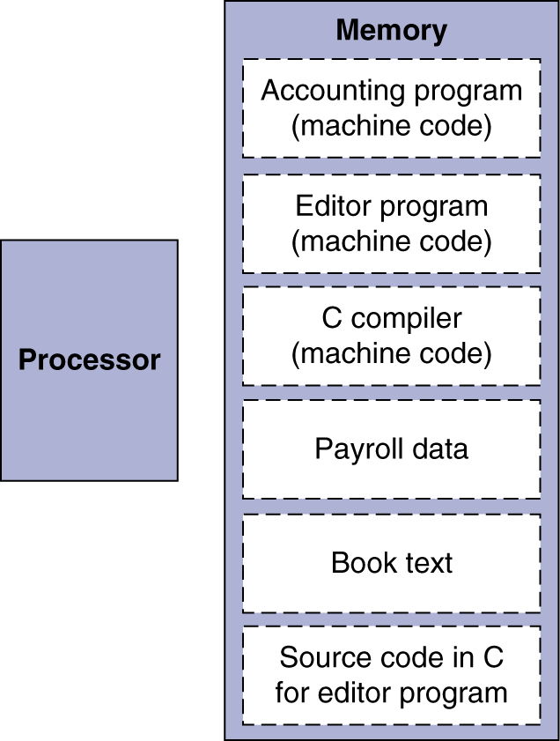
Stored Program Computers
The BIG Picture
Instructions represented in binary, just like data
Instructions and data stored in memory
Programs can operate on programs
e.g., compilers, linkers, …
Binary compatibility allows compiled programs to work on different computers
Standardized ISAs

Slide 35
Logical Operations
Instructions for bitwise manipulation
§2.6 Logical Operations
Operation | C | Java | RISC-V
Shift left | << | << | slli
Shift right | >> | >>> | srli
Bit-by-bit AND | & | & | and, andi
Bit-by-bit OR | | | | | or, ori
Bit-by-bit XOR | ^ | ^ | xor, xori
Bit-by-bit NOT | ~ | ~
Useful for extracting and inserting groups of bits in a word

Slide 36
Shift Operations
funct6
immed
rs1
funct3
rd
opcode
6 bits
6 bits
5 bits
3 bits
5 bits
7 bits
immed: how many positions to shift
Shift left logical
Shift left and fill with 0 bits
slli by i bits multiplies by 2^{i}
Shift right logical
Shift right and fill with 0 bits
srli by i bits divides by 2^{i} (unsigned only)

Slide 37
AND Operations
Useful to mask bits in a word
Select some bits, clear others to 0
and x9,x10,x11
x10
00000000 00000000 00000000 00000000 00000000 00000000 00001101 11000000
x11
00000000 00000000 00000000 00000000 00000000 00000000 00111100 00000000
x9
00000000 00000000 00000000 00000000 00000000 00000000 00001100 00000000

Slide 38
OR Operations
Useful to include bits in a word
Set some bits to 1, leave others unchanged
or x9,x10,x11
x10
00000000 00000000 00000000 00000000 00000000 00000000 00001101 11000000
x11
00000000 00000000 00000000 00000000 00000000 00000000 00111100 00000000
x9
00000000 00000000 00000000 00000000 00000000 00000000 00111101 11000000

Slide 39
XOR Operations
Differencing operation
Set some bits to 1, leave others unchanged
xor x9,x10,x12 // NOT operation
x10
00000000 00000000 00000000 00000000 00000000 00000000 00001101 11000000
x12
11111111 11111111 11111111 11111111 11111111 11111111 11111111 11111111
x9
11111111 11111111 11111111 11111111 11111111 11111111 11110010 00111111

Slide 40
Conditional Operations
Branch to a labeled instruction if a condition is true
Otherwise, continue sequentially
beq rs1, rs2, L1
if (rs1 == rs2) branch to instruction labeled L1
bne rs1, rs2, L1
if (rs1 != rs2) branch to instruction labeled L1
§2.7 Instructions for Making Decisions

Slide 41
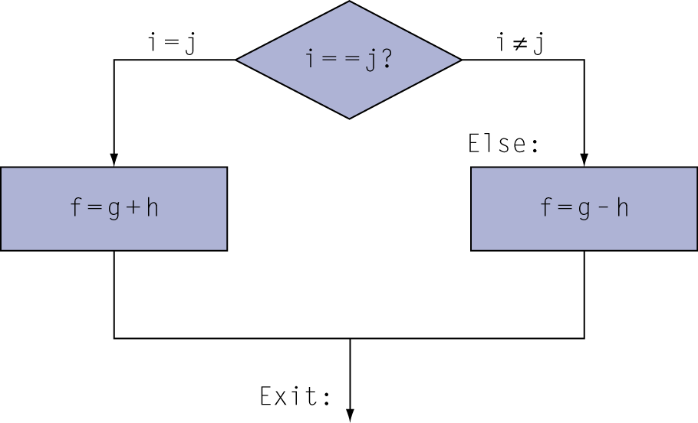
Compiling If Statements
C code:
if (i==j) f = g+h; else f = g-h;
f, g, … in x19, x20, …
Compiled RISC-V code:
bne x22, x23, Else add x19, x20, x21 beq x0,x0,Exit // unconditional Else: sub x19, x20, x21 Exit: …
Assembler calculates addresses

Slide 42
Compiling Loop Statements
C code:
while (save[i] == k) i += 1;
i in x22, k in x24, address of save in x25
Compiled RISC-V code:
Loop: slli x10, x22, 3 add x10, x10, x25 ld x9, 0(x10) bne x9, x24, Exit
addi x22, x22, 1 beq x0, x0, Loop Exit: …

Slide 43
Basic Blocks
A basic block is a sequence of instructions with
No embedded branches (except at end)
No branch targets (except at beginning)
A compiler identifies basic blocks for optimization
An advanced processor can accelerate execution of basic blocks

Slide 44
More Conditional Operations
blt rs1, rs2, L1
if (rs1 < rs2) branch to instruction labeled L1
bge rs1, rs2, L1
if (rs1 >= rs2) branch to instruction labeled L1
Example
if (a > b) a += 1;
a in x22, b in x23
bge x23, x22, Exit // branch if b >= a
addi x22, x22, 1
Exit:

Slide 45
MIPS Design (1/2)
Set result to 1 if a condition is true
Otherwise, set to 0
slt rd, rs, rt
if (rs < rt) rd = 1; else rd = 0;
slti rt, rs, constant
if (rs < constant) rt = 1; else rt = 0;
Use in combination with beq, bne
slt $t0, $s1, $s2 # if ($s1 < $s2) bne $t0, $zero, L # branch to L

Slide 46
MIPS Design (2/2)
Why not blt, bge, etc?
Hardware for <, ≥, … slower than =, ≠
Combining with branch involves more work per instruction, requiring a slower clock
All instructions penalized!
beq and bne are the common case
This is a good design compromise for low-end processors

Slide 47
Signed vs. Unsigned
Signed comparison: blt, bge
Unsigned comparison: bltu, bgeu
Example
x22 = 1111 1111 1111 1111 1111 1111 1111 1111
x23 = 0000 0000 0000 0000 0000 0000 0000 0001
x22 < x23 // signed
–1 < +1
x22 > x23 // unsigned
+4,294,967,295 > +1

Slide 48
Procedure Calling
Steps required
Place parameters in registers x10 to x17
Transfer control to procedure
Acquire storage for procedure
Perform procedure’s operations
Place result in register for caller
Return to place of call (address in x1)
§2.8 Supporting Procedures in Computer Hardware

Slide 49
Procedure Call Instructions
Procedure call: jump and link
jal x1, ProcedureLabel
Address of following instruction put in x1
Jumps to target address
Procedure return: jump and link register
jalr x0, 0(x1)
Like jal, but jumps to 0 + address in x1
Use x0 as rd (x0 cannot be changed)
Can also be used for computed jumps
e.g., for case/switch statements

Slide 50
Leaf Procedure Example
C code:
long long int leaf_example ( long long int g, long long int h, long long int i, long long int j) { long long int f; f = (g + h) - (i + j); return f; }
Arguments g, …, j in x10, …, x13
f in x20
temporaries x5, x6
Need to save x5, x6, x20 on stack

Slide 51
Leaf Procedure Example
RISC-V code:
leaf_example:
addi sp,sp,-24
sd x5,16(sp)
sd x6,8(sp)
sd x20,0(sp
add x5,x10,x11
add x6,x12,x13
sub x20,x5,x6
addi x10,x20,0
ld x20,0(sp)
ld x6,8(sp)
ld x5,16(sp)
addi sp,sp,24
jalr x0,0(x1)
Save x5, x6, x20 on stack
x5 = g + h
x6 = i + j
f = x5 – x6
copy f to return register
Resore x5, x6, x20 from stack
Return to caller

Slide 52
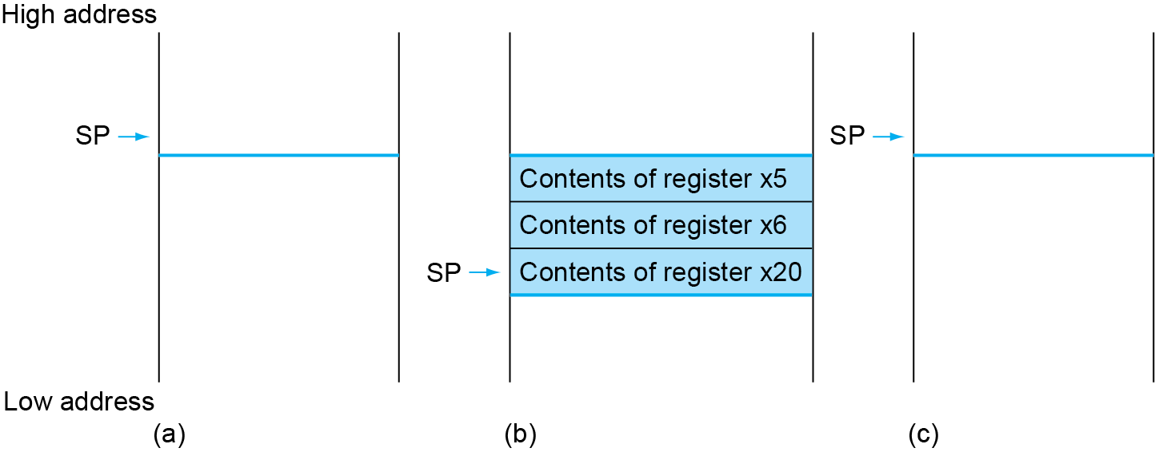
Local Data on the Stack

Slide 53
Register Usage
x5 – x7, x28 – x31: temporary registers
Not preserved by the callee
x8 – x9, x18 – x27: saved registers
If used, the callee saves and restores them

Slide 54
Non-Leaf Procedures
Procedures that call other procedures
For nested call, caller needs to save on the stack:
Its return address
Any arguments and temporaries needed after the call
Restore from the stack after the call

Slide 55
Non-Leaf Procedure Example
C code:
long long int fact (long long int n) { if (n < 1) return f; else return n * fact(n - 1); }
Argument n in x10
Result in x10

Slide 56
Non-Leaf Procedure Example
RISC-V code:
fact:
addi sp,sp,-16
sd x1,8(sp)
sd x10,0(sp)
addi x5,x10,-1
bge x5,x0,L1
addi x10,x0,1
addi sp,sp,16
jalr x0,0(x1)
L1: addi x10,x10,-1
jal x1,fact
addi x6,x10,0
ld x10,0(sp)
ld x1,8(sp)
addi sp,sp,16
mul x10,x10,x6
jalr x0,0(x1)
Save return address and n on stack
x5 = n - 1
if n >= 1, go to L1
Else, set return value to 1
Pop stack, don’t bother restoring values
Return
n = n - 1
call fact(n-1)
move result of fact(n - 1) to x6
Restore caller’s n
Restore caller’s return address
Pop stack
return n * fact(n-1)
return

Slide 57
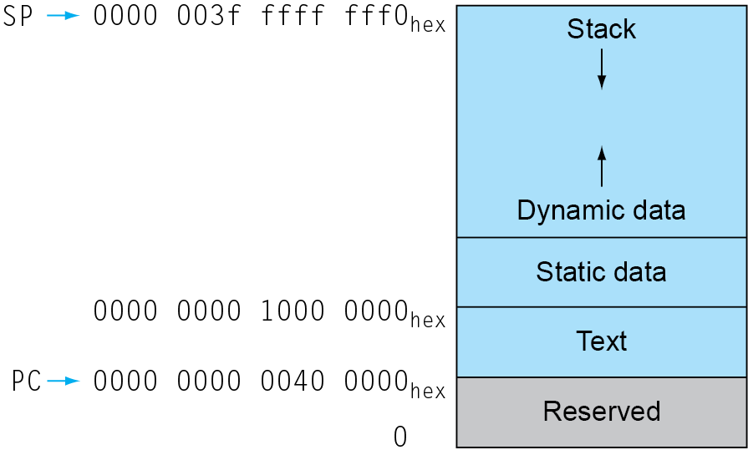
Memory Layout
Text: program code
Static data: global variables
e.g., static variables in C, constant arrays and strings
x3 (global pointer) initialized to address allowing ±offsets into this segment
Dynamic data: heap
E.g., malloc in C, new in Java
Stack: automatic storage

Slide 58
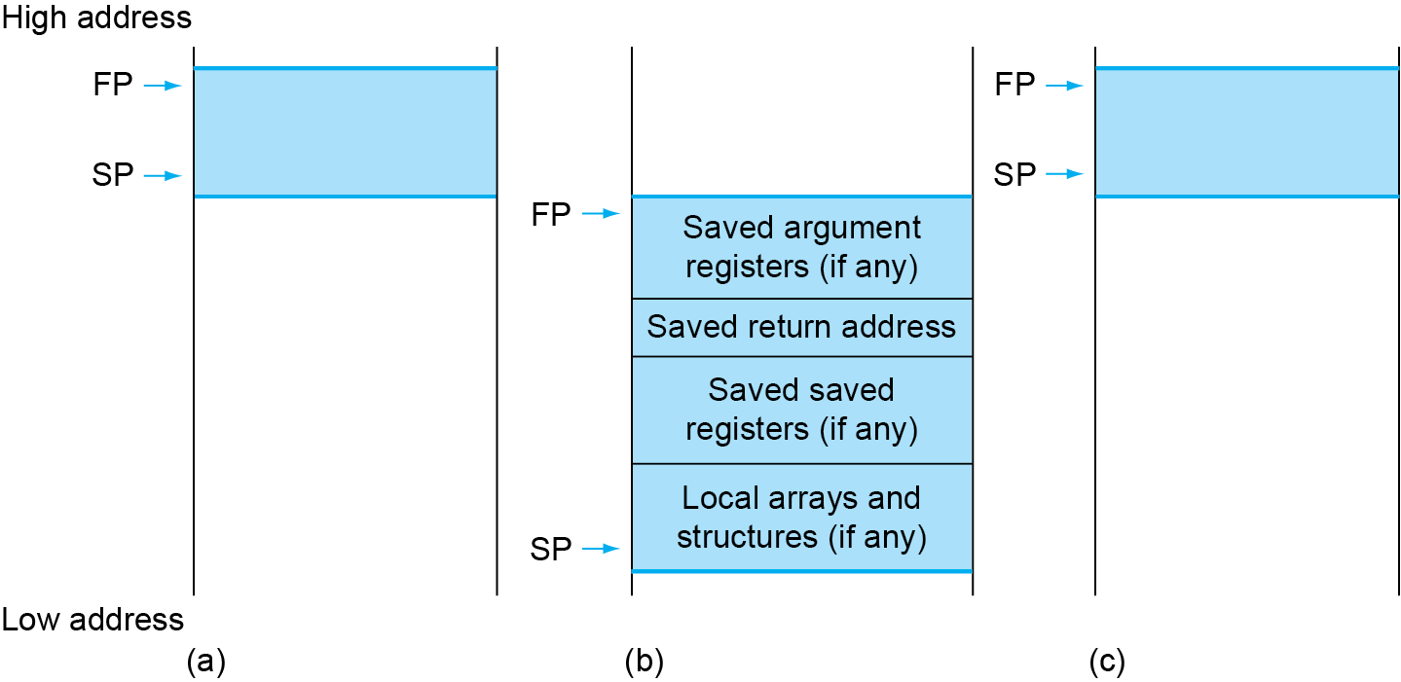
Local Data on the Stack
Local data allocated by callee
e.g., C automatic variables
Procedure frame (activation record)
Used by some compilers to manage stack storage

Slide 59
Character Data
Byte-encoded character sets
ASCII: 128 characters
95 graphic, 33 control
Latin-1: 256 characters
ASCII, +96 more graphic characters
Unicode: 32-bit character set
Used in Java, C++ wide characters, …
Most of the world’s alphabets, plus symbols
UTF-8, UTF-16: variable-length encodings
§2.9 Communicating with People

Slide 60
Byte/Halfword/Word Operations
RISC-V byte/halfword/word load/store
Load byte/halfword/word: Sign extend to 64 bits in rd
lb rd, offset(rs1)
lh rd, offset(rs1)
lw rd, offset(rs1)
Load byte/halfword/word unsigned: Zero extend to 64 bits in rd
lbu rd, offset(rs1)
lhu rd, offset(rs1)
lwu rd, offset(rs1)
Store byte/halfword/word: Store rightmost 8/16/32 bits
sb rs2, offset(rs1)
sh rs2, offset(rs1)
sw rs2, offset(rs1)

Slide 61
String Copy Example
C code:
Null-terminated string
void strcpy (char x[], char y[]) { size_t i; i = 0; while ((x[i]=y[i])!='\0') i += 1; }

Slide 62
String Copy Example
RISC-V code:
strcpy: addi sp,sp,-8 // adjust stack for 1 doubleword sd x19,0(sp) // push x19 add x19,x0,x0 // i=0 L1: add x5,x19,x11 // x5 = addr of y[i] lbu x6,0(x5) // x6 = y[i] add x7,x19,x10 // x7 = addr of x[i] sb x6,0(x7) // x[i] = y[i] beq x6,x0,L2 // if y[i] == 0 then exit addi x19,x19, 1 // i = i + 1 jal x0,L1 // next iteration of loop L2: ld x19,0(sp) // restore saved x19 addi sp,sp,8 // pop 1 doubleword from stack jalr x0,0(x1) // and return

Slide 63
32-bit Constants
Most constants are small
12-bit immediate is sufficient
For the occasional 32-bit constant
lui rd, constant
Copies 20-bit constant to bits [31:12] of rd
Extends bit 31 to bits [63:32]
Clears bits [11:0] of rd to 0
§2.10 RISC-V Addressing for Wide Immediates and Addresses
lui x19, 976 // 0x003D0
0000 0000 0000 0000
0000 0000 0000 0000
0000 0000 0011 1101 0000
0000 0000 0000
addi x19,x19,128 // 0x500
0000 0000 0000 0000
0000 0000 0000 0000
0000 0000 0011 1101 0000
0101 0000 0000

Slide 64
Branch Addressing
Branch instructions specify
Opcode, two registers, target address
Most branch targets are near branch
Forward or backward
SB format:
imm [10:5]
rs2
rs1
funct3
imm [4:1]
opcode
imm[12]
imm[11]
PC-relative addressing
Target address = PC + immediate × 2

Slide 65
Jump Addressing
Jump and link (jal) target uses 20-bit immediate for larger range
UJ format:
imm[10:1]
imm[19:12]
rd
opcode
5 bits
7 bits
imm[20]
imm[11]
For long jumps, eg, to 32-bit absolute address
lui: load address[31:12] to temp register
jalr: add address[11:0] and jump to target

Slide 66
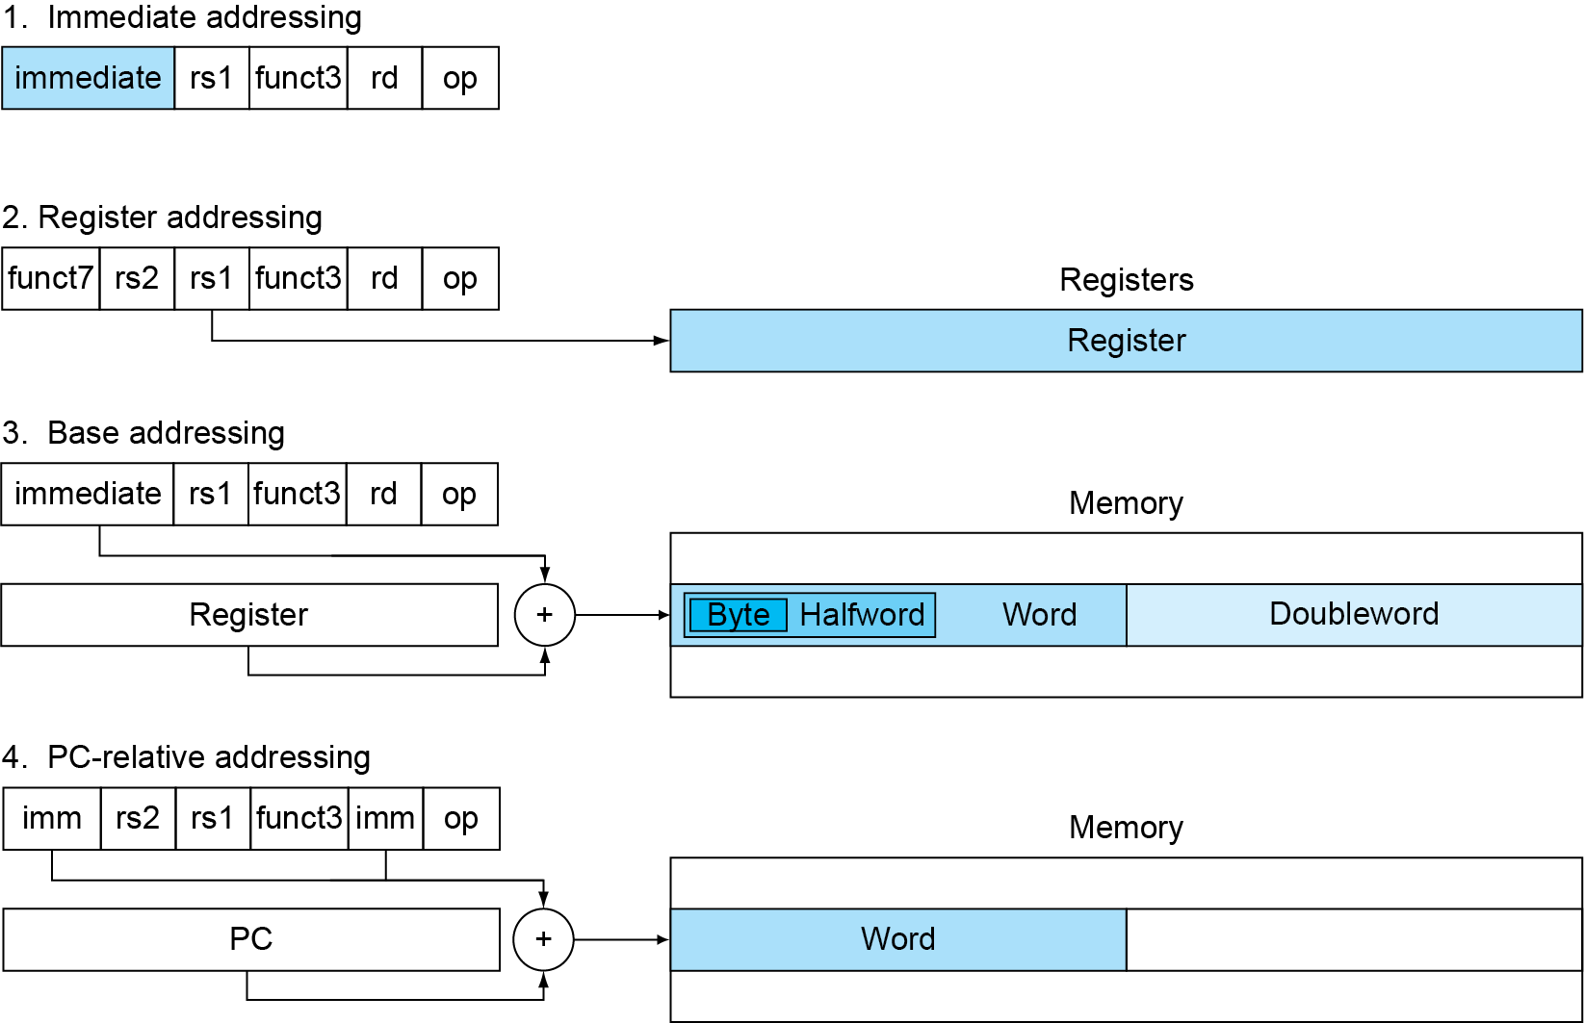
RISC-V Addressing Summary

Slide 67
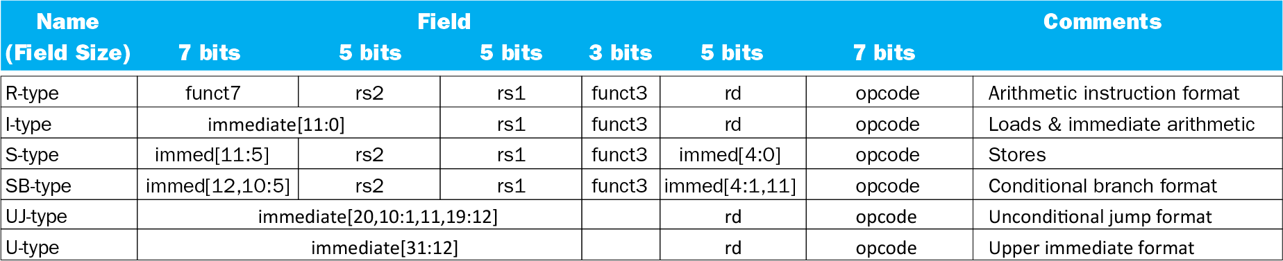
RISC-V Encoding Summary

Slide 68
Synchronization
Two processors sharing an area of memory
P1 writes, then P2 reads
Data race if P1 and P2 don’t synchronize
Result depends of order of accesses
Hardware support required
Atomic read/write memory operation
No other access to the location allowed between the read and write
Could be a single instruction
E.g., atomic swap of register ↔ memory
Or an atomic pair of instructions
§2.11 Parallelism and Instructions: Synchronization

Slide 69
Synchronization in RISC-V
Load reserved: lr.d rd,(rs1)
Load from address in rs1 to rd
Place reservation on memory address
Store conditional: sc.d rd,(rs1),rs2
Store from rs2 to address in rs1
Succeeds if location not changed since the lr.d
Returns 0 in rd
Fails if location is changed
Returns non-zero value in rd

Slide 70
Synchronization in RISC-V
Example 1: atomic swap (to test/set lock variable)
again: lr.d x10,(x20)
sc.d x11,(x20),x23 // X11 = status
bne x11,x0,again // branch if store failed
addi x23,x10,0 // X23 = loaded value
Example 2: lock
addi x12,x0,1 // copy locked value
again: lr.d x10,(x20) // read lock
bne x10,x0,again // check if it is 0 yet
sc.d x11,(x20),x12 // attempt to store
bne x11,x0,again // branch if fails
Unlock:
sd x0,0(x20) // free lock

Slide 71
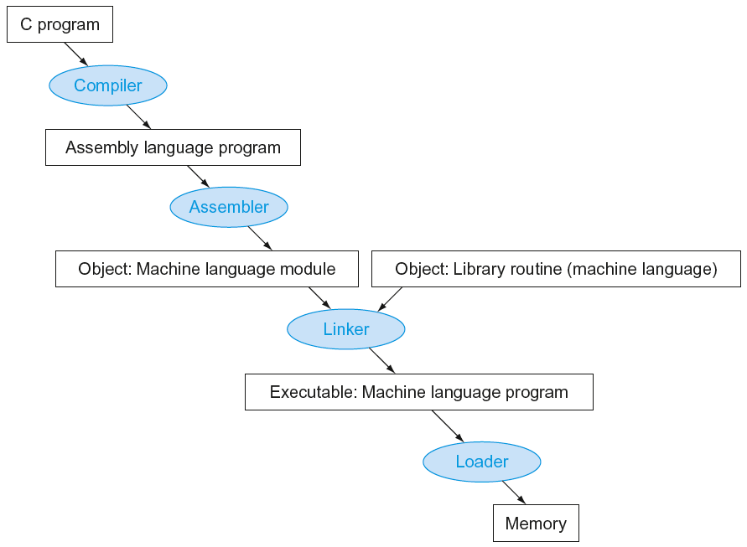
Translation and Startup
Many compilers produce object modules directly
§2.12 Translating and Starting a Program
Static linking

Slide 72
Producing an Object Module
Assembler (or compiler) translates program into machine instructions
Provides information for building a complete program from the pieces
Header: described contents of object module
Text segment: translated instructions
Static data segment: data allocated for the life of the program
Relocation info: for contents that depend on absolute location of loaded program
Symbol table: global definitions and external refs
Debug info: for associating with source code

Slide 73
Linking Object Modules
Produces an executable image
1. Merges segments
2. Resolve labels (determine their addresses)
3. Patch location-dependent and external refs
Could leave location dependencies for fixing by a relocating loader
But with virtual memory, no need to do this
Program can be loaded into absolute location in virtual memory space

Slide 74
Loading a Program
Load from image file on disk into memory
1. Read header to determine segment sizes
2. Create virtual address space
3. Copy text and initialized data into memory
Or set page table entries so they can be faulted in
4. Set up arguments on stack
5. Initialize registers (including sp, fp, gp)
6. Jump to startup routine
Copies arguments to x10, … and calls main
When main returns, do exit syscall

Slide 75
Dynamic Linking
Only link/load library procedure when it is called
Requires procedure code to be relocatable
Avoids image bloat caused by static linking of all (transitively) referenced libraries
Automatically picks up new library versions

Slide 76
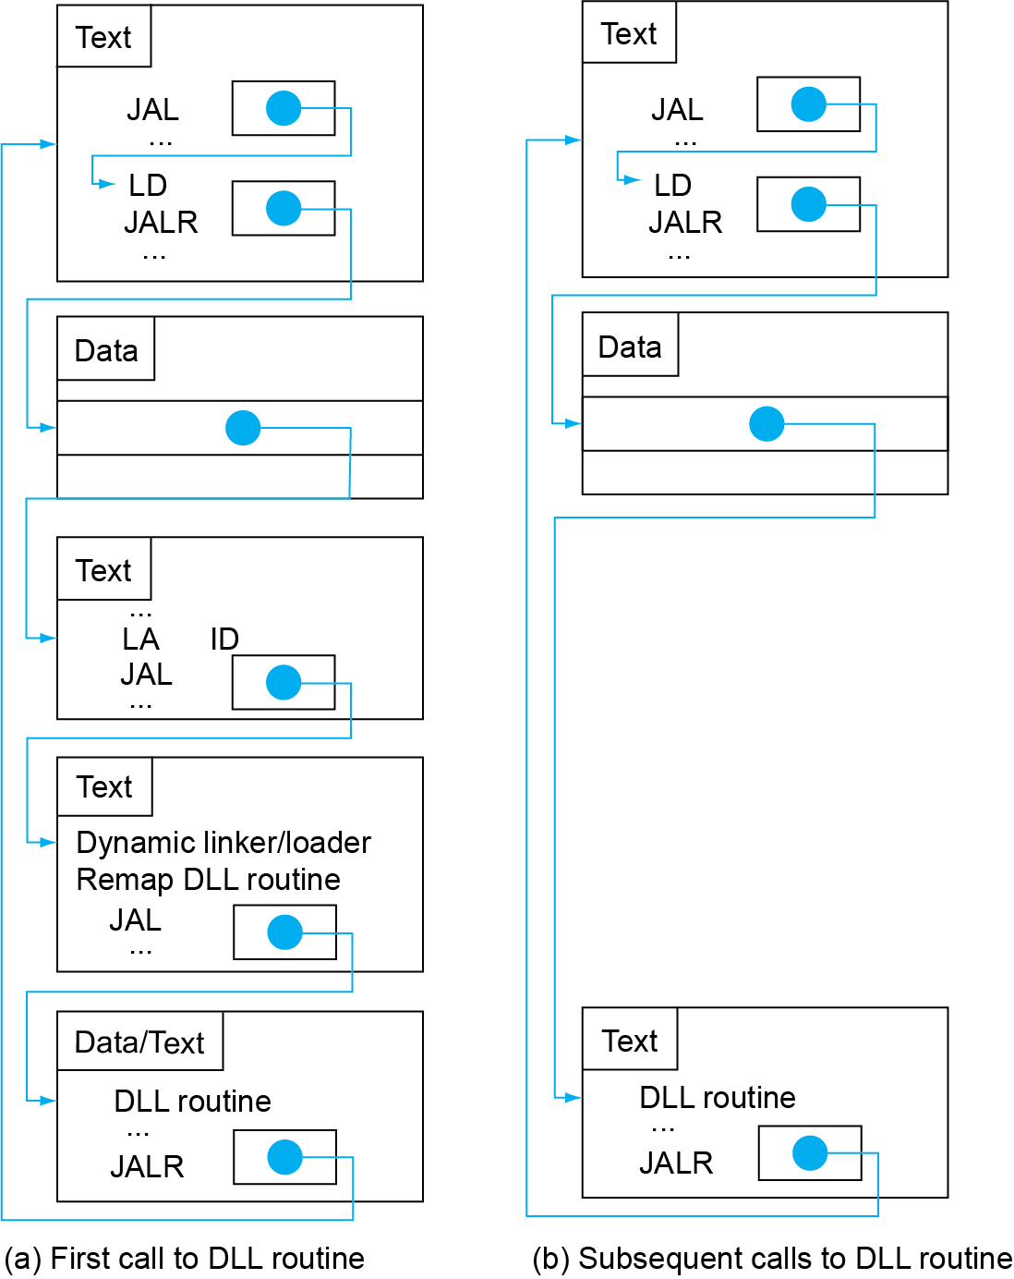
Lazy Linkage
Indirection table
Stub: Loads routine ID, Jump to linker/loader
Linker/loader code
Dynamically mapped code

Slide 77
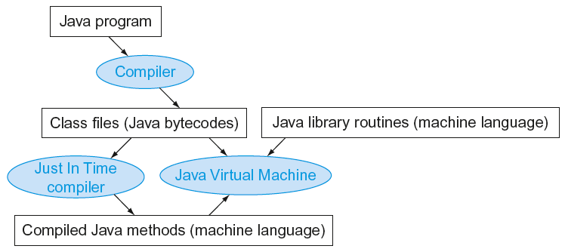
Starting Java Applications
Simple portable instruction set for the JVM
Compiles bytecodes of “hot” methods into native code for host machine
Interprets bytecodes

Slide 78
C Sort Example
Illustrates use of assembly instructions for a C bubble sort function
Swap procedure (leaf)
void swap(long long int v[], long long int k) { long long int temp; temp = v[k]; v[k] = v[k+1]; v[k+1] = temp; }
v in x10, k in x11, temp in x5
§2.13 A C Sort Example to Put It All Together

Slide 79
The Procedure Swap
swap:
slli x6,x11,3 // reg x6 = k * 8
add x6,x10,x6 // reg x6 = v + (k * 8)
ld x5,0(x6) // reg x5 (temp) = v[k]
ld x7,8(x6) // reg x7 = v[k + 1]
sd x7,0(x6) // v[k] = reg x7
sd x5,8(x6) // v[k+1] = reg x5 (temp)
jalr x0,0(x1) // return to calling routine

Slide 80
The Sort Procedure in C
Non-leaf (calls swap)
void sort (long long int v[], size_t n)
{
size_t i, j;
for (i = 0; i < n; i += 1) {
for (j = i – 1;
j >= 0 && v[j] > v[j + 1];
j -= 1) {
swap(v,j);
}
}
}
v in x10, n in x11, i in x19, j in x20

Slide 81
The Outer Loop
Skeleton of outer loop:
for (i = 0; i <n; i += 1) {
li x19,0 // i = 0
for1tst:
bge x19,x11,exit1 // go to exit1 if x19 ≥ x11 (i≥n)
(body of outer for-loop)
addi x19,x19,1 // i += 1
j for1tst // branch to test of outer loop
exit1:

Slide 82
The Inner Loop
Skeleton of inner loop:
for (j = i − 1; j >= 0 && v[j] > v[j + 1]; j − = 1) {
addi x20,x19,-1 // j = i −1
for2tst:
blt x20,x0,exit2 // go to exit2 if X20 < 0 (j < 0)
slli x5,x20,3 // reg x5 = j * 8
add x5,x10,x5 // reg x5 = v + (j * 8)
ld x6,0(x5) // reg x6 = v[j]
ld x7,8(x5) // reg x7 = v[j + 1]
ble x6,x7,exit2 // go to exit2 if x6 ≤ x7
mv x21, x10 // copy parameter x10 into x21
mv x22, x11 // copy parameter x11 into x22
mv x10, x21 // first swap parameter is v
mv x11, x20 // second swap parameter is j
jal x1,swap // call swap
addi x20,x20,-1 // j –= 1
j for2tst // branch to test of inner loop
exit2:

Slide 83
Preserving Registers
Preserve saved registers:
addi sp,sp,-40 // make room on stack for 5 regs
sd x1,32(sp) // save x1 on stack
sd x22,24(sp) // save x22 on stack
sd x21,16(sp) // save x21 on stack
sd x20,8(sp) // save x20 on stack
sd x19,0(sp) // save x19 on stack
Restore saved registers:
exit1:
sd x19,0(sp) // restore x19 from stack
sd x20,8(sp) // restore x20 from stack
sd x21,16(sp) // restore x21 from stack
sd x22,24(sp) // restore x22 from stack
sd x1,32(sp) // restore x1 from stack
addi sp,sp, 40 // restore stack pointer
jalr x0,0(x1)

Slide 84
Effect of Compiler Optimization
Compiled with gcc for Pentium 4 under Linux

Slide 85
Effect of Language and Algorithm

Slide 86
Lessons Learnt
Instruction count and CPI are not good performance indicators in isolation
Compiler optimizations are sensitive to the algorithm
Java/JIT compiled code is significantly faster than JVM interpreted
Comparable to optimized C in some cases
Nothing can fix a dumb algorithm!

Slide 87
Arrays vs. Pointers
Array indexing involves
Multiplying index by element size
Adding to array base address
Pointers correspond directly to memory addresses
Can avoid indexing complexity
§2.14 Arrays versus Pointers

Slide 88
Example: Clearing an Array
clear1(int array[], int size) { int i; for (i = 0; i < size; i += 1) array[i] = 0; } | clear2(int *array, int size) { int *p; for (p = &array[0]; p < &array[size]; p = p + 1) *p = 0; }
li x5,0 // i = 0 loop1: slli x6,x5,3 // x6 = i * 8 add x7,x10,x6 // x7 = address // of array[i] sd x0,0(x7) // array[i] = 0 addi x5,x5,1 // i = i + 1 blt x5,x11,loop1 // if (i<size) // go to loop1 | mv x5,x10 // p = address // of array[0] slli x6,x11,3 // x6 = size * 8 add x7,x10,x6 // x7 = address // of array[size] loop2: sd x0,0(x5) // Memory[p] = 0 addi x5,x5,8 // p = p + 8 bltu x5,x7,loop2 // if (p<&array[size]) // go to loop2

Slide 89
Comparison of Array vs. Ptr
Multiply “strength reduced” to shift
Array version requires shift to be inside loop
Part of index calculation for incremented i
c.f. incrementing pointer
Compiler can achieve same effect as manual use of pointers
Induction variable elimination
Better to make program clearer and safer

Slide 90
MIPS Instructions
MIPS: commercial predecessor to RISC-V
Similar basic set of instructions
32-bit instructions
32 general purpose registers, register 0 is always 0
32 floating-point registers
Memory accessed only by load/store instructions
Consistent use of addressing modes for all data sizes
Different conditional branches
For <, <=, >, >=
RISC-V: blt, bge, bltu, bgeu
MIPS: slt, sltu (set less than, result is 0 or 1)
Then use beq, bne to complete the branch
§2.16 Real Stuff: MIPS Instructions

Slide 91
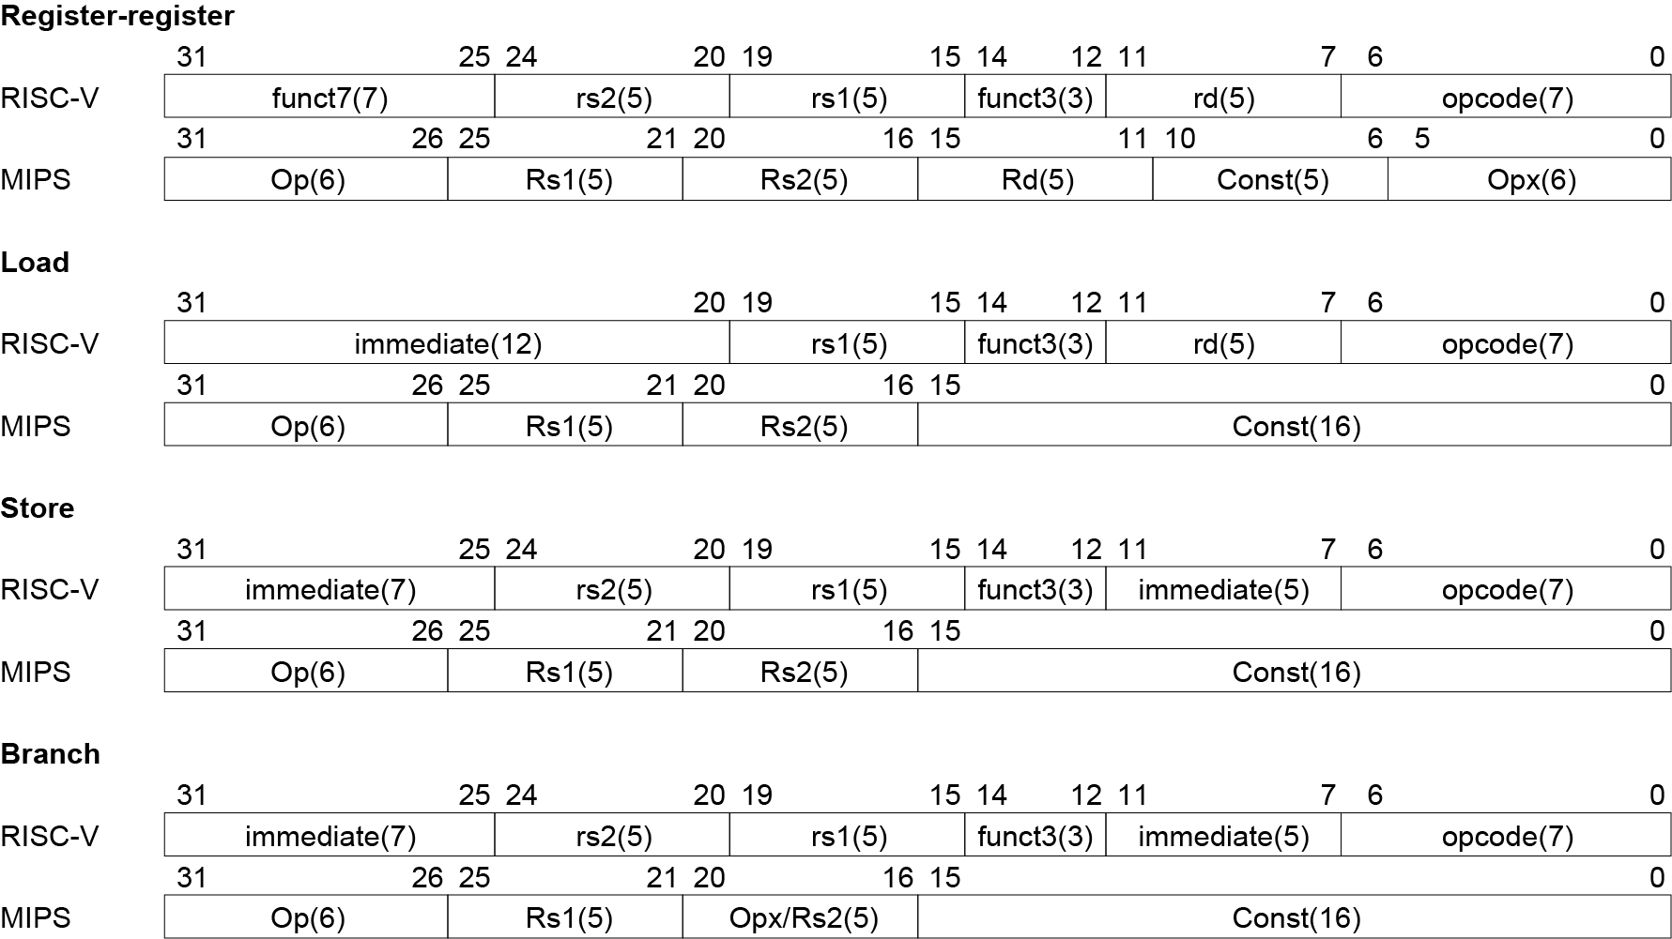
Instruction Encoding

Slide 92
The Intel x86 ISA
Evolution with backward compatibility
8080 (1974): 8-bit microprocessor
Accumulator, plus 3 index-register pairs
8086 (1978): 16-bit extension to 8080
Complex instruction set (CISC)
8087 (1980): floating-point coprocessor
Adds FP instructions and register stack
80286 (1982): 24-bit addresses, MMU
Segmented memory mapping and protection
80386 (1985): 32-bit extension (now IA-32)
Additional addressing modes and operations
Paged memory mapping as well as segments
§2.17 Real Stuff: x86 Instructions

Slide 93
The Intel x86 ISA
Further evolution…
i486 (1989): pipelined, on-chip caches and FPU
Compatible competitors: AMD, Cyrix, …
Pentium (1993): superscalar, 64-bit datapath
Later versions added MMX (Multi-Media eXtension) instructions
The infamous FDIV bug
Pentium Pro (1995), Pentium II (1997)
New microarchitecture (see Colwell, The Pentium Chronicles)
Pentium III (1999)
Added SSE (Streaming SIMD Extensions) and associated registers
Pentium 4 (2001)
New microarchitecture
Added SSE2 instructions

Slide 94
The Intel x86 ISA
And further…
AMD64 (2003): extended architecture to 64 bits
EM64T – Extended Memory 64 Technology (2004)
AMD64 adopted by Intel (with refinements)
Added SSE3 instructions
Intel Core (2006)
Added SSE4 instructions, virtual machine support
AMD64 (announced 2007): SSE5 instructions
Intel declined to follow, instead…
Advanced Vector Extension (announced 2008)
Longer SSE registers, more instructions
If Intel didn’t extend with compatibility, its competitors would!
Technical elegance ≠ market success

Slide 95
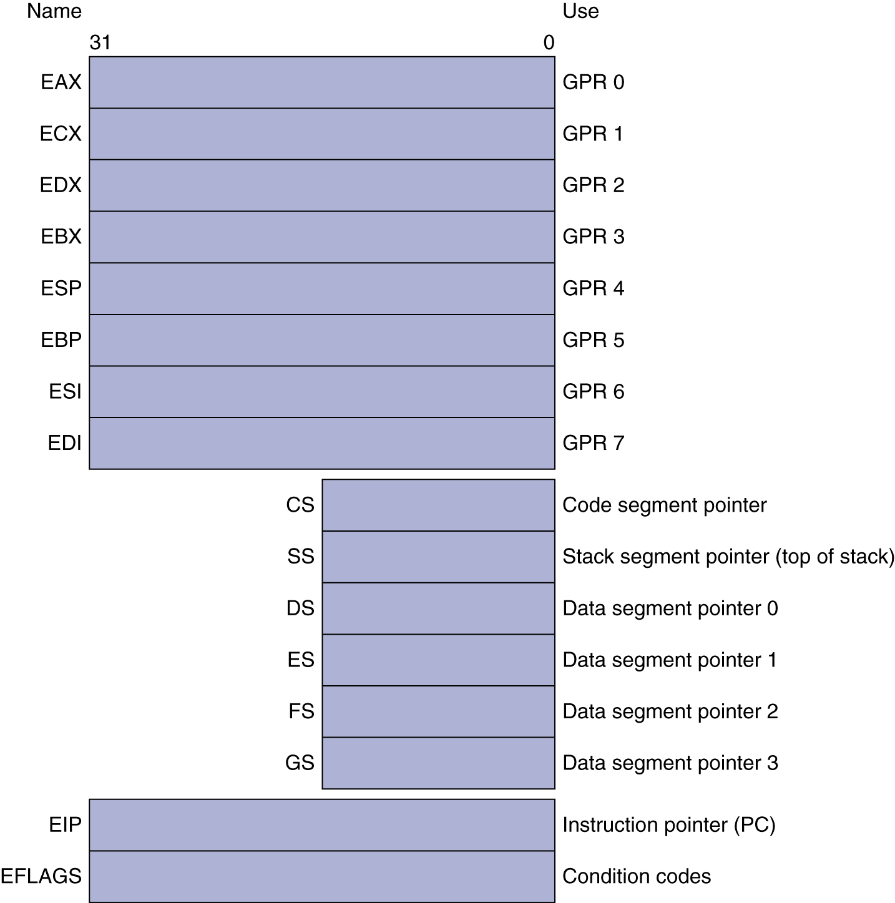
Basic x86 Registers

Slide 96
Basic x86 Addressing Modes
Two operands per instruction
Source/dest operand | Second source operand
Register | Register
Register | Immediate
Register | Memory
Memory | Register
Memory | Immediate
Memory addressing modes
Address in register
Address = R_{base} + displacement
Address = R_{base} + 2^{scale} × R_{index} (scale = 0, 1, 2, or 3)
Address = R_{base} + 2^{scale} × R_{index} + displacement

Slide 97
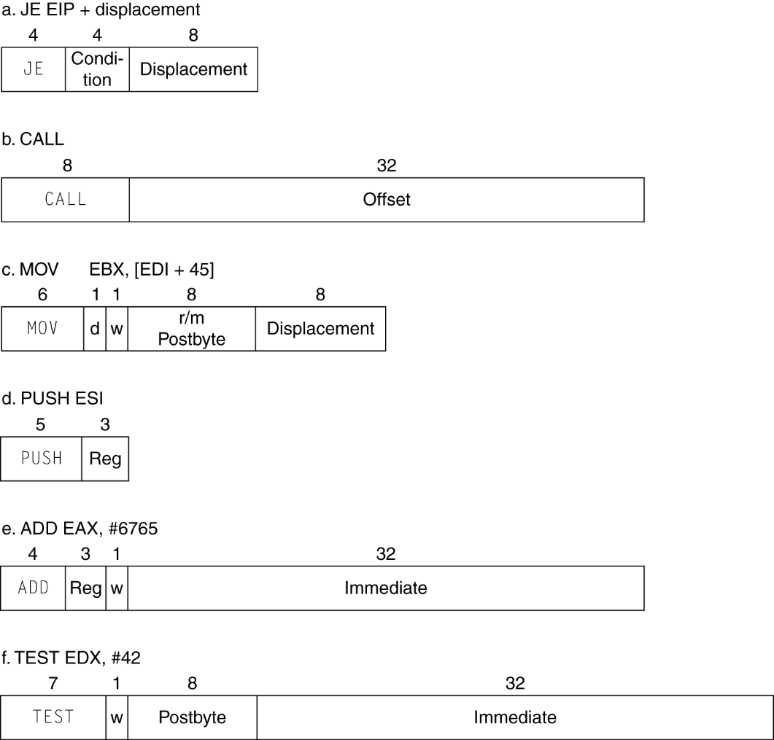
x86 Instruction Encoding
Variable length encoding
Postfix bytes specify addressing mode
Prefix bytes modify operation
Operand length, repetition, locking, …

Slide 98
Implementing IA-32
Complex instruction set makes implementation difficult
Hardware translates instructions to simpler microoperations
Simple instructions: 1–1
Complex instructions: 1–many
Microengine similar to RISC
Market share makes this economically viable
Comparable performance to RISC
Compilers avoid complex instructions

Slide 99
Other RISC-V Instructions
Base integer instructions (RV64I)
Those previously described, plus
auipc rd, immed // rd = (imm<<12) + pc
follow by jalr (adds 12-bit immed) for long jump
slt, sltu, slti, sltui: set less than (like MIPS)
addw, subw, addiw: 32-bit add/sub
sllw, srlw, srlw, slliw, srliw, sraiw: 32-bit shift
32-bit variant: RV32I
registers are 32-bits wide, 32-bit operations
§2.18 The Rest of the RISC-V Instruction Set

Slide 100
Instruction Set Extensions
M: integer multiply, divide, remainder
A: atomic memory operations
F: single-precision floating point
D: double-precision floating point
C: compressed instructions
16-bit encoding for frequently used instructions

Slide 101
Fallacies
Powerful instruction ⇒ higher performance
Fewer instructions required
But complex instructions are hard to implement
May slow down all instructions, including simple ones
Compilers are good at making fast code from simple instructions
Use assembly code for high performance
But modern compilers are better at dealing with modern processors
More lines of code ⇒ more errors and less productivity
§2.19 Fallacies and Pitfalls

Slide 102
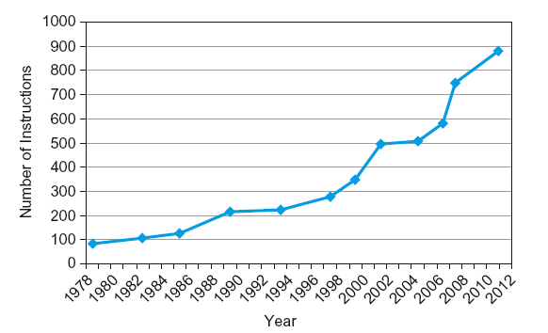
Fallacies
Backward compatibility ⇒ instruction set doesn’t change
But they do accrete more instructions
x86 instruction set

Slide 103
Pitfalls
Sequential words are not at sequential addresses
Increment by 4, not by 1!
Keeping a pointer to an automatic variable after procedure returns
e.g., passing pointer back via an argument
Pointer becomes invalid when stack popped

Slide 104
Concluding Remarks
Design principles
1. Simplicity favors regularity
2. Smaller is faster
3. Good design demands good compromises
Make the common case fast
Layers of software/hardware
Compiler, assembler, hardware
RISC-V: typical of RISC ISAs
c.f. x86
§2.20 Concluding Remarks

