Slide 1
GW3_Transformer
Ethan Jiang

Slide 2
Dataset Explanation
The dataset come from Laser Interferometer Gravitational-Wave Observatory (LIGO)
4 classes in the dataset:
Glitch
Background
Binary Black Hole (BBH)
Sine-Gaussian (SG)
A binary classifier will be created from these 4 datasets.
Glitch and Background will be classified as background
BBH and SG will be classified as signal
Data has the shape of [Batches, num of detector, time steps]

Slide 3
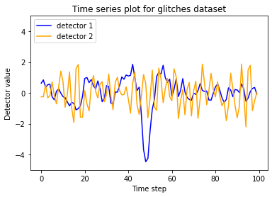
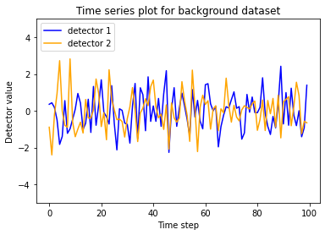
Background (Glitches and Background)

Slide 4
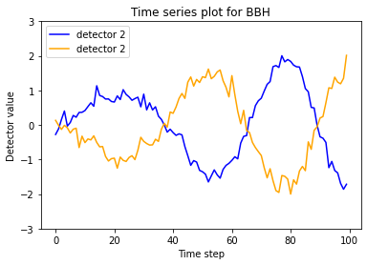
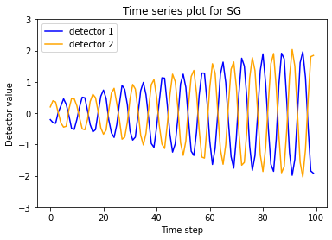
Signal (BBH and SG)

Slide 5
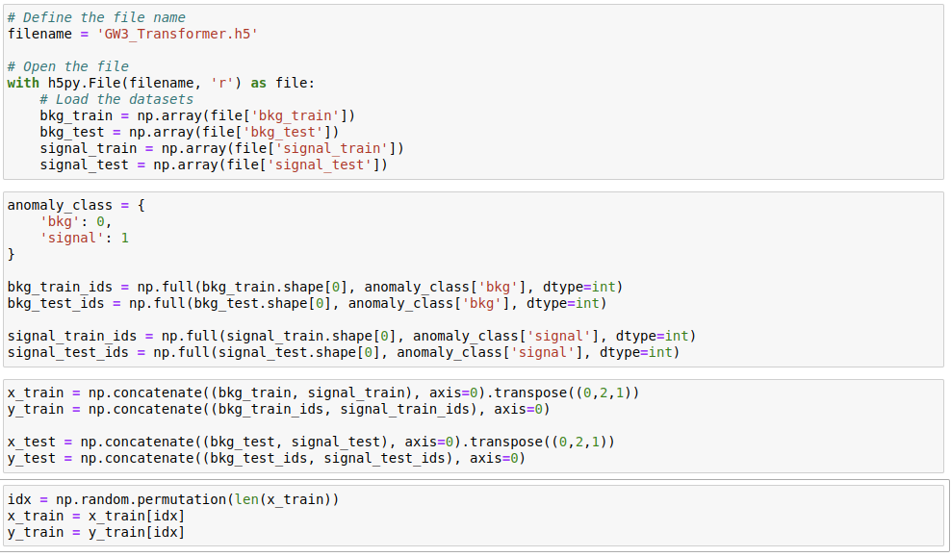
How to load the dataset

