Slide 1
ADVENTIST UNIVERSITY OF CENTRAL AFRICA (AUCA)
MSDA9215: Big Data Analytics
Neo4J: US Road Network
Analysis
BYIRINGIRO Elie Yvan | GWIZA Rodrigue | NTWALI KINANIRA Christian
Lecturer: Temitope Oguntade
87,575
121,961
2.8
Intersections
Roads
Avg Degree

Slide 2
Introduction
What is Neo4j?
Project Objective
A leading graph database management system
Stores data as nodes and relationships (not tables)
Uses Cypher as its query language
Ideal for highly connected data like road networks
Supports powerful graph algorithms via GDS plugin
Load the US road network into Neo4j
Query and analyze the graph structure
Compute shortest paths between intersections
Identify critical intersections using centrality
Visualize insights using interactive dashboards

Slide 3
Dataset Description
Continental US Road Network (usa.txt)
87,575
121,961
2.8
Sparse
Intersections
(Nodes)
Roads
(Edges)
Average
Degree
Graph
Density
File Format Structure:
Line 1: Total number of vertices and edges (e.g. 87575 121961)
Lines 2–87576: Vertex index followed by X and Y coordinates
Remaining lines: Pairs of vertex indices representing roads (edges)
Edge weights are calculated as Euclidean distances between coordinates

Slide 4
Tools & Technologies
Neo4j Desktop 2.1.4
Neo4j 2026.05.0
Graph database management system
Core graph database engine
Graph Data Science (GDS)
Python 3.x
Graph algorithms & analytics
Data parsing and loading
Neo4j Python Driver 6.2.0
NetworkX
Python-Neo4j connectivity
Betweenness centrality computation
Plotly
Jupyter Notebook
Interactive charts and dashboards
Development environment

Slide 5
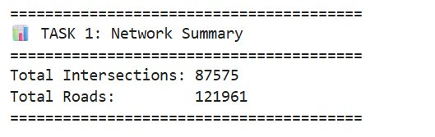
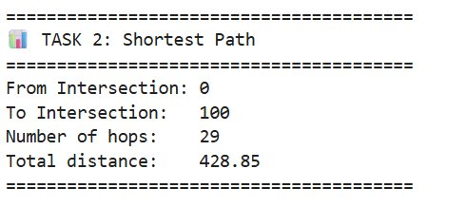
Task 1 & 2: Network Summary & Shortest Path
Task 1: Network Summary
Task 2: Shortest Path
Total Intersections: 87,575
Total Roads: 121,961
Confirms complete dataset loaded into Neo4j
Ratio of 1.39 edges/node confirms sparse network
From Intersection 0 → Intersection 100
Number of hops: 29 intersections
Total distance: 428.85 units
Used Neo4j built-in shortestPath() function

Slide 6
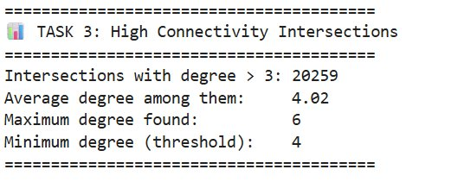
Task 3: High Connectivity Intersections (Degree > 3)
20,259
4.02
6
High Degree
Intersections
Average
Degree
Maximum
Degree Found

Slide 7
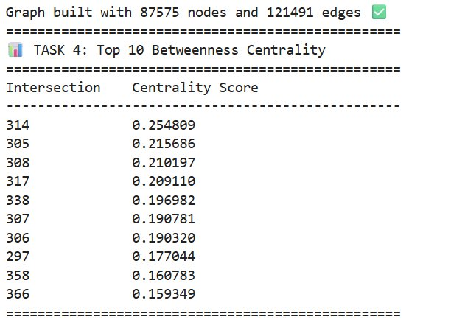
Task 4: Betweenness Centrality Analysis
Betweenness Centrality measures how often a node lies on the shortest path between other nodes — high score = critical bridge point.
#1
Intersection 314
Score: 0.2548
#2
Intersection 305
Score: 0.2157
#3
Intersection 308
Score: 0.2102
Intersection 314 is the most critical bridge point
Removing it would disrupt the most paths in the network
Computed using NetworkX on a 500-node subgraph

Slide 8
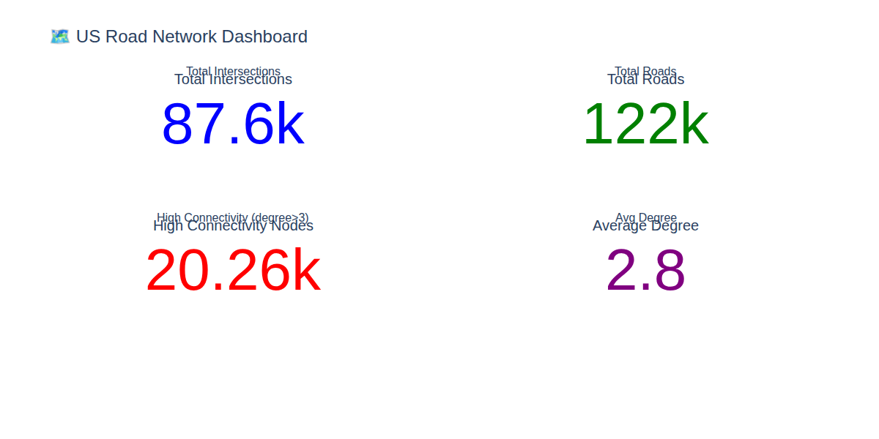
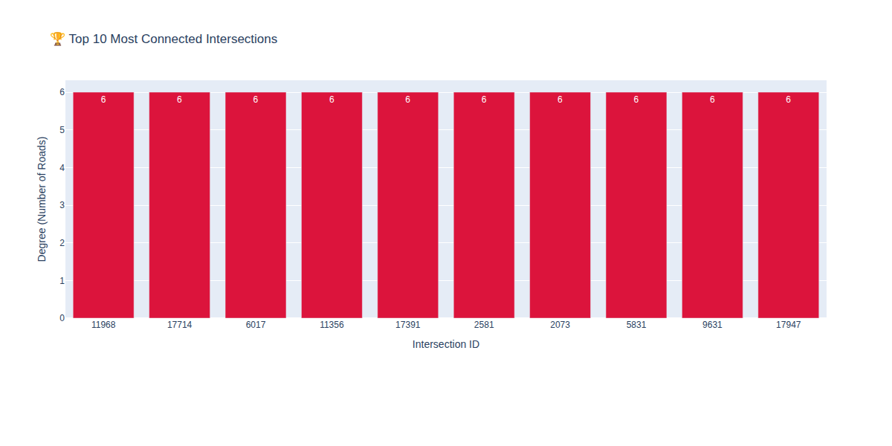
Task 5 & 7: Dashboard & Top 10 Intersections
Task 5: Key Metrics Dashboard
Task 7: Top 10 Most Connected Intersections
All Top 10 intersections share degree 6 — the maximum observed in the network, representing major highway interchanges.

Slide 9
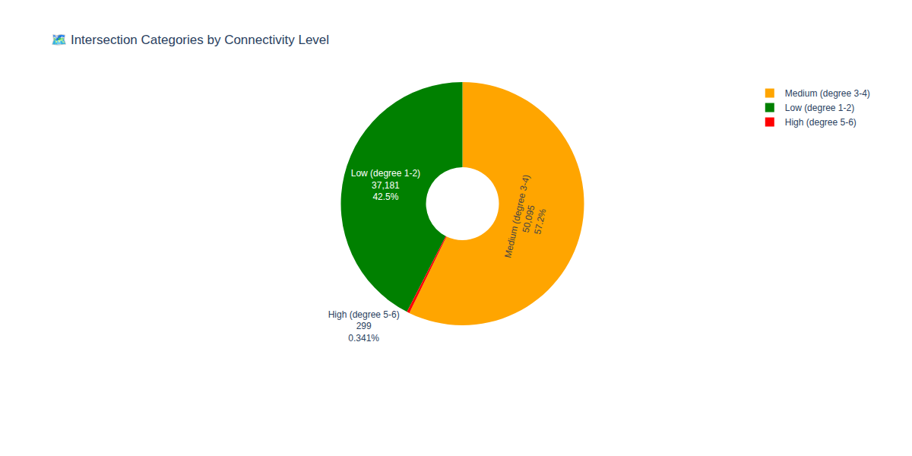
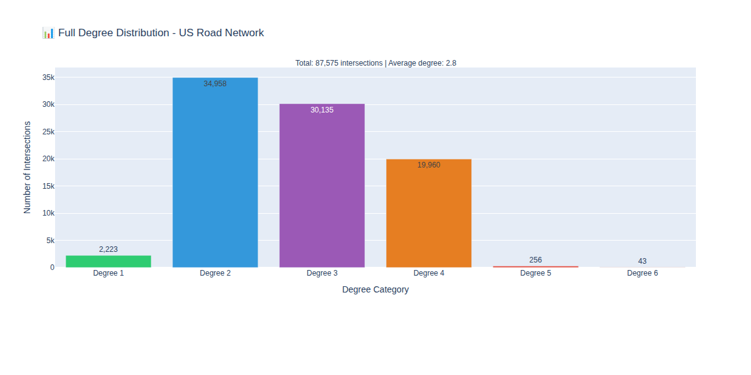
Task 8 & 9: Categories & Degree Distribution
Task 8: Intersection Categories by Degree
Task 9: Final Degree Distribution
Category | Degree Range | Count | Percentage
Low Connectivity | 1 - 2 | 37,181 | 42.46%
Medium Connectivity | 3 - 4 | 50,095 | 57.20%
High Connectivity | 5 - 6 | 299 | 0.34%

Slide 10
Key Insights & Conclusions
🌐 Sparse Network
🔴 Critical Node
Average degree of 2.8 — most intersections connect to only 2 or 3 roads
Intersection 314 has the highest betweenness centrality (0.2548) — most critical bridge
🛣️ Hub Minority
📍 Shortest Path
Only 0.34% (299 nodes) are high-connectivity hubs but play a disproportionate role
Path from node 0 to node 100 takes 29 hops and covers 428.85 distance units
⚡ Neo4j Power
📊 Degree Cap
Cypher queries efficiently handled 87,575 nodes and 121,961 relationships
Maximum degree is 6 — even the busiest interchanges connect to at most 6 roads

Slide 11
Conclusion
This project successfully demonstrated the power of graph databases for analyzing large-scale road networks.
Neo4j proved to be an excellent tool offering intuitive Cypher queries, efficient path-finding, and seamless Python integration.
Future work could include real geographic mapping, traffic simulation, and community detection.
87,575
121,961
9
Neo4j
Intersections
Roads
Tasks Completed
Core Platform
BYIRINGIRO Elie Yvan | GWIZA Rodrigue | NTWALI KINANIRA Christian

