Slide 1
Xen Hypervisor
Advanced Operating Systems - Clan of Xen

Slide 2
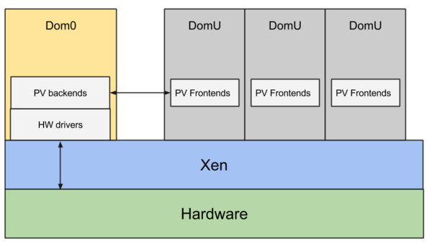
Xen Hypervisor
Virtual Machine (VM) Hypervisor that provides full hardware virtualization allowing VMs to boot with ParaVirtualization (PV) at the same time
As a type-1 or bare-metal hypervisor, Xen operates below the host OS itself, right on top of the machine hardware

Slide 3
Xen Hypervisor - Key Features
Only Type-1 Hypervisor available as open source
Small footprint and interface (around 1 MB in size)
Operating System agnostic
Driver Isolation
Paravirtualization

Slide 4
Target Domain
Xen Project runs in a more privileged CPU state than any other software on the machine
Responsibilities include memory management and CPU scheduling of all VMs and launching dom0 (most privileged domain) which is typically a version of Linux or BSD
User domains could be traditional OSes like Windows issuing privileged hardware virtualization instructions or paravirtualized OSes where the OS is aware of being run inside a VM so to make direct hypercalls
Boots from a bootloader such as GNU GRUB, and then usually loads a paravirtualized host OS into dom0 (host domain)

Slide 5
Target Domain - Where its valuable and a good fit
Most valuable where multiple OSes need to run concurrently on same hardware. To quote Barham et al. from “Xen and the Art of Virtualization”, Xen is a good fit when the resources are oversubscribed or the users are uncooperative
Primary users are Internet hosting service companies as they use hypervisors to provide virtual private servers. Amazon EC2, IBM SoftLayer, Liquid Web, Rackspace, OrionVM, etc. use it as their primary hypervisor for product offerings
Research firms (especially computer-security) use it to run various sandboxed guest OSes to observe and study effects of viruses or worms without compromising host OS
VMMs also operate on mainframes and large servers running IBM, HP, and other systems
Hardware appliance vendors may decide to ship their appliances running several guest OSes, for greater compatibility for various software requiring different OSes

Slide 6
Target Domain - Where its not a good fit
Primarily not a good fit where only small number of OSes need to be run concurrently without much system administration to provide support for things like performance isolation, scheduling priority, etc.
Highly susceptible to attack as it employs a monolithic design (single point of failure) and comprises a complex set of growing functionality including VM management, scheduling, instruction emulation, IPC (event channels), and memory management
With increasing functionality, Xen’s code base has also increased thus adding many security vulnerabilities such as attackers easily exploiting a known hypervisor vulnerability to “jail break” from a guest VM to the hypervisor to gain full control over the system
In their research “Deconstructing Xen”, Shi et al. observed that 61.81% of the known security vulnerabilities lead to DoS attacks, 15.28% lead to privilege escalation, 13.98% lead to information leak, and 13.20% use the hypervisor to attack guest VMs

Slide 7
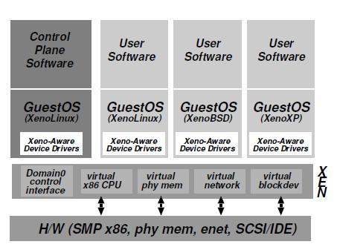
System Modules
Full Hardware Virtualization
Domain0 (control)
Hardware emulation required

Slide 8
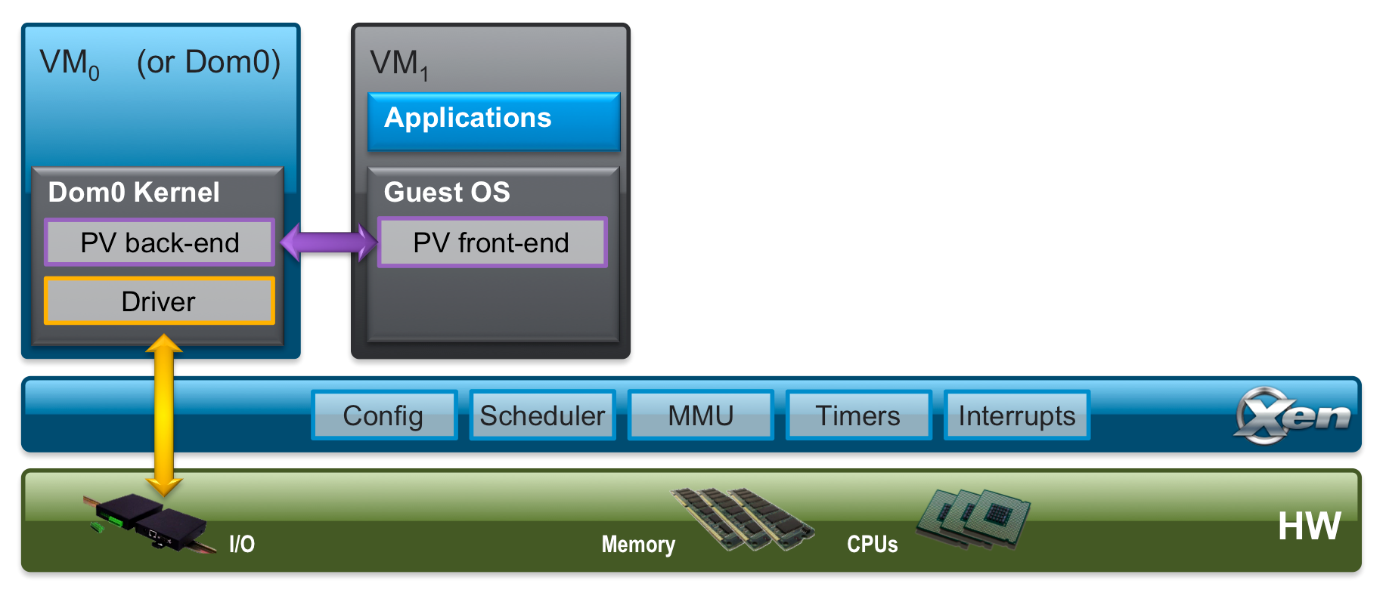
Core Abstractions - Paravirtualization
Requires deep kernel modifications
Significant performance increase

Slide 9
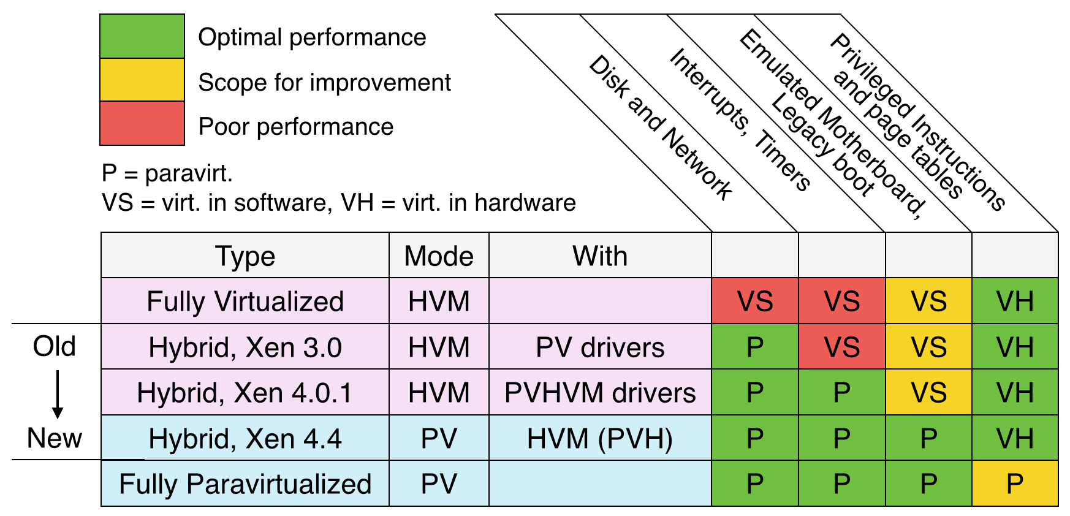
Core Abstractions - PV vs HVM
h

Slide 10
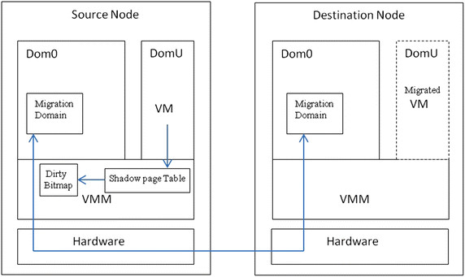
Core Abstractions - VM Migration
h

Slide 11
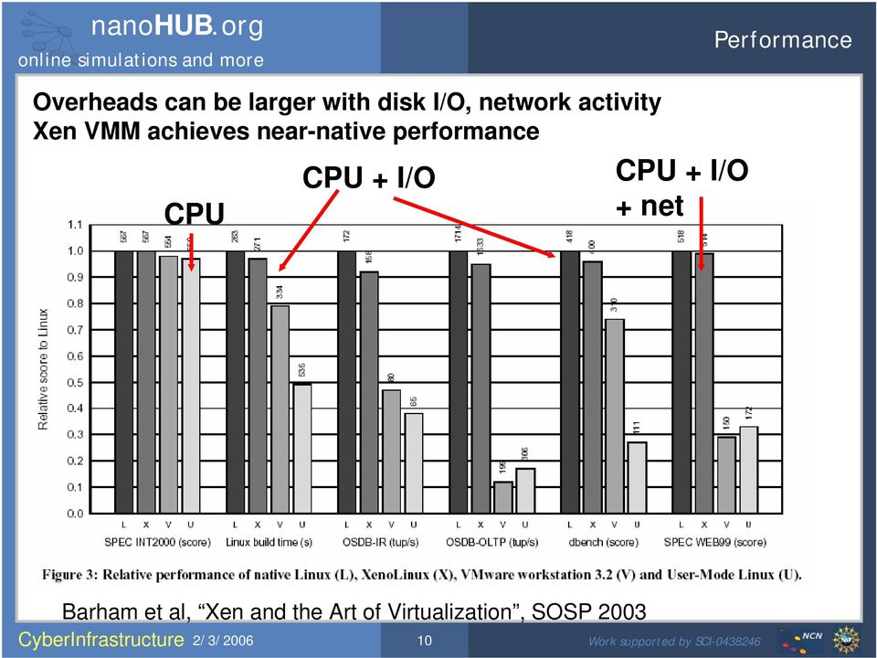
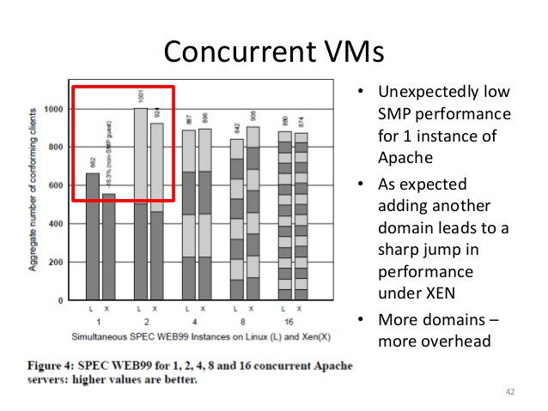
Performance

Slide 12
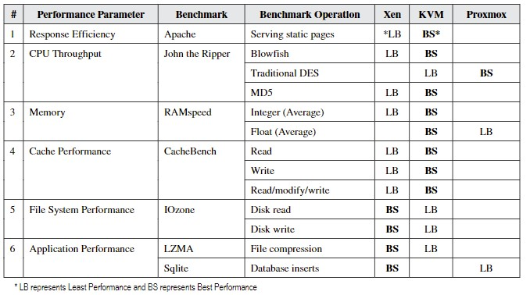
Performance - Compared to other Hypervisors
Xen has the best performance under traditional server loads, yet falls behind with more intensive workloads

Slide 13
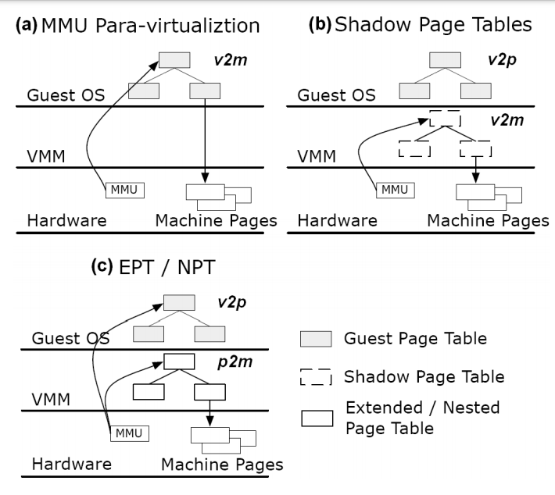
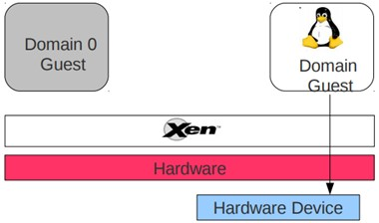
Optimizations and Features
Direct Paging
Xen PCI Passthrough

Slide 14
Security Feature
Overview of Xen’ｓ Security feature (Without Stubdom version)
①Dom0
Responsible for communicate with hardware
Can monitor dom users
Dom0 (Control Domain)
DomU1
DomU2
Dom0 Kernel
Guest OS
App
Guest OS
App
③larger TCB
(Trusted Computer Base)
Not so good feature...
Device Driver
Communication
Via Argo: Hypervisor-Mediated Exchange (HMX)
②ＸＳＭ(Xen Security Module)
Provide MAC (Mandatory Access Control)
Policies(user/role/types)
Xen-
Hypervisor
Scheduler
MMU
XSM
Hardware
CPU
Memory
I/O

Slide 15
Security Feature
Overview of Xen’ｓ Security feature (Without Stubdom version)
Stub dom
DomU1
DomU2
Dom0 (Control Domain)
mini-OS
Guest OS
App
Guest OS
App
Dom0 Kernel
Drivers
The size of TCB can be reduced.
Xen-Hypervisor
Scheduler
MMU
XSM
Hardware
CPU
Memory
I/O

Slide 16
AWS moving from Xen to KVM
AWS is juggling between Xen and other hypervisors for different instance types, and currently, they are the only big services provider that still use Xen
The reason why they are using KVM is to cut some costs for development and support and to overcome scalability and performance issues
After using Xen over a decade, AWS is challenged to transfer everything to KVM, but they are still not completely abandoning Xen
They are still working on many details that need to be perfected first. The AWS tools for cloud management must go towards new direction and evolve into multi-hypervisor
The new hypervisor will likely fit well with AWS hardware such as the custom Intel Skylake Xeons and will provide optimized security features and performance, but the final consumers will likely not notice any big difference besides a decent decrease in pricing

Slide 17
Subjective Discussion - Positives
Our team appreciated how Xen is separate from the OS and goes even further by separating out each component, it provides reasonable security, better performance in comparison to its competitors, and lets you run any OS in a virtual environment
Being ahead in the ParaVirtualization space is quite impressive as it is an extremely cool technology that helps a lot of systems boost performance in many scenarios
Xen is open source, which has many benefits, as most developers would agree

Slide 18
Subjective Discussion - Negatives
Xen’s monolithic architecture is quite worrisome as it is vulnerable to security hacks, given the size of its Trusted Computing Base (TCB)
Xen is not always suited to modern hypervisor tasks. With faster hardware, developers are beginning to take advantage of incredibly performant memory and clock speeds. Unless the end goal is to run many different VMs, admins can shoot themselves in the foot using Xen
Like all solutions to a problem, it is important to recognize that Xen has a time and a place

Slide 19
References
1. [KVM vs Xen vs VMWare]
https://www.serverwatch.com/server-news/hypervisor-face-off-kvm-vs-xen-vs-vmware/
2. [KVM vs Xen]
https://www.linux.com/news/kvm-or-xen-choosing-virtualization-platform/
3. [Baremetal vs Xen vs KVM]
https://xenproject.org/2011/11/29/baremetal-vs-xen-vs-kvm-redux/
4. [How Does Xen Work]
http://www-archive.xenproject.org/files/Marketing/HowDoesXenWork.pdf
5. [Event Channel Internals]
https://wiki.xenproject.org/wiki/Event_Channel_Internals

Slide 20
References
6. [Xen and the Art of Virtualization]
https://www.cl.cam.ac.uk/research/srg/netos/papers/2003-xensosp.pdf
7. [Virtualization in Xen 3.0]
https://www.linuxjournal.com/article/8909
8. [Unikernels: Library Operating Systems for the Cloud]
https://dl.acm.org/doi/10.1145/2490301.2451167
9. [Advanced Systems Security:Virtual Machine System]
http://www.cse.psu.edu/~trj1/cse544-f15/slides/cse544-vmm.pdf
10. [Xen Security Modules:XSM-FLASK] https://wiki.xenproject.org/wiki/Xen_Security_Modules_:_XSM-FLASK

Slide 21
References
11. [Stub Domain A Step Towards Dom0 Disaggregation]
http://www-archive.xenproject.org/files/xensummitboston08/SamThibault_XenSummit.pdf
12. [Xen Project 4.4: Features and Futures]
https://events.static.linuxfound.org/sites/events/files/slides/Xen%20Project%204-4%20Features%20and%20Futures_Rev6_0.pdf
13. [Breaking Up is Hard to Do: Security and Functionality in a Commodity Hypervisor]
https://www.cs.ubc.ca/~andy/papers/xoar-sosp-final.pdf
14. [Verifying the Safety of Xen Security Modules]
https://ieeexplore.ieee.org/document/6004499
15. [Deconstructing Xen]
https://www.trustkernel.com/uploads/pubs/nx.pdf

Slide 22
References
16. [Virtual Cluster Management with Xen]
https://link.springer.com/content/pdf/10.1007/978-3-540-78474-6_23.pdf
17. [Inter-domain socket communications supporting high performance and full binary compatibility on Xen]
https://dl.acm.org/doi/pdf/10.1145/1346256.1346259?casa_token=EEidqpPOJ3QAAAAA:S4NWWNXZ8Lee6ZSrqWU6TPF9PFOJXHpI6Bgt3YoACALvtG_zo0on5A-XPGKEUJKNd1G99LUmPRPe2Q
18. [Selective Hardware/Software Memory Virtualization]
research/Wang2011.pdf

