Slide 1
Zomato Restaurants Database Analysis
EMSE 6586
Spring 2021
Jose Garcia
Kahang Ngau

Slide 2
Objectives
OBJECTIVES
Restructure a flattened dataset and load into a SQL database
Demonstrate the convenience of the database
Provide an efficient and easier way for end-users to search specific information

Slide 3
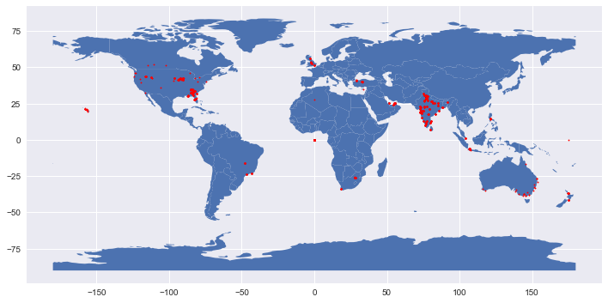
Exploratory Data Analysis
SOURCE
Zomato dataset from Kaggle
Dataset collected from Zomato API and stored in comma separated value file.
RESTAURANTS
9542 restaurants
Data includes: location, rating, cuisines, evaluation, price.
Cuisines: [‘Fast food’, ‘Italian’, ‘Asian’, ‘North Indian’, ...]
Locality: [‘Soho’, ‘Macon’, ‘Savannah’, ...]
Yes/No: has table booking? Is delivering now?
RESTRUCTURE DATA
Restaurant info
Ratings
Evaluation
Cuisines
Localities
Restaurant ID
Exploratory_Data_Analysis.ipynb

Slide 4
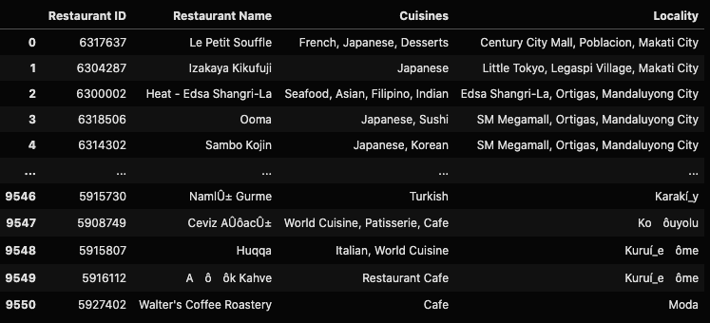
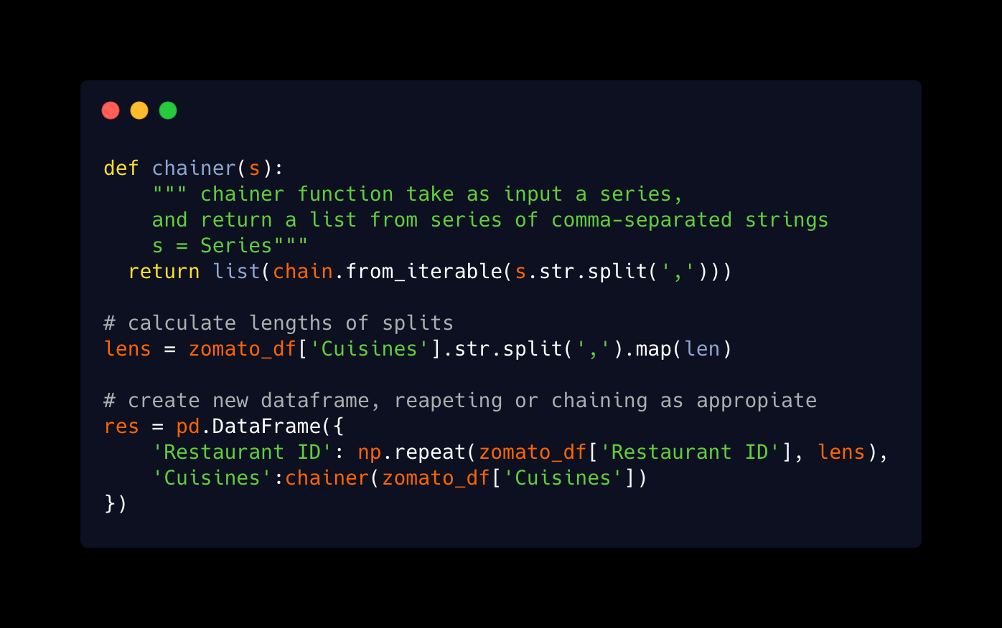
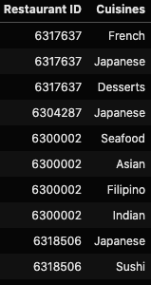
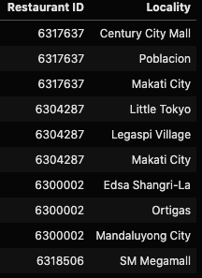
Cuisines and Locality disaggregation

Slide 5
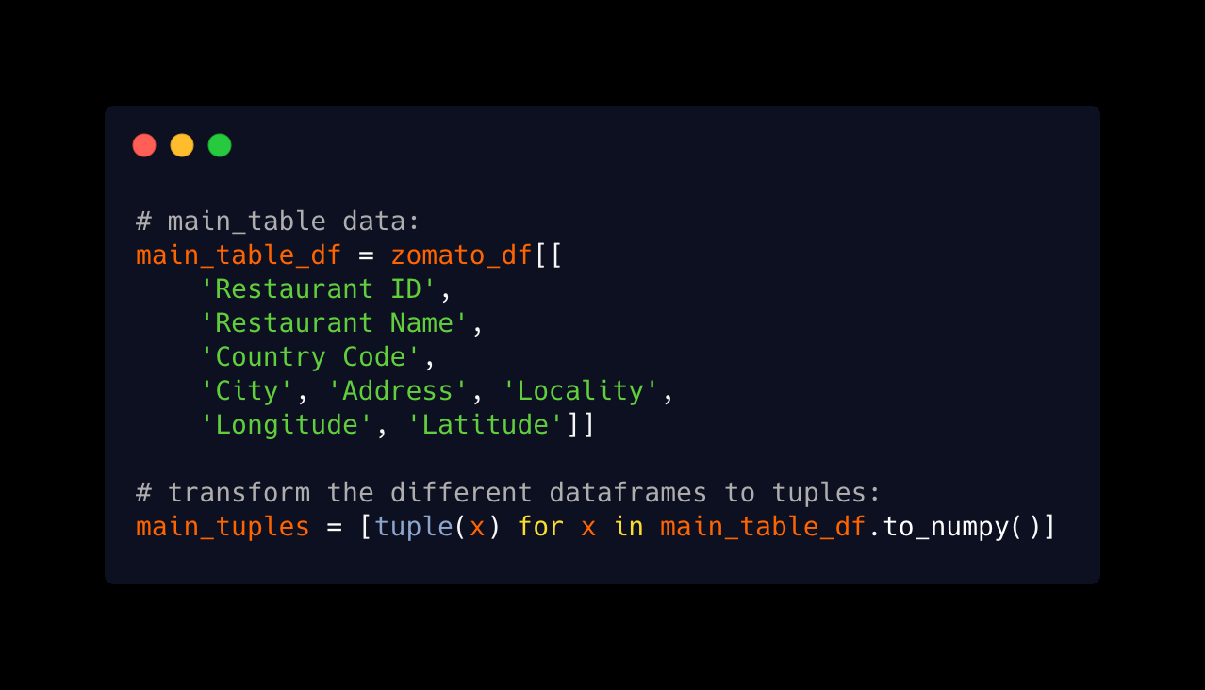
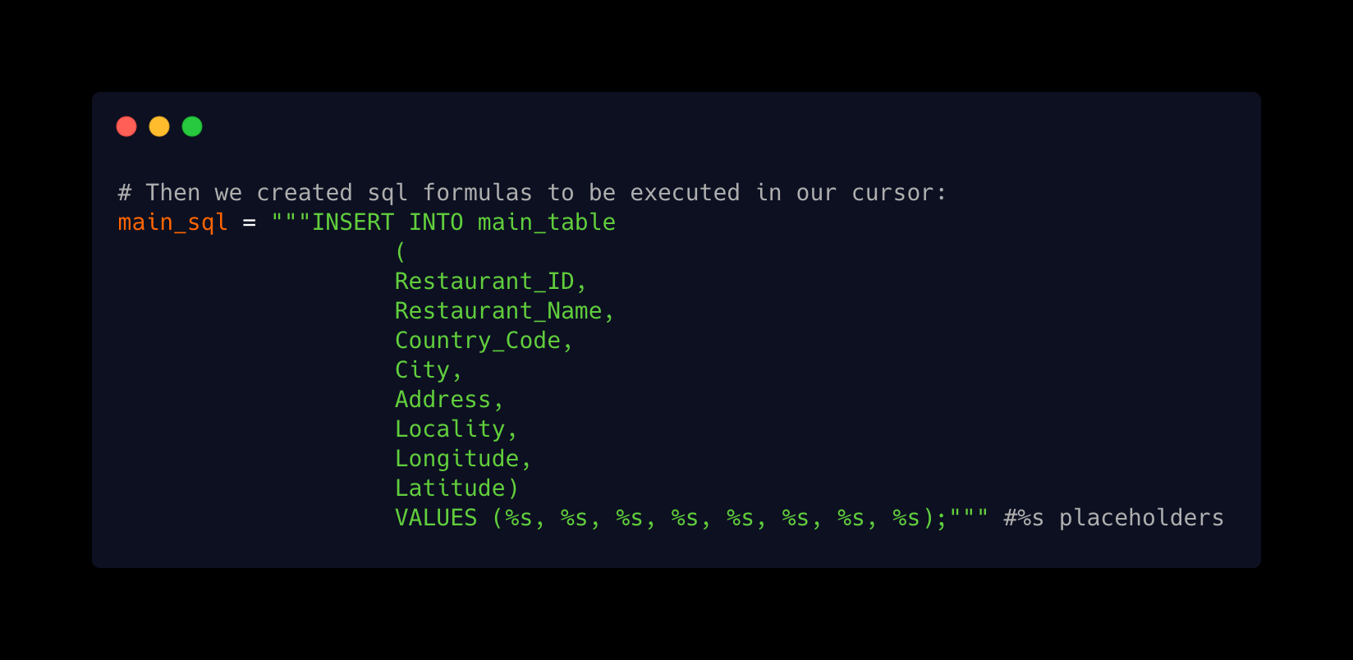
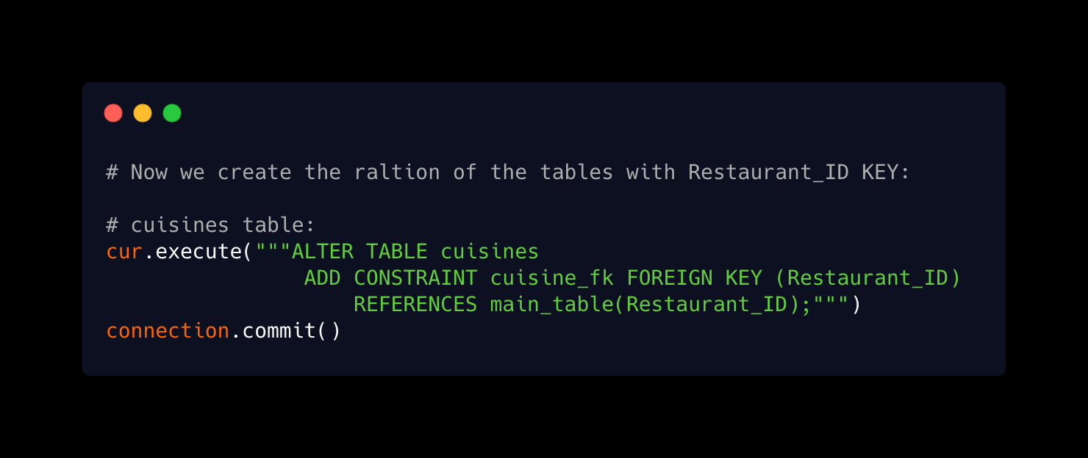
Approach
Restructure
Tables creation
Migration
Relation
MySQLconnection.ipynb

Slide 6
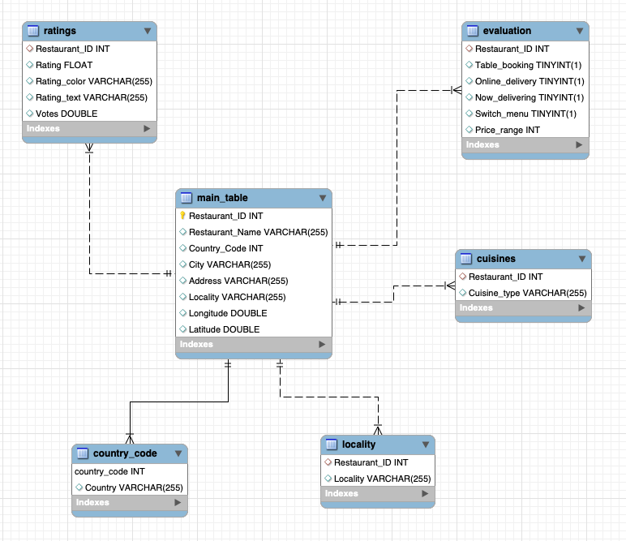
Database schema:
Primary keys: Restaurant_ID
‘main_table’
Foreign keys: Restaurant_ID
‘Ratings’, ‘evaluation’, ‘cuisines’, ‘locality’
Keys: Country_code

Slide 7
Benefits & Advantages
Minimize the size of the main table.
Relatively easy to update / modify the database.
Convenient to search for information based on the characteristics of different tables.
Additional tables can be added to the database to have a more complex structure.

Slide 8
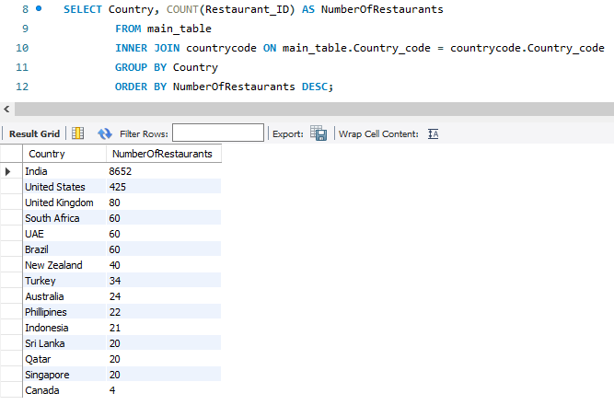
Which country has the majority of restaurants in the dataset?

Slide 9
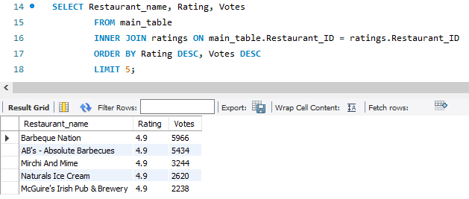
What are the top 5 rating restaurants and how many votes does each of them collected?

Slide 10
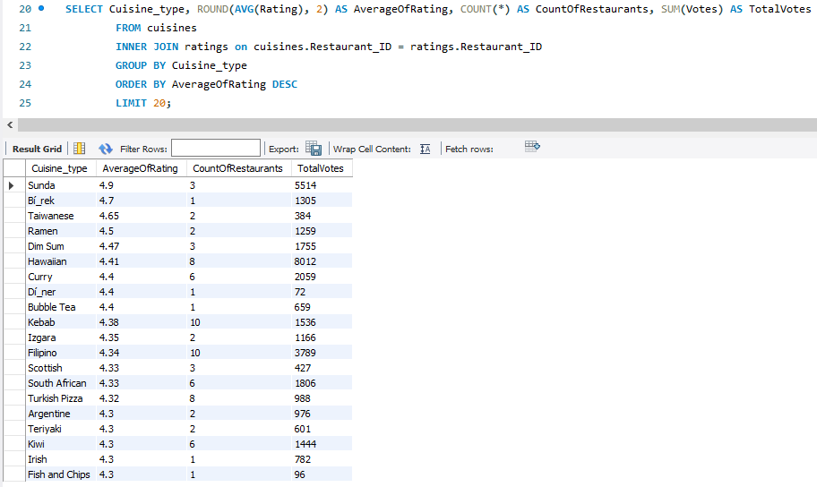
What are the top 20 cuisine types that have the highest average rating?

Slide 11
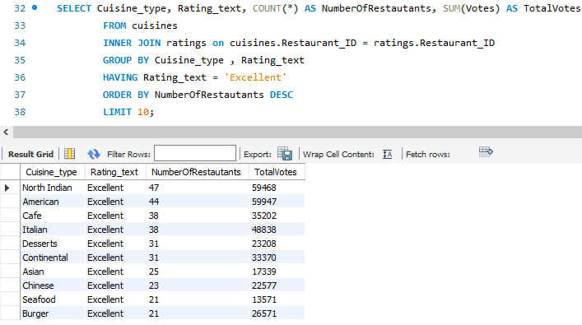
What are the top 10 cuisine types that have the most rating as “Excellent” ?

Slide 12
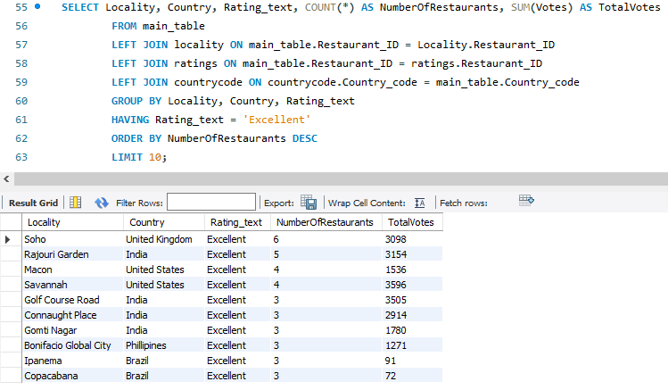
What are the top 10 localities have the most restaurants that are rated as “Excellent” ?

Slide 13
Thank you!

