Slide 1
Online Community Monitoring
Tracking Changes in Subreddit Sentiments
Natural Language Processing
DATS 6312, Section 11
Team 3, Final Project
Ashish Telukunta, Jonathan Schild, Thomas Stanton

Slide 2
Project Outline
Conceptualization/description
Training model to predict emotion and sentiment of text
Scrape Reddit data
Apply model(s)
Plot sentiments over time

Slide 3
Model Approach
Data
Model identification
Bert 1, Bert 2
Electra
RoBerta
Fine tuning
Hyperparameters
Optimizer
Loss function

Slide 4
Model Performances
Model | Validation Accuracy | F1 Score
Bert (w/o Reddit data) | 0.9520 | 0.9582
Bert (w/Reddit data) | 0.91?? | 0.9140
Electra | 0.9531 | 0.9530
Roberta | 0.9502 | 0.9502

Slide 5
Reddit Scraper
Praw
Duration restrictions: day, week, month, year
No ability to specify date ranges
Data retrieved
Posts & comments; specify number of each
Dates

Slide 6
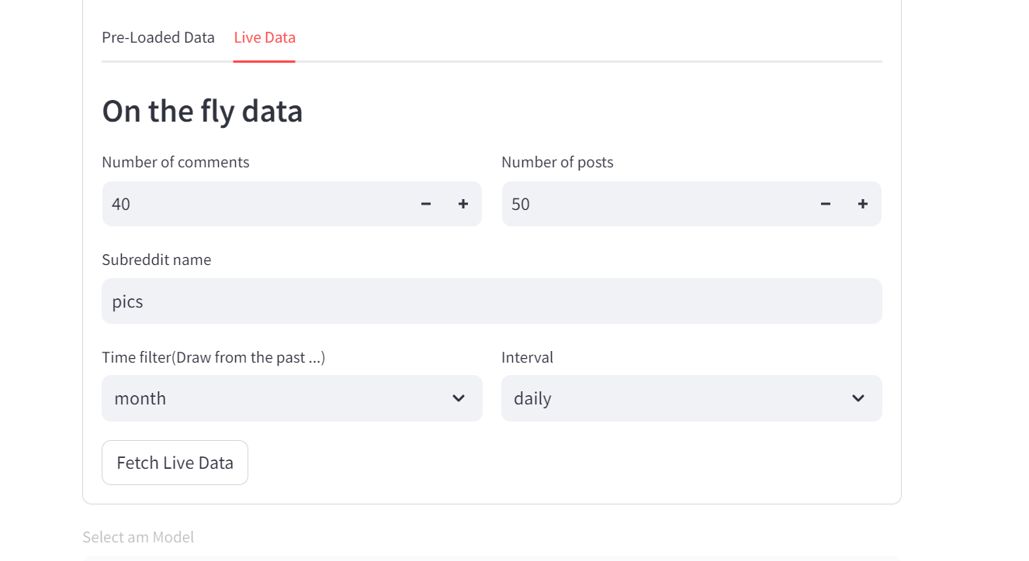
Model Application: Preview
Scrape parameters
Top 40 comments for the top 50 posts
Daily intervals, for past month
r/pics
Demonstration…

Slide 7
Questions...

Slide 8
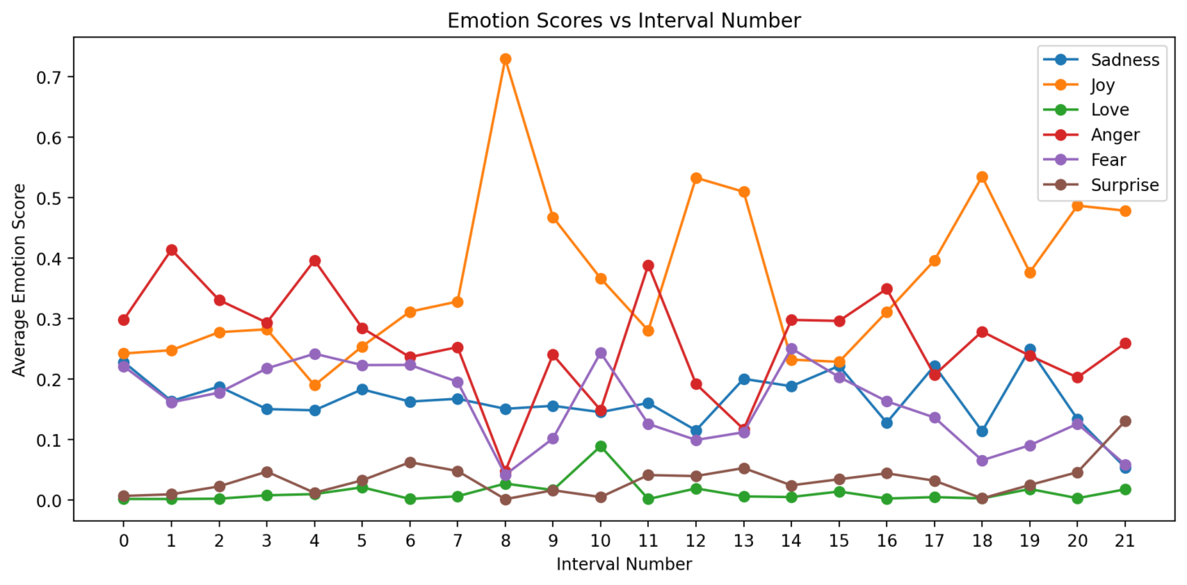
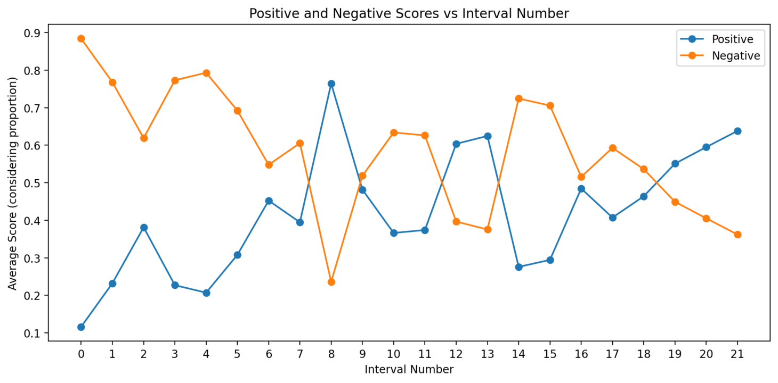
Electra

Slide 9
Questions...

Slide 10
Questions...

Slide 11
Questions...

