Slide 1
File Processing : Hash
2014, Spring
Pusan National University
Ki-Joune Li

Slide 2
Index vs. Hash
Index
  Needs a Data Structure : such as B+-tree
    Stored on Disk
    Primary or Secondary Index
      Block number can be determined before the insertion in index
Hash
  Needs a Hash Function
    h(v)=b (h : hash function, v : key value, b : block number)
      Block number (b) is determined by hash function
        where to store data and where to retrieve data
        Only Primary Index
v
h
b
Record

Slide 3
Primary Index vs. Secondary Index
Secondary Index
  Step 1: Store a record in a certain block b
    e.g. Sequential order
  Step 2: Insert the key value v into B+-tree with b
  The determination of block number is independent with B+-tree
Primary Index
  Step 1: Compute hashing function h(v)=b
  Step 2: Store the record on block b
  The block number is determined by the Hashing Function

Slide 4
Hash
Different Keys may map to the Same Block Number
  One block may contain more than one record
Hash Function for
  Insertion
  Search
  Deletion
Static Hash
Dynamic Hash

Slide 5
Static Hash
Number of Available Blocks : Fixed
h(v) :
  specifies the block where this record is to be stored
“Romeo”
+ 120
h(v) = 35
35/m = 2
b120
b121
b122
b123
“Juliet”
h(v) = 13
13/m = 0
b124
b125
b126
b127
h(v) = 22
22/m = 9
b128
b129
b130
b131
b132
b133
b134
b135
“Hamlet”

Slide 6
Handling of Block Overflow
Block overflow can occur because of
  Insufficient buckets
  Skew in distribution of records
  multiple records have same search-key value
  hash function produces non-uniform distribution
It cannot be eliminated, although the probability of bucket overflow can be reduced,
  Need overflow buckets.

Slide 7
Overflow Handling
Overflow chaining
  linked list for overflow block
  closed hashing
Next Block
  B + h(v) + n
Bucket 0
Bucket 1
Bucket
Bucket
Bucket 2
Overflow Bucket

Slide 8
Hash Function
Worst Case :
  Hash function maps all search-key values to the same bucket
    Linear Search Time : No meaning
Two Conditions
  Uniformity
  Randomness
Typical hash functions :
  internal binary representation of the search-key
    For example, for a string search-key, the binary representations of all the characters in the string could be added and the sum modulo the number of buckets could be returned. .

Slide 9
Discussion on Static Hash
Static Hash
  The bucket number remains unchanged
Advantages
  Simple
  Optimal Hashing Function for static environment
    When the number of records is fixed : No problem : we prepare a fixed number of blocks
When the number of records is variable (DB grows)
  If it may exceed the N_{b}*B_{f}
    Extension of Blocks
    An Extensible (or Dynamic) Hashing Mechanism is necessary
    Or Periodic reorganization

Slide 10
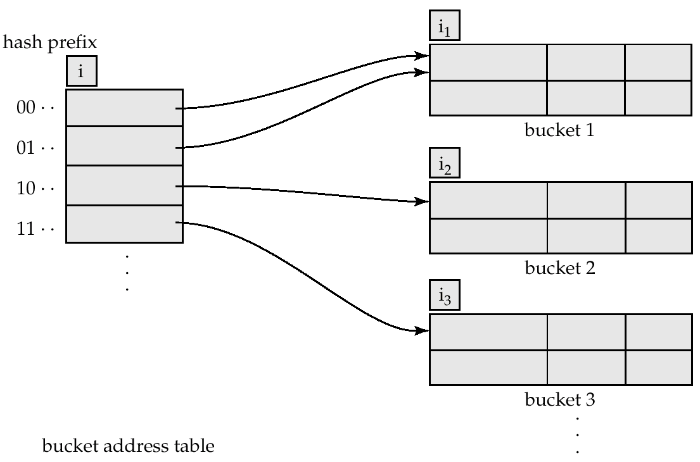
Dynamic Hash
b₃₁b₃₀b₂₉,…b₂b₁b₀
i

Slide 11
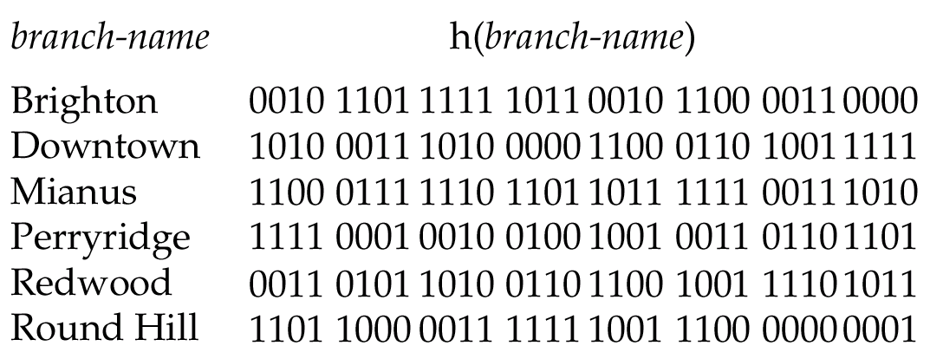
Dynamic Hash : Example
i

Slide 12
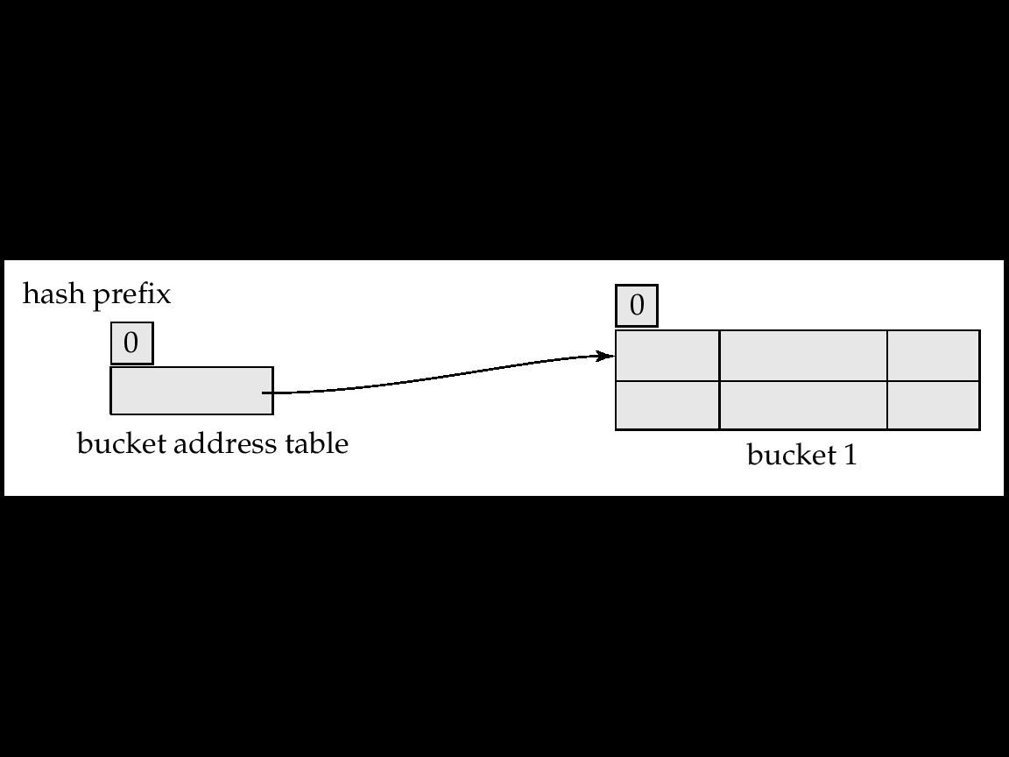
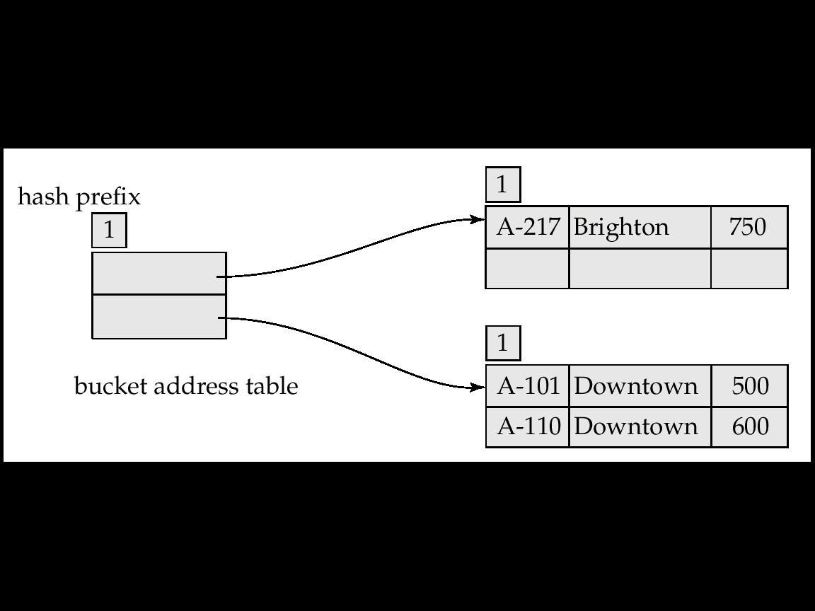
Dynamic Hash : Example (3 Records)
Overflow
+1
Split
+1
Overflow

Slide 13
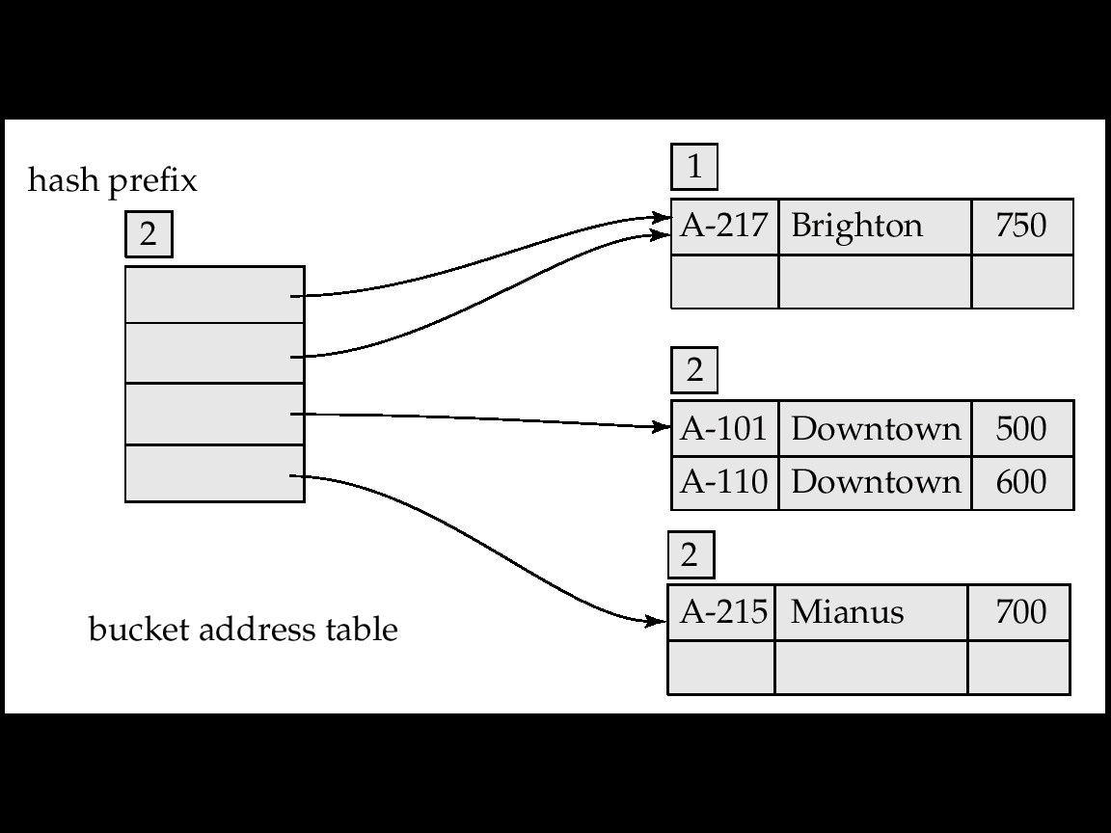
Dynamic Hash : Example (4 Records)
Split

Slide 14
Dynamic Hash
Good for database that grows and shrinks in size
  Allows the hash function to be modified dynamically
Extendable hashing – one form of dynamic hashing
  Hash function generates values over a large range
    typically b-bit integers, with b = 32.
  At any time use only a prefix of the hash function
    Let the length of the prefix be i bits, 0 ≤ i ≤ 32.
    Bucket address table size = 2^{i}. Initially i = 0
    Value of i grows and shrinks according to the size of the database
  Multiple entries in the bucket address table may point to a bucket.
    Thus, actual number of buckets is < 2^{i}
    The number of buckets also changes dynamically due to coalescing and splitting of buckets.

Slide 15
Index vs. Hash
Index
  Needs a Data Structure
    such as B+-tree
    Requires Disk Accesses : such as node accesses in B+-tree
  Range Query and Exact Match Query
  Secondary and Primary Index
Hash
  Need no data structure
    except hash table : much lighter than tree
    No disk accesses in general
  Exact Match Query
    For 1-D key value
  Primary Index Only

