Slide 2
Data Collection
Clustering
Regression

Slide 3
Data Collection
1. Run tensorflow pose estimation on different pi(pi2b, pi3b, pi4b)
2. Adjust sdram_freq, cpu_cores, cpu_freq,mem_lim_kb
3. Collect avg_fps and total_time.

Slide 4
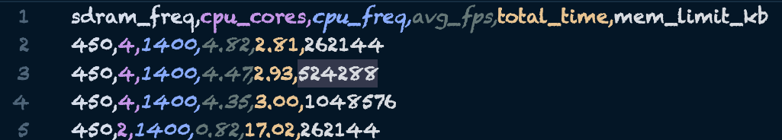
Data Collection
Setup pi
1. miniconda python3.9
2. git clone https://github.com/GXG-CS/Smart-Cameras.git
3. tensorflow pose_estimation setup
4. Install GTK libraries: sudo apt-get install libgtk2.0-dev
5. sudo apt-get install xvfb
6. sudo apt-get install cpufrequtils
data_collection steps: (tf_pose_estimation)
1. sudo nano /boot/config.txt sdram_freq=450
2. crontab -e @reboot xxx
3. change counter.txt to 0
4. change sdram_freq.txt sdram_freq list
5. debug info: log.txt and error_log.txt
6. results.txt stores the results of [cpu_cores, cpu_freq, avg_fps, sdram_freq, total_time, mem_limit_kb]
7. ./4_metrics.sh

Slide 5
Clustering
Use 10 clustering methods and 6 preprocessors
Visualization
Remove outliers
Select clustering model(s)

Slide 6
Clustering verification
Loading data from CSV files
Preprocessing the data with scaling techniques
Applying PCA for dimensionality reduction
Visualizing the data with matplotlib

Slide 7
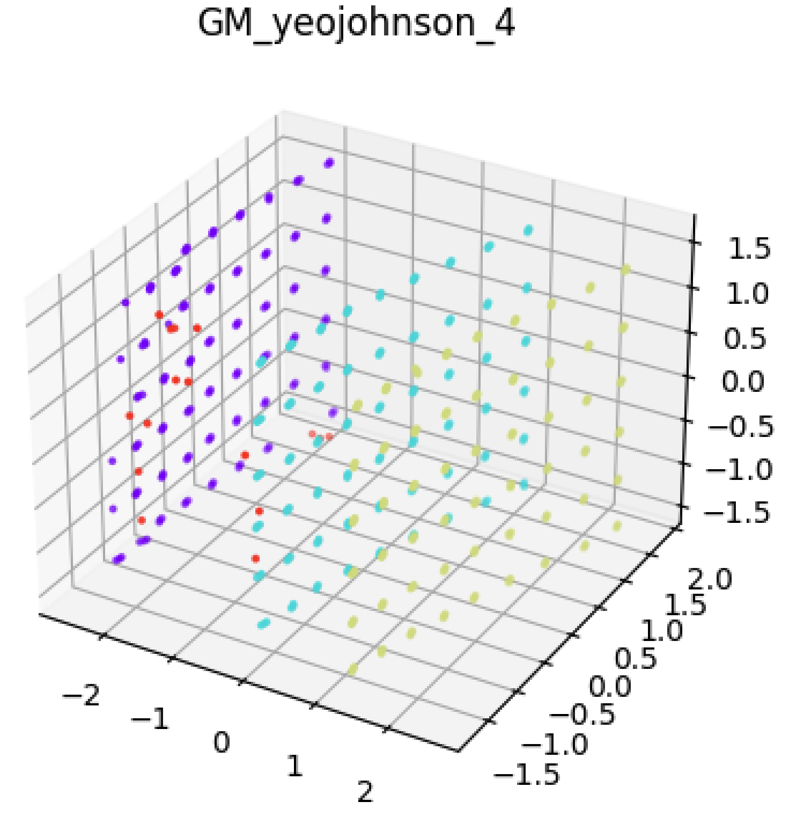
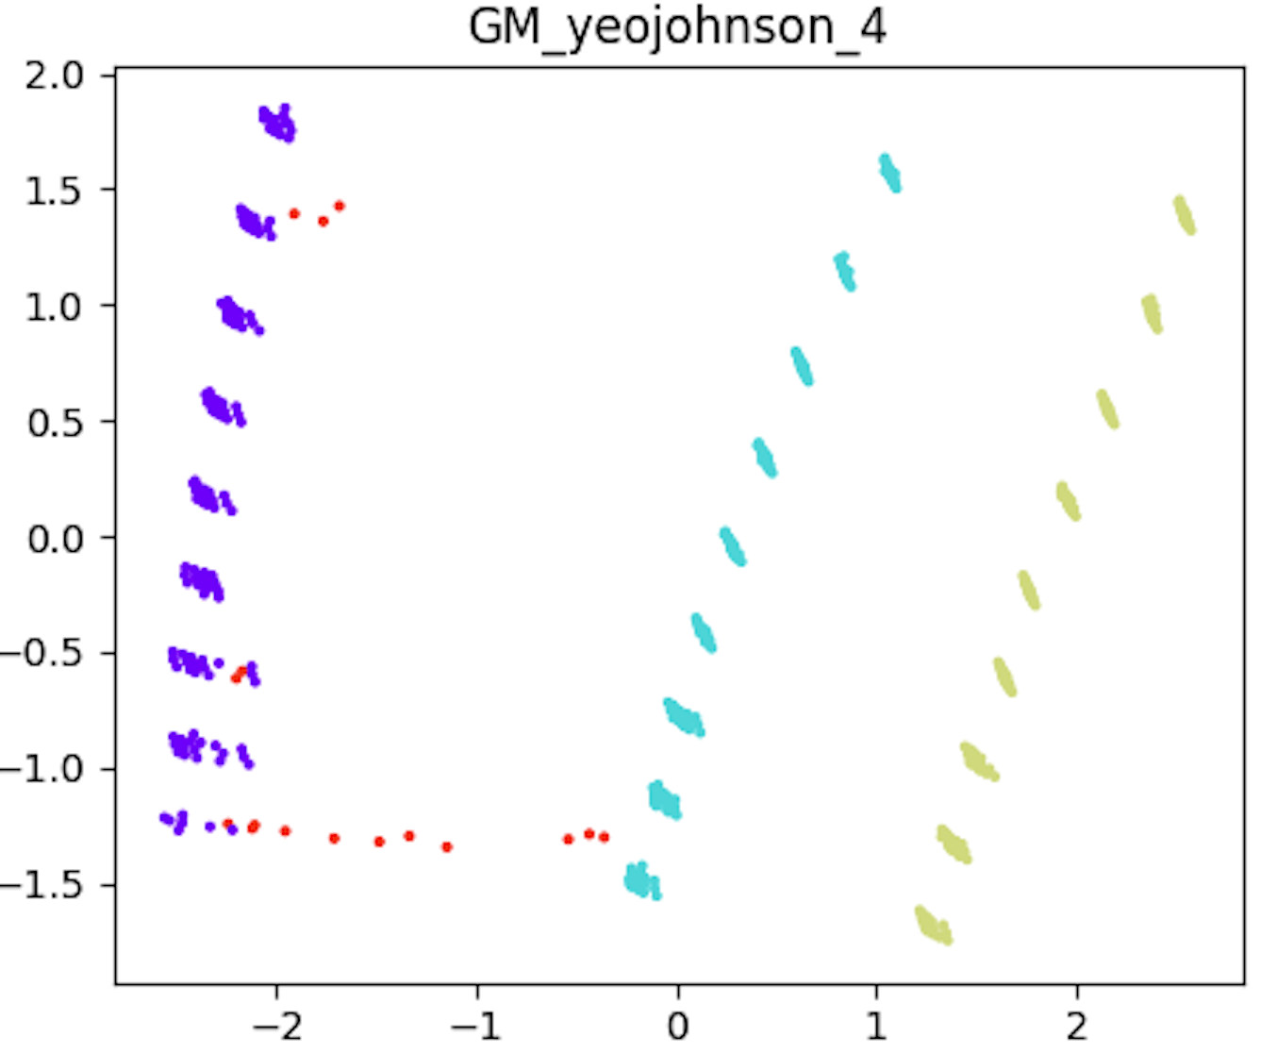
Clustering visualization
Pi3b

Slide 8
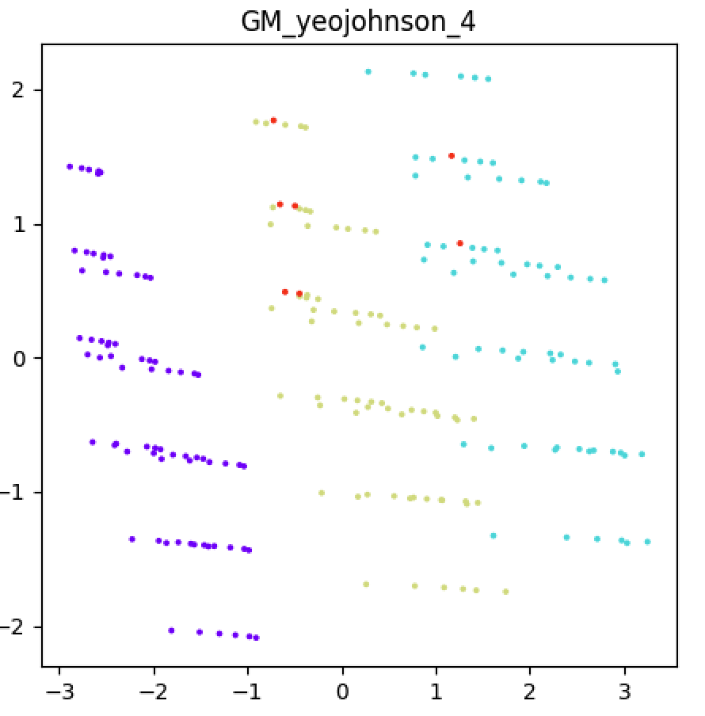
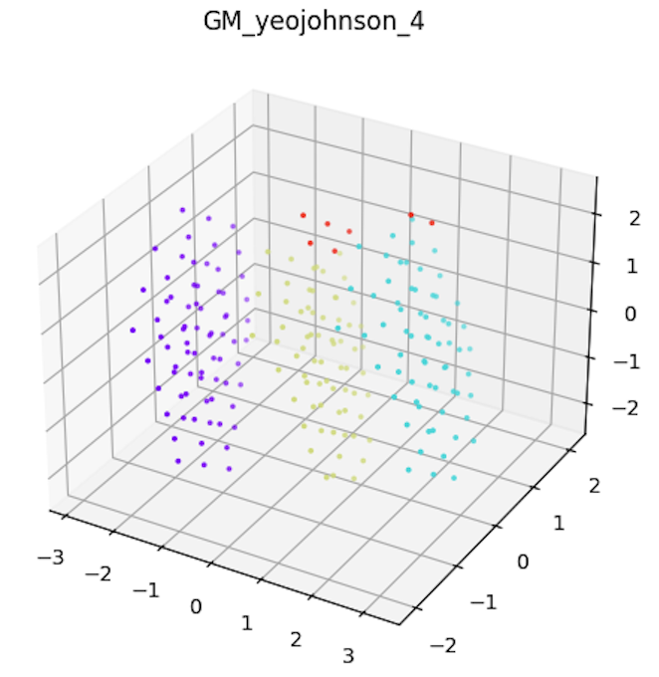
Clustering visualization
Pi2b

Slide 9
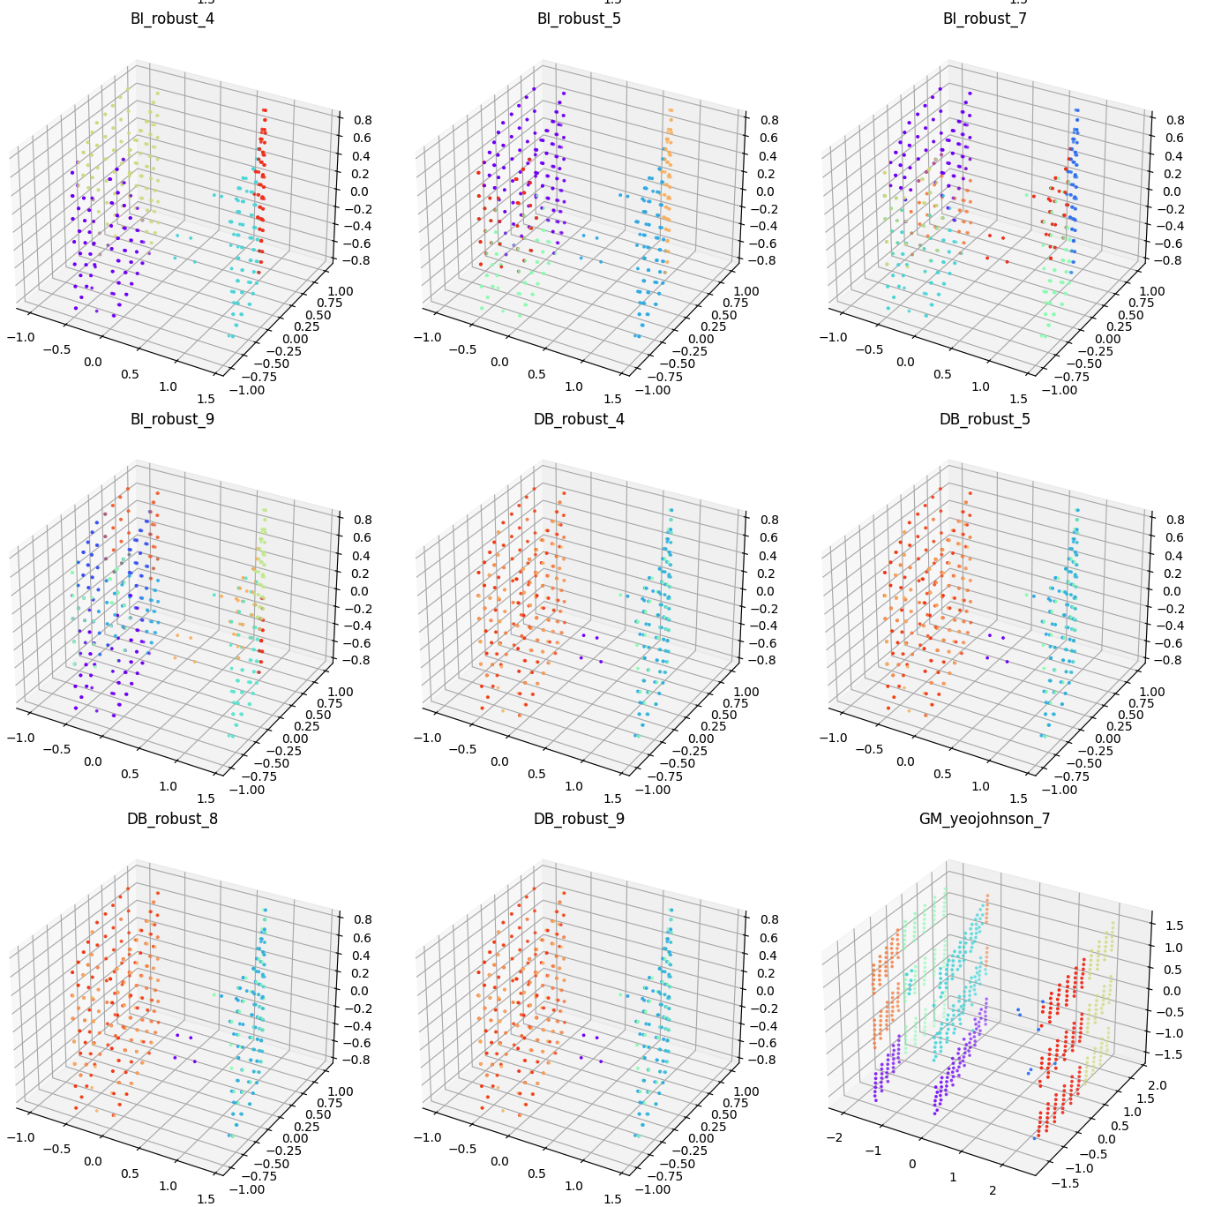
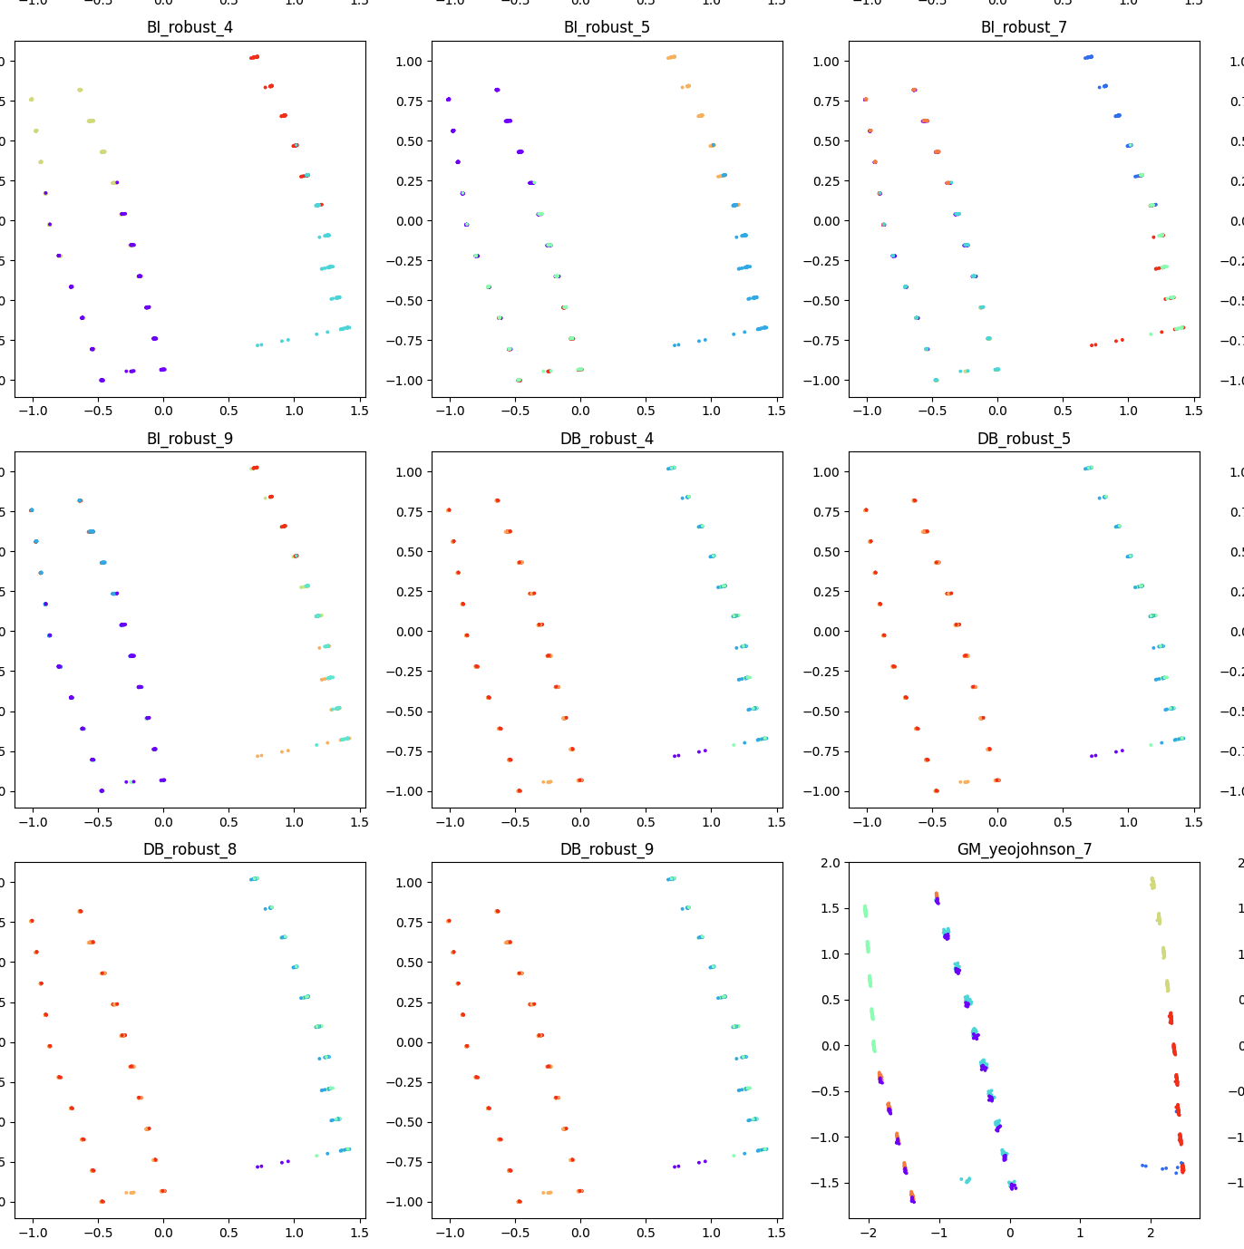
Clustering visualization
Pi4b

Slide 10
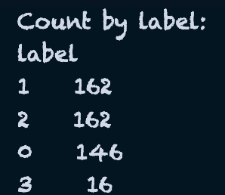
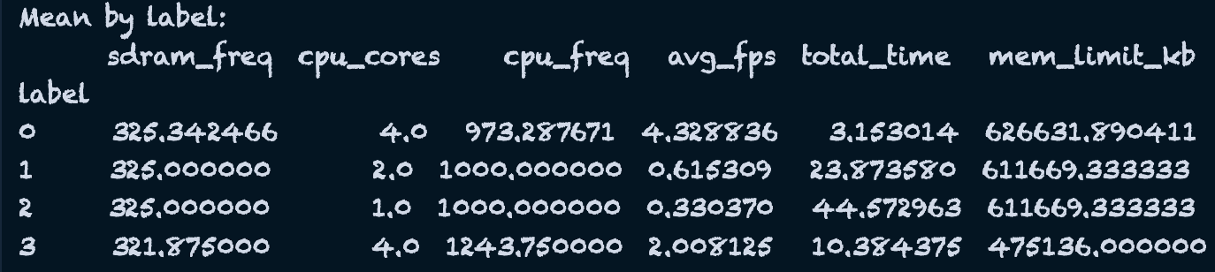
Data cleaning
P3b:p3b_yeojohnson_4.csv

Slide 11
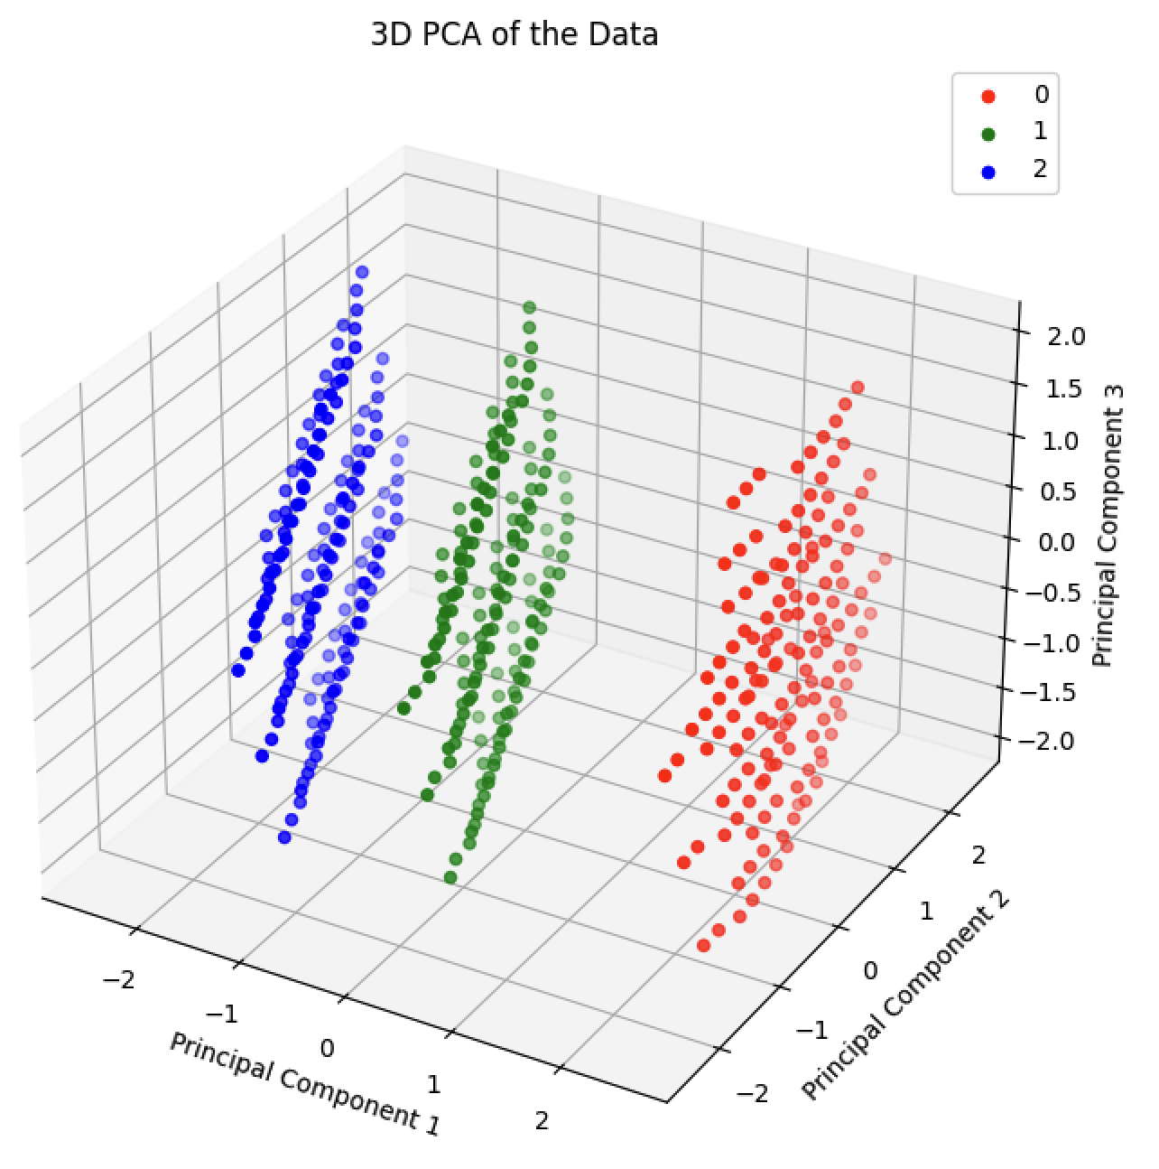
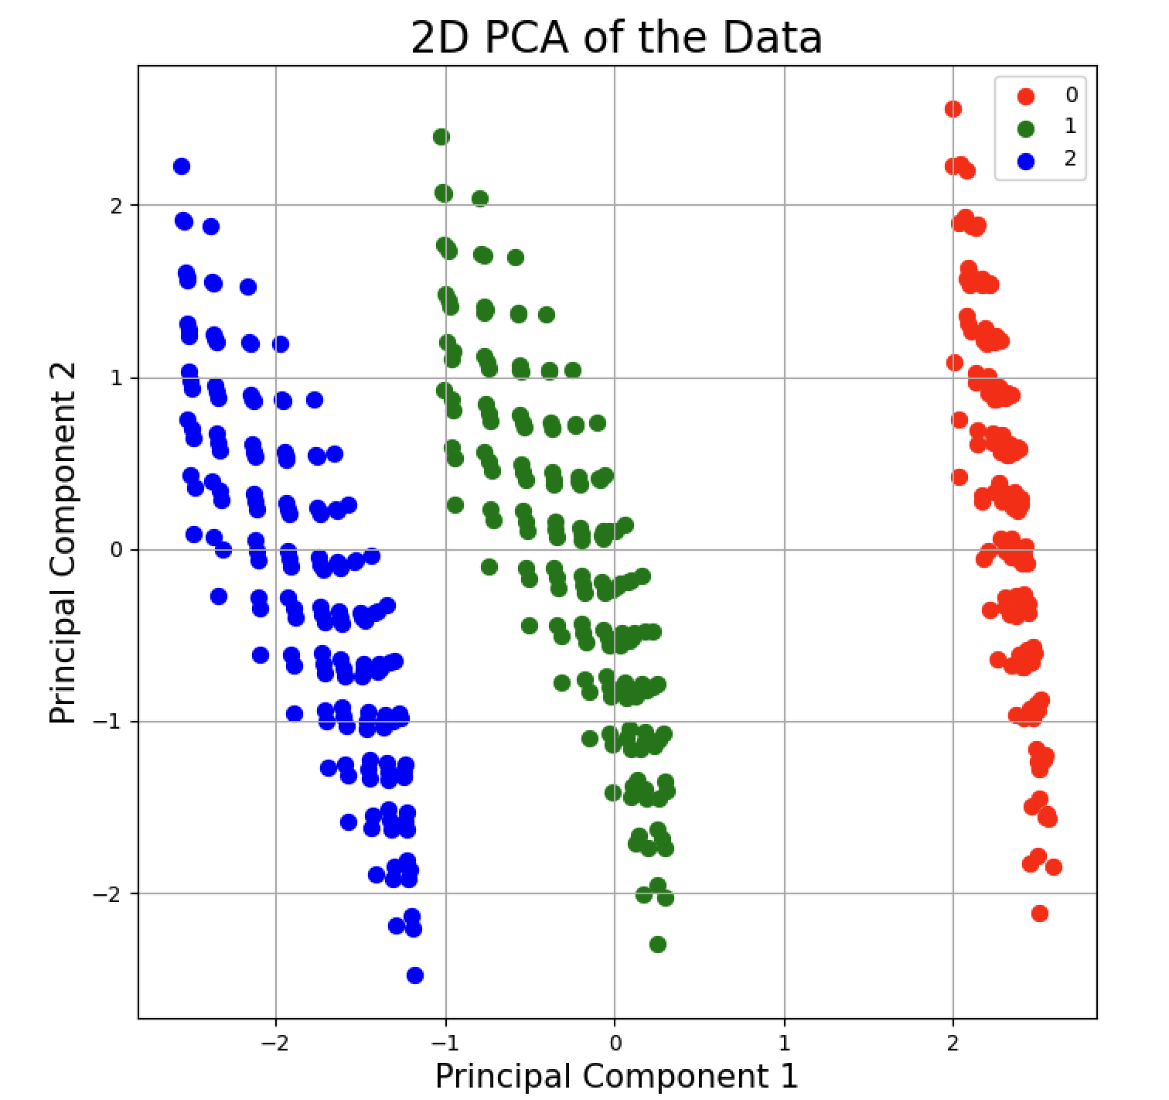
Data Cleaning
Pi3b
Removing label 3

Slide 12
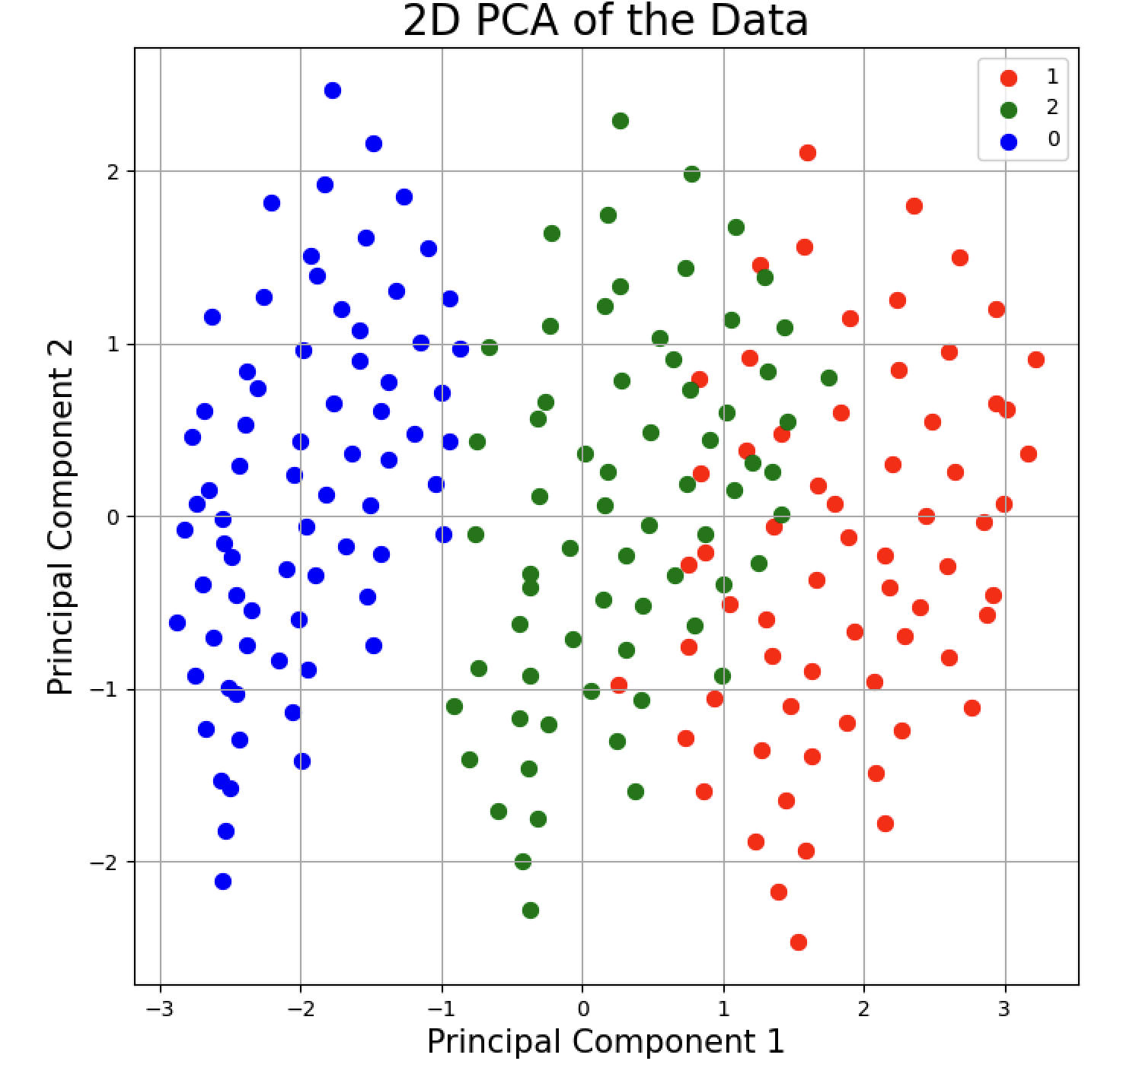
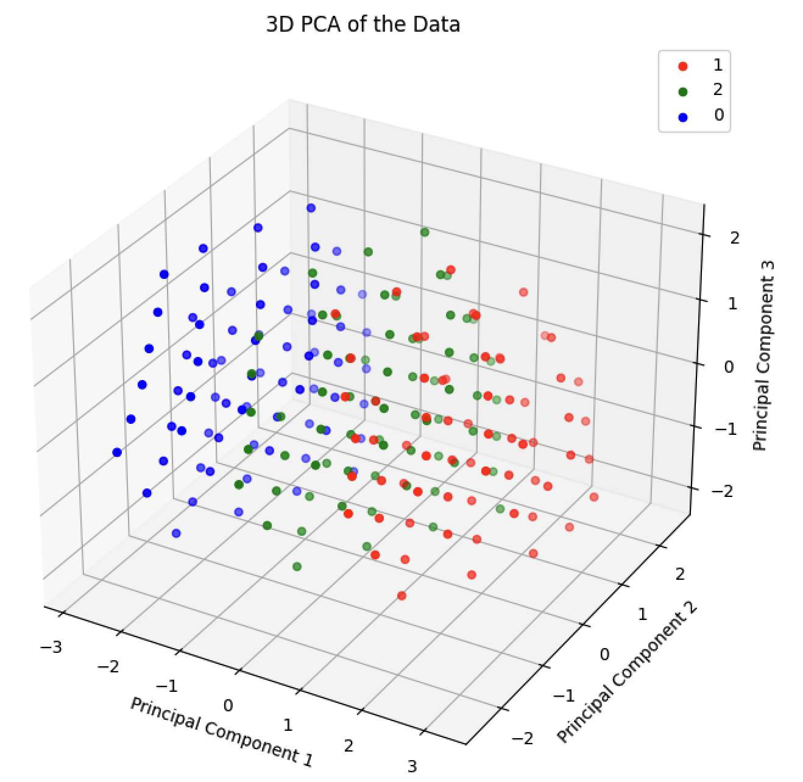
Data Cleaning
Pi2b

Slide 13
Regression

