Slide 1
Micro-network-project
Xiaoguang Guo

Slide 2
Outline
1. Overview
2. System Design and Pipeline
3. Existing Works
4. Inference Performance Predictor
5. Insights
6. Search

Slide 3
1. Overview
The goal is to optimize the partitioning of DNN models across resource-limited MCU nodes in a BLE mesh network without internet connectivity, focusing on minimizing computation and transfer time while considering memory and energy constraints.
This involves:
1. How to make multiple MCUs cooperate?
WiFi and BLE-Mesh
2. How to run inference on multiple MCUs?
Model Partitioning

Slide 4
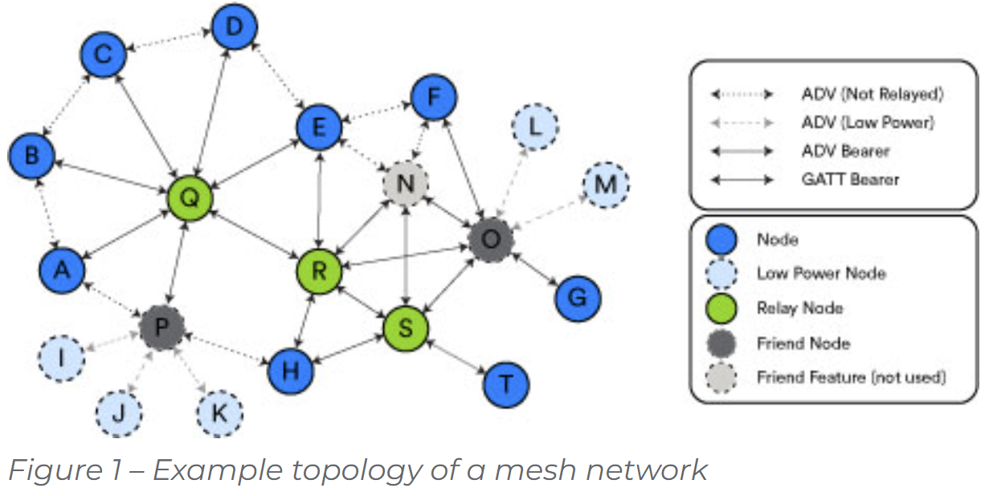
2.1 System Design
1. Network Construction
Network topology
Roles assignment
Link
Scheduler:
1. Preconfigure the network
2. Model partitioning and deployment
3. Monitor the network (feedback loop)
Communication API
Scheduler

Slide 5
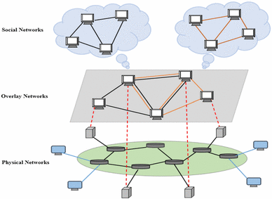
2.1 System Design
Distributed Inference/retraining
Collaborative Virtual Network Our new virtual network
BLE 1.1 Mesh Network
We will use computing/super nodes to establish the distributed learning path on the overlay network.

Slide 6
2. 2 Pipeline
1. Network Initialization
2. Profiling
Network conditions:
Nodes capabilities(CPU, Memory, Architecture)->processing time
Network bandwidth -> transfer time
DNN Model (per layer)
Latency, memory, energy, data size
3. Model Partitioning
Per layer execution time (Assume that each layer is independent)
Assignment(layer-device) determination
4. Model Deployment
Select virtual ‘routing’ for distributed inference
5. Optimization (optional)
Feedback loop (Network <-> Model performance)
Model optimization

Slide 7
Latency
Model Partitioning
Scheduler
Profiler
Inference performance predictor for MCUs
Memory
Energy
Data Size
Network Conditions
Profiler
Bandwidth
Nodes Capabilities
Search
Overlay Network
Routing
Provisioning
Relaying
BLE Mesh Network
Flooding

Slide 8
2. 3 Model Partitioning Pipeline
Determination of assignment(layer-device): (search problem)
Input(network, model)
Network(nodes,)
Model(layers,)
Output(assignment)
Model partition:
Input(assignment, model)
Output(model segment 1, model segment 2)
Model deployment:
Model segment 1 -> MCU 1
Model segment 2 -> MCU 2
……

Slide 9
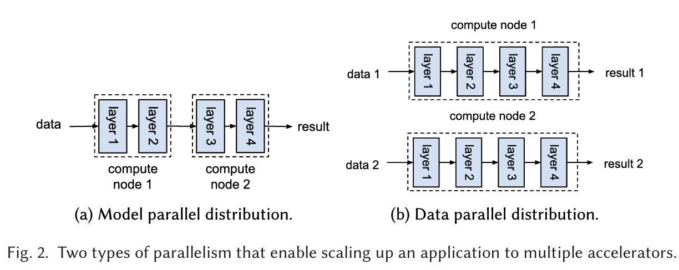
3. Distributed Inference
Notes:
[1]: Alonso, Tobias, Lucian Petrica, Mario Ruiz, Jakoba Petri-Koenig, Yaman Umuroglu, Ioannis Stamelos, Elias Koromilas, Michaela Blott, and Kees Vissers. "Elastic-df: Scaling performance of dnn inference in fpga clouds through automatic partitioning." ACM Transactions on Reconfigurable Technology and Systems (TRETS) 15, no. 2 (2021): 1-34.

Slide 10
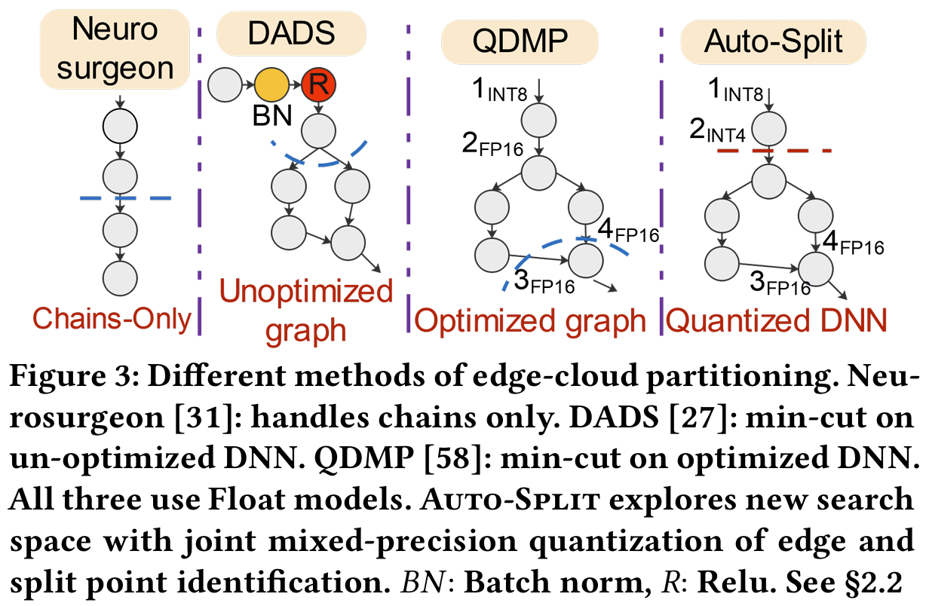
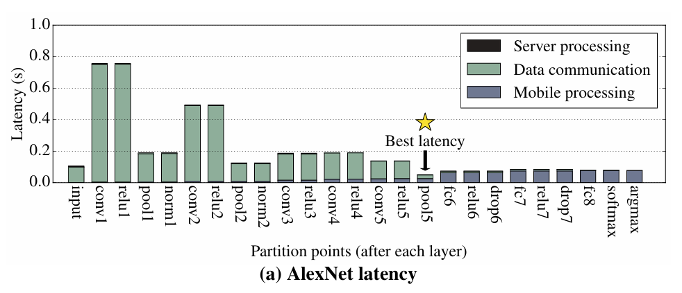
3.1 Model Partitioning Existing Works(Edge - Cloud)
Neurosurgeon(ASPLOS’17)[1]:
Analyze DNN Architecture-> Predict Layer Performance->Evaluate Partition Points->Execute Partitioned DNN
DADS(INFOCOM’19)[2]: Min-Cut
QDMP(IMWUT’20)[3]: Per layer latency is calculated by subtracting the maximum latency of all precursor layers from the total latency up to the current layer.
Auto-Split(KDD’21 ADS Track)[4]: Graph Optimization(Layer folding, layer fusion)
Notes:
[1] Kang, Y., Hauswald, J., Gao, C., Rovinski, A., Mudge, T., Mars, J., & Tang, L. (2017). Neurosurgeon: Collaborative intelligence between the cloud and mobile edge. ACM SIGARCH Computer Architecture News, 45(1), 615-629.
[2] Hu, Chuang, Wei Bao, Dan Wang, and Fengming Liu. "Dynamic adaptive DNN surgery for inference acceleration on the edge." In IEEE INFOCOM 2019-IEEE Conference on Computer Communications, pp. 1423-1431. IEEE, 2019.
[3] Zhang, Shigeng, Yinggang Li, Xuan Liu, Song Guo, Weiping Wang, Jianxin Wang, Bo Ding, and Di Wu. "Towards real-time cooperative deep inference over the cloud and edge end devices." Proceedings of the ACM on Interactive, Mobile, Wearable and Ubiquitous Technologies 4, no. 2 (2020): 1-24.
[4] Banitalebi-Dehkordi, Amin, Naveen Vedula, Jian Pei, Fei Xia, Lanjun Wang, and Yong Zhang. "Auto-split: A general framework of collaborative edge-cloud AI." In Proceedings of the 27th ACM SIGKDD Conference on Knowledge Discovery & Data Mining, pp. 2543-2553. 2021.

Slide 11
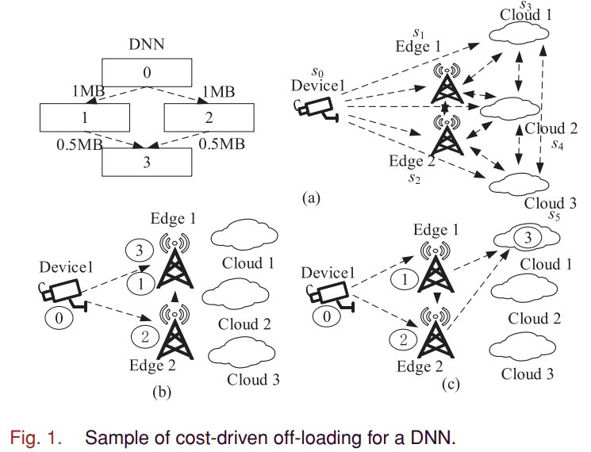
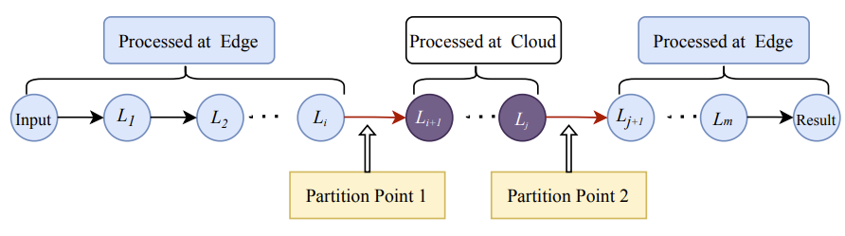
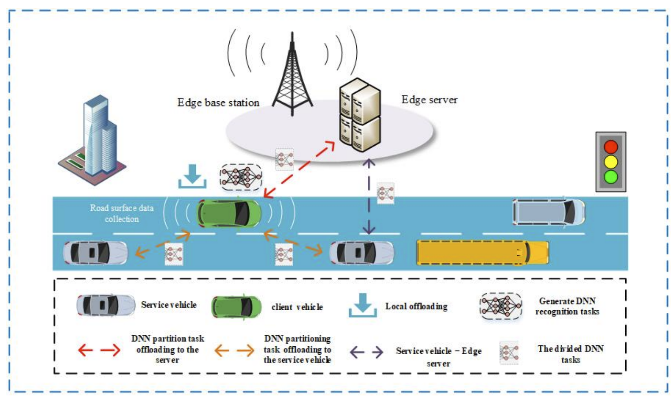
3.2 Model Partitioning Existing Works(Three-tier)
DECC[1]: Iteration
PSO-GA:
Cloud-Edge-End[2]
VEC[3]: Vehicles - Edge servers – Service vehicles
DNNSplit[4]:
Greedy Search
Deployment cost
Notes:
[1]: Chen, Jianan, Qi Qi, Jingyu Wang, Haifeng Sun, and Jianxin Liao. "Accelerating dnn inference by edge-cloud collaboration." In 2021 IEEE International Performance, Computing, and Communications Conference (IPCCC), pp. 1-7. IEEE, 2021.
[2]: Lin, Bing, Yinhao Huang, Jianshan Zhang, Junqin Hu, Xing Chen, and Jun Li. "Cost-driven off-loading for DNN-based applications over cloud, edge, and end devices." IEEE Transactions on Industrial Informatics 16, no. 8 (2019): 5456-5466.
[3]: Li, Chunlin, Long Chai, Kun Jiang, Yong Zhang, Jun Liu, and Shaohua Wan. "DNN partition and offloading strategy with improved particle swarm genetic algorithm in VEC." IEEE Transactions on Intelligent Vehicles (2023).
[4]: Kayal, Paridhika, and Alberto Leon-Garcia. "DNNSplit: Latency and Cost-efficient Split Point Identification for Multi-tier DNN Partitioning." IEEE Access (2024).

Slide 12
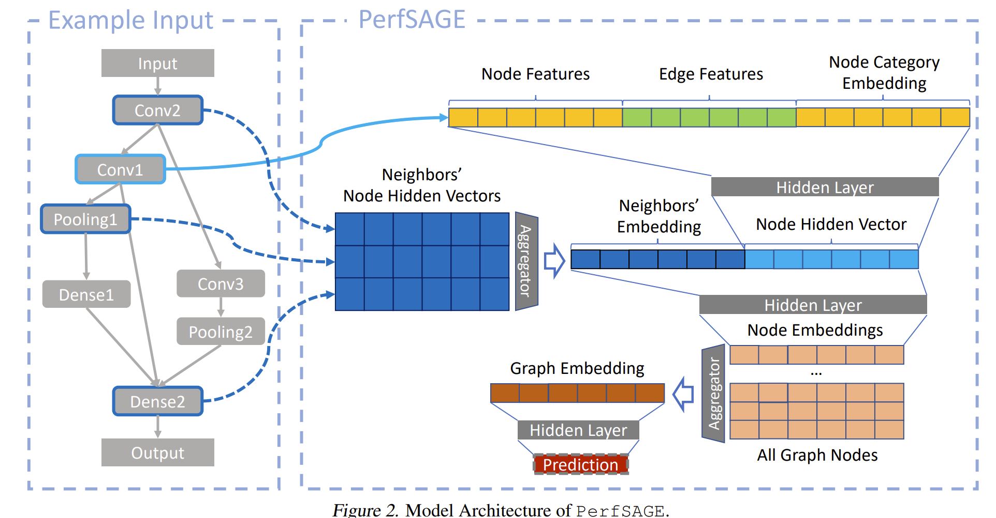
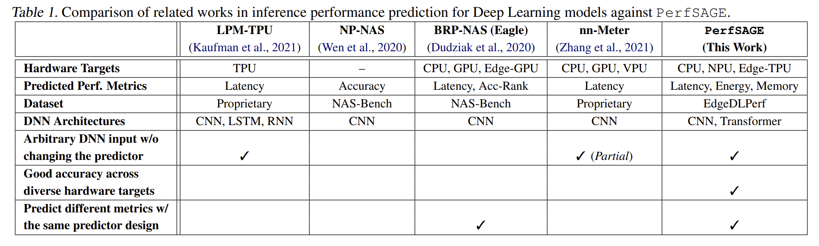
3.3 Inference Performance Predictor Existing Works
LPM-TPU[1]
NP-NAS[2]
BRP-NAS (Eagle)[3]
nn-Meter[4]
PerfSAGE[5]
Notes:
[1]: Kaufman, S., Phothilimthana, P., Zhou, Y., Mendis, C., Roy, S., Sabne, A., and Burrows, M. A learned performance model for tensor processing units. Proceedings of Machine Learning and Systems, 3:387–400, 2021.
[2]: Wen, Wei, Hanxiao Liu, Yiran Chen, Hai Li, Gabriel Bender, and Pieter-Jan Kindermans. "Neural predictor for neural architecture search." In European Conference on Computer Vision, pp. 660-676. Cham: Springer International Publishing, 2020.
[3]: Dudziak, Lukasz, Thomas Chau, Mohamed Abdelfattah, Royson Lee, Hyeji Kim, and Nicholas Lane. "Brp-nas: Prediction-based nas using gcns." Advances in Neural Information Processing Systems 33 (2020): 10480-10490.
[4]: Zhang, Li Lyna, Shihao Han, Jianyu Wei, Ningxin Zheng, Ting Cao, Yuqing Yang, and Yunxin Liu. "Nn-meter: Towards accurate latency prediction of deep-learning model inference on diverse edge devices." In Proceedings of the 19th Annual International Conference on Mobile Systems, Applications, and Services, pp. 81-93. 2021.
[5]: Chai, Yuji, Devashree Tripathy, Chuteng Zhou, Dibakar Gope, Igor Fedorov, Ramon Matas, David Brooks, Gu-Yeon Wei, and Paul Whatmough. "Perfsage: Generalized inference performance predictor for arbitrary deep learning models on edge devices." arXiv preprint arXiv:2301.10999 (2023).

Slide 13
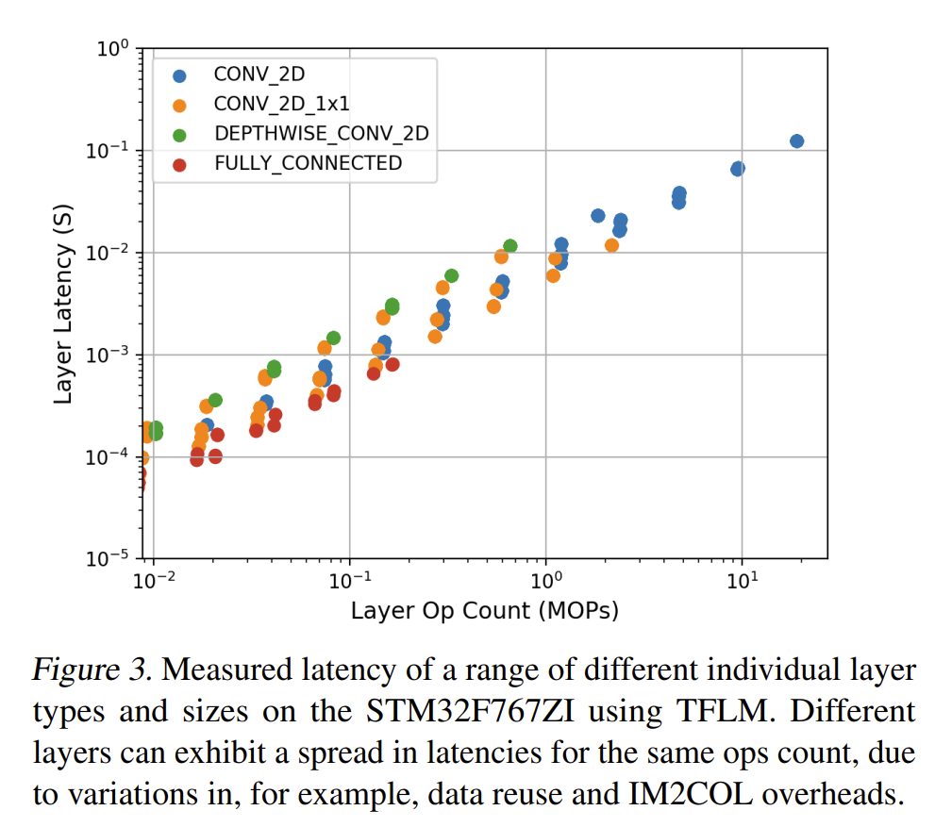
3.4 Inference Performance Predictor Existing Works
MicroNets[1]:
TinyMLPerf[2]: overall performance of TinyML models.
Regression model
Notes:
[1]: Banbury, C., Zhou, C., Fedorov, I., Matas, R., Thakker, U., Gope, D., ... & Whatmough, P. (2021). Micronets: Neural network architectures for deploying tinyml applications on commodity microcontrollers. Proceedings of machine learning and systems, 3, 517-532.
[2]: Banbury, Colby R., Vijay Janapa Reddi, Max Lam, William Fu, Amin Fazel, Jeremy Holleman, Xinyuan Huang et al. "Benchmarking tinyml systems: Challenges and direction." arXiv preprint arXiv:2003.04821 (2020).

Slide 14
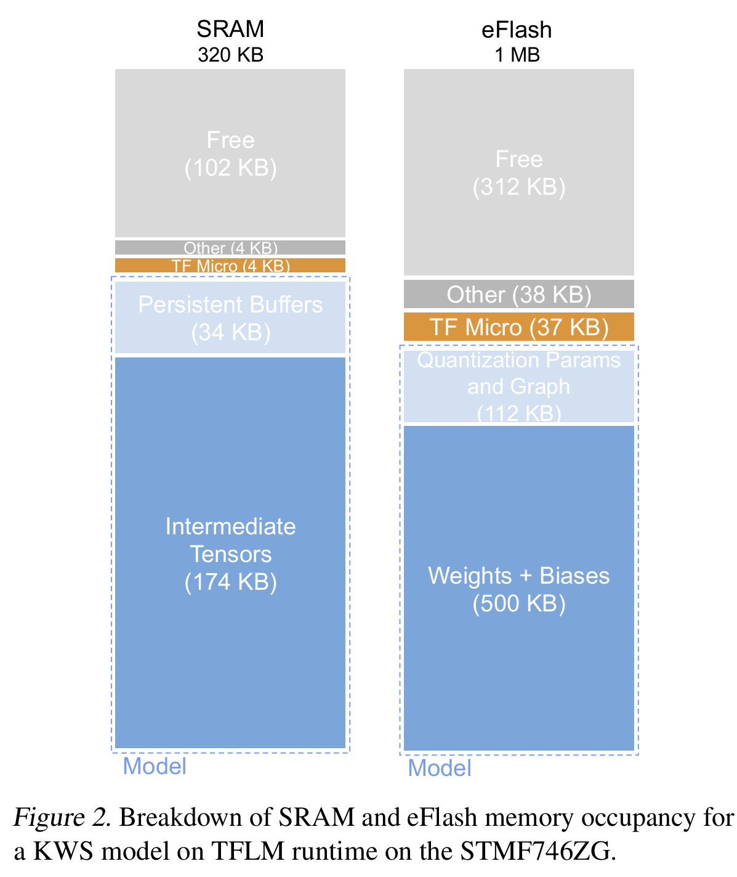
4. Inference Performance Predictor
Datasets
Latency datasets:
The latency for various MCUs, across different types of layers and sizes, is measured using TensorFlow Lite for Microcontrollers (TFLM).
Memory footprint datasets:
Simulation on Server?
Energy consumption datasets:
Predictor(MCU, Layer) =
Latency
Memory footprint (memory, storage)
Energy consumption
Notes:
[1]: Banbury, C., Zhou, C., Fedorov, I., Matas, R., Thakker, U., Gope, D., ... & Whatmough, P. (2021). Micronets: Neural network architectures for deploying tinyml applications on commodity microcontrollers. Proceedings of machine learning and systems, 3, 517-532.

Slide 15
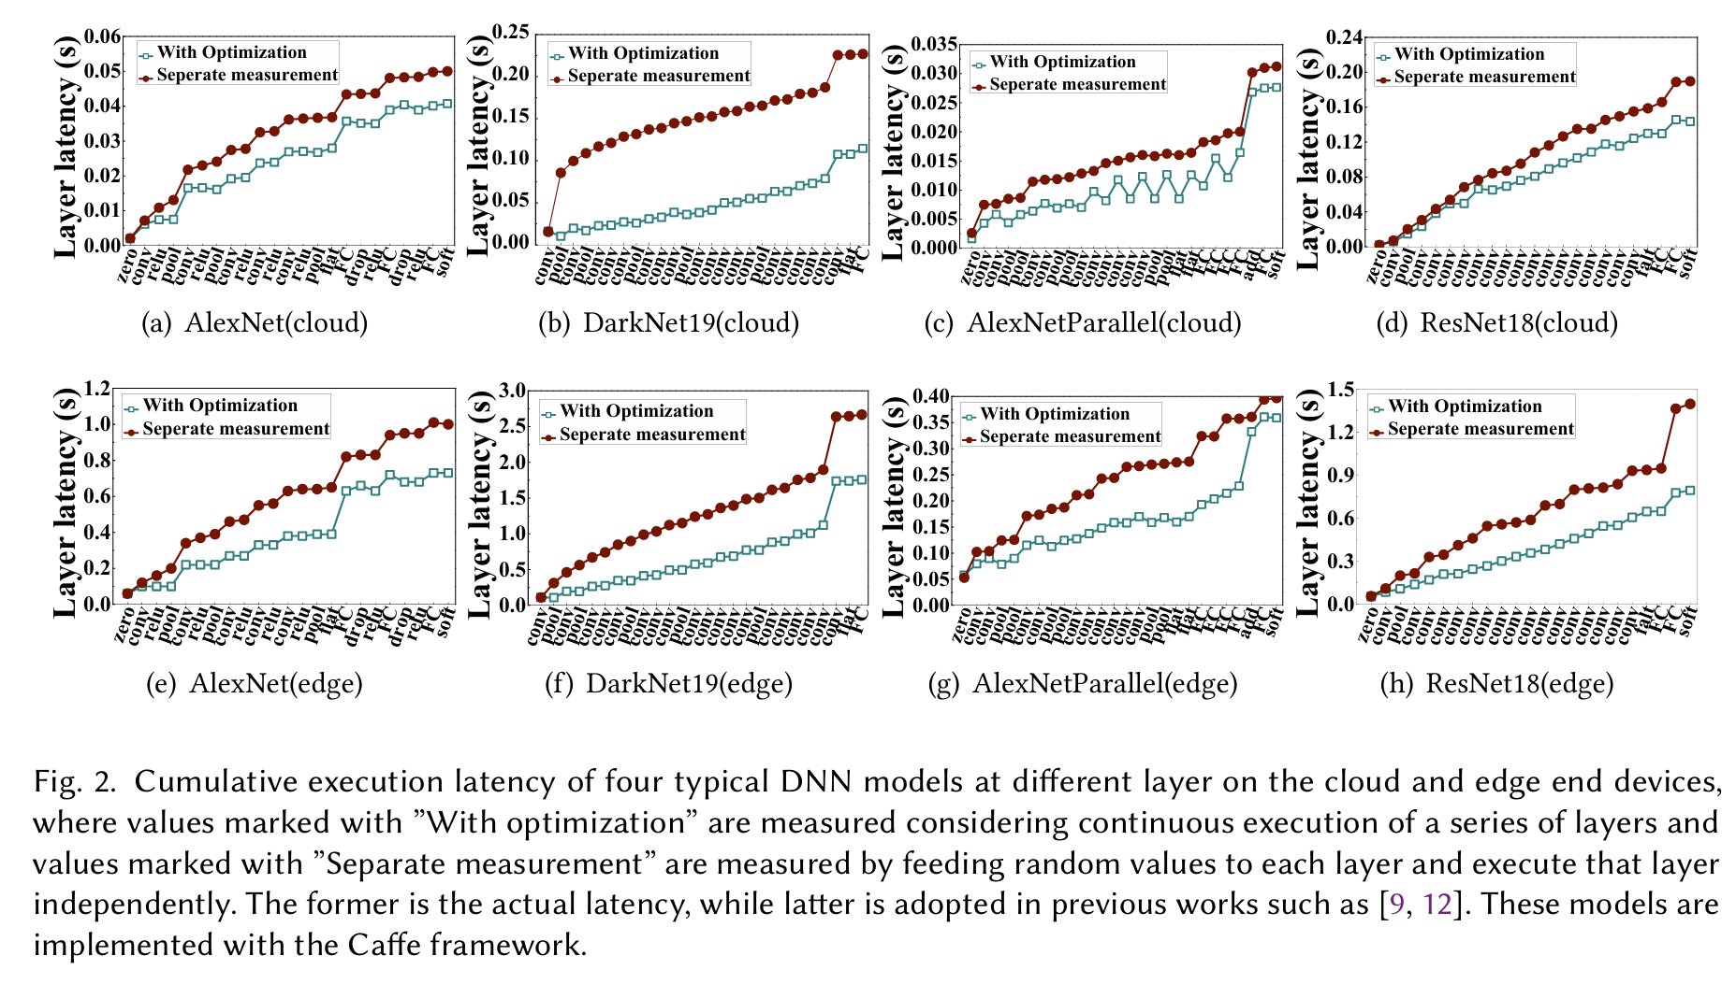
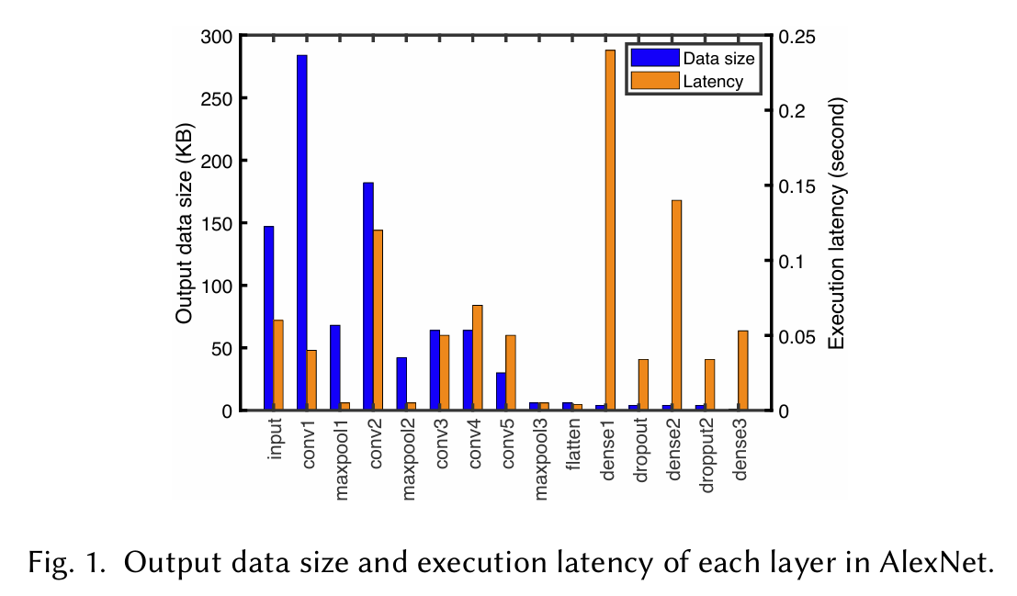
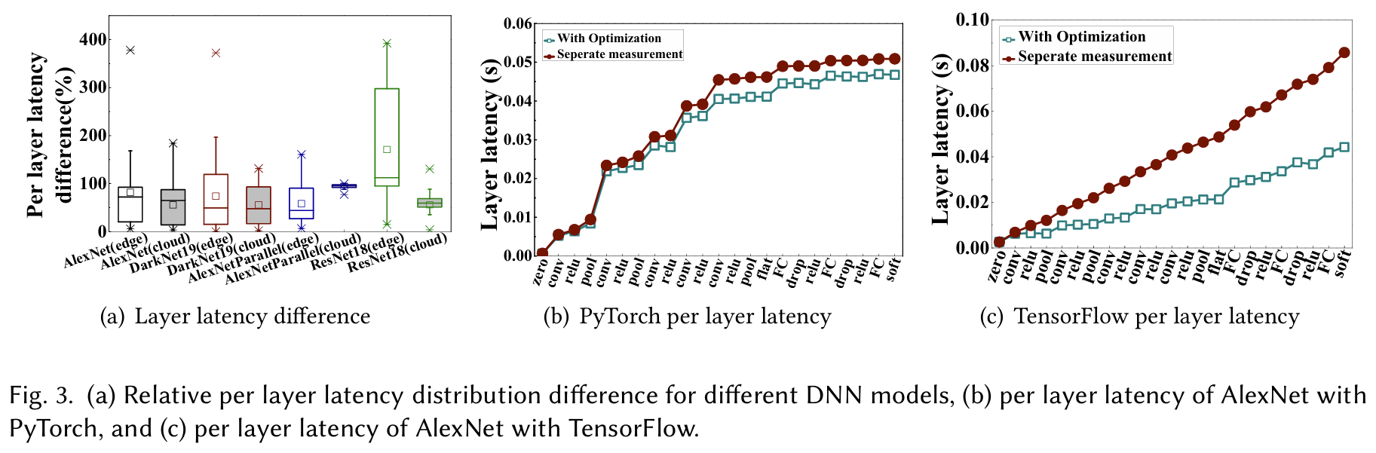
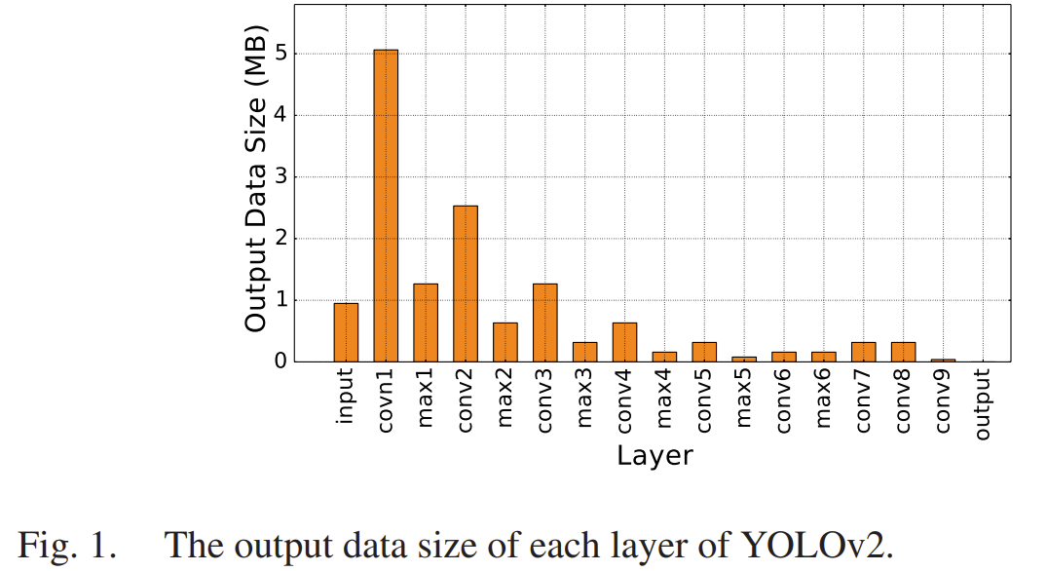
5. Insights
1. Per layer latency
2. Data size distribution
Notes:
[1]: Zhang, Shigeng, Yinggang Li, Xuan Liu, Song Guo, Weiping Wang, Jianxin Wang, Bo Ding, and Di Wu. "Towards real-time cooperative deep inference over the cloud and edge end devices." Proceedings of the ACM on Interactive, Mobile, Wearable and Ubiquitous Technologies 4, no. 2 (2020): 1-24.
[2]: Liang, Huanghuang, Qianlong Sang, Chuang Hu, Dazhao Cheng, Xiaobo Zhou, Dan Wang, Wei Bao, and Yu Wang. "DNN surgery: Accelerating DNN inference on the edge through layer partitioning." IEEE transactions on Cloud Computing 11, no. 3 (2023): 3111-3125.

Slide 16
5. Insights
1. Per layer latency
As much as possible, concentrate multiple layers on one single node
Reduce transferring time
Utilize cross-optimization
2. Data size distribution
High memory: model parallel distribution (Layer-Partitioning )
High computation and low memory: data parallel distribution (maybe in optimization step)
3. Layer types:
After Pooling Layers: Pooling layers reduce the dimensionality of the data
After Dense Layers: Small output

Slide 17

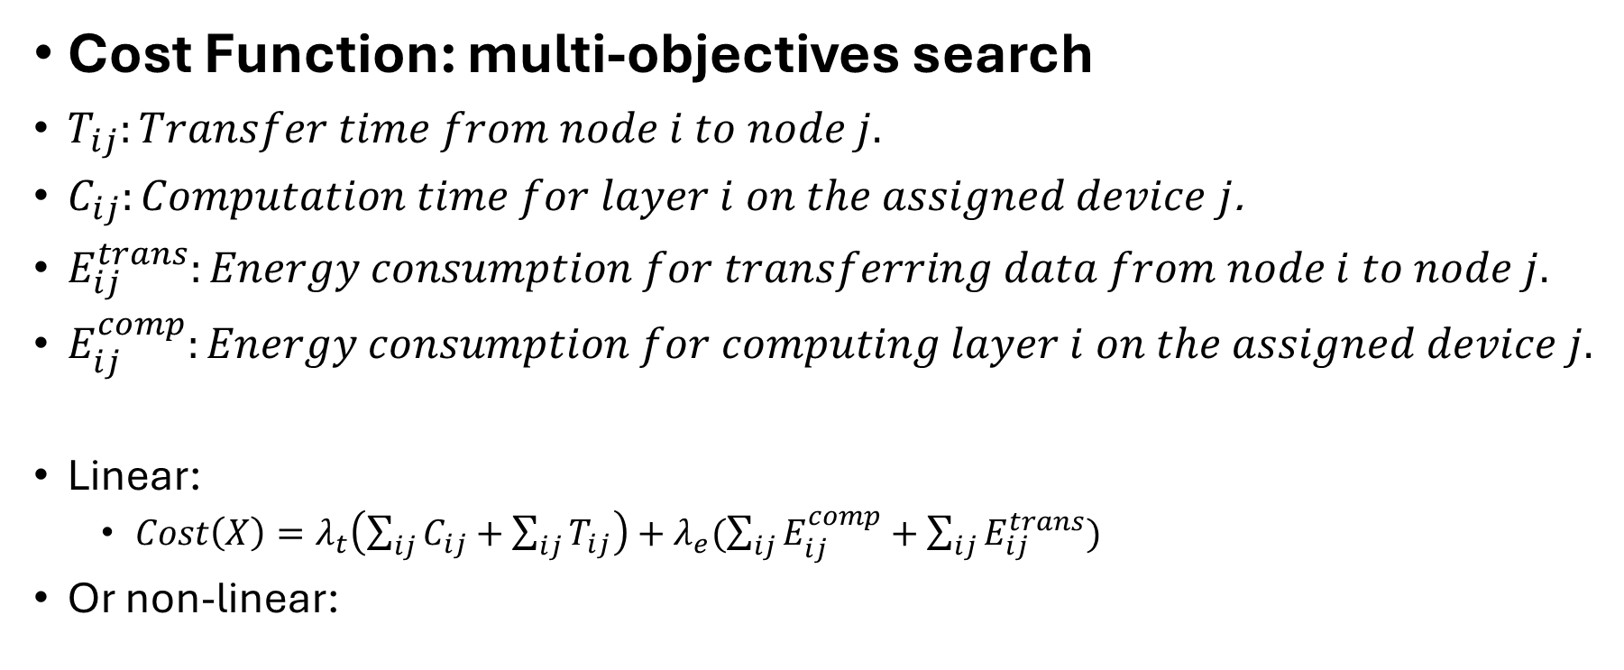
6. Search
Cost Function: multi-objectives search
$T_{ij}:Transfer time from node i to node j.$
$C_{ij}:Computation time for layer i on the assigned device j$.
$E_{ij}^{trans}:Energy consumption for transferring data from node i to node j.$
$E_{ij}^{comp}:Energy consumption for computing layer i on the assigned device j.$
Linear:
$Cost\left(X\right)=λ_{t}\left(\sum_{ij}{C_{ij}}+\sum_{ij}{T_{ij}}\right)+λ_{e}(\sum_{ij}{E_{ij}^{comp}}+\sum_{ij}{E_{ij}^{trans}})$
Or non-linear:

Slide 18
MILP
Binary Assignment Variables
Energy Variables
Time Variables
Objective function

Slide 19
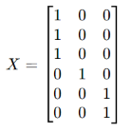

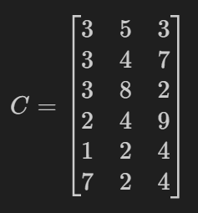
6. Search
Computation and transfer time:
1. Layer-Device Assignment Matrix (X)
Represents which device each layer is assigned to.
Rows correspond to layers, and columns correspond to devices.
A ‘1’ in the matrix indicates the layer is assigned to that device.
2. Transfer Time Matrix (T)
Represents the time required to transfer data between devices.
Rows and columns correspond to devices.
An element T[i,j] indicates the time to transfer data from Device i to device j.
3. Computation Time Matrix (C)
An element C[i,j] indicates the computation time that device j process layer i

Slide 20
6. Search Methods
Greedy Algorithm
Simulated Annealing
Genetic Algorithm
Particle Swarm Optimization
Ant Colony Optimization
Branch and Bound
Hill Climbing
Random Search
Mixed-Integer Linear Programming
Tabu Search
Table: Performance Comparison of Different Partitioning Algorithms for Layer-Device Assignment in Distributed Inference on a 6-Layer Model Across 5 Devices

Slide 21
Multiple partitioning solutions
Pre-compute Multiple Solutions
Store locally
To handle with node failures or dynamic changes
Redundancy through
Store extra layers
Predefined backup paths
Dynamic Reassignment

Slide 22
Local scheduler
Monitor Task Execution:
Ensure that inference tasks are proceeding as expected.
Monitor Task Queue:
ensure that tasks are processed in order of priority.
Sync?
Handle Timeouts/Failures:
Detect if tasks fail to execute within expected timeframes

Slide 23
Local Scheduler Pipeline
1. Task Scheduling & Execution

Slide 24
Questions
1. Per layer execution time
2. Feedback: model <-> network
2. How to evaluate search methods?
4. Contributions
5. Deployment cost
6. tflite optimization

Slide 25
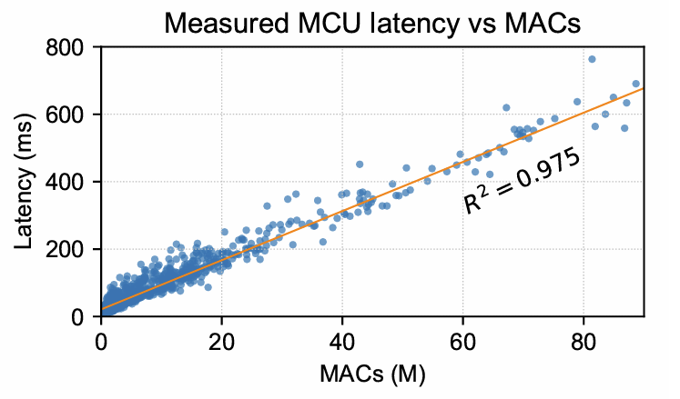
Latency Estimation
Hardware:
Processor
Persistent program memory (Flash)
Volatile static RAM
On a different device, the same operator can have different latency.

Slide 26
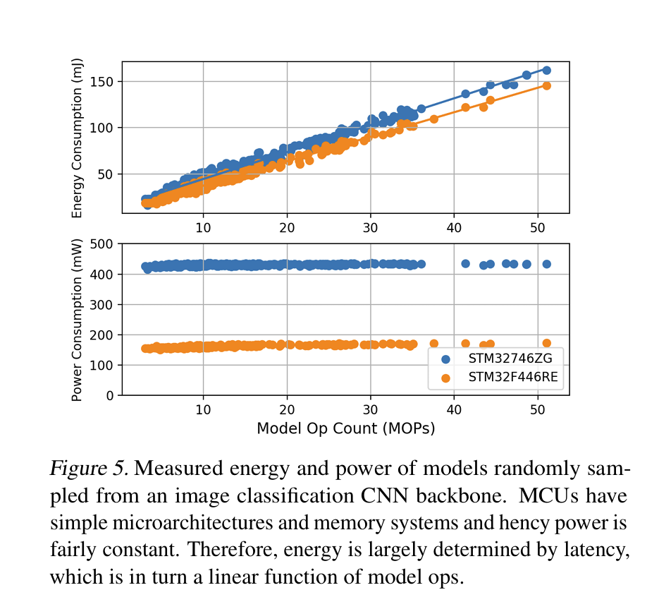
Energy Estimation

Slide 27
Workflow
1. Build and train a model using `TensorFlow`
2. Convert the TensorFlow model to a `.tflite` file using `TFLiteConverter`
3. Apply optimizations like `quantization`, `pruning`, `operator`. (Optional)
Profiling MACs
4. Adapt the TensorFlow Lite Model for TensorFlow Lite Micro.
Model structure is not modified

Slide 28
Model Generator
Model Converter:
Load Pre-trained Model
Optional Modifications
Convert the Model

Slide 29
Challenges in Determining Exact Memory U
Dynamic Memory Allocation:
Memory Overheads:
the persistent buffers are generally allocated automatically by the TFLM runtime during the model's initialization phase.
Layer-Specific Memory Needs

Slide 30
Step 1: Load the .tflite model and determine the size of the weights, biases, and graph.
Step 2: Profile or estimate the peak memory usage for tensors during model execution.
Step 3: Determine the fixed overhead for TFMicro by compiling a small example program.
Step 4: Analyze your model or use tools to estimate the memory required for persistent buffers.

Slide 31
the SRAM section shows that the Intermediate Tensors (174 KB) and Persistent Buffers (34 KB) are both part of the memory allocated by the tensor_arena.

Slide 32
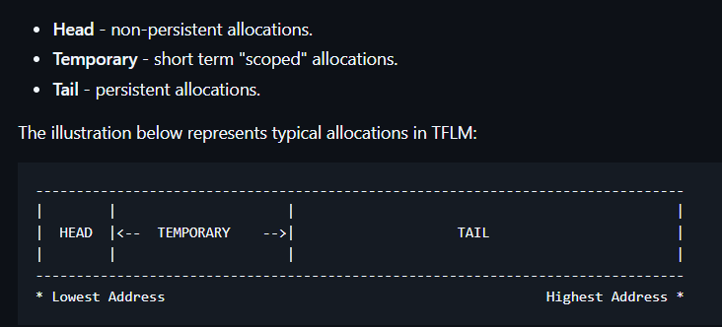
TFLM Memory Management
Arena allocation total: peak memory requirement
Arena allocation head:
Input tensors
Largest intermediate tensor
Final output tensor
Additional buffers required by the layers(non-persistent buffers)
Arena allocation tail:

