Slide 1
Xiaoguang Guo
11/26/2023

Slide 2
Outline
Problem definition
Data collection for real
Recording devices for real
Data preprocessing

Slide 3
Problem Definition
Model M M(W) → C
Content of user conversations C with Alexa (the text of speeches)
WiFi traffic rate data W collected by Raspberry Pi
Questions:
How to align C with W? By timestamps? Sync.
Notes:
Can we collect simple dataset. Not long question.
And the beginning, From text to voice. https://pytorch.org/audio/stable/tutorials/tacotron2_pipeline_tutorial.html
TEXT-TO-SPEECH WITH TACOTRON2

Slide 4
Data Collection for real
Configure Raspberry Pi as a WiFi router and data collector
Detect the WiFi traffic data(W) of Alexa Echo Dot through its IP
Design recording trigger mechanism
Record Alexa sessions by USB microphone when interactions happen
Save conversation audio files(A) and traffic data(W) with timestamps(T)
Transcribe the conversation recording for analysis using NLP(A -> C)
Align conversation content(C) with traffic data(W) based on timestamps(T).
Capture traffic rate data by Raspberry Pi (W)
Notes:
Scapy, tcpdump,
Use pc to play audio
compared

Slide 5
Recording Devices for real
USB microphone compatible with the Raspberry Pi 4 Model B.
Blue Yeti
Audio-Technica ATR2100x-USB
Rode NT-USB
Samson Go Mic
Shure MV5
Fifine Metal Condenser Recording Microphone
…

Slide 6
Data Preprocessing
Traffic Data
Pattern recognition processing
Time series analysis
feature extraction
Notes:
Accent & Background noise & Network latency

Slide 8
Xiaoguang Guo
11/29/2023

Slide 9
Outline
Data collection simple version
Datasets components
Traffic data components
Incoming/outgoing data
Sync text data with traffic data
Apply multiple different TTS models

Slide 10
Data Collection Simple Version
Text Preparation: Create scripts of text(C)
Speech Synthesis: Use Tacotron2 to convert these texts into audio files (A)
Play Audio Files for Interaction: Play one speech at a time on Pi
Traffic data collection(W): Record the traffic data at the same time.

Slide 11
Datasets Components
Ground True Data(C):
User’s Input(C_u): The original text used to generate the speech.
Alexa’s Response(C_r): The transcribed text from responses of Alexa.
Audio Data(A):
User’s Input Audio(A_u):
Generated from the user’s input text(C_u) by Tacotron2 in the simple version step.
Recorded by Pi for real later.
Alexa’s Response(A_r):
Traffic Data(W): Captured traffic data corresponding to interaction.

Slide 12
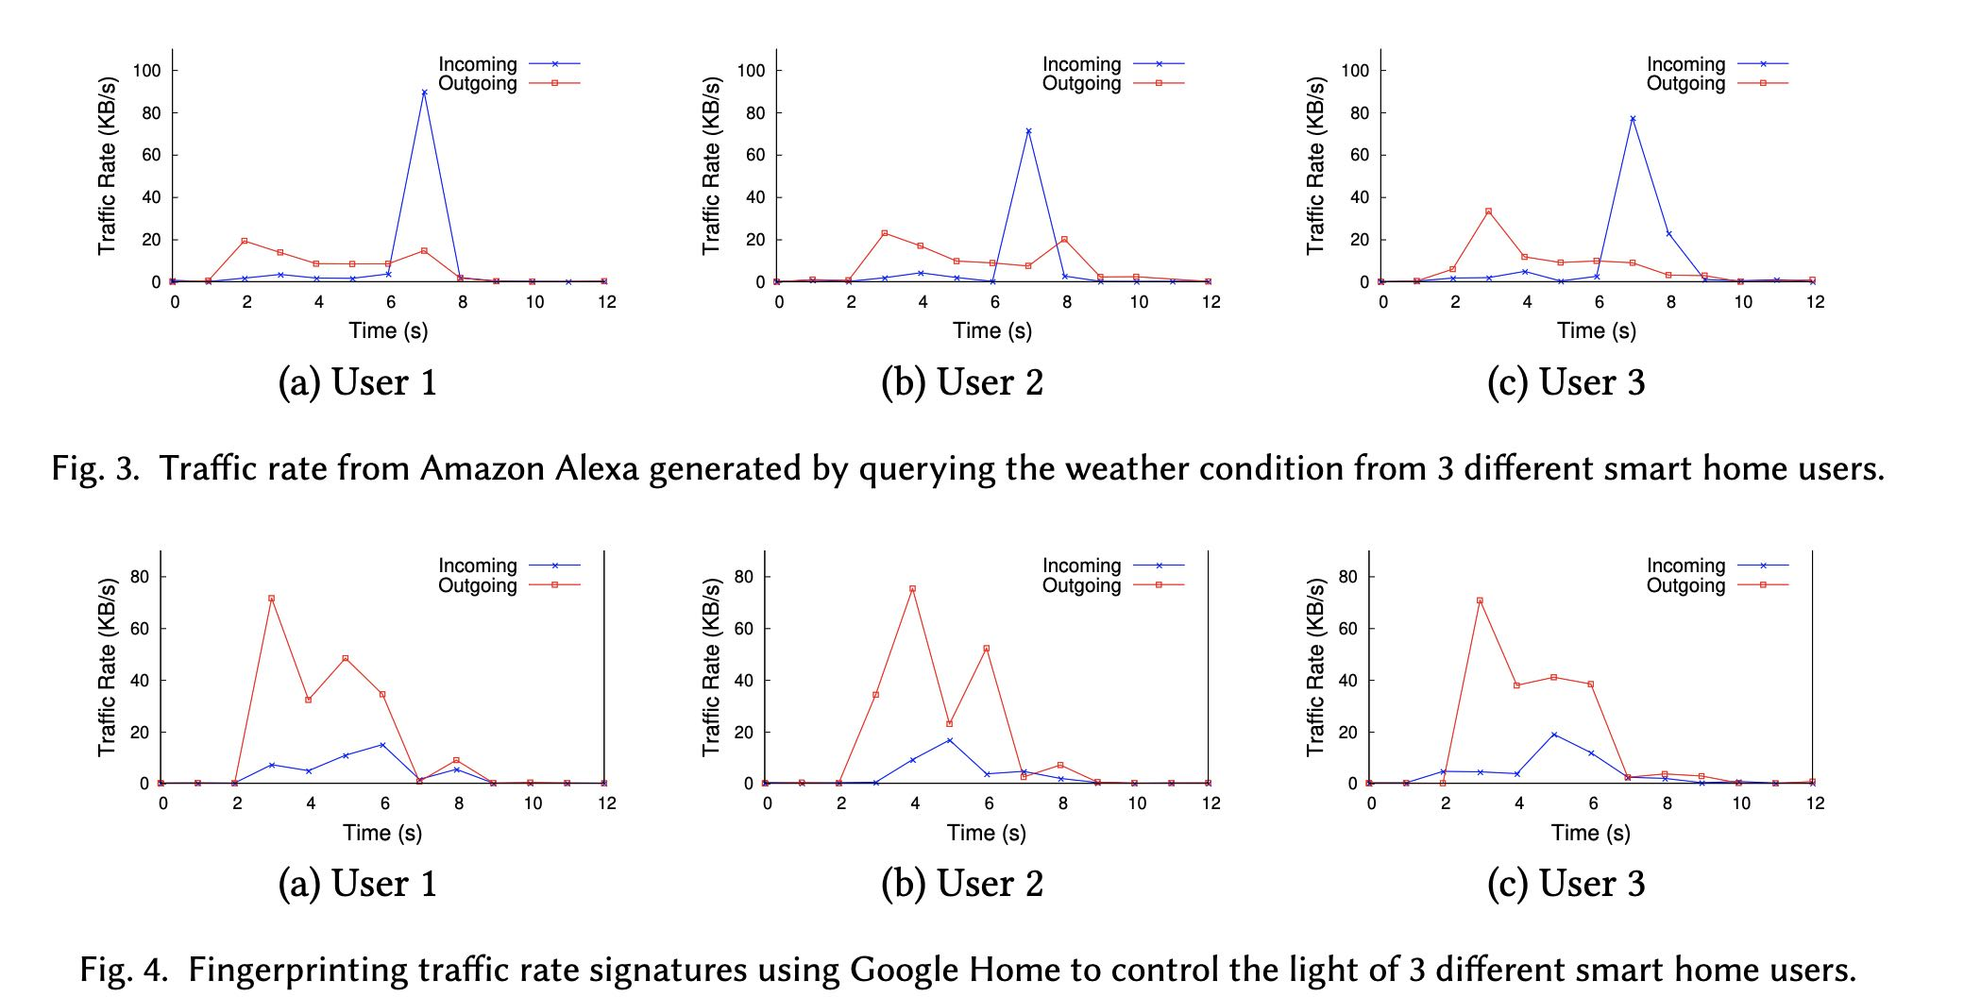
Traffic Data Components:
Timestamps: When the interaction occurred
Source and Destination:
Alexa Echo Dot’s IP: 10.3.141.158
Amazon server’s IP: 3.217.147.217
Protocol: TCP, TLSv1.2
Packet Sizes: Sizes of the packets sent and received

Slide 13
Incoming/Outgoing Data
Incoming data: 3.217.147.217 -> 10.3.141.158
Amazon’s servers process the request and send back a response to Alexa. This response could include data for speech synthesis(Alexa’s reply), streaming audio, or control signals for smart home devices.
Outgoing data: 10.3.141.158 -> 3.217.147.217
Alexa processes the audio and sends a request to Amazon’s servers. This request likely includes a digitized version of spoken command or query.

Slide 14
Incoming/Outgoing Data
We must make sure that the traffic data have some patterns to learn.
Learn from incoming data?
Both user’s input and the cloud response have contributions.
We cannot get the response to the Alexa from cloud directly.
Learn from outgoing data?
Only user’s audio input has contributions.
Questions:
What is our motivation? Design a way to gain privacy?
What is the application scenario? Attack and capture the traffic data so that the model can get what people said.
Are Alexa’s responses important? I think attacker can get info from them. Maybe in the first step we can ignore the Alexa’s response.

Slide 15
Sync Text Data with Traffic Data
Capture Duration:
All captures should have the same duration time.
Start from playing audio and sleep(12). And Stop.

Slide 16
Apply Multiple Different TTS Models
One TTS model says 10 more times for one thing like “01234”, “Alexa”.
Maybe I can apply multiple models to generate ”0” audio files repeatedly.
Questions:
Machine learning advice?

Slide 18
Related Works
I Can Hear Your Alexa: Voice Command Fingerprinting on Smart Home Speakers. CNS’19
ML models: LL-Jaccard, LL-NB, VNG++ and P-SVM
Small real-word datasets(100 commands with 10 traffic traces per command)
33.8% accuracy
Fingerprinting Encrypted Voice Traffic on Smart Speakers with Deep Learning. WiSec ’20
DL models: CNN, LSTM, SAE
Large not real-word datasets(1500 traffic traces per command)
92.89% accuracy

Slide 19
I Can Hear Your Alexa
33.8%
Real-word datasets

Slide 20
Fingerprinting Encrypted Voice Traffic on Smart Speakers with Deep Learning.
Limitations:
Synthetic dataset
Use incoming traffic only
Inferring the IP address of a smart speaker?

Slide 22
Contribution
Design a voice attack system which can infer interaction contents via traffic data(inside attack or outside attack) without knowing ip.
Learning Method: Voice Traffic Data Fingerprinting

Slide 23
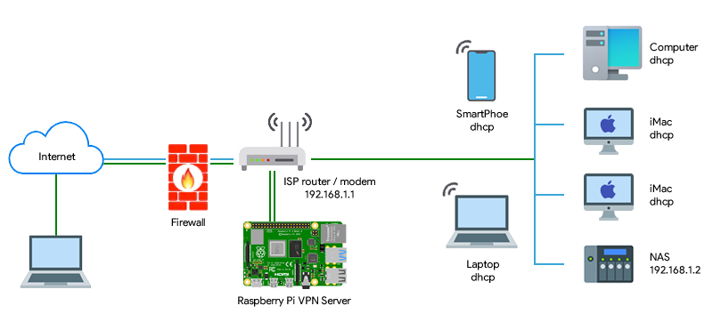
PiVPN

Slide 24
System Components
Router
Pi A (Wireless Access Point setup via RaspAP)
Role: Acts as a Wireless Access Point
Pi B (VPN Server setup via PiVPN)
Role: Serves as a VPN server(WireGurad)
Pi C (Alexa-Enabled device)
Role: Functions as an Alexa-Enabled device for voice interactions
Maybe VPN Server can be integrated in Pi A(Wireless Access Point)

Slide 25
Pi A Wireless Access Point
Role:

Slide 26
Pi B VPN Server
Tasks:
1. Generate VPN Configuration: ‘pivpn add’ to create a client profile for Pi C
2. ufw: Uncomplicated Firewall
3. Enable IP forwarding
4. Configure NAT for the Wi-Fi Interface

Slide 27
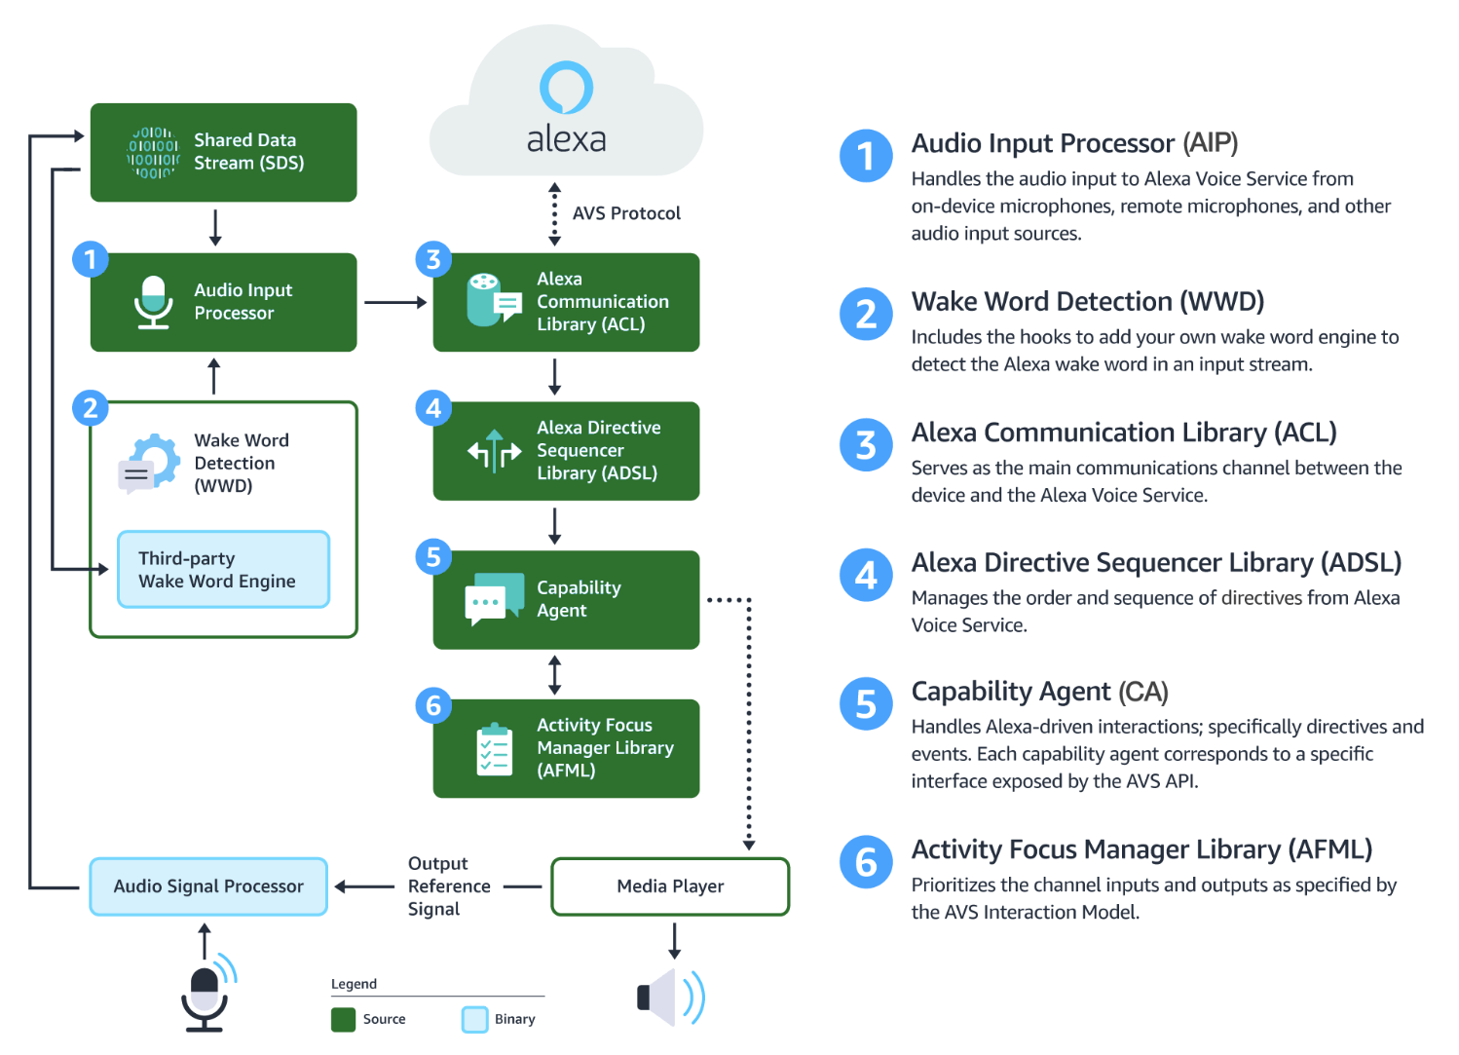
Pi C Alexa-Enable Device
Alexa Voice Service (AVS)
AVS Device SDK Console Sample Application (Voice only)
AVS Device SDK IPC Server Sample Application (Smart Screen device)
Alexa Skills Kit (ASK) CLI(Command Line Interface)
Set up the AVS Device SDK on Raspberry Pi
Notes:
https://developer.amazon.com/en-US/docs/alexa/avs-device-sdk/smart-screen-raspberry-pi.html

Slide 28
Review Last Disscussion
Question: Can we still attack if we don’t know actually ip or the ip is changing all the time.
VPN
To answer the question: Can we still attack if people use VPN on a router?
Also VPN will bring some noise traffic, more challenge
But people typically don’t use VPN at their home I think. Not sure if it is a major contribution. Maybe a case study?
Turn Pi into an Alexa Echo
Why? Make it easy for more operations: Keyboard interaction

Slide 30
Questions
Can we do voice command fingerprint if knowing IP (Alexa & Amazon Server) and models of IoT Devices in smart home? Maybe Yes
In below scenario, can we still attack?
The traffic data is encrypted by VPN.
Don’t know the Amazon Server’s IP because of VPN.
Don’t know the model of IoT devices in smart home.
Don’t know the IP of IoT devices because the IP is changing all the time.
Is this scenario common?

Slide 31
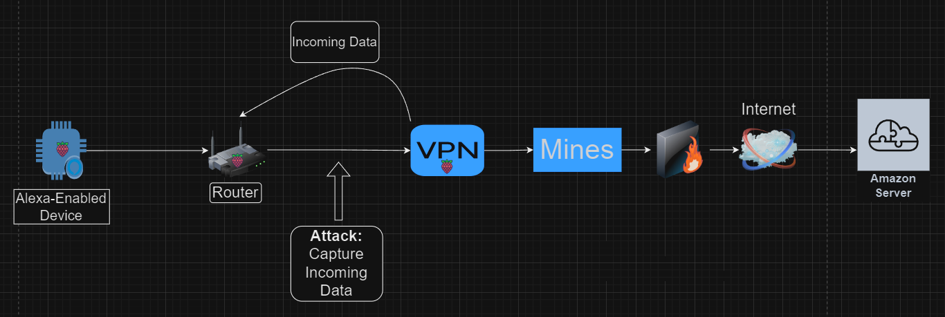
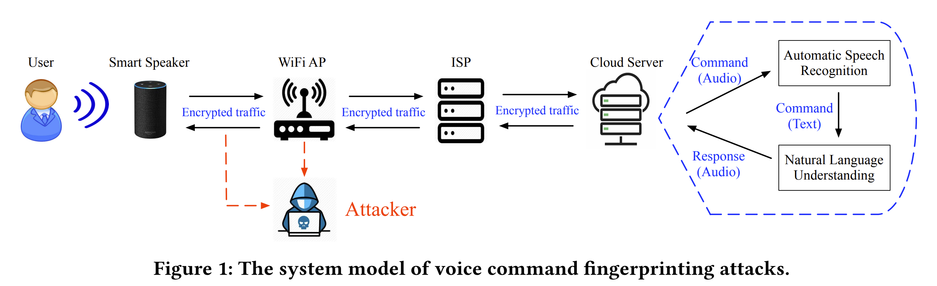
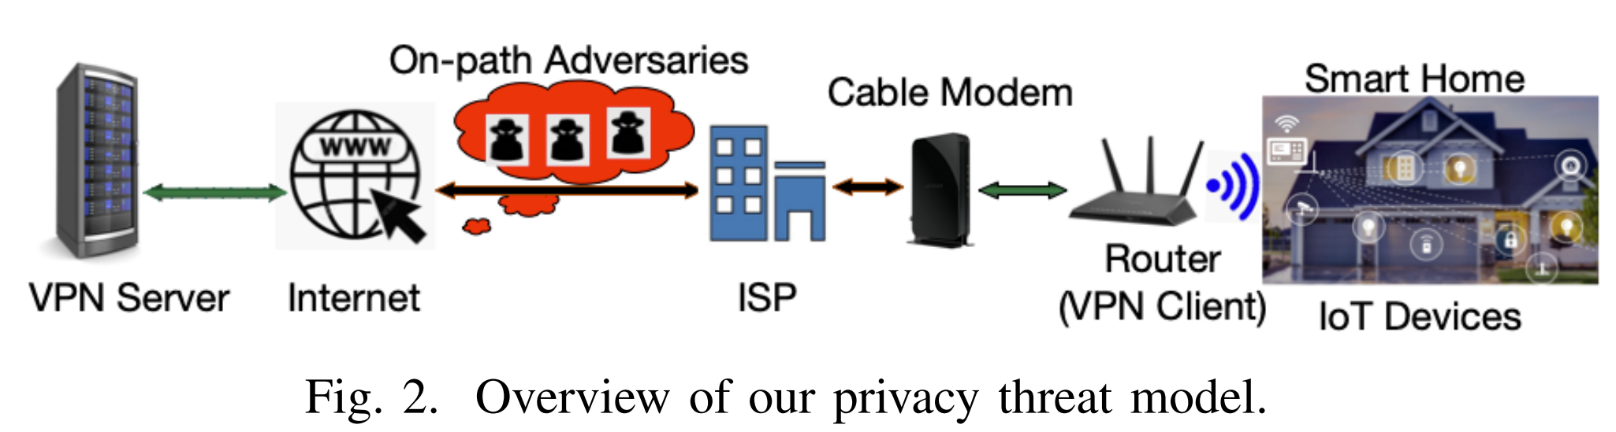
Why VPN?
Tunneling: can it hide Amazon Server’s IP?
Encryption: can it encrypt traffic?
Attacker Model:
Local eavesdropper(inside attack)?
What attacker can get?
If VPN Server is set in other place:
Outgoing: Alexa -> VPN?
Incoming: VPN -> Alexa
If VPN can only encrypt data:
Outgoing: Alexa -> Amazon Server
Incoming: Amazon Server -> Alexa
local eavesdropper
Assumption Scenario:
Smart Speaker’s IP is changing all the time(DHCP? Leasing time?)
Amazon Server’s IP is hide because of VPN.
Traffic data is encrypted by VPN.
Don’t know the model of IoT devices.

Slide 32
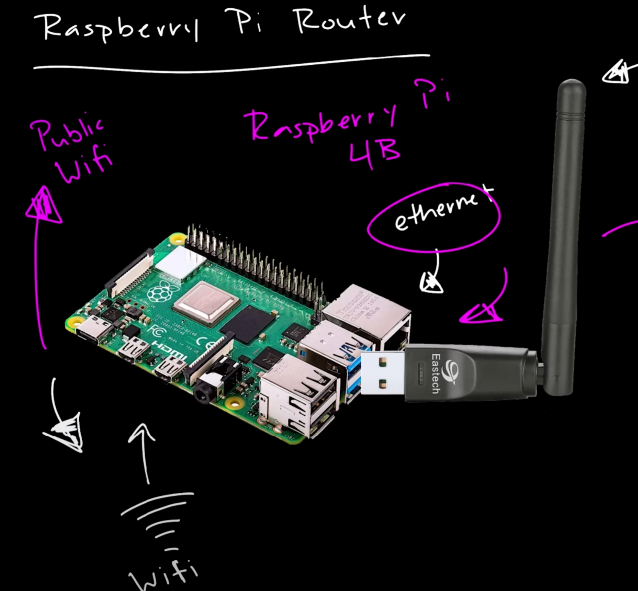
Raspberry Pi Router
I want to set up OpenWrt on pi, and enable VPN on it.
Device:
USB Wifi Adaptor
Switch maybe
VPN: CyberGhost

Slide 33
What finally model we want?
Input: whole-house traffic data.
Output: we can know which part of traffic is from Alexa or Google home, and the content of this traffic.
Maybe we can only focus on incoming data, because the response content of smart speaker is directly decided by incoming data and more fixed.

Slide 35
Text Interface
Use Node.js to handle HTTP requests.
Text interface needs to be integrated with the AVS SDK.
Convert text input into a format that the AVS SDK can understand
Notes:
https://developer.amazon.com/en-US/docs/alexa/smapi/quick-start-alexa-skills-kit-command-line-interface.html

Slide 36
Interact with Alexa
What data format will be sent to Alexa Cloud Server?
Audio file
Device and User Identification
Additional Metadata
Encrypted Communication: All data is sent over an HTTPS connection
Response Format:

Slide 37
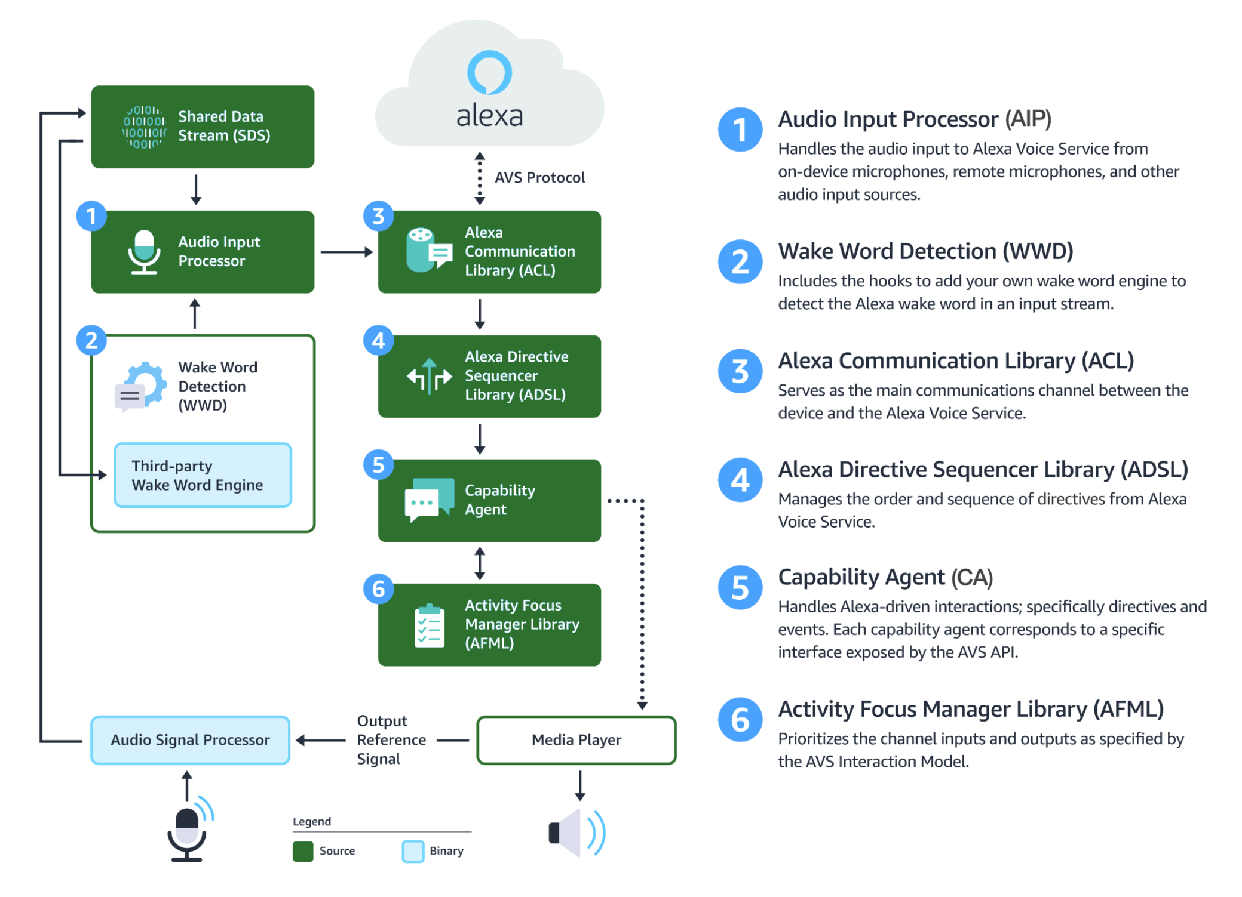

Slide 38
Modify the AVS SDK sample code to automate the sending of audio. Instead of capturing audio from a microphone
za user can only invoke alexa using an app or another alexa built-in device

Slide 39
Multiple types of Alexa products:
Smart speaker, Alexa mobile app, Alexa Echo Dot, Alexa Echo Show
Multiple types of interaction with Alexa products:
Voice, Typing, Tapping
Alexa has multiple types of responses: Audio, Texts
If these responses have the same meaning, do these responses have same pattern?
Should we compare all these types of traffic data.
Can the voice attack model apply in text or tapping?

Slide 40
Always online sensor
Spying on the smart home

Slide 42
Alexa Echo Dot Model
Audio Capture and Compression:
Raw audio data:
Capture audio using built-in microphones.
Data format: PCM(Pulse Code Modulation) or Opus
Compressed audio data:
Encryption and Transmission:
HTTPS
Server Processing and Response:
Speech recognition and natural language understanding
Generate a response in the form of a voice reply or an action
Voice reply will synthesize via TTS converted into an audio format
Response Reception and Playback

Slide 43
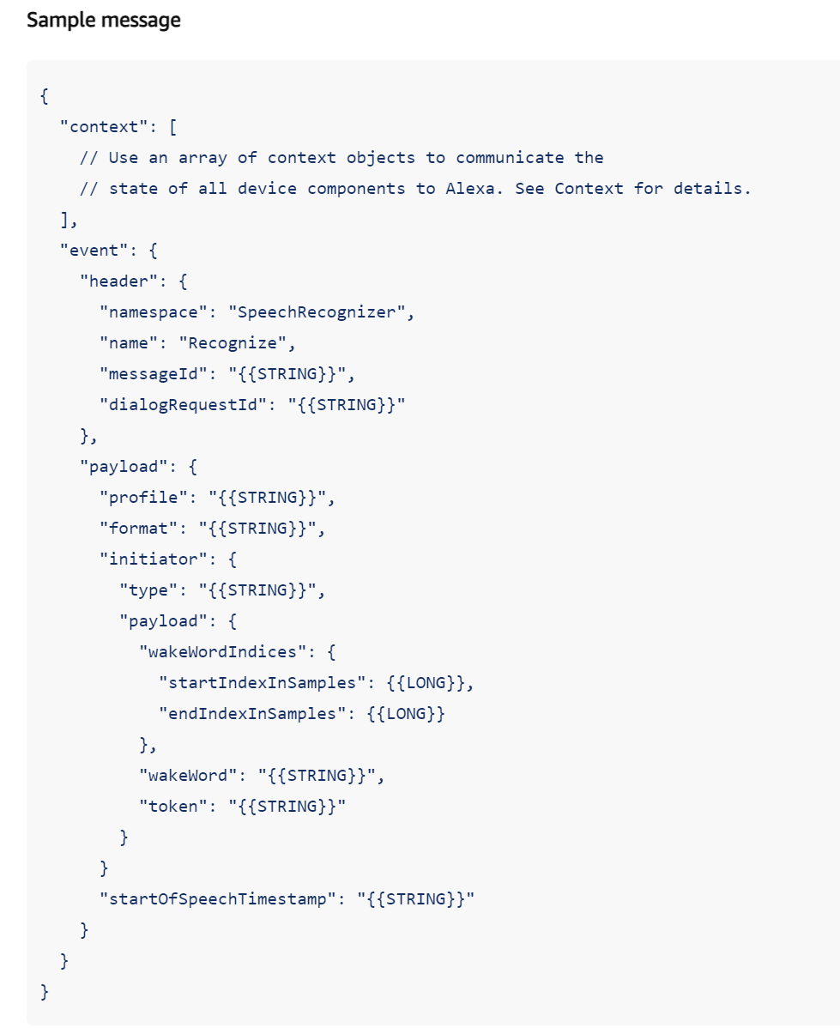
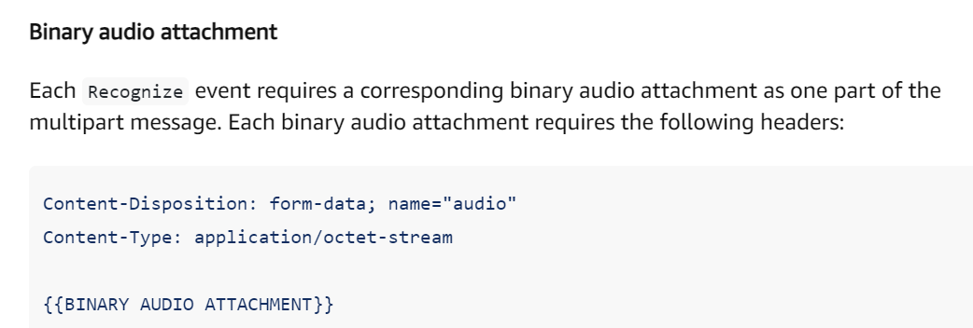
Recognize Event
A JSON-formatted object
The binary audio captured by the device microphone
PCM or Opus
Notes:
https://developer.amazon.com/en-GB/docs/alexa/alexa-voice-service/speechrecognizer.html#recognize

Slide 44
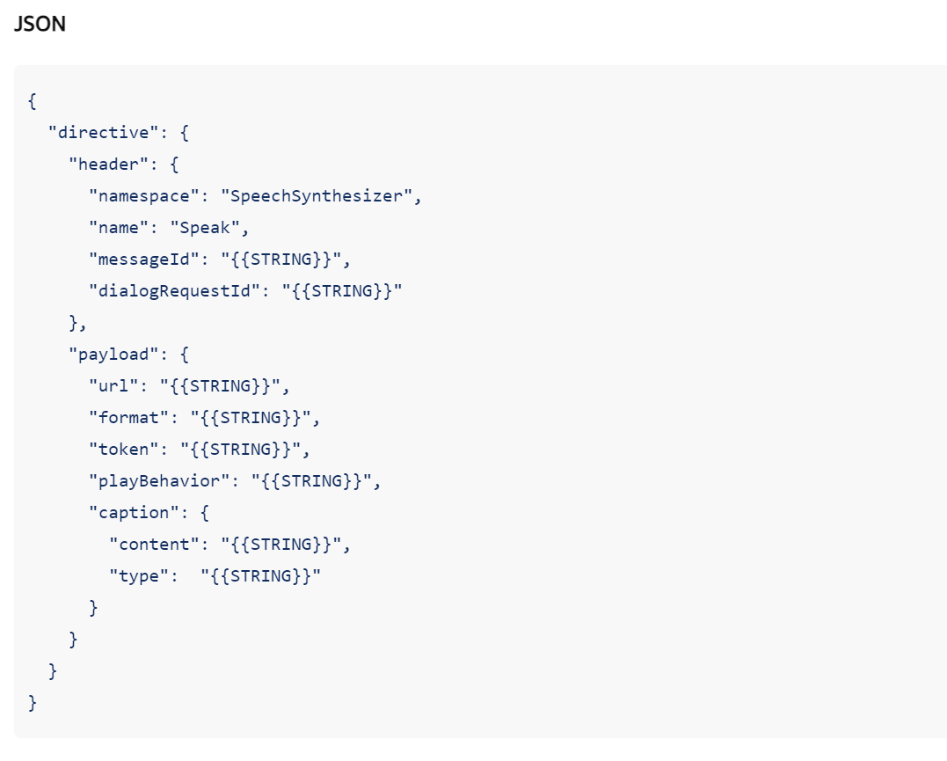
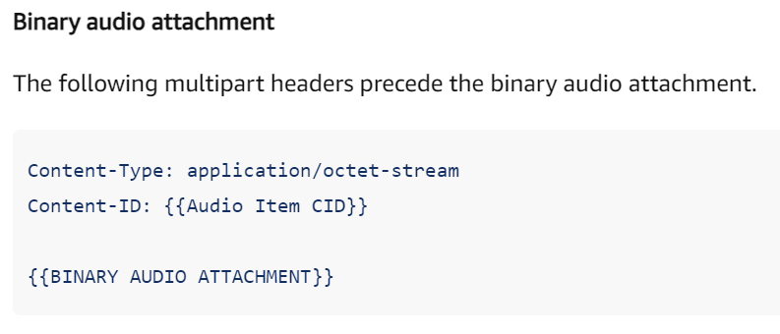
Speak Directive
The Speak directive(AVS->Client) is a multipart message containing two different formats – one JSON-formatted directive and one binary audio attachment.
Notes:
https://developer.amazon.com/en-GB/docs/alexa/alexa-voice-service/speechrecognizer.html
https://developer.amazon.com/en-GB/docs/alexa/alexa-voice-service/speechsynthesizer.html#speechstarted

Slide 46
Pi VPN Router Setup
OpenVPN
Ext4 partitions
Opkg redirect to new partition (failed)

Slide 48
Ok I have three devices, one is mac pro, one is raspberry pi 4b model, one is Alexa Echo Dot. I want to capture the traffic data when mac pro interact with Alexa Echo and do some voice command fingerprint research. I use mac to play voice command audio files, also record the responses from Alexa Echo Dot. Pi enabled with openvpn is running openwrt as a router. In order to sync, mac use ssh to control the start and stop of capturing traffic data. Do you understand the whole process now?

Slide 49
Next step, I think we have implemented the initial program running on mac now. This program firstly establish a ssh connection with vpn pi router. And then repeat the process of "start capture", "play audio", "record audio", "stop capture".

Slide 50
Above is the process of data collection for training. Now I am considering the model to learn the pattern of this traffic data. My goal is to train a model that input is traffic data and output is the interaction content so definetly timestamp is necessary. And I think the data should be aligned? You know the voice command play with Alexa is converted from text (A) via TTS tools. And the Alexa's responses recorded will also need to convert to text content (C). Meanwhile I will need to capture the traffic data (W) including incoming and outgoing data . So data collection contains three parts: A, C, W. The data A and data C are text data. I use these three parts data to train the model.

Slide 51
Well one piece of data looks like <A, C , W>. I am considering the data formation of W. I think W = {w_1, w_2, w_3, ... , w_n} is total traffic data of one voice command. Well, w_i = <b_i, s_i, t_i> represents one frame of traffic data. Specifily, b represents the direction, s represents the length, t represents the timestamp.

Slide 52
Data Collection Process
Establish SSH Connection
Loop:
Start Capturing
Playing Voice Command
Recording Responses
Stop Capturing
Duration of capturing is 20s.

Slide 53
I mean I enable open VPN on this pi, but i use dhcp protocal on this pi vpn router. Even though the pi's VPN is set up successfully, the traffic of devices connected to pi still will go through main router instead of vpn server. do you think is the problem of bridge mode?

Slide 55
Wake Word Engine
Interface 1: Handles general wake word detection
Interface 2: Handles specific wake word models
Sensory: TrulyHandsfree wake word engine

Slide 58
Data Collection:
text_A: the scripts play to Alexa
audioPlay_A: the audio files converted from text_A
audioRecord_C: the Echo response audio files recorded
text_C: the text converted from audioRecord_C
traffic_W_raw: traffic data during interaction
Data Collection Process:
Devices:
Mac Pro (play audio files and record)
VPN-Enabled OpenWRT Raspberry Pi 4 Model B (Router)
Alexa Echo Dot (Voice assistant)
Steps:
Establish SSH connection between Mac and Pi
For each voice command audio file (audioPlay_A), repeat 1000 times:
Start capturing traffic data via tcpdump
Mac plays audioPlay_A to Echo and then records the responses from Echo
After 5 seconds recording, stop capturing traffic data

Slide 59
Data Preprocess:
Raw data: .pcap
traffic_W_raw: all traffic data
Traffic filter: .pcap
traffic_W_incoming: VPN Server to Alexa Echo Dot
traffic_W_outgoing: Alexa Echo Dot to VPN Server
pcap2csv: .csv
traffic_W_incoming_csv: convert .pcap to (tshark)
traffic_W_outgoing_csv: convert .pcap to (tshark)
traffic2timeSeries: .csv
traffic_W_incoming_timeSeries: convert to time series data (t,l,d) & (t,l)
Traffic_W_outgoing_timeSeries: convert to time series data (t,l,d) & (t,l)
csv2tuples: .pkl
traffic_W_incoming_timeSeries_pickles: convert to tuples data
traffic_W_outgoing_timeSeries_pickles: convert to tuples data

Slide 60
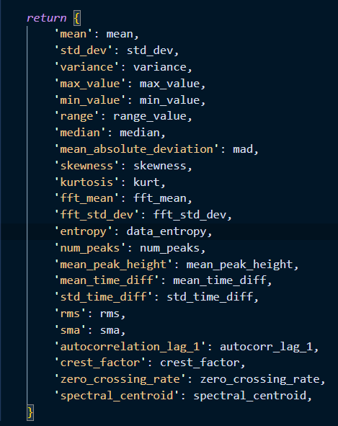
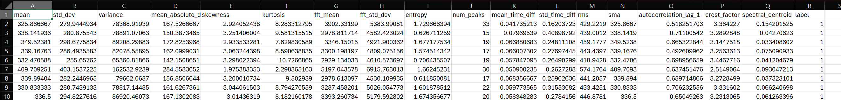
Features Extraction:
traffic_W_outgoing_features
Traffic_W_outgoing_features_csv (8 .csv files)
combined_data.csv with labels 1-8
What features should be selected? How to search?

Slide 61
How to do data cleaning for time series traffic data?
When should I do cleaning? After features extraction?

Slide 62
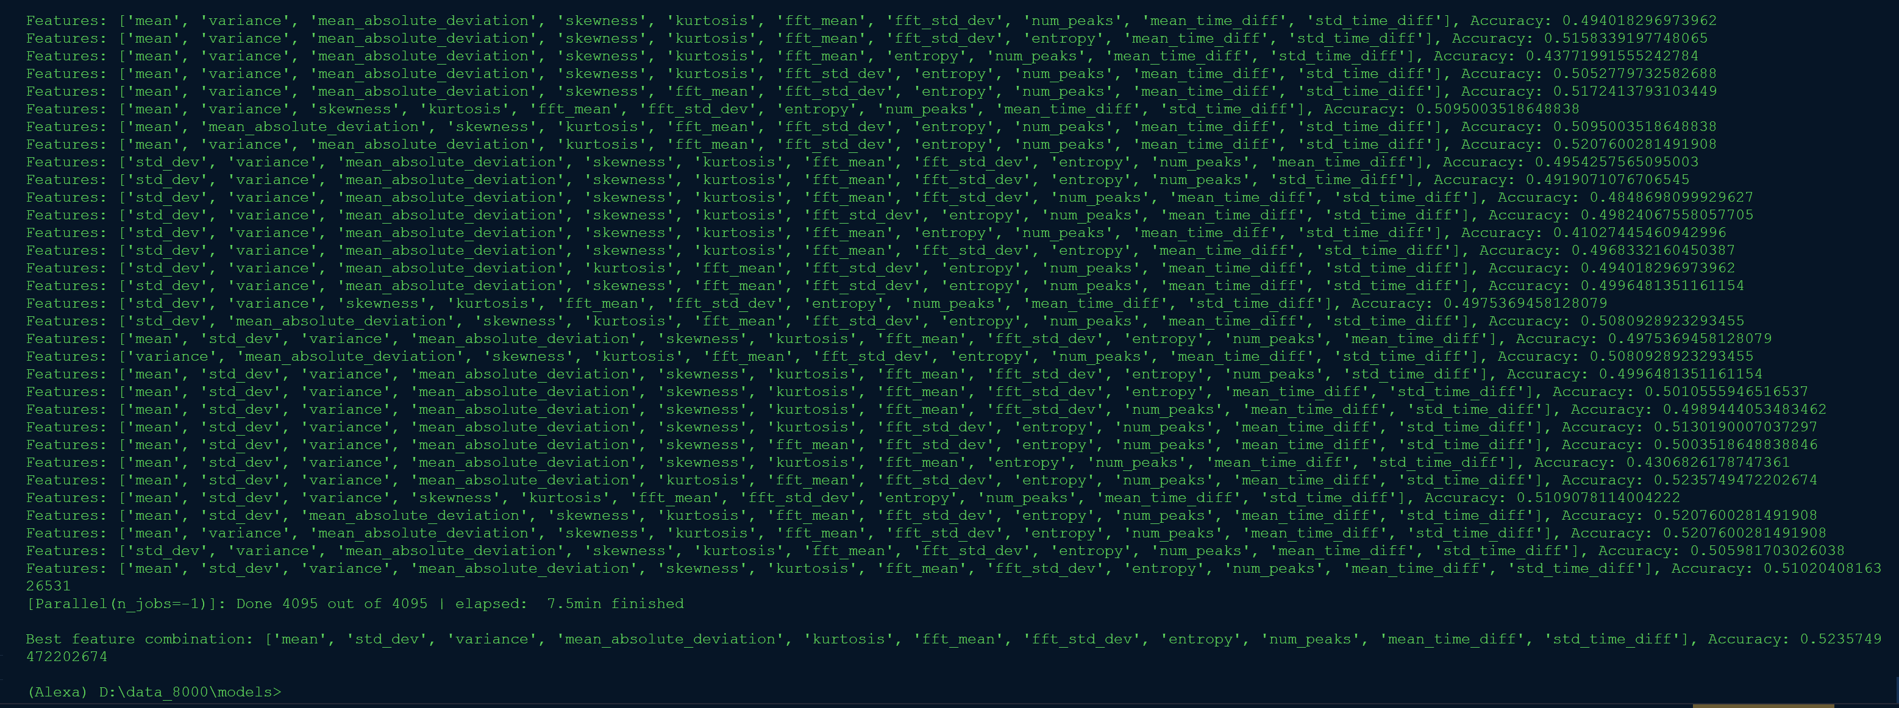
Classifiers
RandomRorestClassifier
XGBoost
AdaBoost
Traverse all feature combinations
Accuracy about 50%

Slide 64
Classifier
Skill
Simple
Stream
First I want to implement a script.

Slide 65
Top K
Similarity between different voice commands

Slide 66
Image study

Slide 67
Type Classification
Sentence-Level Inference
Word-Level Decoding

Slide 68
Type Classification
Data Collection Process:
Devices:
Mac Pro (play audio files and record)
VPN-Enabled OpenWRT Raspberry Pi 4 Model B (Router)
Alexa Echo Dot (Voice assistant)
Steps:
Establish SSH connection between Mac and Pi
For each voice command audio file (audioPlay_A), repeat 1000 times:
Start capturing traffic data via tcpdump
Mac plays audioPlay_A to Echo and begin silence detection
After continuous 3 sec silence, stop capturing traffic data

Slide 69
Deep learning
LSTM
1D_CNN

Slide 70
Data Cleaning
Remove unusually large or small files
Remove duration time less than 1 sec

Slide 71
Features Extraction for Traffic Analysis(I/O)
Statistical Features:
Mean, Standard Deviation, Variance, Max, Min, Range, Median, MAD, Skewness, Kurtosis: The size distribution of packets
Temporal Features:
Duration: Time taken for a complete interaction cycle
RMS, SMA: Reflect the ‘energy’ or intensity of the traffic
Spectral Features:
FFT, Spectral Centroid, Spectral Rolloff, Spectral Flux, Spectral Entropy:
Frequency domain representation of packet sizes or inter-arrival times
Rhythmic patterns in the traffic.
Notes:
PCA

Slide 72
Features
Time-Series Analysis Features:
Autocorrelation , Zero Crossing Rate:
Repetitive patterns or the frequency of sign changes in packet sizes or times,
Entropy and Energy Features:
Entropy, Entropy of Energy:
Measure the randomness or predictability in packet sizes and inter-arrival times
More ….

Slide 73
Similarity
Questions:
Will similarity of different voice commands affect the accuracy of traffic analysis?
How to measure the similarity?
More details:
The concept of similarity is from perspective of smart speaker. From the view of Alexa Echo, the two voice commands look the same, their similarity are high, otherwise, low.
Voice commands interact with smart speakers in audio format.
So analyzing the audio files may be a good way to measure the similarity.

Slide 74
Similarity
The relationship between voice commands and network traffic features is not direct.
Alexa API Interaction:
Voice Command Capture and Transmission(stream to server) Outgoing
Processing Response: No traffic
Speech Recognition
NLP
Sending Command Response: Incoming
Assumption:
Outgoing traffic is only affected by audio files (voice commands) transmission.
Incoming traffic is only affected by responses sending after server processing.

Slide 75
Similarity Experiments
Only use outgoing traffic to do classification.
Two voice command with high/low similarities.

Slide 76
Voice Commands Categorization
Class-level
Sentence-level
Phrase-level

Slide 77
Integrated Model
Inference:
Coarse Grained
Smart Speaker Models: Alexa Echo/Google Nest/Others
Basic Types: Simple/Skills/Streaming
Categories: Shopping/Weather/Timer/Traffic/…
Fine Grained:
Sentences Level: Mixed 50 or 100 sentences
Phrases Level
Words Level
Notes:
reinforcement

Slide 78
Phrase Level
In a same class, for example, “weather”
"What is the weather?"
"What is the weather today?“
"will it rain tomorrow“
"Will it rain tomorrow in Golden, Colorado?“
Trim some part of traffic, will it decrease or increase accuracy?
Assumption:
Outgoing traffic data will be affected after trimming.
Incoming traffic data will be the same if the response is still the same.
I believe the incoming traffic of "will it rain tomorrow“ and "Will it rain tomorrow in Golden, Colorado?“ will be the same. But outgoing traffic data will be different.
Notes:
Top k

Slide 79
Activities History

Slide 80
Database
Application Scenarios:
Outside attacker monitors traffic continuously for a long time.

