Slide 1
Binary Search Trees BST
<
6
2
>
9
1
4
=
8
13

Slide 2
Binary Search Tree
A binary search tree is a binary tree storing keys (or key-element pairs) satisfying the following property.
Let u,v,and w be three nodes such that u is in the left-subtree of v and w is in the right-subtree of v.
key(u) < key(v) < key(w)
v
u
6
w
2
9
1
4
8
X
X
X
X
X
X
X

Slide 3
BST Operations
isEmpty - return true if empty, false if not
search (private) - return pointer to node in which key is found, otherwise return NULL
search (public) - return true if key is found, otherwise return false
findMin - return smallest node value
findMax - return largest node value

Slide 4
BST Operations
insert - insert a new node into the tree maintaining BST property. All inserts are done at a leaf
remove - remove a node from the tree maintaining BST property.
display - print a tree in an ordered traversal

Slide 5
Array Implementation of a BST
A BST can be implemented with an array
Given a node i
parent(i) = (i - 1)/2
If i == 0, then no parent since root
leftChild(i) = 2i+1
If 2i+1 <= N, otherwise no child
rightChild(i) = 2i+2
If 2i+2 <= N, otherwise no child

Slide 6
Array Implementation of a BST
0 1 2 3 4 5 6 7
6 3 11 1 4 7 12
Find children
6
(2*0)+1 = 1 (2*0)+2 = 2
(1-1)/2 = 0
3
11
(2-1)/2 = 0
Find parents
1
4
7
12

Slide 7
Array Implementation of a BST
In class exercise - show the array for the following tree
5
0 1 2 3 4 5 6 7 … 14
6
5 6 7 8
7
8

Slide 8
Linked Implementation of a BST
Linked implementation
Similar to linked list – dynamic size can grow and shrink easily during runtime
class Node {
itemtype item
Node* left
Node* right
}
class BST {
private:
Node root
// internal functions
public:
// functions for
operating on BST
}

Slide 9
Search
To search for a key k, we trace a downward path starting at the root
The next node visited depends on the outcome of the comparison of k with the key of the current node
If we reach a leaf, the key is not found and we return null
Example: find(4)
<
6
2
>
9
1
4
=
8

Slide 10
Search
Recursive implementation of search (private)
Node search ( Node* nodePtr, itemtype key )
if (nodePtr == NULL)
return NULL
else if ( nodePtr->item == key )
return nodePtr
else if ( nodePtr->item > key )
return search(nodePtr->left, key)
else
return search(nodePtr->right, key)

Slide 11
Inorder Traversal
Recursive implementation of inorder traversal
void inorder(Node* nodePtr)
if ( nodePtr )
inorder (nodePtr->left)
print node
inorder (nodePtr->right)

Slide 12
Preorder Traversal
void preorder(Node* nodePtr)
if ( nodePtr )
print node
preorder (nodePtr->left)
preorder (nodePtr->right)

Slide 13
Postorder Traversal
void postorder(Node* nodePtr)
if ( nodePtr )
postorder (nodePtr->left)
postorder (nodePtr->right)
print node

Slide 14
Insertion
To perform operation insertItem(k, o), we search for the position k would be in if it were in the tree
All insertions create a new leaf node
Example: insert 5
<
6
2
>
9
1
4
>
8
X
6
2
9
1
4
8
5

Slide 15
Insertion
Insert 7
6
2
9
1
4
8
5
7
Insert 3
6
2
9
1
4
8
3
5
7

Slide 16
Deletion
Traverse tree and search for node to remove
Five possible situations
Item not found
Removing a leaf
Removing a node with two children
Removing a node with one child - right only
Removing a node with one child - left only

Slide 17
Deletion - Removing a leaf
6
6
3
8
3
8
Remove 4
1
5
7
1
5
7
0
4
0
4

Slide 18
Deletion - Removing a leaf
6
6
3
8
3
8
Remove 1
1
5
7
0
5
7
0
4
4

Slide 19
Deletion:
Removing a node with children
Otherwise the node has children - find replacement node
If the left child exists
Replace node information with the largest value smaller than the value to remove
findMax(leftChild)
Else there is a right child
Replace node information with the smallest value larger than value to remove
findMin(rightChild)

Slide 20
Deletion:
Removing a node with children
Splice out replacement node (call remove recursively)
Just copy info of replacement node over the value to remove (overload = if necessary)
Delete replacement node if leaf

Slide 21
6
3
7
1
5
7
6
0
4
3
8
6
1
5
7
3
7
0
4
Remove 8
1
5
7
0
4

Slide 22
6
3
9
1
5
9
6
0
4
3
8
Remove 8
6
1
5
9
9
3
0
4
1
5
9
0
4

Slide 23
5
3
8
6
1
5
9
3
8
Remove 6
0
4
1
5
9
5
5
0
4
3
8
3
8
1
4
9
1
4
9
0
4
0
4

Slide 24
3
In class exercise
1
8
Remove 6
0
9
6
0
3
8
3
1
9
1
8
0
0
9

Slide 25
Removal Operation – Commutative?
Remove 6, 7
5
5
5
7
7
9
6
9
9
8
11
8
11
8
11
Remove 7, 6
5
5
8
8
6
9
9
11
11

Slide 26
Analysis of BST Operations
h =N
h = log N
 | Worst Case | Average Case
empty | O(1) | O(1)
search | O(N) | O(log N)
findMin | O(N) | O(log N)
findMax | O(N) | O(log N)
insert | O(N) | O(log N)
remove | O(N) | O(log N)
display | O(N) | O(N)

Slide 27
Inorder Traversal
3
5
6
7
8
9
if ( cur )
inorder(cur->left)
print cur->value
inorder(cur->right)
if ( cur )
inorder(cur->left)
print cur->value
inorder(cur->right)
if ( cur )
inorder(cur->left)
print cur->value
inorder(cur->right)
if ( cur )
inorder(cur->left)
print cur->value
inorder(cur->right)
if ( cur )
inorder(cur->left)
print cur->value
inorder(cur->right)
6
if ( cur )
inorder(cur->left)
print cur->value
inorder(cur->right)
if ( cur )
inorder(cur->left)
print cur->value
inorder(cur->right)
if ( cur )
inorder(cur->left)
print cur->value
inorder(cur->right)
if ( cur )
inorder(cur->left)
print cur->value
inorder(cur->right)
if ( cur )
inorder(cur->left)
print cur->value
inorder(cur->right)
3
8
if ( cur )
inorder(cur->left)
print cur->value
inorder(cur->right)
if ( cur )
inorder(cur->left)
print cur->value
inorder(cur->right)
if ( cur )
inorder(cur->left)
print cur->value
inorder(cur->right)
if ( cur )
inorder(cur->left)
print cur->value
inorder(cur->right)
if ( cur )
inorder(cur->left)
print cur->value
inorder(cur->right)
if ( cur )
inorder(cur->left)
print cur->value
inorder(cur->right)
if ( cur )
inorder(cur->left)
print cur->value
inorder(cur->right)
if ( cur )
inorder(cur->left)
print cur->value
inorder(cur->right)
if ( cur )
inorder(cur->left)
print cur->value
inorder(cur->right)
if ( cur )
inorder(cur->left)
print cur->value
inorder(cur->right)
X
5
7
9
if ( cur )
inorder(cur->left)
print cur->value
inorder(cur->right)
X
X
X
X
X
X
Binary Search Trees

Slide 28
Right Rotate
Right rotate around y
Y
X
X
Y
c
a
a
b
b
c
BST ordering
properties hold:
<
X
X
<
<
Y
a
b
>
Y
X
<
Y
c

Slide 29
Left Rotate
Left rotate around X
X
Y
Y
X
c
a
b
c
a
b
BST ordering
properties hold:
<
X
X
<
<
Y
a
b
>
Y
X
<
Y
c

Slide 30
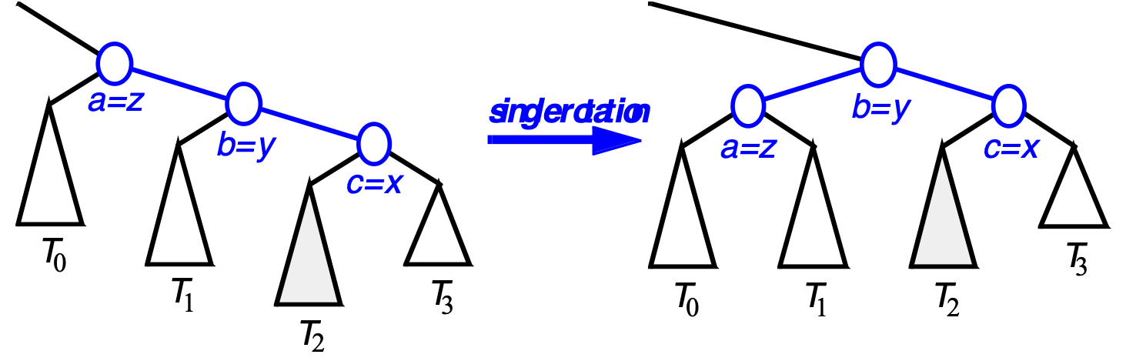
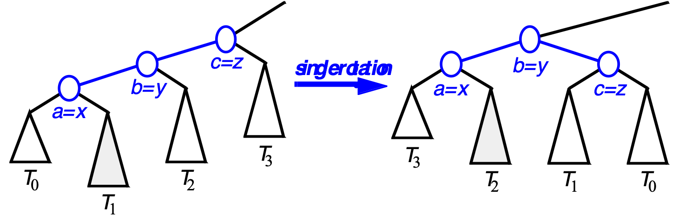
Restructuring (as Single Rotations)
Single Rotations:
7/15/13
2004 - Goodrich, Tamassia

Slide 31
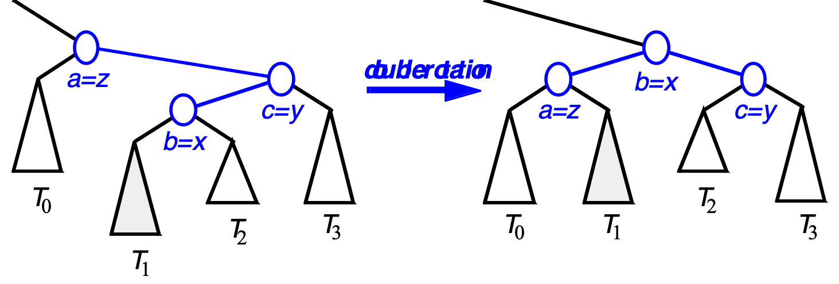
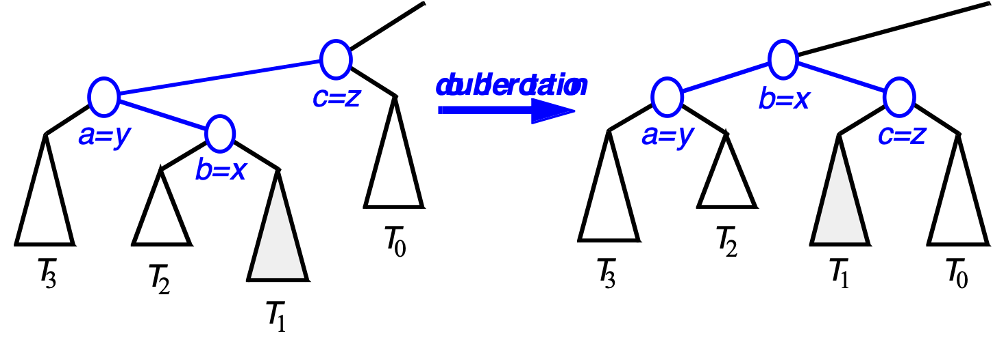
Restructuring (as Double Rotations)
double rotations:
7/15/13
2004 - Goodrich, Tamassia

Slide 32
BST Insert
7, 25, 47, 35, 37, 6, 3, 1
7
6
25
Exam 4 Q4: Summer 17
3
47
1
35
37

Slide 33
BST Remove
6
5
3
8
3
8
1
5
7
1
4
7
0
4
0
Exam 4 Q7: Summer 17

Slide 34
Binary Search Tree?
7
4
9
1
5
8
6
Exam 3 Q9: Summer 17

Slide 35
BST Remove
6
6
3
8
2
8
1
9
1
9
0
2
0
Exam 4 Q8: Summer 17
Remove 3

Slide 36
BST as an Array
5
3
7
Exam 4 Q9: Summer 17
1
9
A[0] | A[1] | A[2] | A[3] | A[4] | A[5] | A[6]
5 | 3 | 7 | 1 | NULL | NULL | 9

Slide 37
BST Traversal
6
3
3
8
2
8
1
9
1
9
0
2
0

Slide 38
BST Insert
4
3
6
2
5
7
1
Insert into empty BST:
4, 3, 2, 1, 6, 7, 5

Slide 39
BST Remove
4
3
3
6
2
6
2
5
7
1
5
7
1
Remove root from BST
Use in-order predecessor

Slide 40
BST Insert
Insert into empty BST:
11, 22, 17, 21, 16, 7
11
7
22
17
16
21

Slide 41
BST Remove
11
16
17
17
7
22
7
22
7
22
7
22
17
17
17
21
16
21
21
21
Remove 11
Remove 16

Slide 42
BST Insert
Insert into empty BST:
4, 1, 3, 2, 8, 11, 7, 6
4
1
8
2
3
7
11
6

Slide 43
AVL Tree Insert
Insert 1 into AVL tree
7
6
25
7
3
6
25
7
3
3
25
1
1
6

Slide 44
AVL Tree Rebalance
7
7
6
3
6
3
7
6
3

