Slide 1



LIVE STREAMING OF DEVICES/SENSOR DATA USING CUSTOM WIDGETS WITHIN COGNOS DASHBOARD
Group Members:
Gyanangkush Borgohain, Bhaskas Jyoti Gogoi,
Nikita Dey, Aditya Joarder, Sandip Burhagohain
7th Semester, 2019
Dept. of CSE, ECE, EE

Slide 2

Mentors
External mentors:
Yogendra Solanki
Jitendra Shremali
Internal mentors:
Manashee Kalita

Slide 3
INTRODUCTION
Live streaming of device/sensor data is a continuous process.
Data is generated from wide variety of sources.
Implementation in various manufacturing and other engineering fields.

Slide 4
COMPONENT DETAILS
IBM Cognos Analytics:
Cloud-based business and intelligence and analytics solution.
Used for visualization of data.
Text editors:
Text editors for source code viewing and editing.
eg. Atom IDE, Visual Studio, etc.

Slide 5
FEATURED TECHNOLOGIES
CSS: Cascading Style Sheets (CSS)
describes how HTML elements are to be displayed
JSON: JavaScript Object Notation
a lightweight format for storing and transporting data
often used when data is sent from a server to a web page
JS: JavaScript (JQuery)
a JavaScript library which simplifies JavaScript programming

Slide 6
STEPS AND PROCEDURE
Building the codes for the custom widget
Create a .zip file of the above files.
Upload the .zip file to the IBM Cognos Analytics
JSON, JS, CSS, Images
Create the dashboard
Use the custom widget and the visualize the data

Slide 7
SCALABILITY
Large scale implementation
Manufacturing industries and other engineering fields.
Use of Arduino boards and Raspberry PI for real sensor time data.
Automatic maintenance reporting
Reporting of device or environment status and generate automated reports

Slide 8
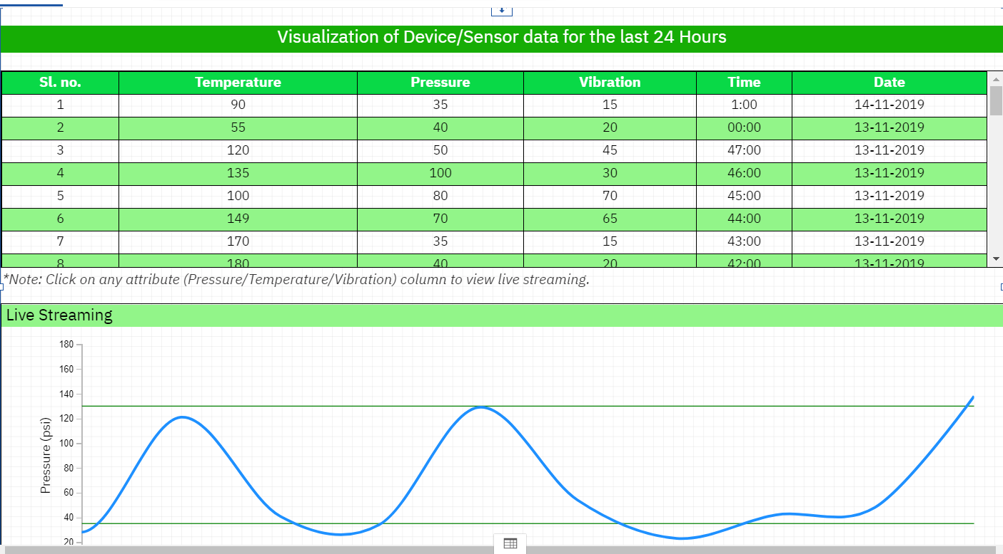
CONCLUSION
This project shows a moving chart that captures volatile data and incrementally update itself.
This pattern demonstrates displaying live-insights of the device health metrics within Cognos dashboard.
This analytics may also help in understanding the device or senor data and make effective decisions.

Slide 9


Slide 10
Reference
Source: Secondary source
Link: https://github.com/IBM/cognos-dancing-dashboard
GitHub repository link:
https://github.com/GYANANGKUSH/CognosCustomWidget-LiveDataStream

