Slide 1
COMP 5411 PA3

Slide 2
Main objective
Hard shadows generated with point lights
  Shadow volume
  Shadow map
Experiment with geometry shaders
Better understanding of transformations
Notes:
In this assignment, we are gonna learn how to generate hard shadows in real time.
You’ll need to implement two methods that you’ve just learnt: shadow volume and shadow map.
With shadow volume,you’ll experiment with geometry shaders and get familiar with dynamically generated geometry.
With shadow map, you’ll probably need to have a good understanding of spatial transformations.

Slide 3
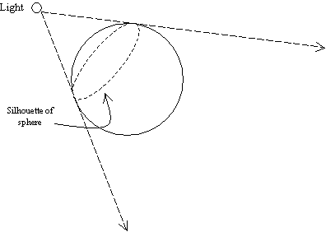
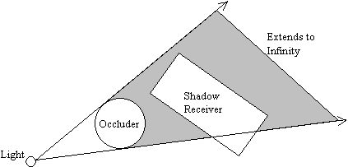
Shadow volume review
Extrude a “volume” around the occluder
  Wrap along the silhouette towards infinity
Occluder/receiver are interchangeable
Notes:
First task: shadow volume. Lets’ first review the basic idea of shadow volume.
The idea is to extrude a volume around the occluder, as shown in the graph below.
The volume is actually a surface, starts from and wraps the silhouette of the occluder, and extends to infinity.
The silouette is the one that is visible from the light position.
All points in the volume are in shadow. And all points outside the volume are not.
Note that we have occluders and receivers here. But in reality, their roles can switch with a different light.
A receiver can also be an occluder for a farther object. A non-convex model, like the dragon, can shed shadow to itself.
So below we do not differentiate between them and simply assume all the models are at the same time occluders and receivers.

Slide 4
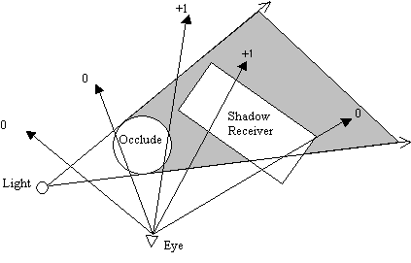
Shadow volume review
For every visible surface that we shade
  Count how many times the view ray intersects the shadow volume before hitting the visible surface
  Shadow volume front face +1, back face -1
  “0” = no shadow
image
Notes:
With a shadow volume, the question is how do we determine if a point is in it or not.
The answer is to use intersection counting.
We count….
Eg. With the example below, assume the occluder is a sphere, the shadow volume is then a cone. From the light point of view, it has front faces and back faces. If a view ray intersects a front face, its counter increases by 1,… .

Slide 5
Shadow volume review
Ray intersection counting implementation
  Every ray is a pixel
  Rasterize the shadow volume into the scene
    With depth test (but do not write to depth buffer)
  Keep the count using stencil buffer (per-pixel counter)
image
Notes:
The problem is we don’t want to do ray tracing in a real-time rasterization framework.
So instead, we rasterize the shadow volume into the scene, just as we do with regular scene objects. Each ray is now a pixel.
Assume the depth buffer contains the depths of all visible surfaces in the scene, represented by these blue dots.
We then render the shadow volume with depth test, but do not modify the depth buffer, just to only render those volume faces that are closer to the camera.
The counter of each ray, or pixel here, are stored in a stencil buffer.
For every front face that passes the depth test, we increase their counter by one. Like these green dots.
For every back face that ….
The faces that do not pass the depth test, we keep the counter value untouched.
Then we have the shadow results. If the counter is 0, we know that the pixel is not in a volume and is lit. otherwise, it is in a shadow.
This is simply done by a stencil test.

Slide 6
Algorithm outline
Render ambient light into the color buffer
For each light:
  Clear the stencil buffer to 0
  Render shadow volume
  keep the counter in stencil buffer
  Render diffuse/specular light with stencil test =0; blend (accumulate) the light into the final color if not in shadow

Slide 7
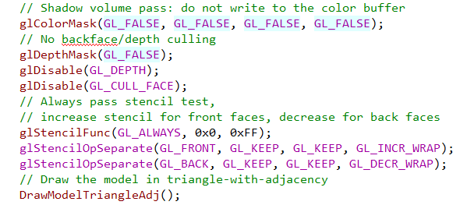
Shadow volume stencil test state
Stencil fail:
Keep
Depth fail:
Keep
Depth pass:
+1

Slide 8
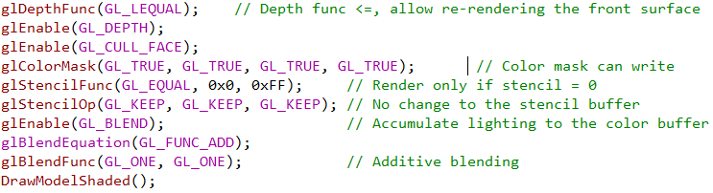
Per-light rendering state

Slide 9
Shadow volume extrusion
Use a geometry shader
For each input triangle T
  For each edge e
    If e is a silhouette edge:
    Extrude a quad based on the
    light position L
L
e
T
Notes:
The geometry shader operates on each input traingle.

Slide 10
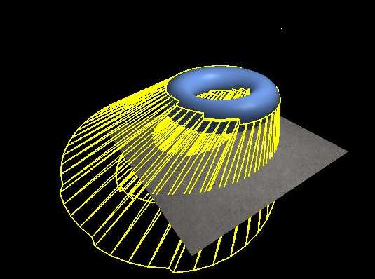
Shadow volume extrusion

Slide 11
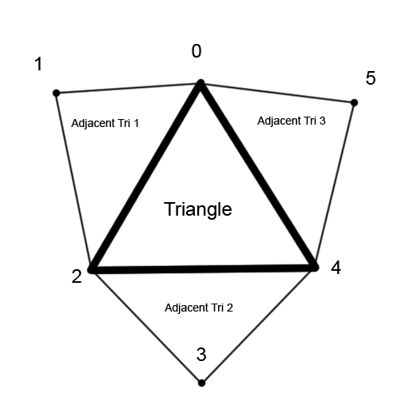
Shadow volume extrusion
Triangle with adjacency
  Every input triangle is specified by 6 vertices
gl_in[0].gl_Position
gl_in[1].gl_Position
gl_in[2].gl_Position
gl_in[3].gl_Position
gl_in[4].gl_Position
gl_in[5].gl_Position
Notes:
Three from the triangle itself, 0, 2, 4; and three from the three adjacent triangles 1,3,5

Slide 12
Shadow volume extrusion
Detect silhouette edge
  Compute face normals: cross product
  Compute facing: dot product with V_{L}
Silhouette can be detected twice
  Only extrude when T is front facing w.r.t. L
v₄
N
N_{adj}
L
e
V_{L}
T
v₂
v₀
v₃ (v_{adj})
Notes:
A silhouette edge is: either one isolated edge with only one adjacent triangle, or a shared edge, with one adjacent triangle facing the light, and another facing away from the light.
To determine whether the triangles are facing the light, we need to compute triangle normals, which can be done by a cross produce of any of the two edges. Note the order.

Slide 13
Shadow volume extrusion
Emit a quad (in triangle strip)
  Facing: agree with the existing triangles
    Triangle strip: (q₀, q₁, q₂, q₃)
    = Triangle (q₀, q₁, q₂) +
    Triangle (q₂, q₁, q₃)
q₃
q₂
L
e
v₄
q₀
v₂
v₀
v₃ (v_{adj})
q₁

Slide 14
Shadow volume extrusion
Emit a quad (in triangle strip)
  Vertices are in view space, multiply by gl_ProjectionMatrix before emitting
  Code sample:
  gl_Position = v0; EmitVertex();
  gl_Position = v1; EmitVertex();
  gl_Position = v2; EmitVertex();
  gl_Position = v3; EmitVertex();
  EndPrimitive();

Slide 15
Shadow volume extrusion
Emit a quad (in triangle strip)
  Extrude to infinity:
  simply specify (x, y, z, 0)
  (x, y, z) is the direction to extrude.
  Perspective division will correctly handle this.

Slide 16
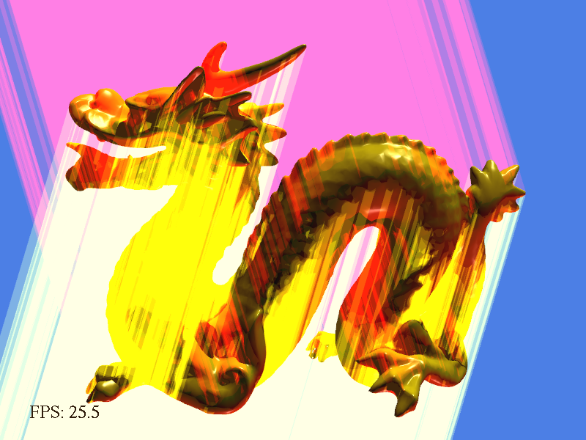
Debugging tips
Use visualization mode (9)

Slide 17
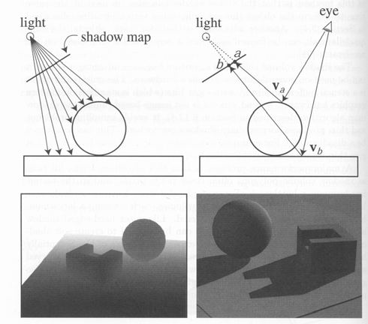
Shadow map review
Requires 2 passes of rendering the model:
  Compute shadow map (depth from light source)
  Render final image,
  check shadow map to see if points are in shadow
Foley et al. “Computer Graphics Principles and Practice”
Notes:
Basic idea of shadow map: Everything that the light sees is lit. Everything else that the light doesn’t see are in shadow.
First pass: View (render) the scene from the light source, record every visible surface by keeping the light-PoV depth.
Second pass: render from the normal camera, check shadow map to see if points are in it. If it is, the surface is lit, otherwise it’s in shadow.

Slide 18
Shadow map review
First pass:
  Render in the light Point of View (PoV)
    Camera in light position, shooting the objects
  All faces that the “light camera” sees are lit
  Depths of “light-visible” faces are stored in the shadow map
  (as an “ID”)
d_{a}
d_{b}
Foley et al. “Computer Graphics Principles and Practice”
Notes:
First pass: put the camera in the light position, shooting at the objects.

Slide 19
Shadow map review
Second pass:
  Render from the eye PoV
  For each point, figure out where it was in the shadow map
    Use light PoV matrix
  Check if the depths match
    Match-> visible from the light -> lit (v_{a})
    Shadow map depth smaller -> something else is closer to the light -> in shadow (v_{b})
d_{a’}
d_{a}
d_{b}
d_{b'}
Foley et al. “Computer Graphics Principles and Practice”
Notes:
Second pass: render from the regular eye point of view.
To determine shadow, for each rendered point, figure out where it should be in the shadow map.
This can be done easily by using the light point of view transformation matrices to transform the point.
By this transformation , we also know the depth from the current point to the light source.
We check if this depth matches the depth in the shadow map.
If they have the same depth, then it means that the point exists in the shadow map, which then means that the point is visible from the light source. Like this point va.
If the shadow map depth is smaller, like this point vb

Slide 20
Algorithm outline
Render ambient light into the color buffer
For each light:
  Render depth from the light PoV into the shadow map
  Render diffuse + specular light based on the shadow map; blend (accumulate) the light into the final color if not in shadow
Notes:
Very similar to the pipeline of rendering the shadow volume.
Note that pass b) for all the lights can be combined with step 1 as a single rendering pass in practical systems. Here for simplicity we separated them.

Slide 21
Task 1: Light PoV matrices
Compute field of view (fov) from the light
fov
g_model.getRadius()
lightPosition
(xpan, ypan, -sdepth)
Notes:
The first task you need to accomplish is to compute and set the light point of view matrix.
These matrices transform the object to the light point of view, and do the projection, so that the rendering pipeline correctly renders from the light pov.
We first need to determine how large an angle the light camera sees the objects. In rendering terms this is called “field of view”.
This value is important when computing the projection matrix. If it is not computed correctly, the model can be either too large or too small in the shadow map, causing problems.
Actually mathematically it’s very simple. You know the light position….

Slide 22
Task 1: Light PoV matrices
Setting the matrices
  The OpenGL way:
  glMatrixMode(GL_PROJECTION);
  …… // set the projection matrix
  glMatrixMode(GL_MODELVIEW);
  …… // set the view * model matrix
Notes:
The next task is to compute and set the model view and projection matrices.
In opengl, you first specify which matrix you want to set by setting the matrix mode to the corresponding one.
Then you simply compute and set the matrix.

Slide 23
Task 1: Light PoV matrices
Useful functions:
  glLoadIdentity(); // clear the current matrix
  gluPerspective(fov, aspect ratio, near, far);
  // generates a perspective projection matrix
  gluLookAt(eye.x, eye.y, eye.z, lookat.x, lookat.y, lookat.z, up.x, up.y, up.z)
  // generates a view matrix that transforms the camera to “eye”, looking at “lookat”. The “up” vector is used to fix the rest degree of freedom.
Notes:
There are some useful helper functions in opengl that you may use to compute and set the matrices.

Slide 24
Task 1: Light PoV matrices
Hint: learn how “SetTransformMatrices” works
(for the main camera)
glMatrixMode(GL_MODELVIEW);
glLoadIdentity();
glTranslatef(xpan, ypan, -sdepth);
glRotatef(-stheta, 1.0, 0.0, 0.0);
glRotatef(sphi, 0.0, 0.0, 1.0);
glTranslatef(-g_center[0], -g_center[1], -g_center[2]);
View matrix is identity!
(In the shadow map matrix it is not!)
A
B
C
D
A * B * C * D * gl_Position
Notes:
If you are not familiar with setting the matrices, you can take a look at the existing function SetTransformMatrices, which sets these matrices for the main camera that we use to view the obejct.
Eg. For the model view matrix, it does this, first load identity, then do translate….
Note that opengl multiplies matrices to the right of a vector. It seems that you apply these A B C and D one by one.
But in reality, the object position is first transformed by D, then C, then B, then A, in the reverse order.
First translates the model to its center, then rotates along the z axis, then rotates along the x axis, which controls the mouse rotation of the object.
Finally it translates the model by xpan, ypan, which controls the horizontal and vertical positions on the screen, and –sdepth, which controls the distance to the viewer.
Note that all these are in the “model” matrix. The view matrix is simply identity for the main camera. That means the main camera just sits at the center of the coordinate system and look towards the z direction.
In the light point of view, you not only need the model matrix to transform the model, but you also need the view matrix to transform the camera to the light position.

Slide 25
Task 2: Shadow map texture matrix
Almost the same as light PoV matrix
Concatenate modelview and projection matrices
Scale from Normalized Device Coordinate (NDC,
[-1, 1]³) to texture coordinate ([0, 1]³)
  Automatically done by viewport transform in normal rendering, but not here. (a linear transform)
  Either: specify a matrix and use “glMultMatrixf”
  Or: generate the matrix using “glTranslatef” and “glScalef”
  Or: do it in the shader
Notes:
The second task is to set the matrix for determining where a world space point is in a shadow map.
As we have learnt, this transformation should be the same as the light PoV transformation.
Therefore, we store the two matrices and pass them in as parameters.
In the code, you concatenate the model view and projection matrices, and simply set it to the pipeline.
An important difference is that the result of this transformation is in the ndc coordinate, ranging -1 to 1, but the texture map is in texture coordinate, ranging from 0 to 1.
In the first pass this scaling is automatically done by the hardware. But since now we are passing this coordinate as a custom value, it’s not scaled.
We can do the scaling by ourselves, by simply hardcode a scaling matrix and use ..

Slide 26
Task 3: Render with shadow test
Implement in the fragment shader “render_perlight_shadow_map.glsl”
  Compute shadow map coordinate (including depth) in texture space
    Hint: use perspective division
  Fetch depth from the shadow map
    Just as regular texture fetch
  Compute "shadow" value based on the comparison of fetched depth and the computed depth
Notes:
The final task is simple and straightforward. In the fragment shader, we first compute the shadow map coordinate, including the depth, by converting from projection space to post-projection space, using perspective division.
Then we …

Slide 27
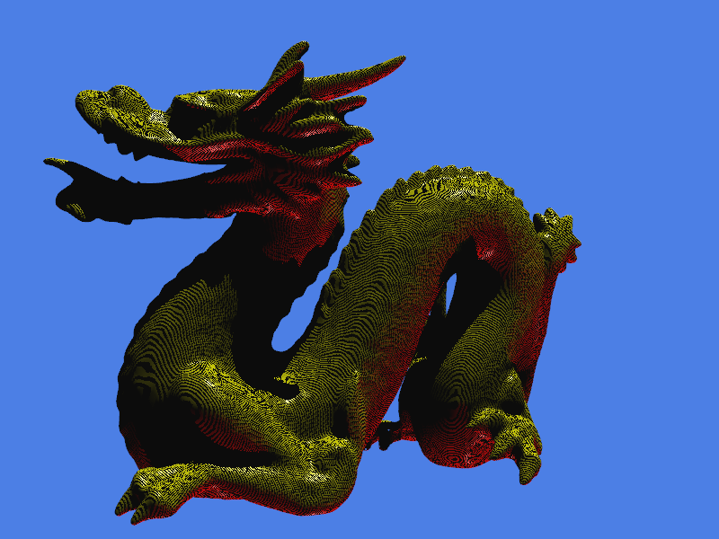
Task 3: Render with shadow test
Shadow map acne
  Appears on lit surfaces
  Insufficient precision of shadow map
  Compare with tolerance “shadowZOffset”
Notes:
There is some detail here. After you’ve done all these, you may see what is called “shadow map acne” which is shown below. This only appears at lit surfaces, where the two depths match. The problem is because the two depths do not match exactly, because of insufficient precision of the shadow map. So to remove this, we should compare with a tolerance called …
This tolerance is specified in the code. You can try to adjust it and see what happens.

Slide 28
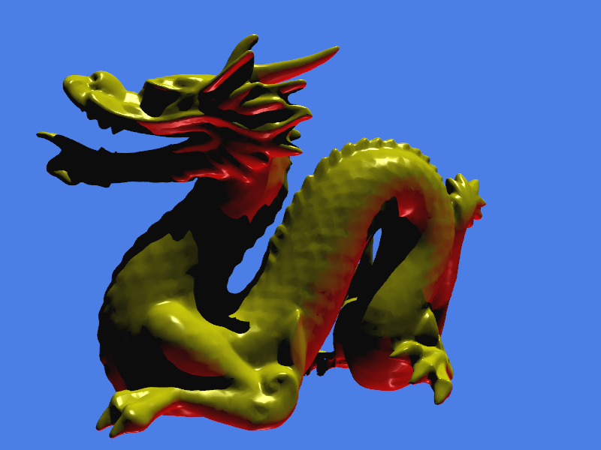
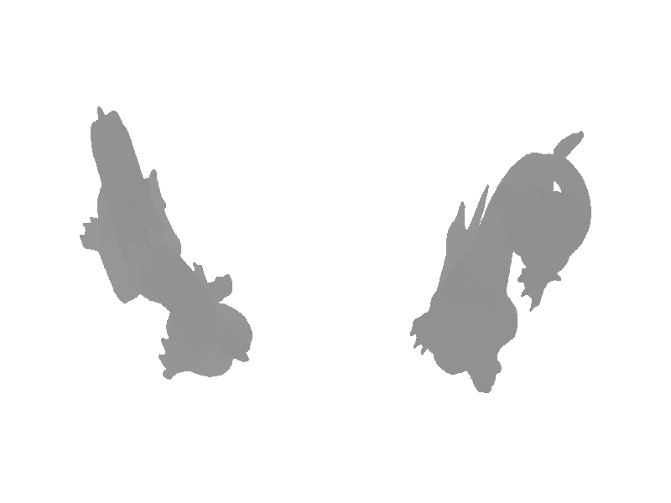
Debugging tips
Check shadow map validity using mode “7”
  Check if the light PoV is correct
  Check if the model fills the shadow map
Light 1’s view Light 2’s view
Notes:
For debugging the shadow map, we also provide a visualization mode which shows the shadow map onto the screen.
You can check three things from this.
First, see if the light point of view is correct.
The two lights are situated above and below the model on the right hand side. With your spatial imagination you can decide whether the lights are viewing the model correctly.
Second, you can check if the model fills the shadow map. If it’s too small, then the shadow map may not have enough precision to produce the correct shadow. If it’s too large, then the shadow map may not capture the object entirely and you’ll see artifacts too.
Finally, check if the shadow map depth are correct. If you don’t see different levels of grayscales, then your matrix may be wrong too.

