Slide 1
COMP 5411 PA2
Instructor: Pedro Sander
TA for this assignment:
Ge Chen (gechen@cse.ust.hk)

Slide 2
Main objective: lighting computation
A Scene with two point lights
Accumulate the contribution of the two lights, plus the environmental ambient illumination

Slide 3
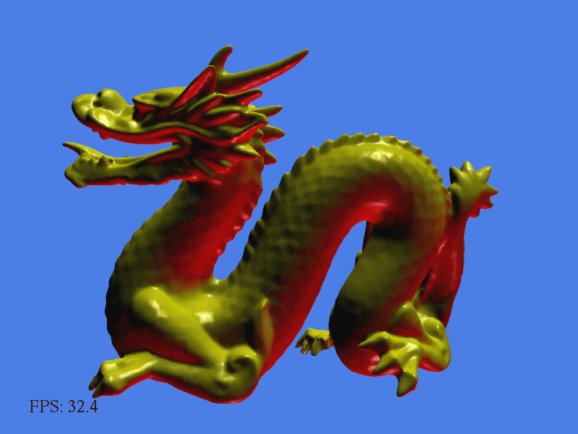
Main objective: lighting computation

Slide 4
Compute lighting at a surface point
Ambient reflection – a crude approximation of indirect lighting
  No direction – same
  everywhere on the surface
  Ambient contribution:
  I_{a} = k_{a} (I_{a_g} + ∑ I_{a,i} )
  k_{a} :gl_FrontMaterial.ambient
  I_{a,i} :gl_LightSource[i].ambient
  k_{e} + k_{a} I_{a_g} : gl_FrontLightModelProduct.sceneColor
Notes:
Ka: ambient reflection coefficient
I: illuminance

Slide 5
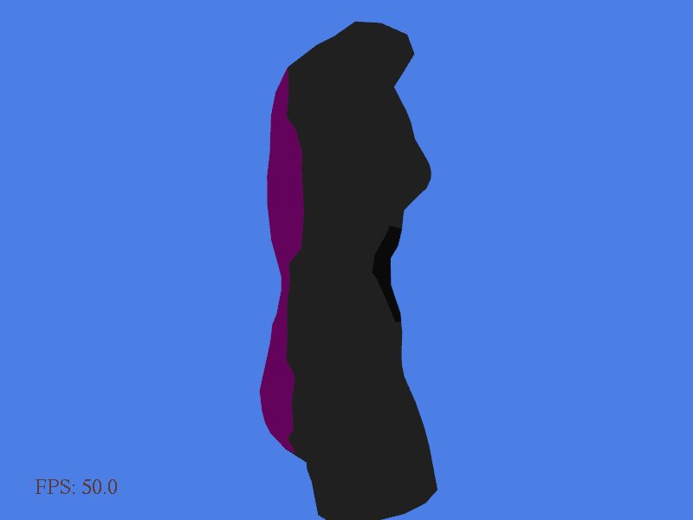
Compute lighting at a surface point
Ambient-only result

Slide 6
Compute lighting at a surface point
Diffuse reflection
  View-independent
  Diffuse contribution:
  I_{d} = k_{d} ∑(I_{d,i} ( N · L )₊ )
  k_{d} :gl_FrontMaterial.diffuse
  I_{d,i} :gl_LightSource[i].diffuse
  N : gl_Normal
  L : gl_LightSource[i].position – P
  (Make sure that N and L are in the
  same space (e.g. world/view) and
  are normalized.)
L
N
P

Slide 7
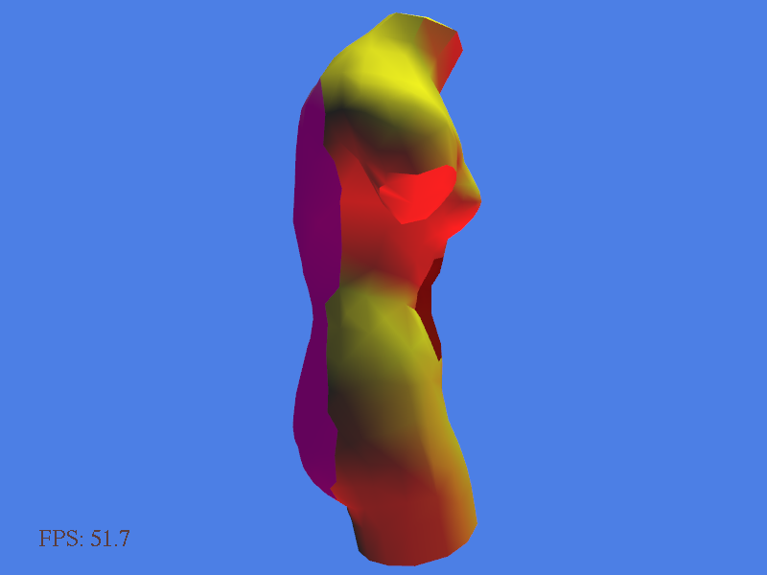
Compute lighting at a surface point
Ambient+diffuse result

Slide 8

Compute lighting at a surface point
Specular reflection
  View-dependent
  Diffuse contribution:
  I_{s} = k_{s} ∑(I_{s,i} ( N · H )₊^{nsi} )
  k_{s} :gl_FrontMaterial.specular
  I_{s,i} :gl_LightSource[i].specular
  N : gl_Normal
  H : normalize( L + V )
  n_{si} : gl_FrontMaterial.shininess
  (Note: for each light, if N · L < 0,
  then set its specular contribution
  to 0 too.)
L
N
V
P

Slide 9
Compute lighting at a surface point
To sum up…
I_{s} = k_{e} + I_{a} + I_{d} + I_{s}
In the code:
  Accumulate the term in the ∑ for I_{a} , I_{d} and I_{s}
  (In the pointLight function)
  Modulate by respective coefficient K and sum up
  (In the main function)

Slide 10
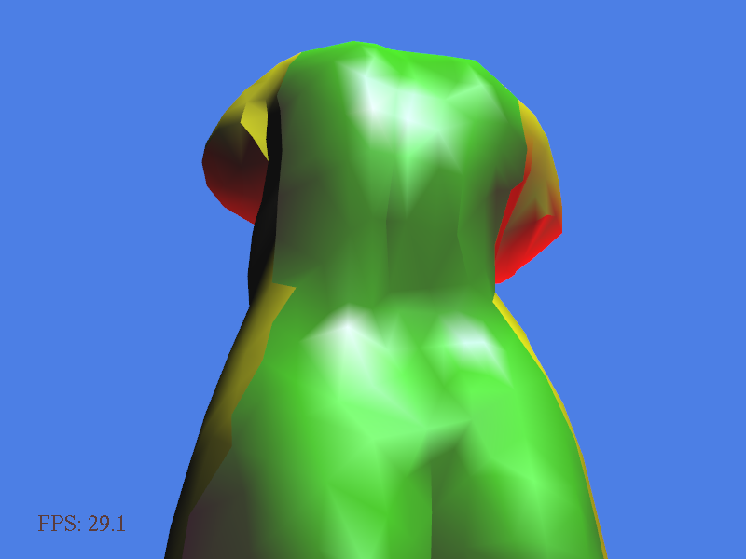
Compute lighting at a surface point
Ambient+diffuse+specular result

Slide 11

Gouraud / Phong shading
Gouraud shading (per-vertex shading)
  Shade at each vertex
  Interpolate at pixels (automatic)
  Implemented by the fixed function pipeline
  First task in this assignment
  (implement in vertex, match
  the fixed-function result)

Slide 12
Gouraud / Phong shading
Phong shading (per-fragment shading)
  Shade at each fragment (pixel)
  Shading inputs are interpolated rather than results
    Can use “in” and “out” specifiers for passing and interpolating values between stages
  Can only be implemented by programmable shaders
  Third task in this assignment

Slide 13
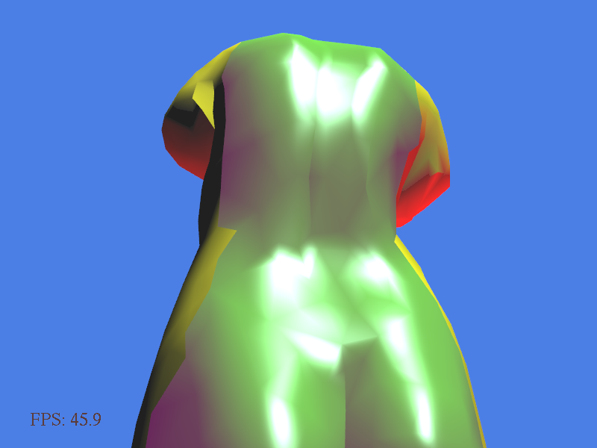
Gouraud / Phong shading
Gouraud shading Phong shading

Slide 14
Adding texture
Texture coordinate is passed down from vertex to pixel stage
  Texturing has to be done in the pixel shader
  Interpolated variable (intrinsic): gl_TexCoord[0]
  (only “xy” contains valid 2D texture coordinates)
  Sampler function:
  texture2D(SAMPLER, COORDINATE)

Slide 15
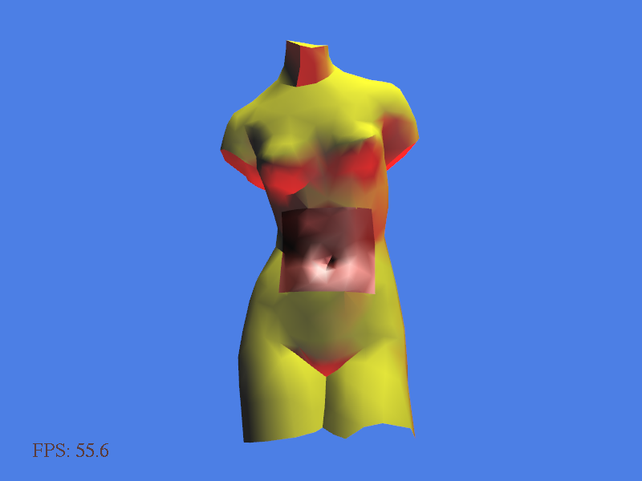
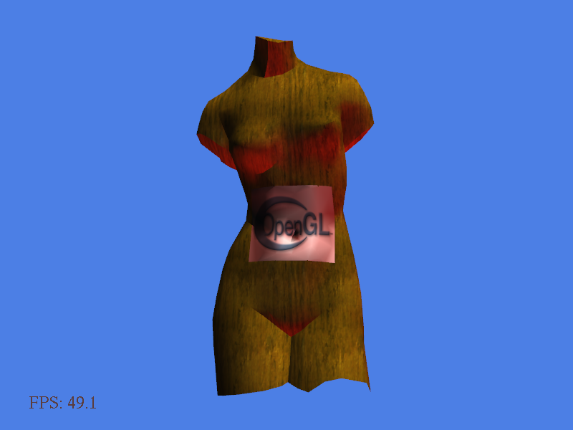
Adding texture
Without texture With texture

Slide 16
Adding texture
Texture color is meant to be “diffuse” only
  Modulate the diffuse and ambient color by the texture color.
  The specular should be added after applying texture
    Required only for “Phong shading” in this assignment

Slide 17
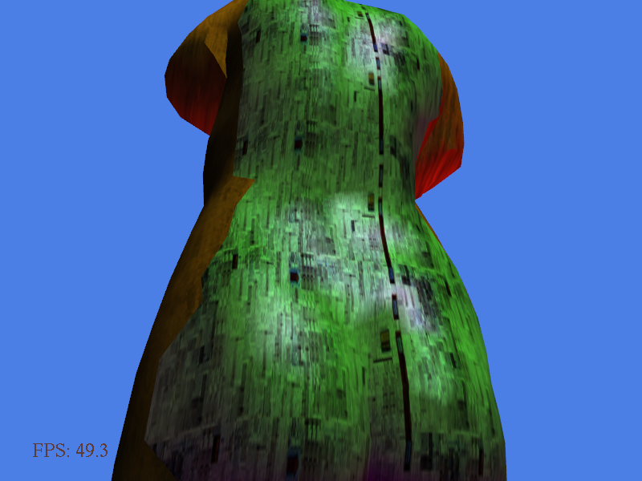
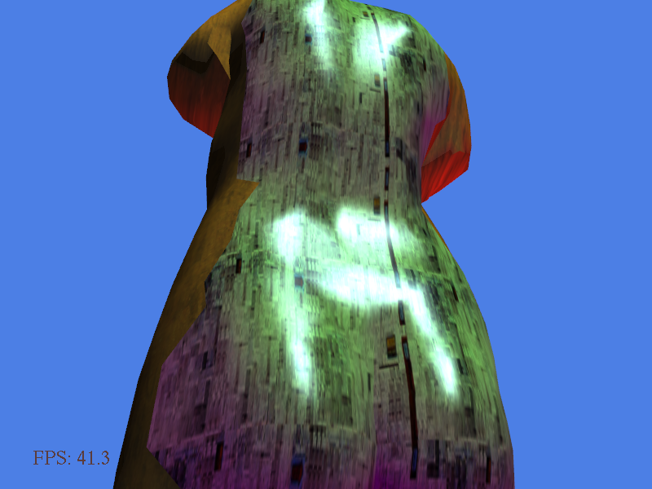
Adding texture
Specular added before applying texture
Specular added after applying texture

Slide 18
Procedural animation
Manipulate the vertex positions consistently using a function of time
  E.g. translation:
    vAnimatedPos.x += g_fFrameTime/3000.0;
  You can also do rotation, deformation
  It has to be an interesting animation

Slide 19
Procedural animation
Video demo

Slide 20
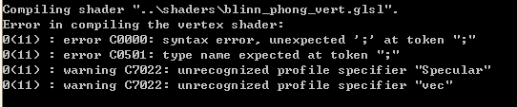
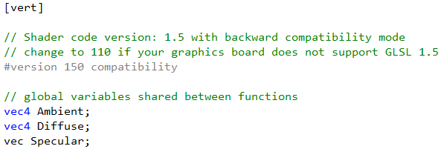
Compiling the shader
Shader will be compiled on-the-fly when the program is loaded
  Check the output console for any compiling error

Slide 21
Useful resources
OpenGL 3.2 and GLSL 1.5 quick reference card
  http://www.khronos.org/files/opengl-quick-reference-card.pdf
GLSL documentation
  http://www.opengl.org/documentation/glsl/

Slide 22
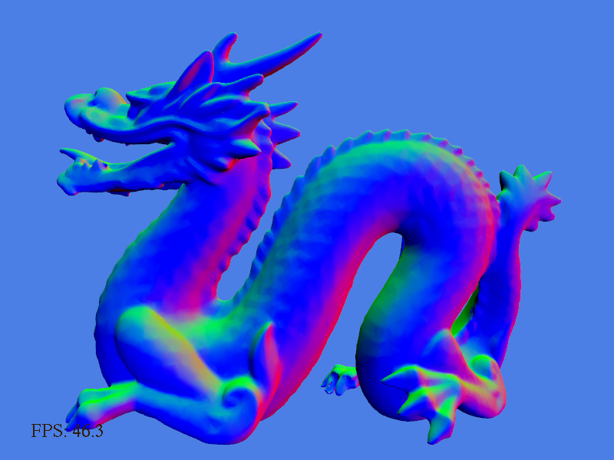
Debugging tip
When the output is incorrect, try to render out intermediate values as color within [0,1]
  E.g. for visualizing “normal”, put in the frag shader
  gl_FragColor = vec4(n,1);

Slide 23
Submission
Just submit the two glsl files
  Together with a doc report with screenshots of each step and a description of what you did for the animation.
  If you have to change the cpp file, please include it in the package and make it clear in the report.

