Slide 1

Thread-Local Storage Design Pattern
By
Ghulam Zain Ul Abideen FA20-BSE-017
Asim Tariq FA20-BSE-037

Slide 2

Intent of Thread-Local Storage Design Pattern
Isolating Data for Each Thread:
Store thread-specific data without interference or conflicts.
The Thread-Local Storage Design Pattern allows individual threads within a process to have their own local storage, providing a unique data space for each thread.

Slide 3

Motivation behind Thread-Local Storage Design Pattern
Concurrent Execution:
Enable concurrent execution of multiple threads by avoiding data sharing issues.

Slide 4

Applicability of Thread-Local Storage Design Pattern
1
Multi-threaded Applications
2
Concurrency Control
This pattern is useful in multi-threaded environments where multiple threads are accessing and modifying shared data.
It is applicable when you want to avoid synchronization issues, such as race conditions, in concurrent programming.

Slide 5
Advantages of using Thread-Local Storage Design Pattern
Thread Isolation
Performance Optimization
Simplified Code
Each thread has its own private data storage, preventing interference and reducing the need for locks and synchronization.
Using the Thread-Local Storage Design Pattern can lead to simpler code, as it eliminates the complexity of shared variables and synchronization mechanisms.
By eliminating the need for synchronization, this pattern can improve the overall performance and scalability of multi-threaded applications.

Slide 6

Consequences of using Thread-Local Storage Design Pattern
1
Increased Memory Usage
2
Increased Complexity
Using thread-local storage may increase memory usage, as each thread requires its own separate copy of data.
Implementing thread-local storage adds complexity to the codebase, as developers need to manage and maintain the thread-local variables.
3
Data Inconsistency
If not used carefully, thread-local storage can lead to data inconsistencies when different threads depend on shared data.

Slide 7

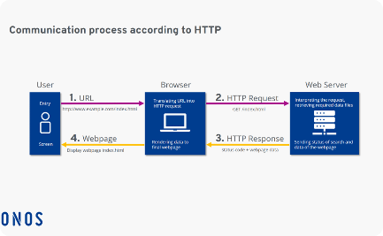
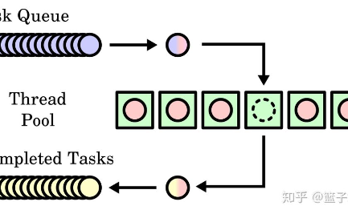
Real-World Examples of Thread-Local Storage Design Pattern
Banking Applications
Web Servers
Thread Pools
In banking applications, each bank teller can have their own thread-local storage to maintain their customer interactions and service logs.
In web servers, thread-local storage can be used to store user-specific session data, such as user preferences or authentication details.
Thread pools use thread-local storage to assign and manage tasks efficiently, ensuring thread-specific data is readily available.

Slide 8

Is Thread-Local Storage Design Pattern Standalone?
Yes, the Thread-Local Storage Design Pattern is considered a standalone design pattern, providing a specific solution to handle per-thread data.

Slide 9
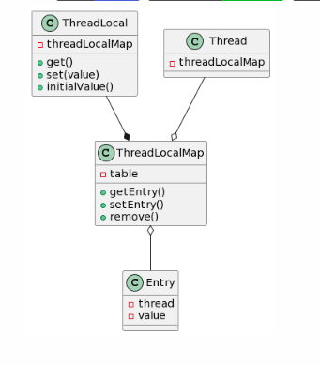
Structure Diagram

Slide 10
Class Diagram Explanation
Class Thread:
represents an individual thread of execution.
Class Entry:
represents a key-value pair that associates a thread with its thread-local variable value.
Class ThreadLocalMap:
responsible for maintaining a mapping between threads and their thread-local variables.
Class ThreadLocal:
acts as a high-level interface for managing thread-local variables.

