Slide 1



Ultimate Game Card:
Using Promotional Codes to Incent Sales
Powered By:

Slide 2
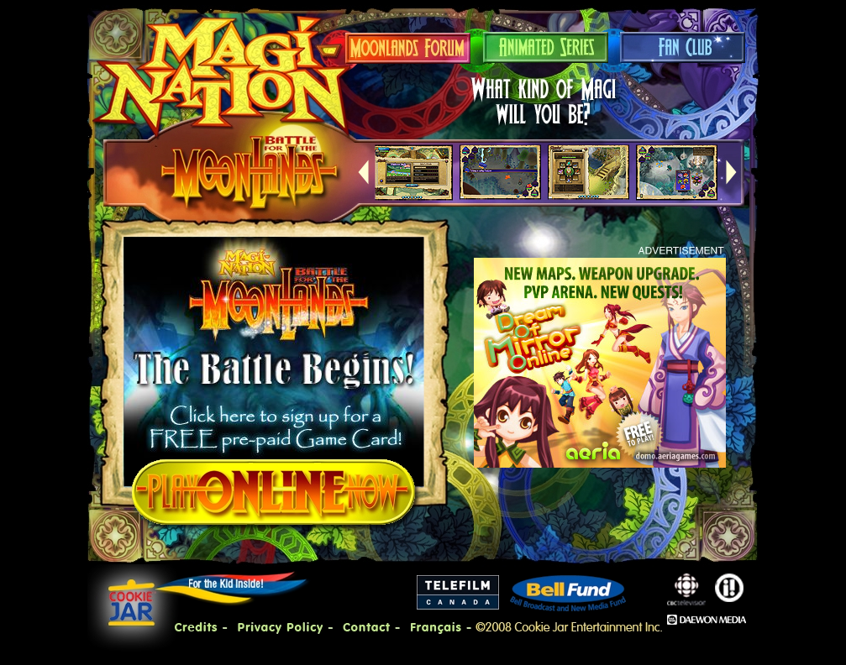
Magi-Nation: Home Page with Promotional UGC advertised

Slide 3
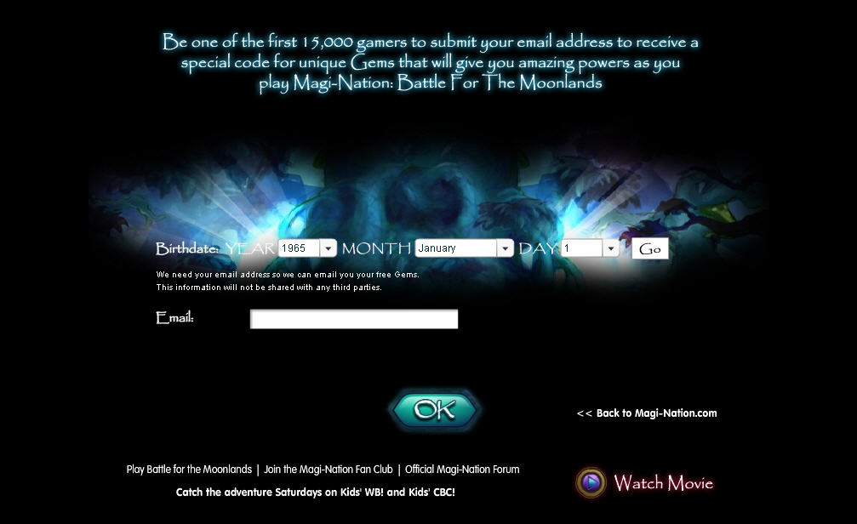
Enter birthday & email to receive your code

Slide 4
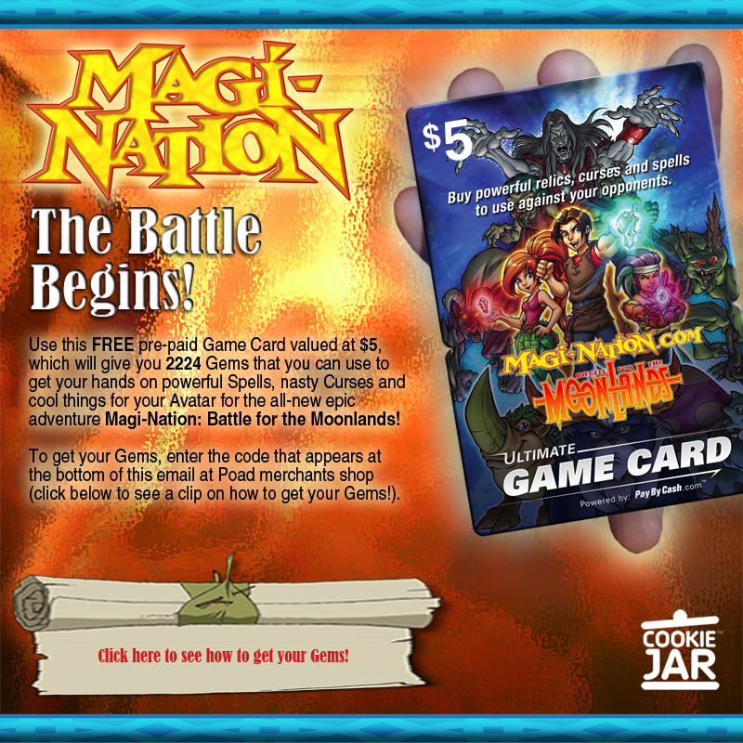
Confirmation email is sent with a Promotional UGC code at the bottom
CEZYQ-RXPLJ-HMLLW-OWYIH-EICGW

Slide 5
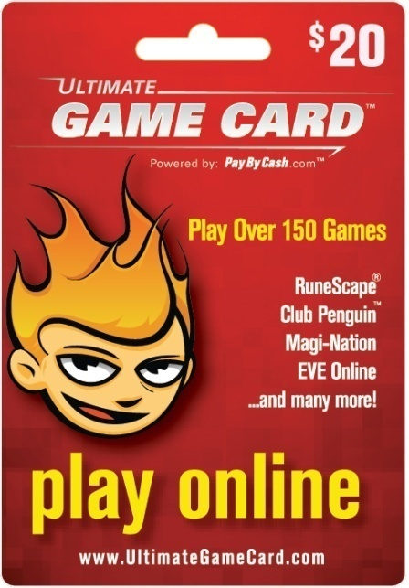
Ultimate Game Card
Promotional Codes:
A great customer acquisition or reacquisition tool
Entice your customers with premium content
Ann Whitener
Director, Business Sales
PayByCash
703.430.4890
awhitener@paybycash.com
www.ultimategamecard.com
www.paybycash.com

