Slide 1
General Meats
CS 180

Slide 2
General Meats
About
General Meats is a small family owned butcher shop that sells only land animals from local organic farms, no seafood. They receive deliveries two days a week from multiple local organic farms.The carcasses are cut into forequarter and hind quarters. Then from there they are broken down dependent on the cuts that are processed by the type of animal being processed. Birds can be sold as whole birds, half birds, breast with bones, boneless breast, leg quarters, thigh bone in, thigh boneless, legs, wings, and bones.
General Meats is open 7 days a week.

Slide 3
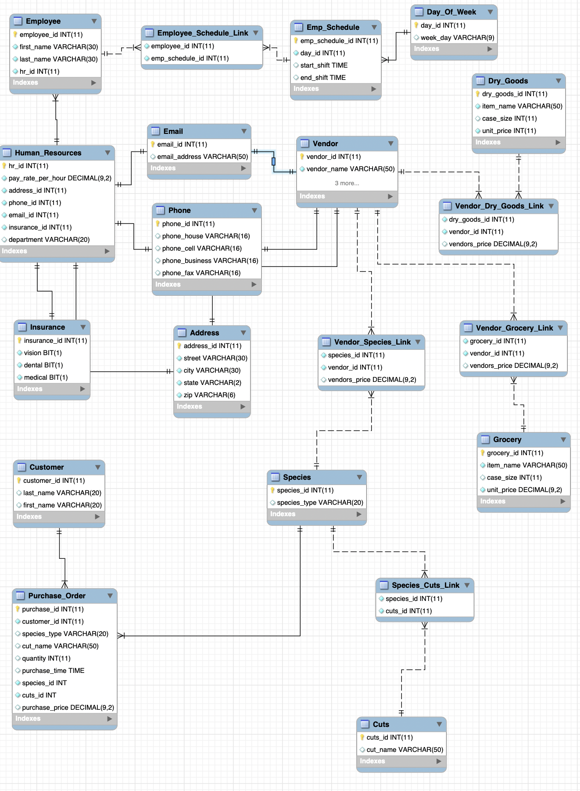
Erd

Slide 4
select concat(last_name,", ", first_name) as Employee,
street , city, state,
pay_rate_per_hour as "Hourly Rate",
department as "Department"
from
Employee join Human_Resources using(hr_id)
join Address using(address_id);
List of Employee with name, address, and hourly rate--

Slide 5
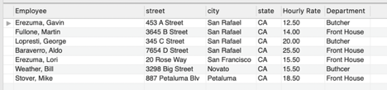
Output

Slide 6
create procedure printSchedule
(
employee_first_name_param varChar(50),
employee_last_name_param varChar(50)
)
begin
declare employee_id_var int;
select employee_id into employee_id_var from Employee where employee_id = findEmployee(employee_first_name_param, employee_last_name_param);
if findEmployee(employee_first_name_param, employee_last_name_param) = 0 then
select "No Employee Found" as Message;
else
select concat(first_name, " " , last_name) as "Employee",
week_day as "Day" , start_shift as "Start Time", end_shift as "End Time"
from Employee join Employee_Schedule_Link using(employee_id)
join Emp_Schedule using(emp_schedule_id)
join Day_Of_Week using(day_id)
where Employee_Schedule_Link.employee_id = employee_id_var;
end if;
end//
Printed Schedule for Each Employees--

Slide 7


Output

Slide 8
select vendor_name as "Vendor",
species_type as "Species",
cut_name as "Cut",
vendors_price as "Our Cost"
from Vendor
join Vendor_Species_Link using(vendor_id)
join Species using(species_id)
join Species_Cuts_Link using(species_id)
join Cuts using(cuts_id)
order by species_type desc;
Breakdown of Species by Vendor--

Slide 9
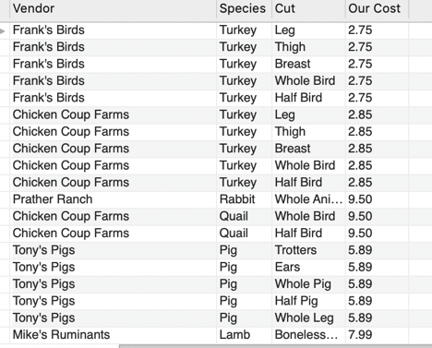
Output

Slide 10
select distinct last_name as "Customer",
Purchase_Order.cut_name as "Cut",
Purchase_Order.species_type as "Species",
purchase_time as "Time of Purchase",
quantity as "Quantity",
purchase_price as "Price",
(quantity * purchase_price) as "Total Line Item"
from Customer
join Purchase_Order using(customer_id)
join Species using(species_id)
join Species_Cuts_Link using(species_id)
join Cuts using(cuts_id)
order by last_name;
Sales report with cut name, species name,
time of sale , quantity, price, and a total of each line item--

Slide 11
create procedure sell_Meat_Item
(
species_param varChar(20),
cut_param varChar(50),
quantity_param int,
price_param decimal(9,2)
)
begin
declare cus_id_var int;
insert into Purchase_Order values (default,findCustomer(),findSpecies(species_param),species_param,
findCuts(cut_param),cut_param,quantity_param,current_timestamp(),price_param);
end//
Procedure--

Slide 12
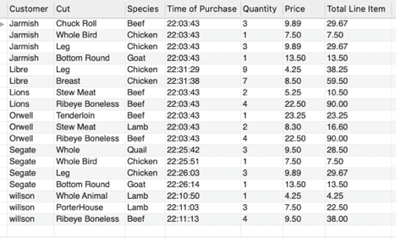
Output

