Slide 1


Sentiment Analysis

Slide 2
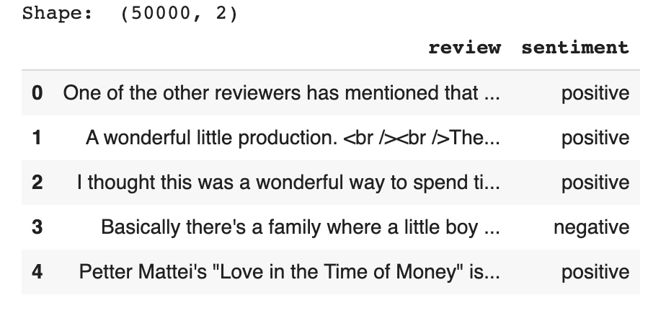
Database
IMDB dataset having 50K movie reviews

Slide 3
Workflow
Load data and quick data exploration
Clean data
Data Exploration
Model preparation
Classical modeling: Random Forest / TF-IDF / Logistic Regression
Deep Learning Model: RNN

Slide 4
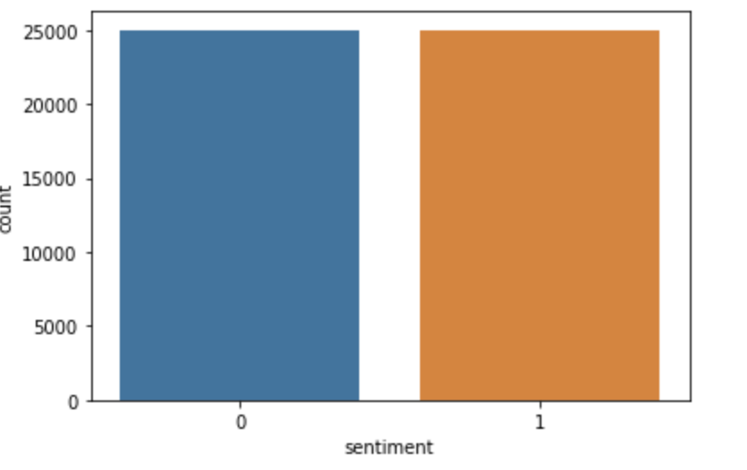
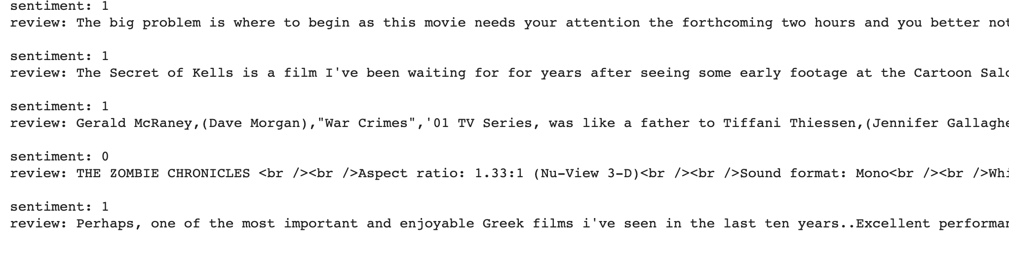
Quick view
Dataset is equilibrated with few duplicated lines

Slide 5
CLEANING
Convert sentiment(label) in integer: (“positive”,”negative”) => (1,0)
2.Remove duplicates
3.Remove stop words

Slide 6
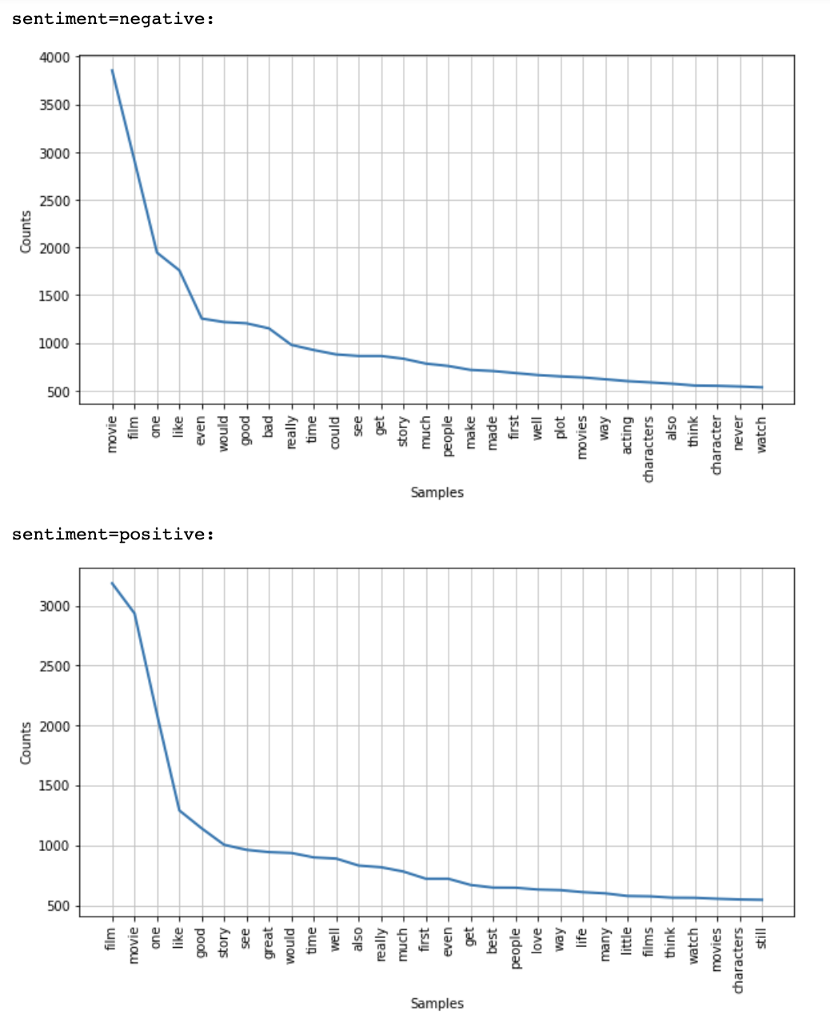
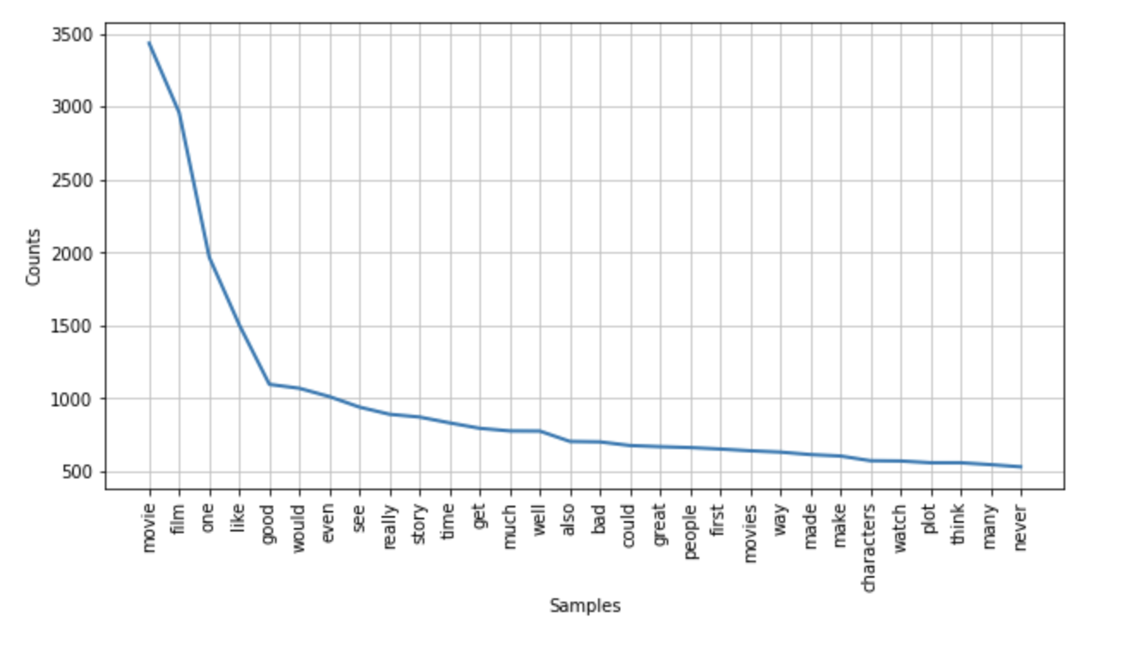
Data exploration: Word Frequency
Global word frequency

Slide 7
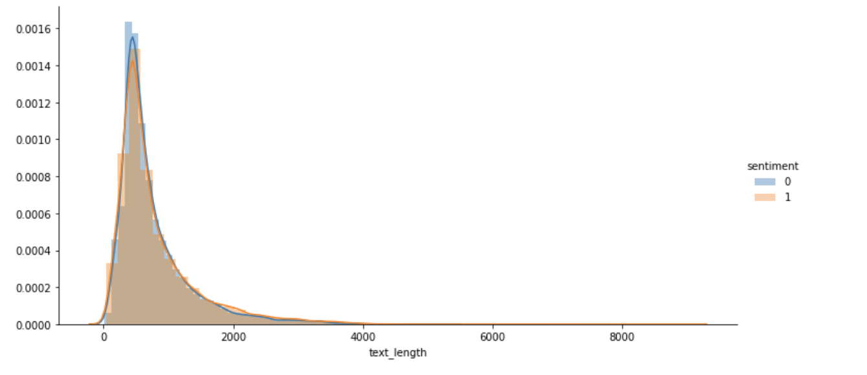
Data exploration
Comment length

Slide 8
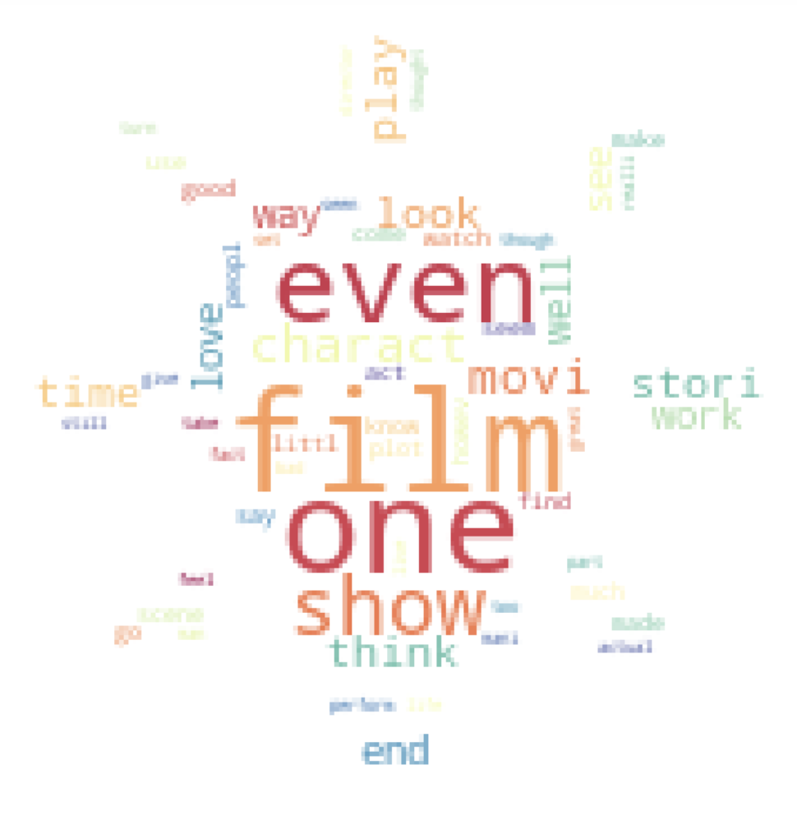
WORD CLOUD

Slide 9
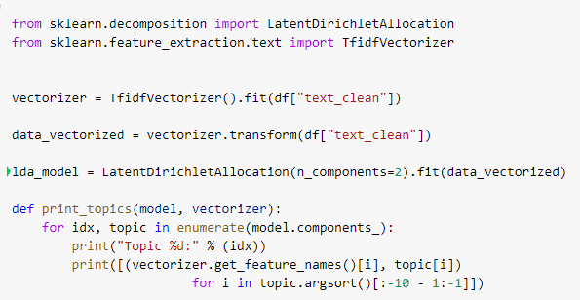
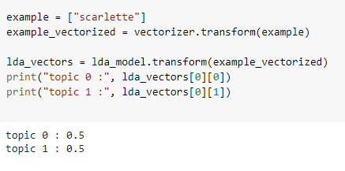
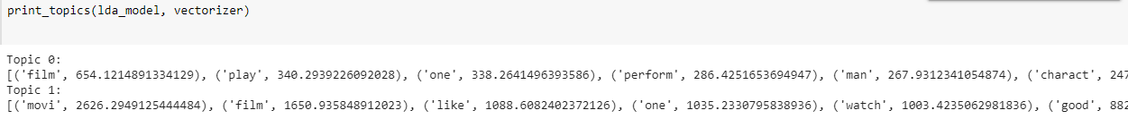
Latent Dirichlet Allocation model

Slide 10
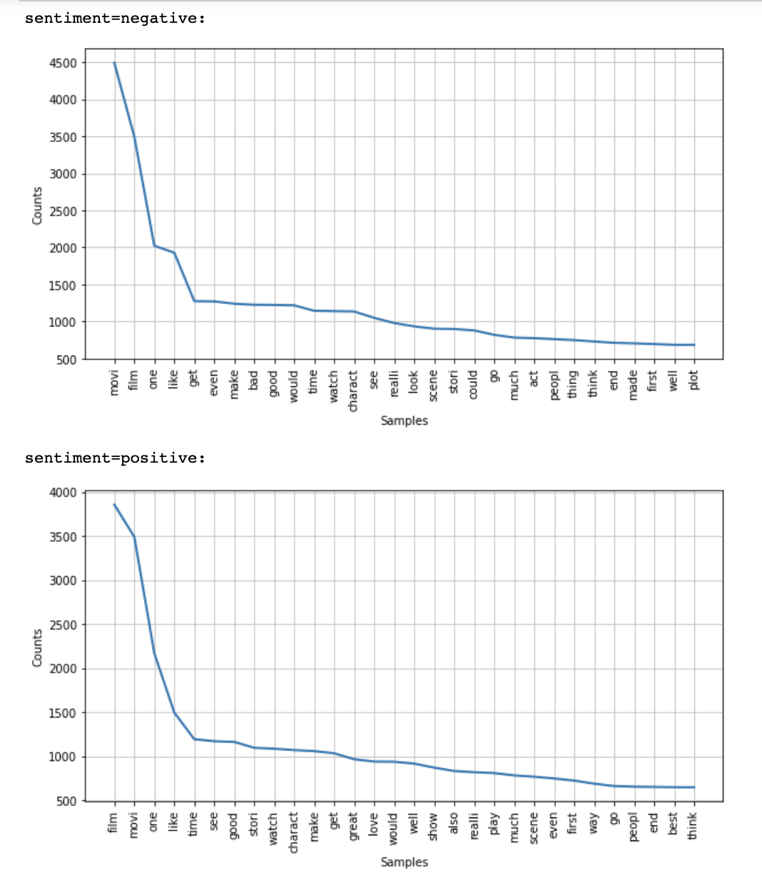
Data Preparation
STEMMING
BAG OF WORD

Slide 11
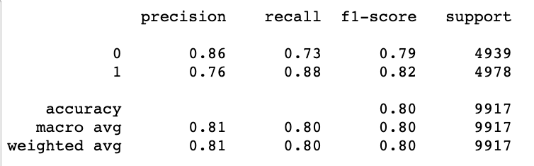
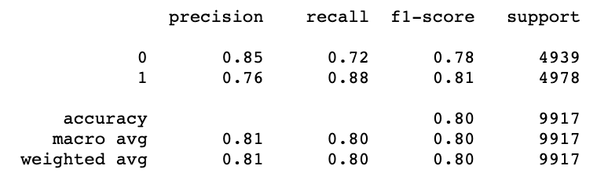
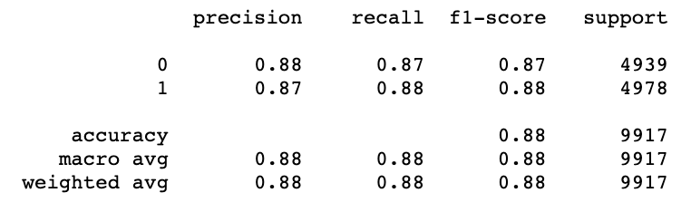
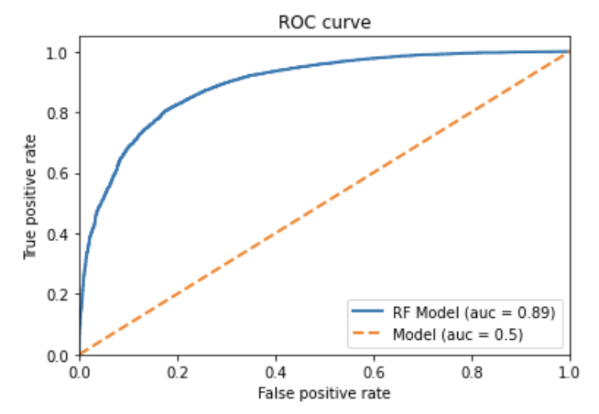
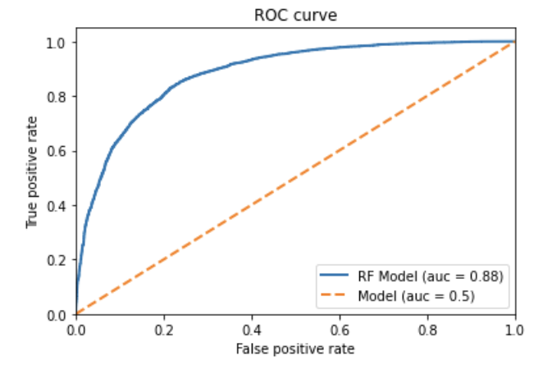
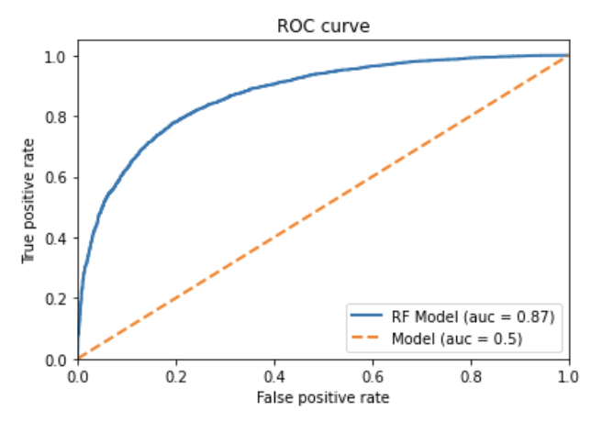
MODEL
Random Forest
TF-IDF
Logistic Regression

Slide 12
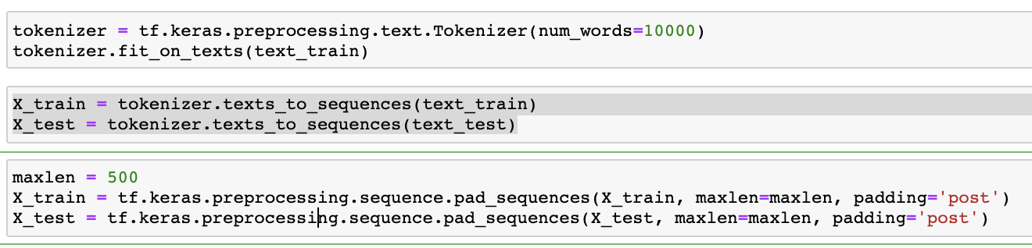
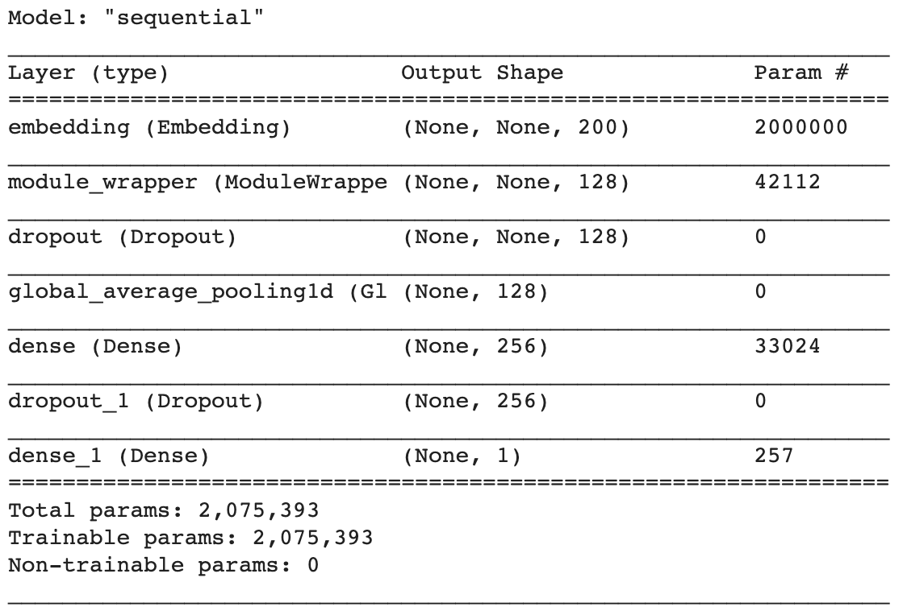
DEEP LEARNING

Slide 13
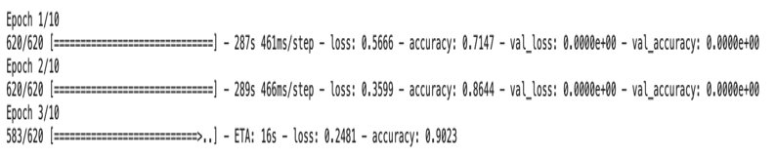
DEEP LEARNING

