Slide 1
Food Recommender
By Ghodrat, Tejal, Shashank and Thomas

Slide 2

Why we need it ?
Because food is the most essential part of life.
In today’s world we have endless number of choices for food.
To get desired food item customer has to go through a deep research e.g.read the ingredients, reviews, methods of preparation.
These endless number of choices confuses the customer.
“Food Recommender System” is made to make life easy for people while choosing food products.

Slide 3




Tools
Git - version control
Node - Programming Environment
PostgreSQL - Database
Sqitch - Data Change Management
Notes:
Shashank

Slide 4
GIT
To push and pull code changes and keep the version history of the code.
NODE
Simple and fast. Need to know javascript to code
Libraries like express helps implement which HTTP requests we wish to respond and how we respond.
Notes:
Shashank

Slide 5
Postgresql
Open Source
Better Data Integrity
Easily handles complex design
SQITCH
To manage changes in Schema we used Sqitch.
Sqitch uses three files: deploy, revert, verify.
It helped us a lot to improve our schema.
Notes:
Shashank

Slide 6
Web Application Architecture
Chrome
Chrome
Node
Request
Response
Postgres
Notes:
Shashnk

Slide 7
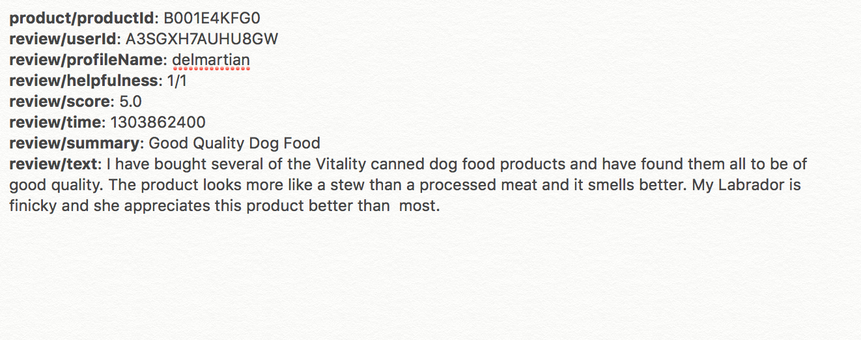
Raw Data
We used Web Fine Food Dataset. This food set contains food items sold by Amazon.
Summary of the dataset :
Food Products : 74,258
Customers : 256,059
Reviews: 568,454
Notes:
Tejal

Slide 8
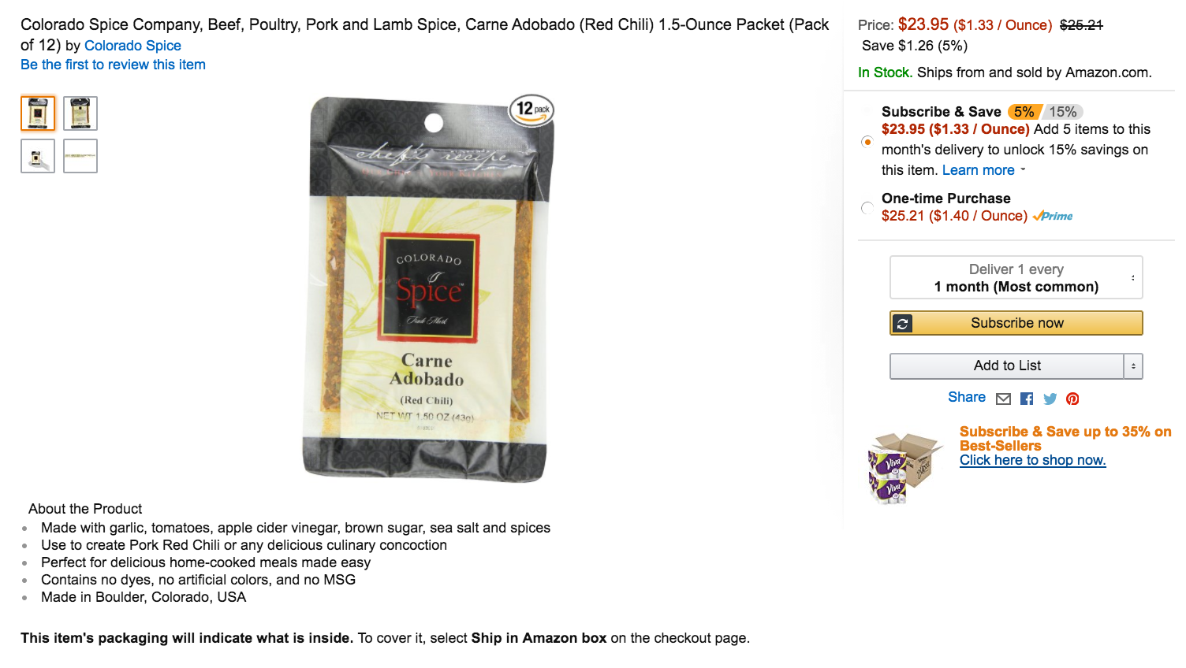
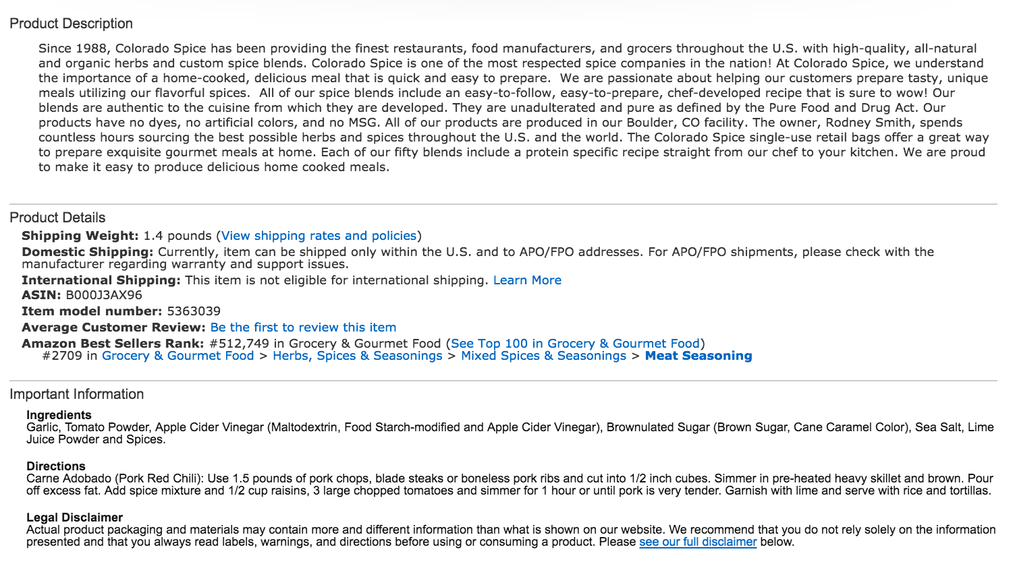
Amazon Data Fetching and Scraping

Slide 9
Normalized Data
product
asin(primary key)
B001E4KFG0
customer
id(primary key) | name
A3SGXH7AUHU8GW | delmartian
review
Product_asin (foreign key) | Customer_id (foreign key) | time | score | summary | body | helpfulness
B001E4KFG0 | A3SGXH7AUHU8GW | 1303862400 | 5.0 | Good Qua... | I have bought several... | 1/1
Notes:
Thomas

Slide 10

Data Munging
Raw Text
(.txt file)
Product API
Node
Insert
Postgres
Node

Slide 11
Data Analysis
For data analysis we used Regression Models.
Built in function of R is used to make
Histogram
Bar-Graph
Scatter-Plot
These graph help us to visualize the data.
Collaborative Filtering is used to find similar items and avoid unrelated items.
Notes:
Ghodrat

Slide 12
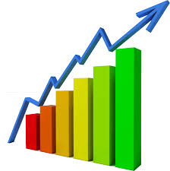

Data Analysis Architecture
DB

Slide 13
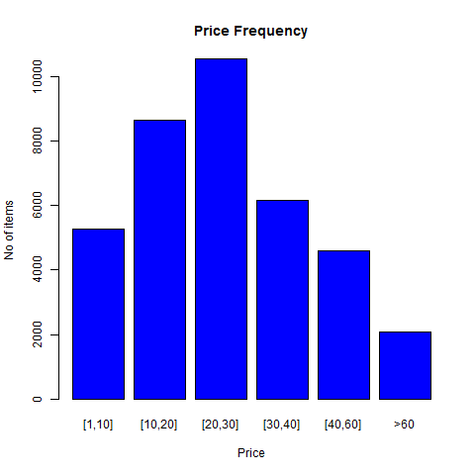
HistoGram

Slide 14
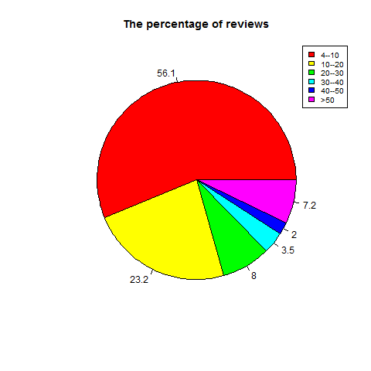
PIe-chart For Percentage of Reviews
Number of Reviews
Products
Half of our products have only 4-10 reviews

Slide 15
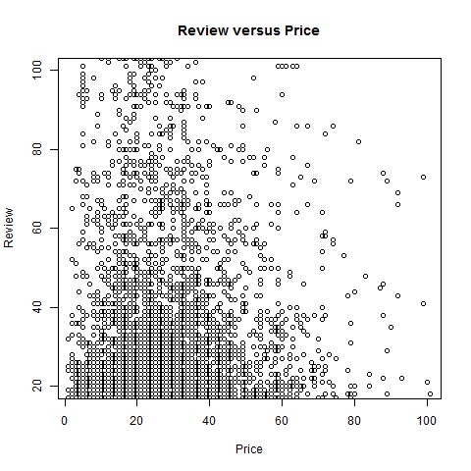
Reviews vs Price

Slide 16
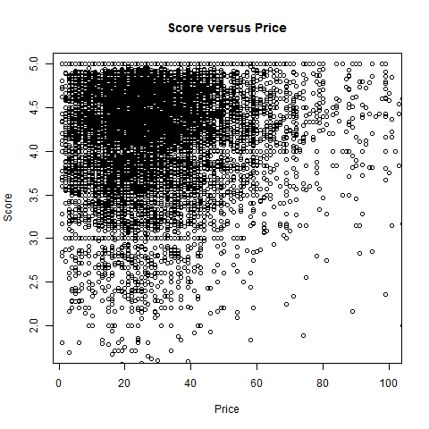
Score vs Price

Slide 17
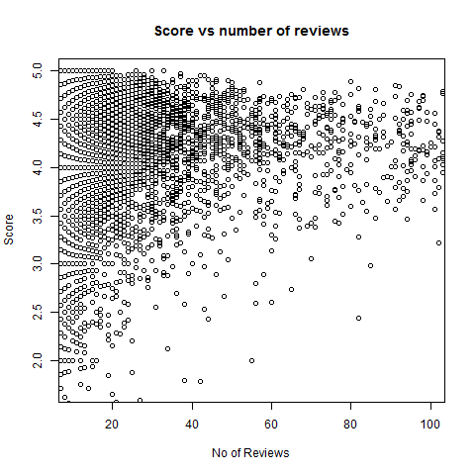
Score Vs Number of Reviews

Slide 18
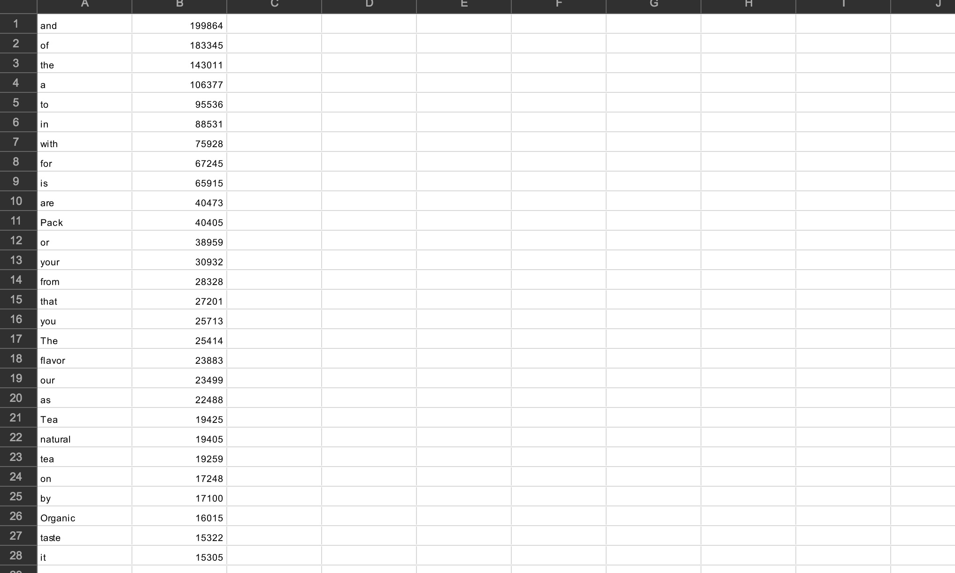
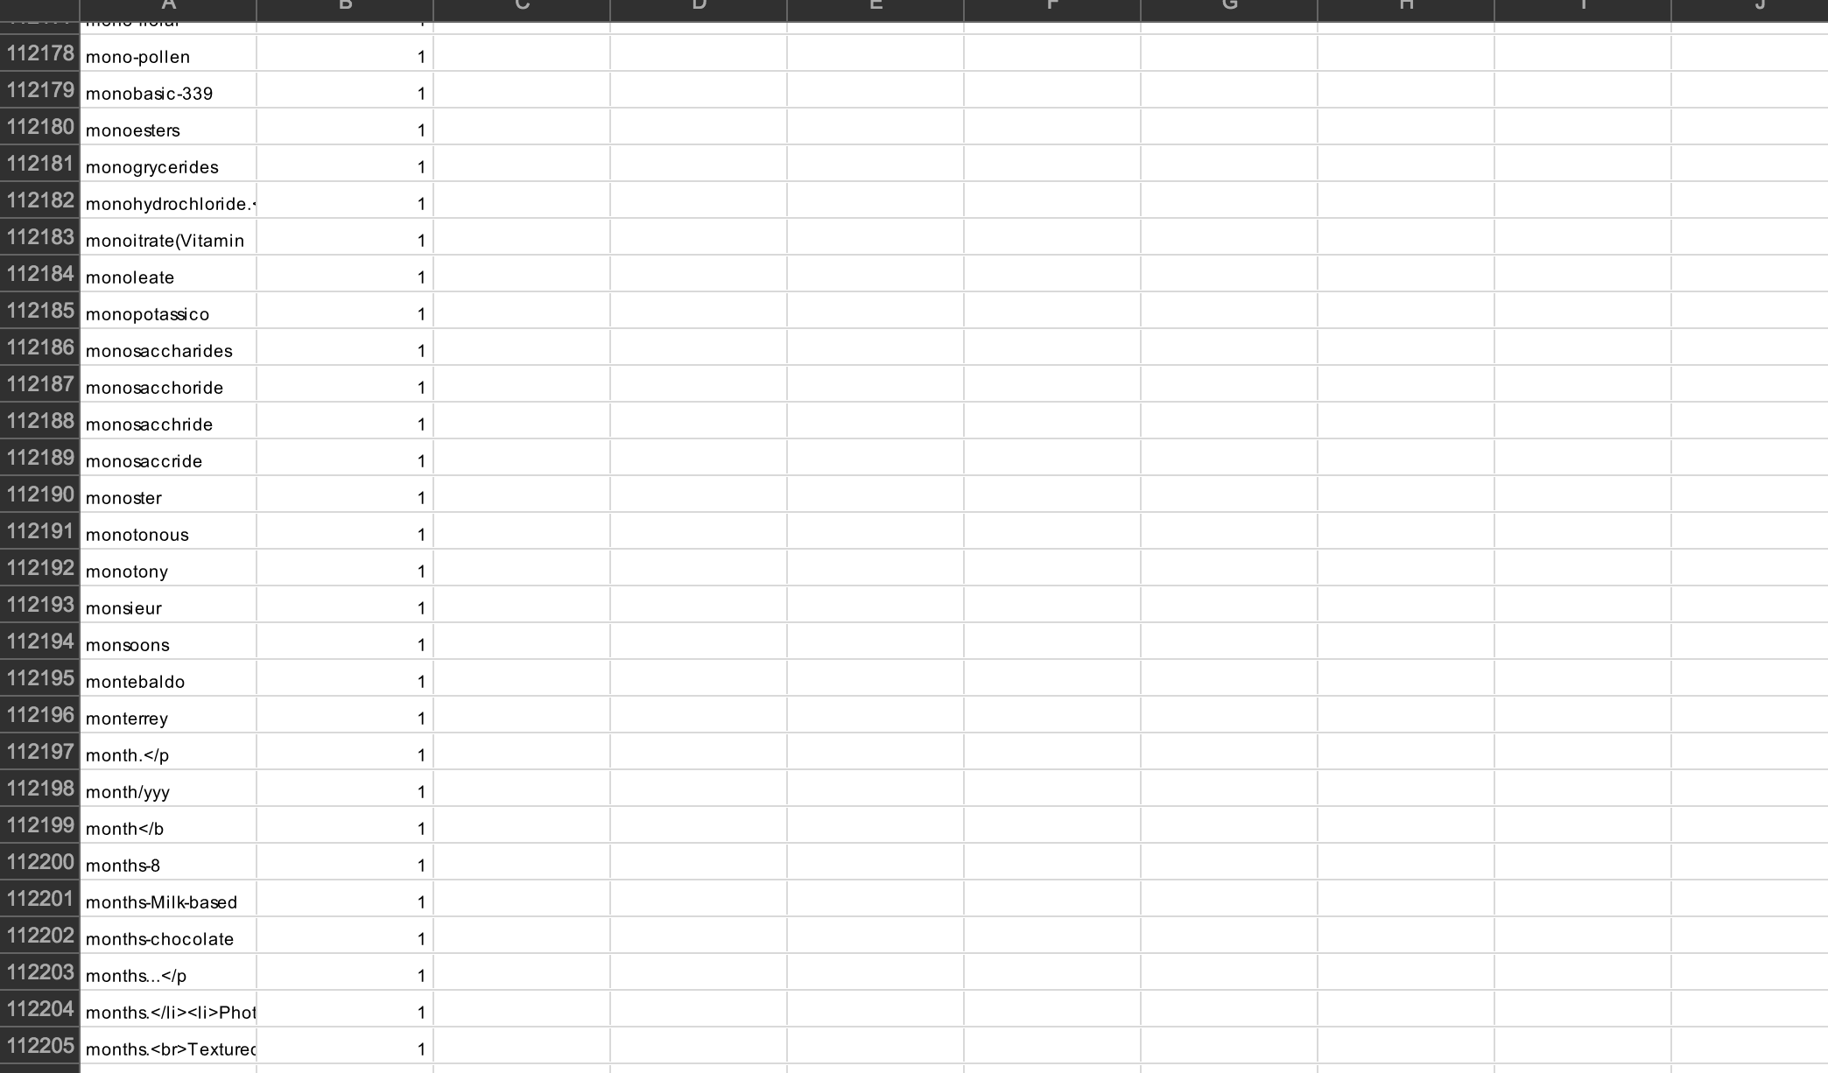
Food word Count
Notes:
Shashank

Slide 19
Example
Tea | Sweet | Chocolate | Array_count_vector
0 | 1 | 5 | [0,1,5]
0 | 0 | 0 | [0,0,0]
1 | 3 | 4 | [1,3,4]
. | . | . | ….
 |  | Average | [.......]
Notes:
Shashank

Slide 20
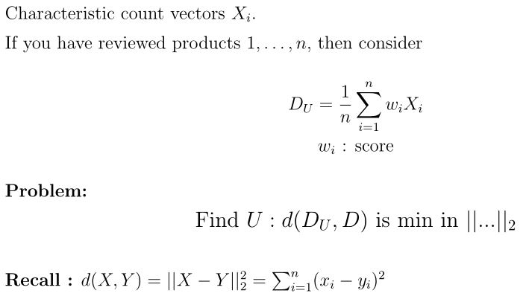
Mathematical Formula
Notes:
Ghodrat

Slide 21
Implementation
CREATE OR REPLACE FUNCTION distance(real[], real[]) RETURNS real AS $$ DECLARE a1 ALIAS FOR $1; a2 ALIAS FOR $2; s real; BEGIN s := 0; FOR i IN array_lower(a1, 1)..array_upper(a1, 1) LOOP s := s + ((a1[i] - a2[i]) ^ 2); END LOOP; RETURN |/ s; END; $$ LANGUAGE plpgsql;

Slide 22
Implementation
WITH dt as ( SELECT prc.* FROM big_prc prc WHERE prc.asin is not a seen item AND prc.score_avg > 3 LIMIT 15000 ) SELECT asin, …, MIN(distance(user's count vector, customer_count_vector)) AS count_dist FROM dt GROUP BY asin, … ORDER BY count_dist asc, score_avg desc

Slide 23
Successes
Programmatically generate giant SQL statement that can insert 10,000 reviews at a time, while concurrently scanning and parsing other data to be inserted.
Get to understand how R is useful in recommendation system.
Find out way to use Amazon HTTP API using Javascript.
Scrape data from amazon using http parser in JS.
Determine method to extract numeric values using word counts
Create numeric representation of customers using extracted word counts
Use collaborative filtering to match users to customers in the database.

Slide 24
Challenges
Setting up tools for mac and windows
Using sqitch and switching from a local database to a centralized one.
Getting numeric values from data for data analysis
Learning New Tools.
Optimizing queries / denormalizing data for efficient searching and fetching from DB.
Notes:
Tejal

Slide 25
Demonstration

Slide 26

Thank You

