Slide 1


Compiler Design and System Software
Dayananda Sagar University
School of Engineering
Devarakaggalahalli, Harohalli Kanakapura Road, Ramanagara, Karnataka 562112
Department of Computer Science & Engineering
(Artificial Intelligence & Machine Learning)
SEMESTER – VI
Course Code: 22AM3603
Chakravyuh: Hybrid Key Exchange and Secure Communication
Under the guidance of
Prof Pavithra A
Team Member
Agasthya R Kumar - ENG22AM0001
Akhila Rao D - ENG22AM0002
Gaana Shree S - ENG22AM0014
Nitya P Shetty - ENG22AM0037

Slide 2
Contents
Abstract
Objective
Literature Survey
Design of Proposed System
Experimental Results
Performance Evaluation
Conclusion
References

Slide 3
Abstract
Increasing Threats to Data Security: Rapid advancements in technology are rendering current data protection systems less effective, making digital privacy more vulnerable.
Inadequacy of Existing Protocols: Popular applications like WhatsApp and Telegram use advanced protocols, yet these are becoming insufficient to fully ensure user privacy.
Faster Cryptographic Breaches: Improved hardware capabilities are significantly reducing the time required to break encryption, heightening the risk to secured data.
Need for Multi-layered Encryption: A robust solution involves implementing a cascading encryption protocol using multiple algorithms (AES, RSA, Blowfish) to strengthen data protection.
Enhanced Key Security: This approach also includes securing the encryption keys with layered cryptographic methods, addressing the limitations of current single-layer security systems.

Slide 4
Objective
The main objective of this project is to build a Hybrid Crypto-system that secures data on multiple layers and also ensures security of keys.
The Hybrid cryptosystem also securely stores the keys so that they don’t lead to any vulnerabilities.
To create a crypto-system that provides excellent security without compromising on performance and speed.
To overcome the performance-security tradeoffs of cryptographic algorithms when used separately.

Slide 5
Literature Survey
TITLE AND AUTHOR | SUMMARY
Application of AES and RSA Hybrid Algorithm in Email - Ye Liu, Wei Gong, Wenqing Fan - ICIS, 2018 | Combining asymmetric encryption with symmetric encryption algorithms makes the system significantly secured and faster. The experimental system also shows that Hybrid Crypto-systems are a great alternative to traditional crypto-systems that rely on higher keys sizes and rounds.
Performance Comparison Between AES256- Blowfish and Blowfish-AES256 Combinations - Kartika Imam Santoso - ICITACEE, 2018 | Result shows that a composite cryptosystem on AES256-Blowfish required longer decryption time compared to the composite cryptosystem in reverse order (Blowfish-AES256) therefore, is considered the most secure algorithm compare to Blowfish-AES256, Blowfish or AES256
Enhancement the Security of Cloud Computing using Hybrid Cryptography Algorithms - Ali Abdulridha Taha, Dr. Diaa Salama AbdElminaam, Prof. Khalid M Hosny - IJACT, 2017 | The proposed system demonstrates that the use of hybrid algorithms increases the level of encryption of encrypted mobile data and also reduces the time required for encryption and decryption.

Slide 6
Literature Survey
TITLE AND AUTHOR | SUMMARY
An Efficient Algorithm for Confidentiality, Integrity and Authentication Using Hybrid Cryptography and Steganography - Chitra Biswas, Udayan Das Gupta, Md. Mokammel Haque - ICECCE, 2019 | A combination of AES-ECC and SHA-256 is implemented and targeted towards securing medical sector data. It proves efficient in securing text and image based data.
Secure File Storage using Hybrid Cryptography - S.Gokulraj , P.Ananthi , R.Baby , E.Janani - SSRN, 2021 | A robust and highly secure cryptosystem is implemented using a combination of AES, DES, RC2 to secure data and LSB Steganography is used to ensure Key Security.
A Research Paper on New Hybrid Cryptography Algorithm - Prof. Swapnil Chaudhari, Mangesh Pahade, Sahil Bhat, Chetan Jadhav, Tejaswini Sawant - IJRDT, 2019 | The paper studies the implementation of a hybrid Crypto-system of symmetric encryption and asymmetric algorithms. It explores the flows in both standalone systems and uses a hybrid approach to enhance security and address the drawbacks of the standalone systems.

Slide 7
Design of Proposed System
Three-Layer Hybrid Encryption Process: The plaintext is first encrypted using the Blowfish algorithm with a secret key. The resulting ciphertext is then encrypted using RSA with the recipient’s public key. Finally, the RSA-encrypted data is encrypted again using the AES algorithm, producing the final ciphertext.
Key Handling and Chaining: After each encryption process, the keys used (Blowfish, RSA, AES) are stored in a key list, maintaining a record of all cryptographic keys applied in the encryption cycle.
AES-Based Key Encryption:This key list is encrypted using AES, where the AES key is derived from a password hash provided by the user, ensuring only authorized users can decrypt and retrieve the keys.
Secure Key Storage via Steganography:The AES-encrypted key list is then embedded into an image using LSB (Least Significant Bit) steganography, hiding the key data within an image file to provide an additional layer of security and obfuscation.

Slide 8
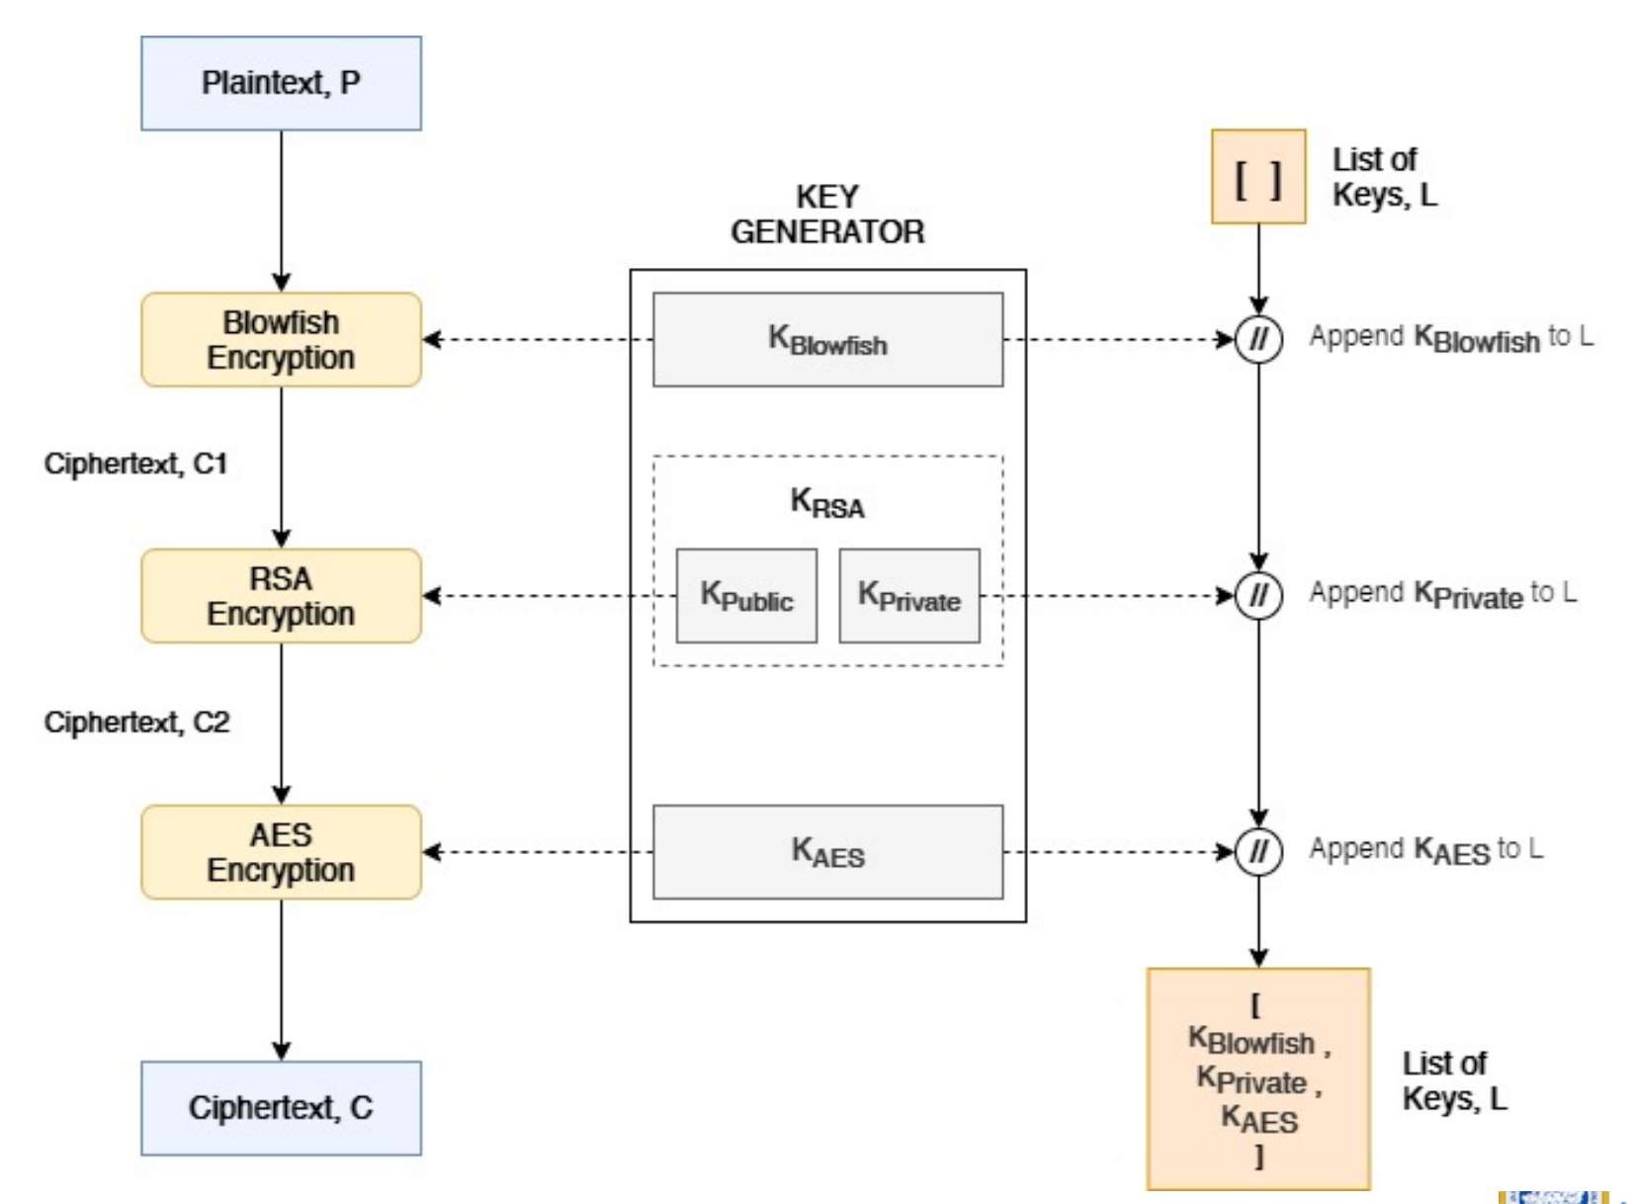
Design of Proposed System
Figure: Data Encryption using Cascading Cryptographic Systems

Slide 9
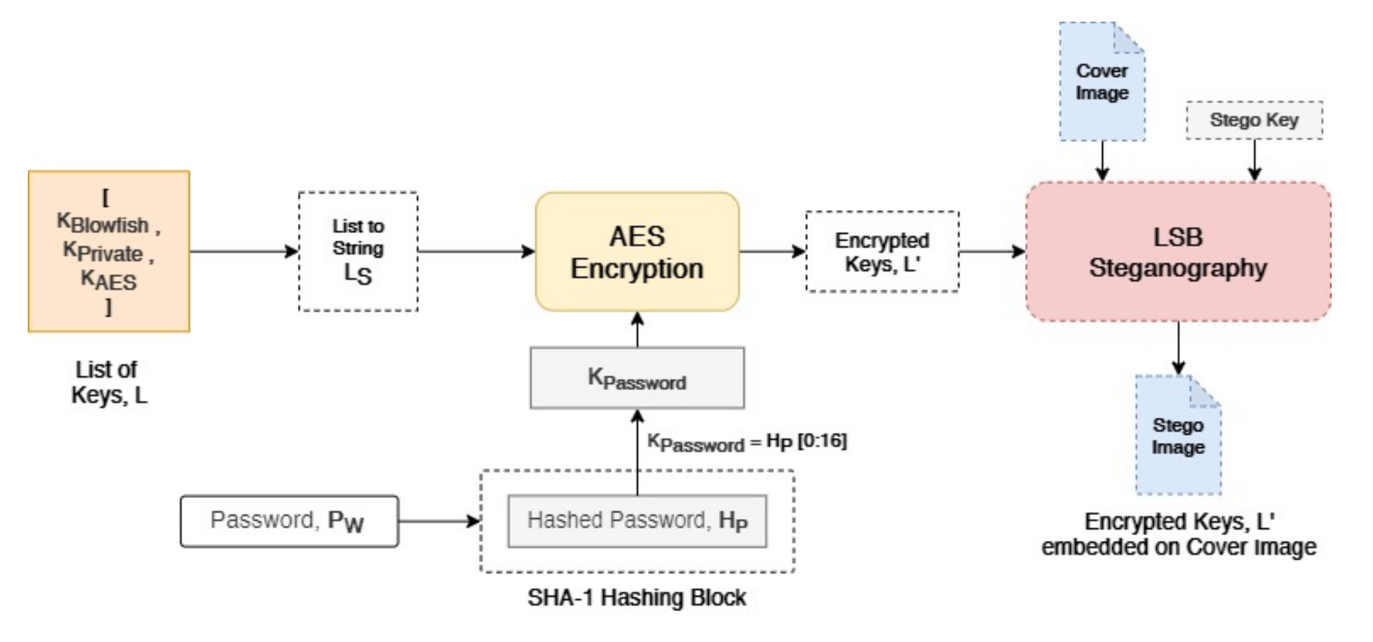
Design of Proposed System
Figure: Secured Key Storage

Slide 10
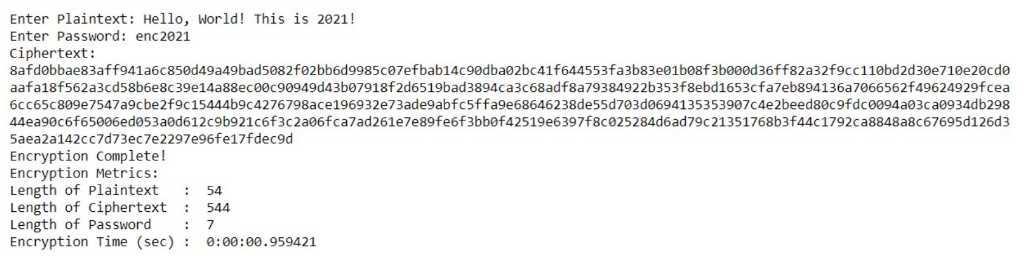
Experimental Results
The Proposed Hybrid Crypto-system was implemented using Python and tested
on a Windows PC with an Intel i3 processor and 4 GB of RAM. For demonstrating
the Encryption of data, the following plaintext was encrypted. To
encrypt the keys, ‘enc2021’ was used as the password.

Slide 11
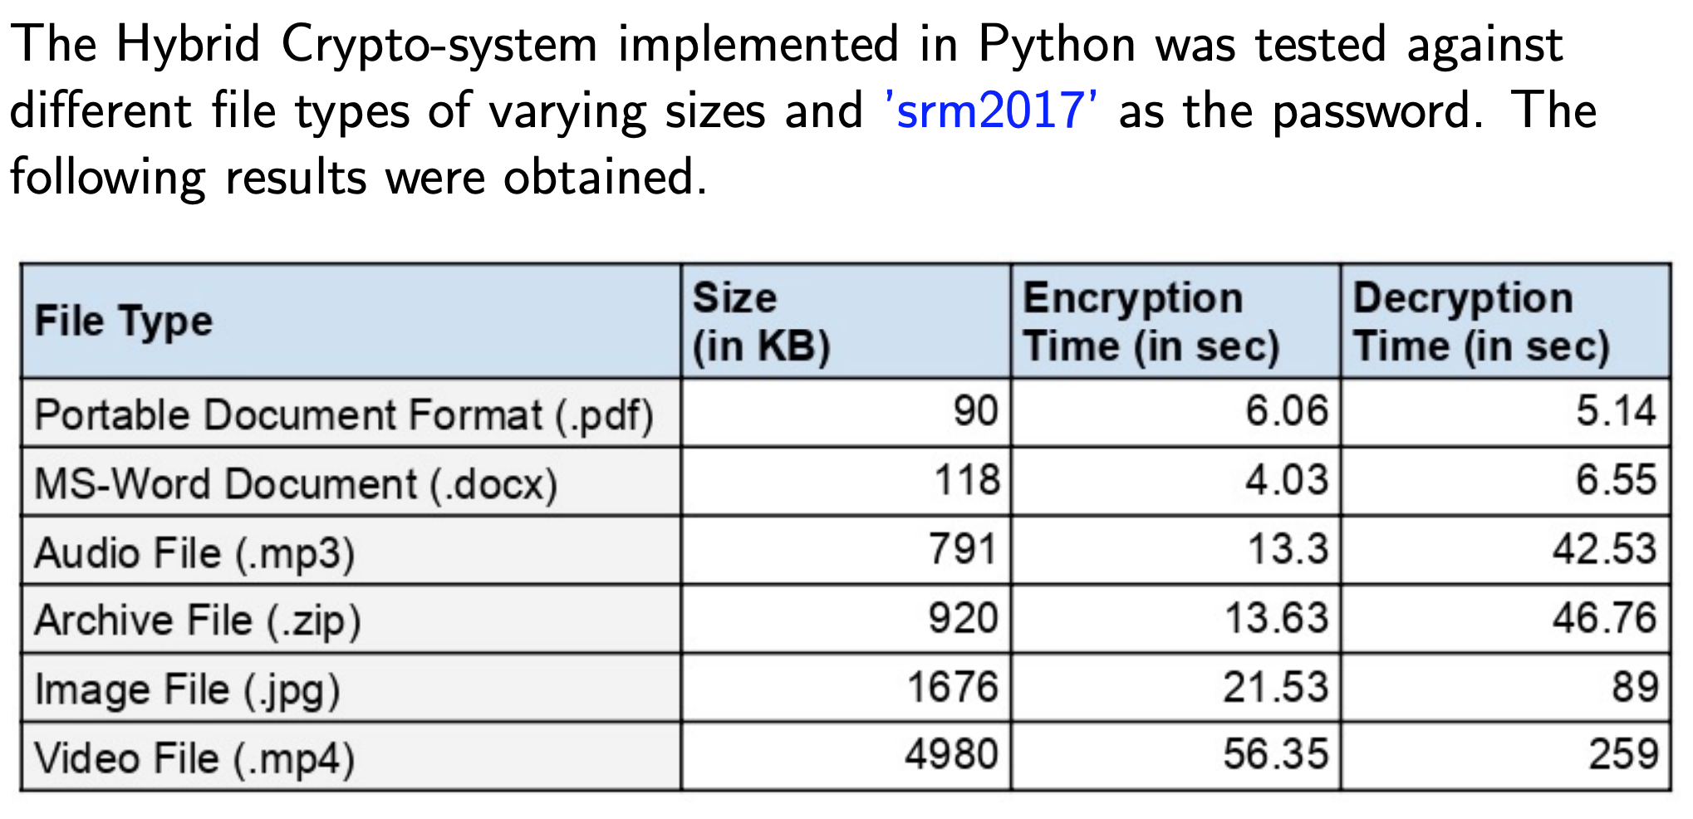
Performance Evaluation

Slide 12
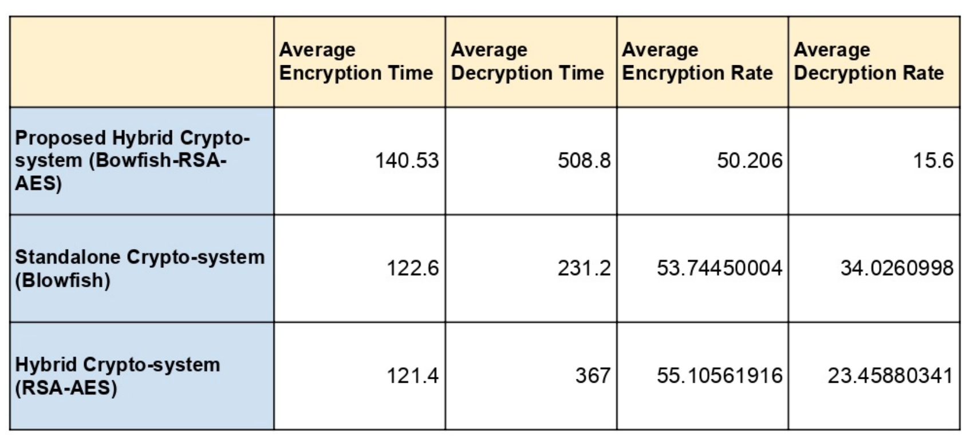
Conclusion
The results of the Comparison test shows that the Proposed System has a significantly higher Decryption Time, compared to the other two, indicating that the Proposed System is hard to break and will take higher computing power and time to break than the other two, making is highly secured.

Slide 13
References
M. Z. Abdullah and Z. J. Khaleefah. Design and implement of a hybrid cryptography textual system. In 2017 International Conference on Engineering and Technology (ICET), pages 1–6, 2017.
C. Biswas, U. D. Gupta, and M. M. Haque. An efficient algorithm for confidentiality, integrity and authentication using hybrid cryptography and steganography. In 2019 International Conference on Electrical, Computer and Communication Engineering (ECCE), pages 1–5, 2019.
S. B. C. J. T. S. Chaudhari Swapnil, Mangesh Pahade. A research paper on new hybrid cryptography algorithm. 05 2018.
M. M. Hoobi. Efficient Hybrid Cryptography Algorithm. Journal of Southwest Jiaotong University, 2020.
A. Jain and V. Kapoor. Novel hybrid cryptography for confidentiality, integrity, authentication. International Journal of Computer Applications, 171:35–40, 08 2017.
Y. Liu, W. Gong, and W. Fan. Application of aes and rsa hybrid algorithm in e-mail. In 2018 IEEE/ACIS 17th International Conference on Computer and Information Science (ICIS), pages 701–703, 2018.
M. A. Muin, M. A. Muin, A. Setyanto, Sudarmawan, and K. I. Santoso. Performance comparison between aes256-blowfish and blowfish-aes256 combinations. In 2018 5th International Conference on Information Technology, Computer, and Electrical Engineering (ICITACEE), pages 137–141, 2018.
D. R. B. Pooja Patil. Performance Evaluation of Hybrid Cryptography Algorithm for Secure Sharing of Text and Images. International Research Journal of Engineering and Technology (IRJET), 07(09), 2020.

