Slide 1
Assessing Cloud Cost Effectiveness: A Comparative Analysis of IaaS and PaaS in Cloud Computing
GARABET ASLO
LUDWIG HAHN
Oponents: Nahom kifle Solomon (TIDAB) & Maximilian Petersson (TIDAB)
Examiner: Ki Won Sung
Supervisor: Voravit Tanyingyong

Slide 2
Table of contents
01
02
03
Introduction
Background
Method
Purpose, problem and goals.
Definition, background and reviews.
Process, paradigm and data collection/ analysis.
04
05
06
Implementation
Results
Conclusion
Selection of CSPs, code, metrics.
Present finding and data analysis.
Overview of findings and future work.

Slide 3
Introduction
01
Rise of cloud services revolutionizing IT infrastructure (contra on-premise servers)
30% growth in enterprise spending on cloud infrastructure services in 2022 ($225 billion)
Cloud Service Models: IaaS and PaaS
Northab's interest in cloud services for recruiting system deployment
Advantages and trade-offs of IaaS and PaaS
OBJECTIVES
1- Compare IaaS and PaaS.
2- Focus on cost-efficiency and deployment complexities.
3- Help organizations make informed decisions.
PROBLEM STATEMENT
1- Complexity of evaluating cloud services.
2- Critical decision between IaaS and PaaS.
3- Need for comparative insights in the field.
GOALS
1- Conduct comparative analysis of cost factors.
2- Evaluate deployment of the recruiting system.
3- Provide insights and recommendations.

Slide 4

Background
02
Pre-Cloud Computing Era
Reliance on physical data centers
Maintenance of own computer systems and infrastructure
High upfront costs and ongoing maintenance
Limited flexibility and higher physical security risks

Slide 5
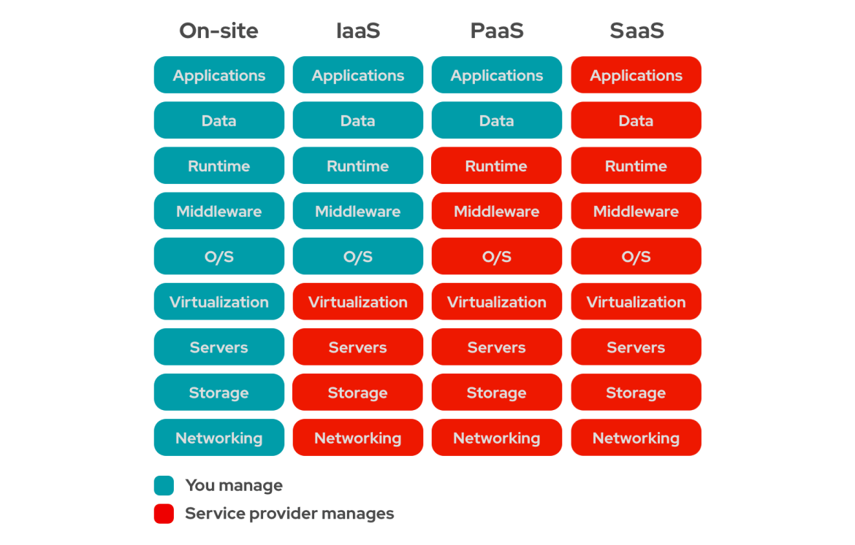
Background - Introduction to Cloud Computing
02
1
Definition: NIST defines cloud computing as distributed technology platforms leveraging advanced innovations to provide highly resilient and scalable environments, remotely accessible by organizations for various purposes. By facilitating resource access via web-based tools and applications over the internet.
2
Characteristics: NIST characterizes cloud computing as agile, scalabile, cost-efficient, and accessible.
3
Cloud Computing Service Models:
Infrastructure as a Service (IaaS)
Platform as a Service (PaaS)
Software as a Service (SaaS)

Slide 6
Background - Pricing Structures
02
Common models: Pay-as-you-go, Subscription and Reserved Instance
PAY-AS-YOU-GO
Based on real-time consumption of resources.
Flexibility and cost control.
Risk of overpayment and resource reservation inefficiencies.
RESERVED INSTANCE
Commitment to a set amount of compute capacity for 1-3 years.
Significant cost savings for long-term commitments.
Limited flexibility and risk of resource waste.
SUBSCRIPTION
Fixed monthly or annual fee for access to cloud resources.
Suitable for predictable workloads.
Risk of overpaying or underpaying based on actual usage.

Slide 7
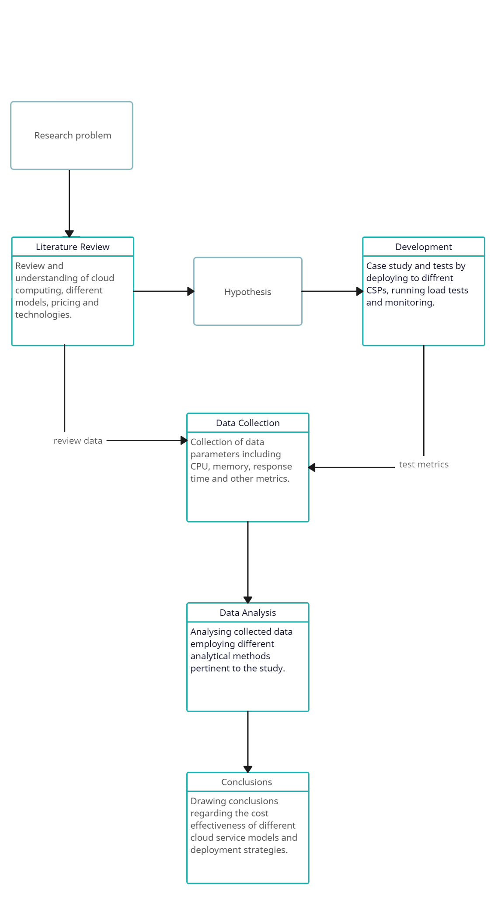
Method
03
The activity diagram illustrates the research and development process involved in investigating the cost effectiveness of cloud service models and deployment strategies. It illustrates the steps taken from academic interest to addressing the original problem.
1. Review and understanding of cloud models: In this step, a comprehensive review and understanding of different cloud models is conducted. This involves examining existing literature, industry reports, and expert opinions to establish foundational knowledge.
2. Case Study and Tests: A case study approach focusing on Northab’s recruiting system is undertaken. This involves deploying the system to different cloud service providers to test various cloud services and collect relevant data.
3. Data Collection: Practical insights into cost effectiveness and performance are gained through observations and data collection.
4. Data Analysis: The data collected from the case study and tests is analyzed. Factors such as initial setup costs, operational expenses, scalability, and deployment complexities are examined to evaluate the cost effectiveness of IaaS and PaaS models.
5. Integrating Insights: This step involves integrating insights obtained from the review of cloud models with the data collected and analysed during the case study of Northab’s Recruiting System. By combining theoretical knowledge with practical findings, a comprehensive understanding of cost effectiveness is achieved.
6. Conclusions and Recommendations: Based on the integrated insights, conclusions are drawn regarding the cost effectiveness of different cloud service models and deployment strategies. Recommendations for optimal cloud utilization will also be provided.

Slide 8

Method - Data Collection
03
Locust - Load testing tool to simulates users
Response Time - Duration between sending a request to the web server and receiving a response
Requests Per Second - Number of requests that the server handles per second
Error Rate - Percentage of requests that result in errors or failures
CSP Monitoring Tools - Monitoring tools provided by each CSP
CPU Utilization - Percentage of allocated compute resources being used
Memory Used - Percentage of total allocated memory currently being used

Slide 9
Method - Data Collection Process
03
Set Up and Configurations - Each cloud
provider’s monitoring tool was configured to track the specified metrics.
Execution of Load Tests - Generated traffic that mirrored real user behavior.
Data Aggregation - Data from Locust and the monitoring tools were aggregated to understand the metrics.
Data Analysis - The collected data was then analyzed to draw insights into each cloud provider’s performance and reliability.

Slide 10
Method - Execution of Load Tests
03
Incremental Load Testing - Start from a low rate of RPS to higher levels while monitoring the metrics
Specifications
Database Specs: 2 vCPU & 2 GiB of memory
VM Specs: start with 1 vCPU & 1 GiB of memory
Termination Of Test Criteria
Average response > 1000 ms
CPU utilization > 80%
Memory Used < 10%
Post Test Adjustments
Clear the database
Terminate process and monitor until metrics stabilize
Locust Tasks Structure
User behaviors are defined to interact with different endpoints. Creating users, logging in etc
Store the data from the user behaviour to use for other endpoints. JWT token, emails etc.
Data is loaded and utilized within each task to ensure variability and realism in the simulation.
Responses are handled to log successes and identify failures

Slide 11




Method - Selection of CSPs
03
IaaS providers
Amazon Web Services (AWS)
Microsoft Azure
PaaS providers
Google Cloud Platform
Heroku

Slide 12
Implementation - Script Overview
04
Locust Tasks Structure
User behaviors are defined to interact with different endpoints. Creating users, logging in etc
Store the data from the user behaviour to use for other endpoints. JWT token, emails etc.
Data is loaded and utilized within each task to ensure variability and realism in the simulation.
Responses are handled to log successes and identify failures

Slide 13
Implementation - IaaS
04
Instance Setup
Ubuntu Server 24.04 LTS
Instance Type:
AWS t2.micro
Azure B1s
Configuring SSH Access
Encrypted connections to the VM
SSH key pair
Public key is used to encrypt data
Private key is used to decrypt data
Network Security
Inbound Traffic
HTTP
HTTPs
SSH access
Environment Setup
Installing software
Node.js
NPM

Slide 14
Implementation - PaaS
04
Heroku Deployment
Utilizes Heroku CLI integrated with Git
Setting up a local repo
Setting .env variables
package.json is set up with necessary start scripts
Push the changes
Heroku’s build system automatically prepares and launches the app
GCP Deployment
Create a dockerfile
Base Image (‘FROM node:latest’)
Env setup (‘WORKDIR /usr/src/app’)
Source code: (‘COPY . .’)
etc
app.yaml
Specify custom runtime, flex env…
Specify CPU, memory, disk size, instances
Utilizes Google Cloud SDK
GCP app deploy
Automatically prepares and launches the app

Slide 15
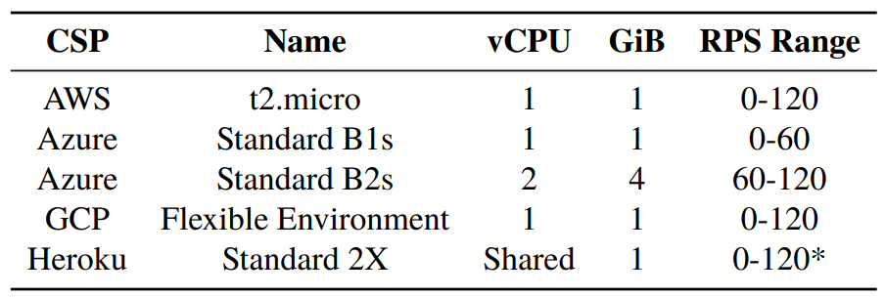
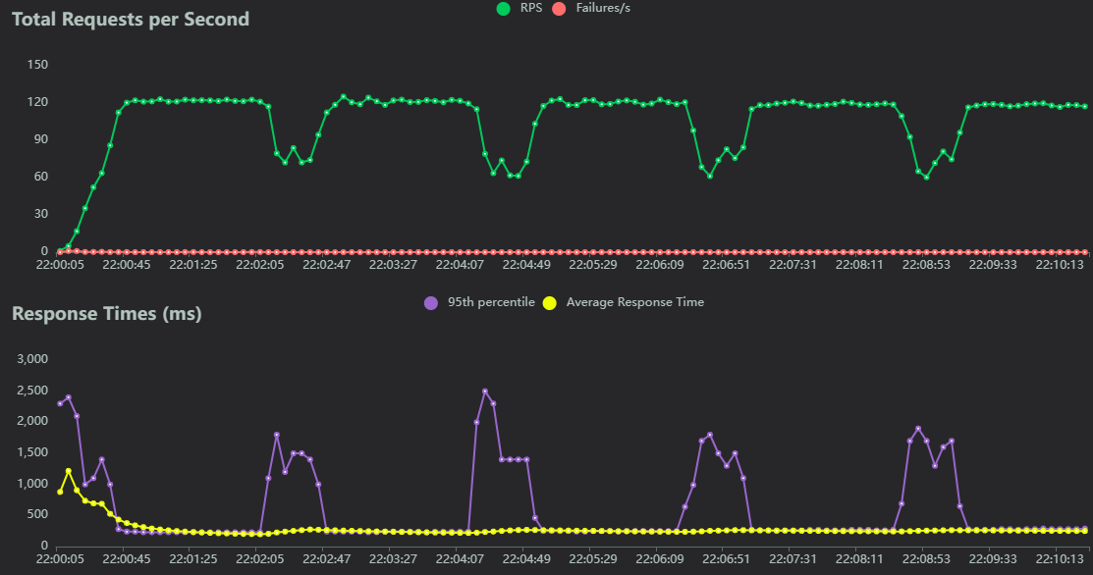
Results - Performance
05
Noteworthy
t2.micro & Azure B2s could probably handle more than 120 RPS
* Heroku could handle 120 RPS but had performance issues

Slide 16
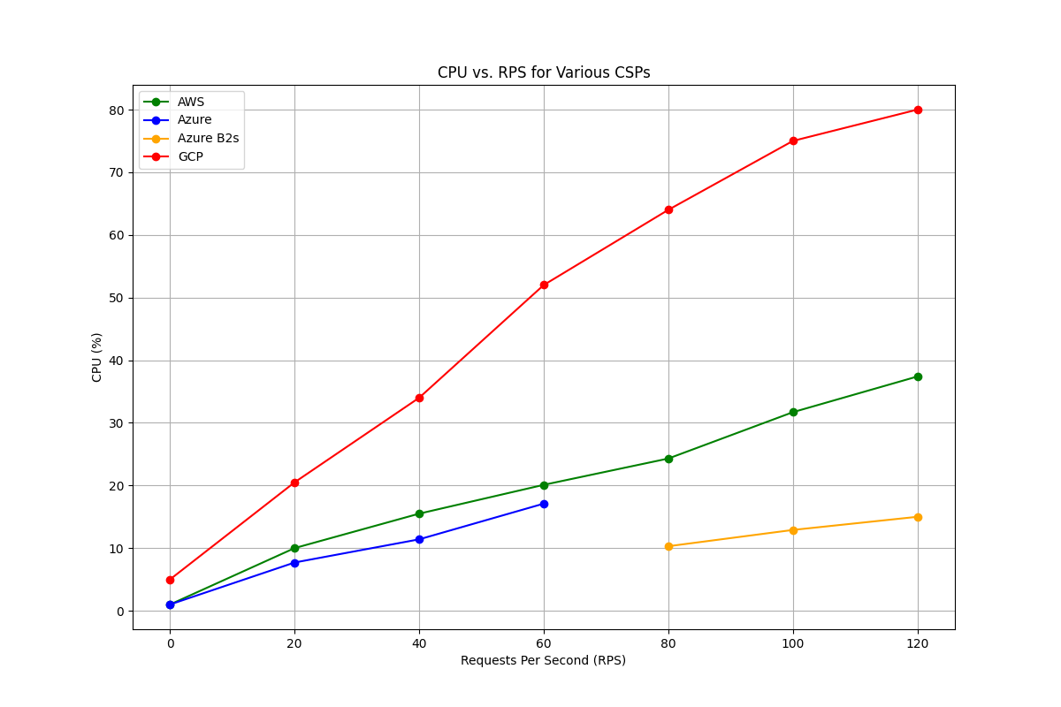
Results - CPU Utilization(%)
05

Slide 17
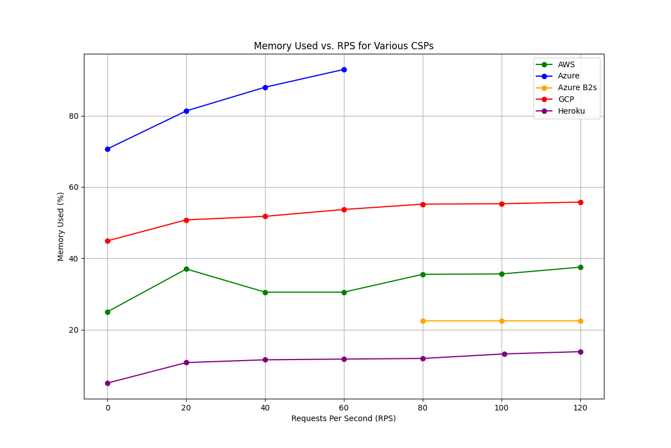
Results - Memory Used(%)
05

Slide 18
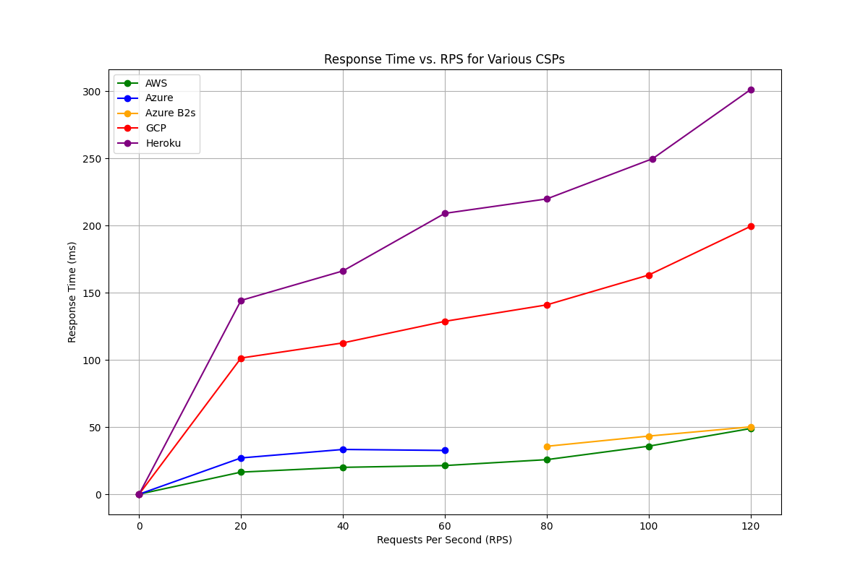
Results - Response Time (ms)
05

Slide 19
Results - Pricing Structures and Models
05
AWS
Pay per instance-hour or per second.
Supports various operating systems and instance types.
Eliminates upfront hardware planning and maintenance costs.
Discounts for reserved instances.
Azure
Influenced by service type, capacity, location, management level.
Free tier for 12 months, permanent free usage for specific services.
Pay-as-you-go based on actual usage.
Discounts for reserved instances.
Review outcomes:
Comprehensive exploration of the study’s outcomes.
In-depth review of different cloud service providers (CSPs).
Detailed account of research findings.
Analysis of documentation, price lists, deployment data
Heroku
Flexible, pay-as-you-go with various pricing tiers.
Operates using "dynos" (Linux containers).
Only pay for the resources consumed.
Fine-grained control over spending without long-term commitments.
GCP
Free tier with limited access to common services.
Pay-as-you-go based on resource consumption.
Transparent and predictable pricing.
Fixed cost per hour for different instance classes.

Slide 20
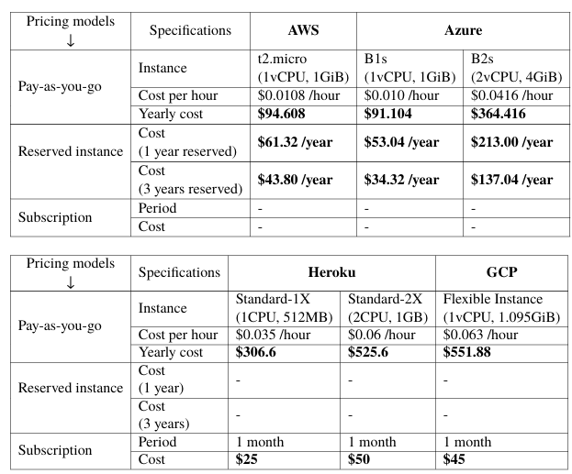
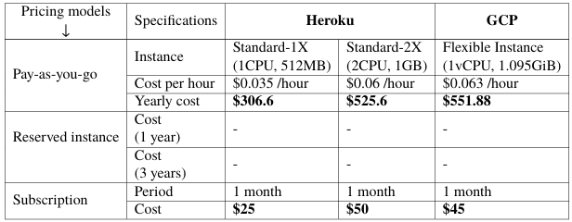
Results - Pricing
05
CSP Cost Comparison
AWS: Cost-efficient with stable yearly costs.
Azure: Higher costs for higher-tier instances.
Heroku and GCP: Higher costs in PaaS, subscription options available.

Slide 21
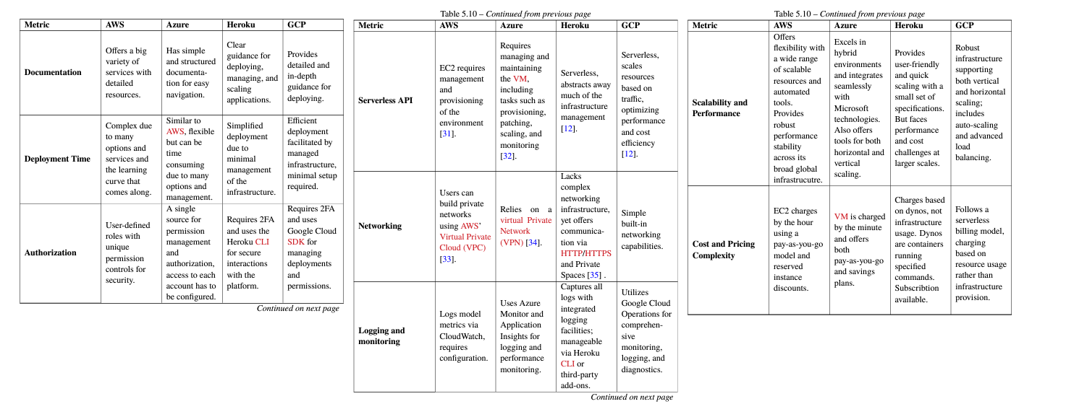
Results - Deployment complexities
05

Slide 22
Results - Deployment complexities
05
Deployment Complexities in IaaS
Managing virtualized infrastructure components
Specifical control and customization
Responsibilities: security, compliance, performance optimization
Deployment Complexities in PaaS
Abstracted infrastructure for simplified deployment
Platform-specific tools for application management
Limited flexibility and potential provider lock-in
Metric | AWS | Azure | Heroku | GCP
Documentation | 7 | 8 | 9 | 7
Deployment time | 6 | 6 | 9 | 7
Authorization | 5 | 6 | 8 | 8
Serverless API | - | - | 10 | 10
Networking | 7 | 7 | 7 | 7
Logging | 6 | 8 | 9 | 9
Scalability & performance | 9 | 7 | 6 | 7
Cost and pricing complexity | 7 | 7 | 9 | 7
Score | 47 | 49 | 67 | 62

Slide 23
Results - Assessing reliability and validity of the data collected
05
Validity of Data Collection
Support from Data Sources:
Data collected via Locust for performance metrics (response time, resource utilization, cost, scalability)
Metrics crucial for evaluating cloud performance.
Pricing Data:
Sourced from official CSP websites, ensuring accuracy
Consistency Over Time:
Tests conducted within a consistent time frame
Minimizes impacts of updates and technology changes
Reliability of Data Collection
Standardized Testing Approach:
Simulated user behavior on web apps
Consistent intervals and loads for testing
Consistency Across CSPs:
Identical testing devices and protocols used for all CSPs
Reduces influence of random fluctuations and discrepancies
Acknowledgment of Limitations:
Range, data availability, and methodology constraints.
Variability due to network conditions, device loads, CSP updates.

Slide 24
Conclusion & Future Work
06
IaaS vs. PaaS
IaaS: cost-effective with proper administration, offers flexibility and control.
PaaS: eliminates server management, focuses on application development.
Business considerations: expertise, time, resource availability
Look over the team.
Does the person with the skillset have time?
NO SOLUTION: Trade-offs between complexity and cost-efficiency.

Slide 25
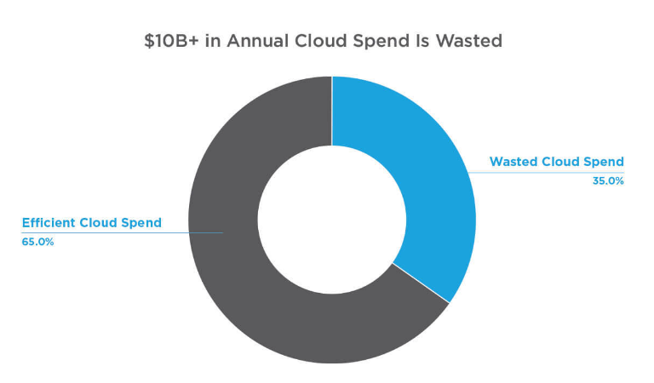
Conclusion & Future Work
06
Understanding Cloud Complexity
Cloud environments exceed initial simplicity promises
Complexity from diverse services and third-party solutions
Importance of managing complexity during architecture and design
Need for proactive and reactive measures to optimize cloud solutions
Cloud Budget Management
Critical concern for financial stability in cloud computing
Flexera 2024 report: ~35% of cloud budgets wasted
Need for improved cost optimization strategies
Organizations prioritize cost optimization over environmental considerations

Slide 26
Conclusion & Future Work
06
Future Implications
Promising future for cloud computing in IT solutions.
Key trends: edge computing, real-time processing, AI and ML.
Hybrid and multi-cloud environments for optimized performance.
Serverless computing: focus on code, accelerate time-to-market.
Reflections
Economic implications: cost-effectiveness, strategic decisions.
Social implications: workforce dynamics, skill requirements.
Environmental implications: energy consumption, data center location.
Ethical implications: data security and privacy responsibilities.

Slide 27
Conclusion & Future Work
06
Future Work
Areas not covered: yearly unavailability, detailed cost models, provider diversity
Geographical impact, network costs, and scaling strategies to be explored
Comparative cost analysis over time
Cost-benefit analysis of IaaS vs. PaaS
Security and environmental impact studies

