Slide 1
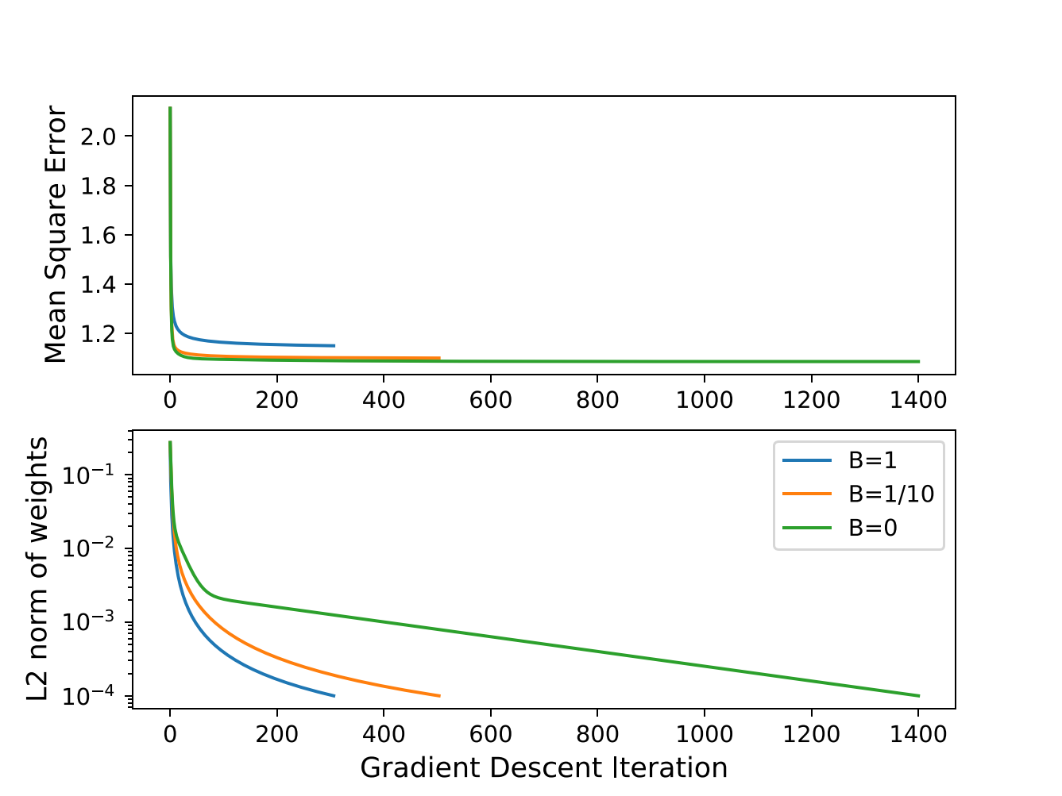
a
b
Figure 1: Evaluating the influence of the parameter β on the convergence of gradient descent with 3 features. a The MSE is represented across iterations of the gradient descent until the ε threshold is met, with different values of β. b The L2-norm of the weight differences between two iterations of the gradient descent is represented across iterations, until ε is reached.

Slide 2
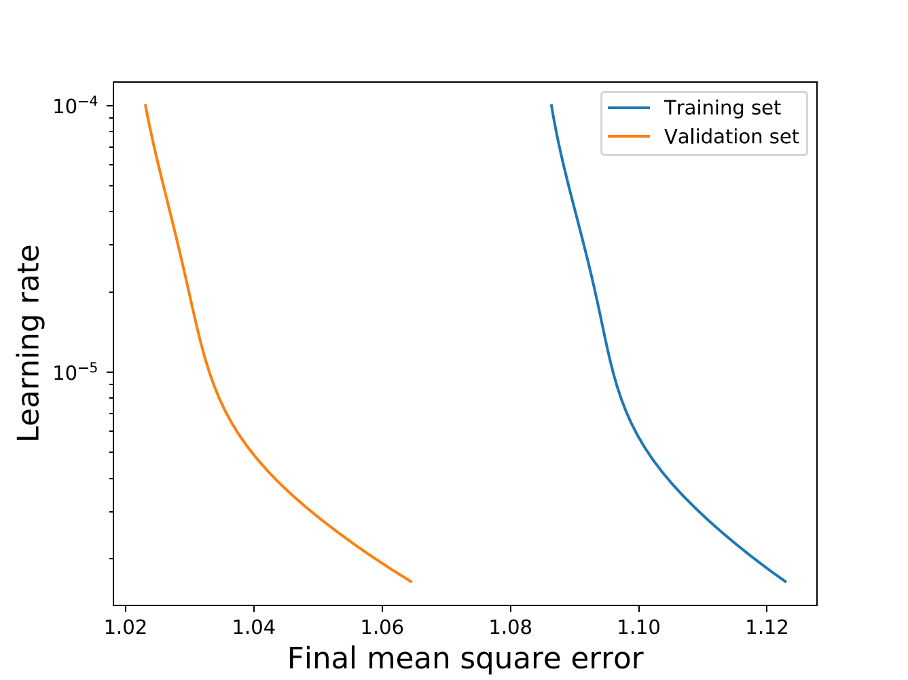
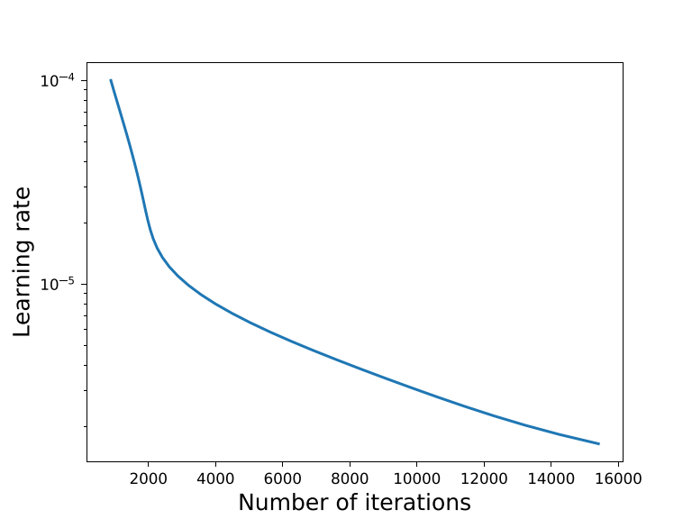
a
b
Figure 2: Performance of the gradient descent with 3 features as a function of the learning rate. a The final MSE reached both on the training and validation sets is represented across different values of η₀. In all cases, ε = η₀ to account for the reduction in steps sizes with decreased η₀. b The number of iterations required to meet ε as a function of η₀.

