Slide 1

COVID-19
PANDEMIC DASHBOARD
Global Impact Overview — Power BI Analytics Project
Prepared by: Gabriel
Tool: Microsoft Power BI
Data Source: Johns Hopkins University CSSE COVID-19 Time Series

Slide 2

Dataset Overview
Understanding the raw data before transformation
3 Source Files
Wide Format
Confirmed, Deaths, and Recovered global time-series CSVs from Johns Hopkins University (JHU CSSE)
Each file held one column per date (Jan 2020 onward), with country, province, latitude and longitude as identifiers
Country + Date Key
Data Limitation
Country/Region and Date together form the unique key used to merge all three datasets into one table
JHU stopped updating the Recovered dataset after August 2021 — a known, documented gap in the source data
2

Slide 3

Business Problem
Why this dashboard was needed
Raw COVID-19 case data is published as fragmented, cumulative daily files that are not analysis-ready. Stakeholders need a single, interactive view to understand how the pandemic spread, which countries were most affected, and how recovery progressed over time.
1
How many people were infected, and how many recovered or died globally?
2
Which countries were hit hardest by confirmed cases and deaths?
3
How fast did the virus spread, and did that pace change over time?
4
How did global recovery rates trend as the pandemic progressed?
3

Slide 4

KPIs Defined
Core metrics built with DAX measures in Power BI
Total Confirmed Cases
Total Deaths
Recovery Rate
Cumulative global infections as of the latest reporting date
Cumulative global fatalities as of the latest reporting date
Total Recovered ÷ Total Confirmed, expressed as a percentage
Active Cases
Daily Growth Rate
Daily New Cases
Confirmed − (Deaths + Recovered) — currently unresolved cases
Day-over-day percentage change in confirmed cases
Day-over-day difference in cumulative confirmed totals
4

Slide 5

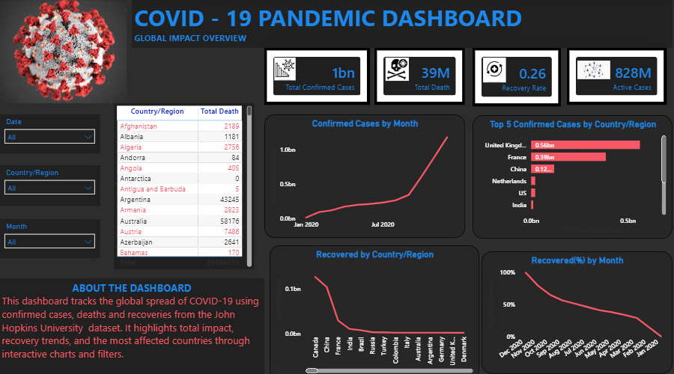
Dashboard Overview
Final Power BI report — Global Impact Overview page
5

Slide 6

Key Insights
What the data revealed
A small group of countries (United Kingdom, France, China) account for a disproportionate share of global confirmed cases, visible in the Top 5 Countries chart.
Confirmed cases climbed gradually through early 2020, then accelerated sharply from mid-2020 onward — visible as a steep upward bend in the monthly trend line.
Global recovery rate (%) declined steadily over time rather than improving — largely a reflection of countries discontinuing official recovery reporting after mid-2021, not a real-world reversal.
Death counts vary widely by country and do not scale directly with confirmed cases, suggesting differences in healthcare capacity and reporting standards.
6

Slide 7

Challenges Faced
Obstacles encountered and how they were resolved
Merging three separate datasets
The Confirmed, Deaths, and Recovered files arrived as three independent tables. Researching how to correctly merge them — using Country/Region and Date together as a composite key — was the biggest hurdle, but it was successfully resolved using Power Query's Merge Queries feature.
Writing correct DAX formulas
Building accurate KPI measures (Total Confirmed, Recovery Rate, Daily Growth Rate) required learning proper DAX syntax such as CALCULATE, FILTER, and time-intelligence functions. AI-assisted guidance was leveraged to learn and apply the correct formula structures.
Date formatting issues
Text-based dates required locale-aware conversion (English - United States) to parse correctly without misreading day/month order.
7

Slide 8

Recommendations & Conclusion
Next steps and project takeaways
Recommendations
Conclusion
Add a population-adjusted metric (cases per 100,000) for fairer country comparisons
This project transformed three raw, cumulative JHU time-series files into a single, interactive Power BI dashboard tracking global COVID-19 spread, mortality, and recovery. Through Power Query transformation, table merging, and custom DAX measures, the dashboard delivers clear, decision-ready KPIs and visuals — while transparently flagging known data limitations such as the 2021 gap in recovery reporting. The experience strengthened practical skills in data cleaning, relational merging, and DAX-driven analysis.
Refresh or supplement the Recovered dataset with a more current source for post-2021 analysis
Introduce a continent/region grouping table to simplify country-level slicing
Add forecasting (trend line or what-if) to project future case growth
8

