Slide 1

SUPERSTORE SALES DASHBOARD
Project Review — Data Pipeline, KPI Design & Dashboard Build
Prepared by: Gabriel
Tools: Power BI · Power Query · DAX

Slide 2
Dataset Overview
Sample Superstore retail transactions dataset
What it represents
9,994
Each row is one product line within a customer order — a US retail transaction log spanning four product categories, four regions, and four full years (2014–2017).
Rows
21
IDs: Order ID · Customer ID · Product ID
Columns
Dates: Order Date · Ship Date
Geography: Country · State · City · Region
0
Product hierarchy: Category · Sub-Category · Product
Missing Values
Measures: Sales · Quantity · Discount · Profit
2014–2017
Date Range

Slide 3




Business Problem
What decision-makers need answered
Leadership has raw transaction-level data but no consolidated view of performance. Without a dashboard, it's impossible to quickly see which regions, products, and customer segments are driving — or draining — profitability.
Which region generates the most profit, and is that consistent over time?
Which products or categories are underperforming or losing money?
Which customer segments and order patterns matter most?
What trends across 2014–2017 should guide strategy going forward?

Slide 4



KPIs Defined
Core metrics selected to track business health
Total Revenue
Total Profit
Total Orders
Total Customers
SUM(Sales)
SUM(Profit)
DISTINCTCOUNT(Order ID)
DISTINCTCOUNT(Customer ID)
Profit Margin
Sales Growth (YoY)
Profit by Region
Sales by Category
DIVIDE(Profit, Revenue)
vs. SAMEPERIODLASTYEAR
Top performing region
Best-selling category

Slide 5
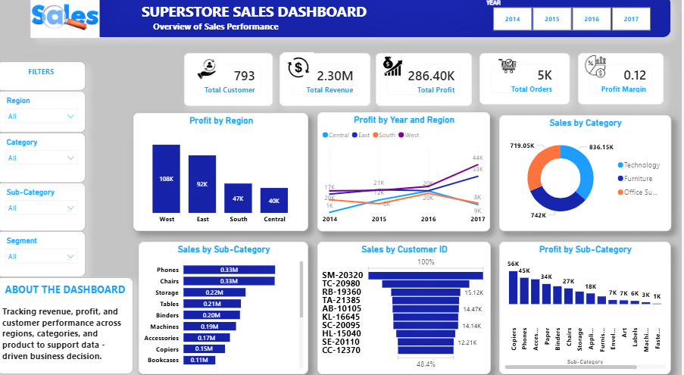
Dashboard Build
Final Power BI dashboard — KPIs, regional, category & customer views

Slide 6

Key Insights
What the dashboard reveals about the business
West leads profitability
West generated the highest profit (~$108K) and led 3 of 4 years; East briefly overtook it in 2015.
Tables & Bookcases lose money
Tables (-$17.7K) and Bookcases (-$3.5K) post negative profit despite strong sales — a discounting issue, not a demand issue.
Steady year-over-year growth
Sales grew every year from 2014 to 2017, with the sharpest jump in the final year.
Technology outperforms on margin
Technology and Furniture have similar revenue, but Technology converts profit far more efficiently.

Slide 7
Recommendations
Actions decision-makers can take from these insights
01
02
Review discount policy on Tables & Bookcases
Replicate West region's approach
Investigate whether high discount rates are eroding margin on these two sub-categories specifically.
Study what West does differently in pricing, mix, or customer focus, and test it in Central, the weakest region.
03
04
Lean further into Technology
Monitor growth momentum into next year
Technology converts revenue to profit most efficiently — prioritize it in promotions and inventory planning.
Sales grew every year through 2017; track whether this trend continues or plateaus.

Slide 8
Challenges Faced
Technical obstacles encountered during the build
Date format conversion
Order Date and Ship Date imported as text. Plain type conversion failed due to a locale mismatch (MM/DD/YYYY). Resolved using Power Query's "Change Type with Locale → English (United States)."
KPI card styling
A persistent white frame appeared around the KPI cards, traced to a duplicate stacked visual, and was removed.
Both issues were resolved within Power BI / Power Query — no external tooling required.

Slide 9

Conclusion
This project transformed raw Superstore transaction data into a functional, decision-ready Power BI dashboard. With clean KPIs, regional and product-level breakdowns, and year-over-year trend tracking, the dashboard gives decision-makers a clear view of where profit is being made — and where it is being lost.
West region and Technology category are the strongest profit drivers
Tables and Bookcases require pricing/discount review
Locale-aware date handling and clean data types were key technical lessons
Thank you

