Slide 1

PRODUCTION • OPERATIONS • FINANCIAL • ENVIRONMENTAL
NIGERIAN UPSTREAM
OIL & GAS PERFORMANCE ANALYSIS
Data Cleaning, Pivot Validation & Power BI Dashboard Design
Prepared by Gabriel

Slide 2

Project Overview
How can Nigerian upstream oil & gas operators improve production efficiency and revenue while minimizing operational downtime, production losses, operating costs, and gas flaring?
→
→
→
→
1
2
3
4
5
Raw Data
Power Query
Cleaning
Pivot Table
Validation
Power BI
Visualization
Insights &
Recommendations
Focus areas: Production performance, Operations & downtime, Financial performance, and Environmental performance (gas flaring).
Dataset: a Nigerian upstream oil & gas operations dataset covering ten operators, twelve oil fields, and monthly production, revenue, and downtime records, cleaned and analyzed end-to-end in Excel and Power BI.

Slide 3

Key Business Questions
01
Which operators and oil fields contribute the most to total crude oil production?
02
What operational issues are responsible for the highest downtime?
03
Which operators generate the highest estimated revenue?
04
Which operators produce the most gas?
PRODUCTION
OPERATIONS
FINANCIAL
ENVIRONMENTAL

Slide 4

Data Preparation in Excel
1
2
3
4
Raw_Data
Power Query Cleaning
Clean Dataset
Pivot Table
The original, messy operator-level dataset — inconsistent naming and unstructured fields, unfit for direct analysis.
Transformed and standardized the data — correcting field names, structuring columns, and preparing consistent numeric types for every operator and oil field.
A single reliable table — one row per record, ready for aggregation without distorting totals.
Cross-validated KPI totals for oil production, revenue, gas production, and downtime by operational status before building the dashboard.
Tools: Microsoft Excel with Power Query for cleaning and pivot-based validation, and Power BI for interactive visualization.

Slide 5





Dashboard: Key Performance Indicators
99.68M bbl
₦7.93bn
175.63M Mscf
7.62%
Total Oil Production
Total Revenue
Total Gas Production
Gas Flare Rate
13.39M Mscf of the gas produced was flared rather than captured — a 7.62% flare rate against total gas production.

Slide 6

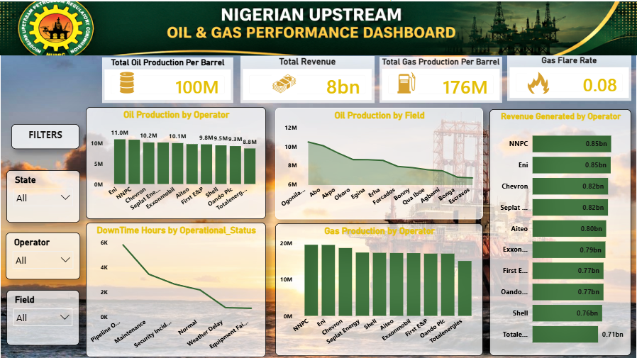
Dashboard: Visual Analysis

Slide 7

Key Findings by Focus Area
Production
Operations & Downtime
Eni leads oil production at 11.01M bbl, narrowly ahead of NNPC at 10.91M bbl.
Ogoniland is the top-producing field at 10.45M bbl; Escravos is lowest at 6.70M bbl.
Pipeline outages cause 5,771 hours of downtime — 37% of all downtime, more than any other cause.
Maintenance (3,420 hrs) and security incidents (2,632 hrs) are the next-largest contributors.
Financial Performance
Environmental Performance
NNPC generates the highest revenue at ₦852.8M, despite Eni producing more oil — pointing to a stronger realized revenue mix.
Totalenergies trails the group on both production and revenue.
Gas flare rate stands at 7.62% of total gas production — 13.39M of 175.63M Mscf flared rather than captured.
NNPC and Eni also lead gas production, making their flaring practices the highest-impact to address.

Slide 8


Recommendations
Prioritize pipeline integrity: outages drive 37% of downtime — targeted monitoring and preventive maintenance offers the single largest efficiency gain.
Study and replicate NNPC and Eni's operating practices, the top performers on production, revenue, and gas output, across lower-performing operators.
Invest in gas capture infrastructure to bring the 7.62% flare rate down, starting with NNPC and Eni given their production scale.
Reassess underperforming fields such as Escravos and Bonga for cost-effective recovery techniques or reallocated investment.
Track revenue-per-barrel by operator, not just volume — NNPC's revenue lead despite lower output than Eni signals monetization gaps worth closing.
Thank You

