Slide 1

NOVATRUST BANK
Performance Review — End-to-End Data Analysis
Excel Power Query • MySQL • Power BI
Data Analytics Portfolio Project

Slide 2



PROJECT METHODOLOGY
From Raw Data to Boardroom-Ready Insights
A three-stage pipeline turning a raw star-schema export into a decision-ready dashboard
→
→
STEP 1
STEP 2
STEP 3
Data Cleaning
Exploratory Analysis
Visualization
Excel — Power Query
MySQL Workbench
Power BI
Deduplicated, standardized, and typed every field across all four tables
Answered 5 business questions using JOINs across the star schema
Built an interactive dashboard with KPI cards and drill-down charts
20
650
10
2,940
Branches
Customers
Products
Clean Transactions

Slide 3




STEP 1 OF 3
Data Cleaning in Power Query
Microsoft Excel — preparing all four star-schema tables for analysis
Removed Duplicate Records
Eliminated 60 duplicate transactions and 15 duplicate customer records, verified against each table's primary key
Standardized Text Formatting
Corrected inconsistent casing and stray whitespace across branch, city, state, and product fields
Converted Date Fields
Transformed text-based dates into true Date types across all tables, enabling accurate trend analysis
Verified Referential Integrity
Confirmed every CustomerID, BranchID, and ProductID in the transaction table matches its source dimension table — zero orphaned records

Slide 4
STEP 2 OF 3
Exploratory Analysis in SQL
MySQL Workbench — joining across the star schema to answer 5 business questions
Business Questions Answered
SAMPLE QUERY — BRANCH REVENUE
Which branch generates the highest revenue?
Which customer segment contributes the most revenue?
Which product has the highest transaction volume?
Is monthly revenue growing, stable, or declining?
How do fee waivers affect profitability?
SELECT b.BranchName,
SUM(t.ActualFeeCollected_NGN
+ t.InterestIncome_NGN) AS Revenue
FROM Fact_Transactions t
JOIN Dim_Branch b
ON t.BranchID = b.BranchID
GROUP BY b.BranchName
ORDER BY Revenue DESC;

Slide 5
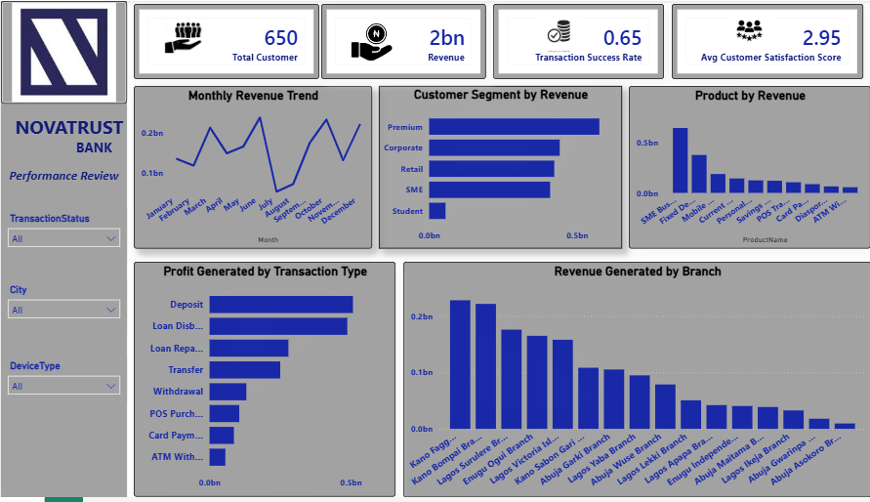




STEP 3 OF 3
The Interactive Dashboard
Microsoft Power BI — KPI monitoring with segment, product, and branch drill-down
650
Total Customers
NGN 2bn
Total Revenue
65%
Transaction Success Rate
2.95 / 5
Avg. Satisfaction Score

Slide 6

KEY RECOMMENDATIONS
Priorities for the Next Review Cycle
Prioritize the Premium Segment
Premium customers generate the highest revenue of any segment — expand relationship banking and premium product offers here first.
Grow Deposit Products
Deposits generate the highest profit by transaction type — a strong candidate for targeted promotional campaigns.
Close the Satisfaction Gap
Average satisfaction sits at 2.95/5 despite strong revenue — invest in customer care training and more personalized service.
Replicate Top-Branch Practices
Kano Fagge and Kano Bompai lead branch revenue — study what's working there and apply it to lower-performing branches.
Improve Transaction Reliability
Success rate stands at 65% — investigate the causes behind failed and pending transactions to protect customer trust.

