Slide 1


Data-Driven Models for Investment
RESEARCH ARC
01 / 04
Multi-Asset Trading
with Quantitative Agents
HYPOTHESIS
Macro + agents
Research Design and Out-of-Sample Evaluation
Addorisio Gianluca · Cafarelli Giovanni · Di Raimondo Gabriele
Final Project
PROFESSORS
Group 9
Antonio Simeone · Villy Edoardo De Luca
November 2026
Notes:
Opening (approximately 20-25 seconds)
We begin with a research hypothesis: can macro information, risk controls and quantitative agents improve the risk-return profile of a diversified investment portfolio? Our presentation follows the process from an initial Treasury hypothesis through systematic multi-asset research to a frozen final evaluation.
Research arc: 01 of 04 - Hypothesis. The remaining stages, Design, OOS Test and Evidence, are introduced in their corresponding milestone slides, rather than previewed on the cover.
[Sources]
- LUISS logo and financial illustration: original user-supplied assets embedded in presentation(8).pptx.
- Course title, project, team members and professors: user-provided presentation(8).pptx.
[/Sources]

Slide 2
Data-Driven Models for Investment
Research Question and Approach
Can macro information, risk controls and quantitative agents improve the risk–return trade-off relative to simple ETF portfolios?
01
›
02
›
03
›
04
Treasury research
Multi-asset framework
Final candidate
Final evaluation
SHY · IEF · TLT
SPY · IEF · GLD · SHY
Core35–Satellite65
SPY Buy & Hold
Macro signals & duration
Risk controls & agents
Frozen models & parameters
60/40 SPY–IEF
Research path
Treasury duration → diversified multi-asset research → frozen candidate → benchmarked final test
Group 9
2
Notes:
Oral script (approximately 35–40 seconds)
Our research asks whether macro information, risk controls and quantitative agents can improve the risk–return trade-off relative to simple ETF portfolios.
We began with Treasury duration allocation, then broadened the universe to equities, bonds and gold, progressively introducing risk controls and agent-based signals.
This process led to the Core35–Satellite65 candidate, which was selected on development data and then frozen for the final evaluation against SPY and a sixty–forty SPY–IEF portfolio.
Methodological clarification
- The research question is a hypothesis, not an established performance advantage.
- Treasury research, multi-asset development and final candidate selection are distinct stages.
- The Core35–Satellite65 candidate was selected using development results; development performance is therefore in-sample with respect to strategy selection.
- The final evaluation uses SPY Buy & Hold and a weekly rebalanced 60/40 SPY–IEF portfolio as benchmarks.
[Sources]
- LUISS logo: original user-supplied asset embedded in the approved deck.
- Group9_Dossier_ricostruzione.pdf, sections 4–10.
- ProjectAgentTrading26 research design, final functional version 437351f.
[/Sources]

Slide 3
Data-Driven Models for Investment
Treasury Research and the Multi-Asset Pivot
INITIAL HYPOTHESIS
CUMULATIVE RETURNS
Promising in train, weak in historical validation
Macro and yield signals may improve duration allocation across SHY, IEF and TLT.
TRAIN · 2008–2016
30Y yield timing
91.80%
TLT Buy & Hold
73.19%
ILLUSTRATIVE RULE
30Y yield timing
1
30Y yield ↓ over 13 weeks
VALIDATION · 2017–2021
100% TLT
30Y yield timing
7.15%
TLT Buy & Hold
38.18%
2
Otherwise
100% SHY
Research decision
Pause Treasury-specific tuning and broaden the universe to SPY, IEF, GLD and SHY.
Test diversification, risk controls and agent signals.
Cumulative returns · weekly close-to-close · historical validation previously inspected
Group 9
3
Notes:
Oral script (approximately 45–50 seconds)
We first tested whether macroeconomic and yield signals could improve Treasury duration allocation.
One illustrative rule moved into TLT when the thirty-year Treasury yield had fallen over the previous thirteen weeks, and into SHY otherwise.
The rule looked promising in the training period, but the advantage disappeared in historical validation. Other scoring and forecasting specifications were also weak.
Rather than continuing to tune the Treasury problem, we broadened the investment universe to equities, bonds and gold, and shifted the research toward diversification, risk control and agent-based signals.
Methodological clarification
- The values shown are cumulative returns, not CAGR.
- Train diagnostic: 15 February 2008 to 23 December 2016.
- Historical validation: 6 January 2017 to 31 December 2021; it had already been inspected during the original research.
- Momentum results are archival/documentary and were not fully reproduced in the later audit.
- Treasury results use the archived weekly close-to-close framework with 3 bps per unit of turnover, distinct from the final daily next-open execution engine.
- The timing strategy and TLT Buy & Hold have different duration exposure profiles.
[Sources]
- LUISS logo: original user-supplied asset embedded in the approved deck.
- treasury_research_review.md, section 4.6.
- Group 9 reconstruction dossier and repository audit notes.
[/Sources]

Slide 4
Data-Driven Models for Investment
Multi-Asset Research Ladder
RESEARCH ARC
HYPOTHESIS
›
DESIGN
›
OOS TEST
›
EVIDENCE
From passive benchmarks to a systematic B–agent consensus.
INCREASING MODEL COMPLEXITY
A1
A2
B
AGENTS
C
Baselines
Risk Control
Regime Allocation
Agent Ensemble
B + Agent Consensus
SPY Buy & Hold
126-session covariance
Macro regime budgets
SMA/EMA · Z-Score · Macro
B momentum × agent signal
60/40 · Equal weight
8% ex-ante volatility cap
21/63-session momentum
RF · SVM · GA Orchestrator
B budgets + 8% vol cap
Establish reference portfolios
Control portfolio risk
Condition ETF exposures
Generate direction & confidence
Trade on directional agreement
DESIGN PRINCIPLE
A1/A2 establish the baseline; B supplies regimes; agents supply signals; C combines both.
Group 9
4
Notes:
Slide 4 — Multi-Asset Research Ladder (five stages)
A1 establishes transparent passive baselines. A2 introduces covariance-based volatility control. B then applies macro regime budgets and 21-/63-session momentum. Separately, five agent families (SMA/EMA, Z-score, macro yield-curve, Random Forest and SVM) generate directions and model-specific confidence scores; a genetic-algorithm Orchestrator combines their views. Standalone Level C brings the two branches together: it requires B momentum and Orchestrator agreement, and inherits B macro budgets with a 126-session covariance / 8% estimated-volatility overlay. C_v1 admits Long/Flat; C_v2 admits Long/Short/Flat. The official Core35–Satellite65 is different: its satellite is selected directly from frozen Orchestrator outputs and does not call the full standalone C allocator.
The 5-stage ladder is conceptual, not a claim that the agents were fitted after B. Research stages were interconnected and tested through development.
[Sources]
- ProjectAgentTrading26, docs/research_design.md and docs/level_c_research.md.
- Frozen agent/backtest strategy source and group evidence.
[/Sources]

Slide 5
Data-Driven Models for Investment
Agent Architecture and Signal Aggregation
Five specialized agents contribute complementary information to one directional decision.
SPECIALIZED AGENTS
TECHNICAL
SMA / EMA
Trend
Z-Score
GA-BASED ORCHESTRATOR
Momentum
Agent weights
MACRO
Rule-based macro signal
Signals +
confidence
Confidence transforms
Economic conditions
Decision thresholds
MACHINE
LEARNING
Random Forest
Next-week direction
FINAL DIRECTIONAL SIGNAL
SVM
+1
0
−1
4-week direction
Long
Flat
Short
METHODOLOGICAL NOTE
Confidence scores are model-specific signals, not calibrated probabilities.
Different agents contribute different information, while the ensemble is selected on development data.
Group 9
5
Notes:
This slide summarizes how the final ensemble is built. We combine five specialized quantitative agents grouped into technical, macro, and machine-learning modules. The technical side includes SMA/EMA for trend and a Z-score signal used in momentum mode. The macro agent is deterministic and rule-based, designed to capture broad economic conditions. The machine-learning block contains two separate models: Random Forest for next-week direction and SVM for four-week direction. Each module produces a discrete signal together with a model-specific confidence score. These confidence scores are not calibrated probabilities. A genetic-algorithm orchestrator then selects, on development data, the agent weights, confidence transformations, and decision thresholds that produce the final discrete output: long, flat, or short. Even though RF and SVM use an out-of-fold prediction protocol, the full ensemble should not be interpreted as fully out-of-sample.
[Sources]
- ProjectAgentTrading26 repository and Group 9 project audit documentation.

Slide 6
Data-Driven Models for Investment
Why Core-Satellite?
Restore market participation while preserving active ETF selection.
LOW MARKET PARTICIPATION
CORE-SATELLITE STRUCTURE
SATELLITE SELECTION
53.0%
B_v2
35%
65%
01
Eligibility
CORE
SATELLITE
signal ≠ 0
confidence ≥ 0.35
42.9%
C_v1
SPY
Selected ETF
02
Score
signal × confidence
/ volatility
47.3%
Nominal 35% SPY core
Long · Flat · Short
C_v2
The Satellite can offset or reverse the Core.
03
SPY preference
above 30-week SMA
Mean realized gross exposure
Development 2010–2021
PORTFOLIO TARGET
SPY long
→ +100% SPY
04
Hysteresis
Lower drawdowns coincided with lower realized exposure.
Other ETF
→ 35% SPY ± 65% ETF
1.5% switching threshold
SPY short
→ −30% SPY
DEVELOPMENT TRADE-OFF
Core35–Satellite65
12.06% CAGR · 0.929 Sharpe · −18.29% MDD
60/40 SPY–IEF
10.86% CAGR · 1.149 Sharpe · −19.49% MDD
Selected as a candidate, not as the maximum-Sharpe strategy.
Group 9
6
Notes:
This slide explains why we introduced the Core-Satellite wrapper. The B and C strategies often achieved lower drawdowns while carrying much less realized market exposure: average gross exposure was about 53 percent for B_v2, 42.9 percent for C_v1 and 47.3 percent for C_v2 over development. The Core-Satellite candidate restores participation by assigning a nominal 35 percent core to SPY and 65 percent to one selected Satellite ETF. The Satellite is eligible only when the signal is non-zero and confidence is at least 0.35. Its ranking score is signal times confidence divided by volatility. In the frozen CSVs, volatility was not available and the wrapper used a common 0.10 fallback, so the final ranking did not distinguish historical volatility across ETFs. SPY also receives a preference when it is above its 30-week weekly SMA, and a 1.5 percent hysteresis reduces unnecessary switching. Importantly, the 35 percent core is not a permanent minimum long exposure: if the Satellite shorts SPY, the net SPY target becomes minus 30 percent. On development, the candidate had a higher CAGR and smaller drawdown than 60/40, but the 60/40 portfolio had the higher Sharpe. Therefore the candidate was not selected as the maximum-Sharpe strategy.
[Sources]
- Group9_Dossier_ricostruzione.pdf — development exposure diagnostics and Core35–Satellite65 candidate rules.
- Frozen Core-Satellite wrapper / archived development comparison metrics in ProjectAgentTrading26.

Slide 7
Data-Driven Models for Investment
Frozen Protocol and Final OOS Test
RESEARCH ARC
HYPOTHESIS
›
DESIGN
›
OOS TEST
›
EVIDENCE
Models and parameters were frozen before the final evaluation.
01
FREEZE
02
DECISION
03
EXECUTION
04
FINAL OOS
Through 2021
After weekly close
Next-open execution
7 Jan 2022 → 9 Oct 2026
RF & SVM models
Signals
Signal formed at weekly close
1,193 daily NAV observations
Agent parameters
Satellite selection
Trade at next market open
GA Orchestrator
Portfolio target
Daily portfolio accounting
No refitting on 2022+ data
249 weekly decisions
Costs included in daily NAV
Frozen evaluation window
EVALUATION PRINCIPLE
Freeze the candidate before observing final test performance.
The freeze protects the final candidate, not the entire earlier research history.
Group 9
7
Notes:
Slide 7 — Frozen Protocol and Final OOS Test
The final candidate, agent parameters and trained RF/SVM models were frozen using data through 2021. The original strategy was then evaluated on the protected 7 January 2022 to 9 October 2026 window, producing 249 weekly decisions and 1,193 daily NAV observations. Each weekly signal is formed using information through the decision close, and the target is implemented at the next available trading-session open. The simulator marks daily NAV, applying a 2 bps commission, a 1 bp slippage charge per traded notional and 1% annualized short-borrow fees when applicable. The scientific freeze and release provenance are independently audited; no fitting takes place during the final OOS evaluation.
[Sources]
- ProjectAgentTrading26, src/execution_engine.py, src/agent_backtest.py and src/core_satellite.py.
- reports/oos_final_2022_2026/evaluation_provenance.json.
[/Sources]

Slide 8
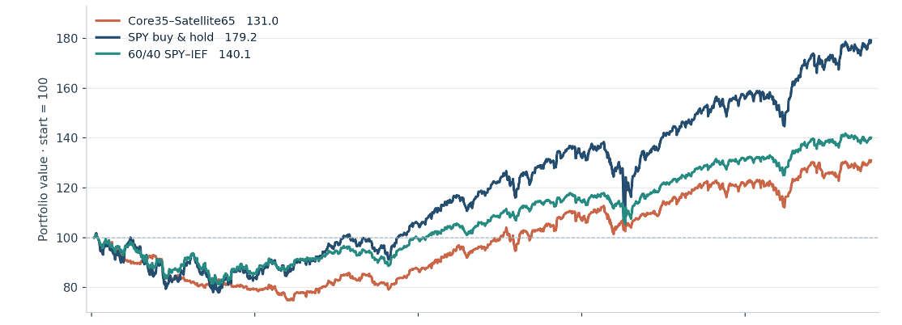
Data-Driven Models for Investment
Final Out-of-Sample Performance
Frozen evaluation · 7 Jan 2022 – 9 Oct 2026
DAILY EQUITY CURVES · INITIAL = 100
Archived net NAV · 1,193 daily observations
FINAL TEST
CAGR
SHARPE
MDD
CORE35–SATELLITE65
5.87%
0.551
−26.54%
SPY BUY & HOLD
13.12%
0.799
−23.42%
60/40 SPY–IEF
7.39%
0.694
−19.84%
Sharpe: daily returns · 252 observations/year · r_f = 0
FINAL RESULT
The candidate did not outperform either benchmark on CAGR, Sharpe or maximum drawdown.
Additional complexity did not translate into superior final-test performance.
Group 9
8
Notes:
This is the frozen final out-of-sample result. The Core-Satellite candidate achieved a 5.87 percent CAGR, a Sharpe ratio of 0.551, and a maximum drawdown of minus 26.54 percent. Both benchmarks performed better on all three headline metrics. SPY delivered 13.12 percent CAGR with a Sharpe of 0.799, while the weekly sixty-forty portfolio achieved 7.39 percent CAGR, a Sharpe of 0.694, and the smallest drawdown. The chart shows the archived daily equity curves from January 2022 to October 2026. We preserve this negative result without post-test re-optimization.
[Sources]
- User-supplied equity-curve figure based on the archived daily OOS NAV series.
- Frozen final OOS metrics: Core35-Satellite65 5.872% CAGR, 0.551 Sharpe, -26.543% MDD; SPY 13.116%, 0.799, -23.424%; weekly 60/40 SPY-IEF 7.388%, 0.694, -19.840%.
[/Sources]

Slide 9
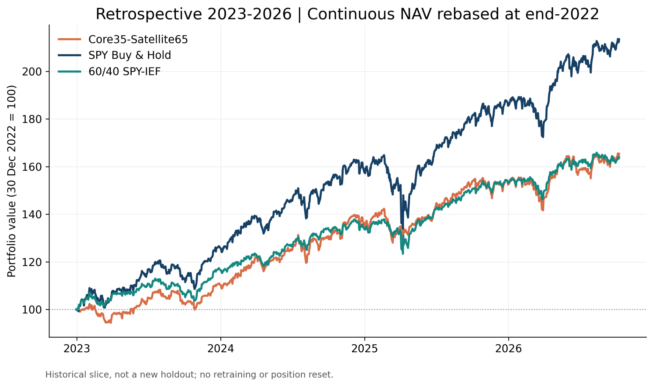
Data-Driven Models for Investment
Temporal Robustness and Trading Costs
Observed performance after 2022, with the original models and execution policy unchanged.
2023–2026 CAGR · RANKED
SPY Buy & Hold
22.381%
Core35–Satellite65
14.343%
60/40 SPY–IEF
14.061%
Core Sharpe 1.234 · MDD −10.035%
TRADING-COST COUNTERFACTUAL
5.872% → 6.750%
Core CAGR: +0.878 percentage points
Same targets, zero trading costs; 1% p.a. borrowing retained.
SPY +0.007 pp · 60/40 +0.021 pp
Retrospective NAV slice, not a new holdout. Cost ablation is full OOS 2022–2026.
Group 9
9
Notes:
Slide 9 — Temporal Robustness and Trading Costs
The left panel shows the existing frozen portfolio NAVs rebased at the end of December 2022. It is a retrospective subset of a single 2022-start OOS path, with no re-training, holdings reset, or independent re-selection. The right-hand bar comparison is sorted strictly by 2023–2026 CAGR: SPY Buy & Hold 22.381%, Core35–Satellite65 14.343%, 60/40 SPY–IEF 14.061%. It does not rank Sharpe or maximum drawdown. Core Sharpe was 1.234; maximum drawdown was -10.035% for that slice. Full-period OOS conclusions are unchanged.
For the cost comparison we hold frozen portfolio targets and the execution engine fixed over 2022–2026 and set commissions/slippage from 2+1 bps to 0 bps. Short borrowing fees still apply at 1% annually. Core CAGR increases from 5.872% to 6.750% (+0.878 percentage points). SPY changes by +0.007 pp, 60/40 by +0.021 pp. This is a controlled transaction-cost ablation, not an alternative independent OOS test.
[Sources]
- reports/oos_final_2022_2026/Core35_Satellite65_daily.csv, SPY_buy_hold_daily.csv, Sixty_Forty_daily.csv.
- src/execution_engine.py, src/evaluator.py, scripts/generate_presentation_charts.py.
- The Core35-Satellite65 and benchmark values are official archived metrics.
[/Sources]

Slide 10
Data-Driven Models for Investment
OOS Diagnostics and Lessons Learned
Observed diagnostics, not a causal attribution of underperformance.
01 CONCENTRATION
02 IMPLEMENTATION INTENSITY
03 GENERALIZATION GAP
172 / 249
130.27
DEVELOPMENT
FINAL OOS
weeks with SPY selected
cumulative turnover
CAGR
12.06%
→
5.87%
139 Long · 33 Short
$3,883
$297
Sharpe
0.929
→
0.551
transaction costs
short-borrow fees
SPY 69%
Other ETFs 31%
MDD
−18.29%
→
−26.54%
Multi-asset eligibility did not guarantee diversified realized exposure.
Directional changes in a 65% Satellite created substantial implementation intensity.
Development performance was in-sample with respect to final strategy selection.
INTERPRETATION
Complexity improved the research architecture, but did not establish robust out-of-sample alpha.
Concentration, regime sensitivity, turnover and costs are plausible contributors, not proven causal explanations.
Group 9
10
Notes:
Oral script (approximately 45–50 seconds)
The final test also helps us understand what the additional complexity actually produced.
First, realized diversification was limited. Despite having four eligible ETFs, the Satellite selected SPY, either long or short, in 172 out of 249 weekly decisions.
Second, the dynamic Satellite generated substantial implementation intensity. Cumulative turnover reached about 130, with roughly 3,883 dollars of transaction costs and an additional 297 dollars of short-borrow fees.
Finally, the favorable development profile did not generalize. CAGR fell from 12.06 to 5.87 percent, Sharpe declined from 0.929 to 0.551, and maximum drawdown deteriorated from minus 18.29 to minus 26.54 percent.
These diagnostics suggest possible roles for concentration, regime sensitivity and implementation costs, but they do not establish a causal explanation. The main lesson is that greater model complexity improved the research architecture, but did not establish robust out-of-sample alpha.
Methodological clarification
- SPY was selected 139 weeks long and 33 weeks short, totaling 172 of 249 weekly decisions.
- Core35-Satellite65 recorded 151 nonzero executed trading sessions, cumulative turnover 130.27, transaction costs of USD 3,883.12 and short-borrow fees of USD 296.52.
- Cumulative turnover is the sum of simulated turnover ratios; it is not an annual turnover percentage.
- Development performance is in-sample with respect to final strategy selection.
- Concentration, regime sensitivity, switching frequency, trading costs and confidence/exposure timing are plausible explanations only; no prespecified causal attribution was estimated.
- Historical FRED vintages and exact macro publication timing are not fully certified point-in-time.
[Sources]
- ProjectAgentTrading26, docs/core_satellite_final_2026.md at commit 437351f, sections 8–10 and 13–14.
- Group9_Dossier_ricostruzione.pdf, sections 10–13.
- Archived final evaluation and diagnostics documented under reports/oos_final_2022_2026/.
[/Sources]

Slide 11
Data-Driven Models for Investment
What We Can Claim
Separate supported evidence from explicit modelling assumptions and unresolved limitations.
SUPPORTED BY THE EVIDENCE
METHODOLOGICAL LIMITATIONS
01
Frozen final evaluation
01
Macro data are not fully vintage-aware
No refitting on 2022+ data.
Conservative fixed 35–45 day lags approximate publication availability.
02
Reconciled portfolio accounting
02
Simplified next-open execution
Daily NAV and direct benchmark comparison.
Decisions after weekly close; positions at next open.
03
Traceable research process
03
Implementation frictions simplified
Comparable baselines · archived decisions · audit and replay support.
2 bps commission + 1 bp slippage included; market impact simplified.
04
Negative result preserved
04
Finite OOS regime coverage
The candidate underperformed both benchmarks.
The 2022–2026 holdout cannot establish robustness across all market regimes.
RESEARCH VALUE
Transparent process
Comparable baselines
Frozen holdout
Reproducible workflow
Experiments and decisions remain traceable.
Complexity was added incrementally.
The negative final result was preserved.
Audit and archived artifacts support verification.
FINAL TAKEAWAY
The frozen test did not confirm our initial hypothesis; the limitations qualify interpretation without changing the preserved OOS result.
Explicit assumptions, not post-test corrections.
Group 9
11
Notes:
Slide 11 — What We Can Claim
The archived official final evaluation uses models and trading parameters frozen through 2021; no OOS refitting was applied. Its daily accounting, frozen targets, and benchmark metrics are reconciled. The final Core35–Satellite65 candidate did not outperform SPY Buy & Hold or a weekly SPY/IEF 60/40 benchmark over January 2022 to October 2026. Weekly decisions are made after the close and orders are simulated at the next available open. Trading costs are included at 2 bps commission plus 1 bp slippage; borrow fees are modeled at 1% annualized for short positions. This is still a stylized execution model and does not fully reproduce real-world market impact, funding/margin terms or true historical point-in-time FRED vintages. The post-freeze SMA200 extension is retrospective and does not alter the official frozen finding.
[Sources]
- ProjectAgentTrading26, src/execution_engine.py, release_config.yaml, reports/oos_final_2022_2026/.
- docs/reproducibility_release_2026.md and docs/regime_adaptive_exploratory_2026.md.
[/Sources]

Slide 12

Data-Driven Models for Investment
Team Contributions and AI-Assisted Workflow
Documented contribution areas and the role of AI support in the research workflow.
GIANLUCA
GABRIELE
GIOVANNI
RESEARCH · AUDIT · INTEGRATION
AGENTS · ML · CORE-SATELLITE
REFACTORING · MODELS · CI
Treasury research
Agent development & testing
Software refactoring
Duration signals & forecasting
Completate qui
Completate qui
A / B / C evaluation
Initial RF / SVM work
Clustering reintegration
Baselines, ablations & comparisons
Completate qui
Completate qui
Temporal & accounting audit
Training & plots
Walk-forward SVM
Execution logic · metric reconciliation
Completate qui
Completate qui
Documentation & final integration
Core35–Satellite65 prototype
CI & integration
Freeze · release · presentation
Completate qui
Completate qui
AI-ASSISTED WORKFLOW
Questo se proprio vogliamo essere intellettualmente onesti!
ChatGPT supported
The team remains responsible for
the methodology, code and final claims.
Code review
Audit & testing
Documentation
Interpretation
Presentation
AI support was separate from the quantitative trading agents.
Contribution areas reflect available Git and project evidence; responsibilities were collaborative and may overlap.
Group 9
12
Notes:
Oral script (approximately 30–35 seconds)
Finally, the project was developed collaboratively. Gianluca worked mainly on the Treasury research, the A-B-C evaluation framework, temporal and accounting audits, documentation and final integration. Gabriele worked on agent development, the initial machine-learning models, training and plots, and the Core-Satellite prototype. Giovanni contributed to refactoring, clustering reintegration, the walk-forward SVM and continuous integration.
ChatGPT was used as a support tool for code review, auditing, testing, documentation, interpretation and presentation preparation. This AI assistance is distinct from the quantitative agents inside the trading system, and the team remains responsible for the methodology, code and final conclusions.
[Sources]
- Group9_Dossier_ricostruzione.pdf, section 14: Contributi ricostruibili e uso degli strumenti AI.
- Project handoff and Git history referenced by the reconstruction dossier.
- LUISS logo: original user-supplied asset.
[/Sources]

Slide 13
Data-Driven Models for Investment
CONCLUSION
What the project delivers
From a research idea
to an auditable
trading system.
A traceable path from hypothesis to systematic execution.
HYPOTHESIS
MODULAR QUANTITATIVE DESIGN
Treasury → four-ETF universe
ETF baselines, macro regimes, five agent families, GA Orchestrator and B/C consensus.
DESIGN
VERIFIABLE IMPLEMENTATION
A/B/C + agent ensemble
Frozen models, next-open execution with costs, reproducible NAVs, audit trail and CI checks.
EVALUATION
RESULTS WITH CONTEXT
Frozen, net-of-cost OOS
Retrospective Core 2023–26 CAGR: 14.343% vs 60/40: 14.061%; full OOS lagged benchmarks.
INSIGHT
Regimes, costs & risk
Thank you for your attention
ProjectAgentTrading26
Questions & Discussion
Group 9 · November 2026
Regime-Adaptive SMA200 remains exploratory; no statistically significant alpha is claimed.
Notes:
Closing — Evidence-backed research and a full multi-agent workflow
Our final deliverable is more than a single backtest. We developed traceable hypotheses, investigated Treasury duration timing, built diversified ETF benchmarks, introduced macro regime budgets, trained heterogeneous technical/macro/ML agents, linked B and agent signals through standalone C, and implemented a frozen Core–Satellite portfolio with a shared next-market-open execution engine and explicit trading and borrowing costs.
The end-to-end workflow is auditable, supported by machine-verified freeze and input records and a green GitHub CI test suite. The official 2022–2026 Core–Satellite test did not beat SPY or 60/40, which we report transparently rather than redesigning the holdout. A retrospective 2023–2026 slice generated Core CAGR 14.343%, marginally higher than the 60/40's 14.061%, without being a new independent test. The SMA200 regime-adaptive variant is a motivated exploratory extension with promising retrospective risk reduction, not proof of statistically significant alpha.
Our contribution is the research architecture, its implementation discipline and the information extracted from what worked and what did not. Thank you for your attention.
[Sources]
- docs/research_design.md, docs/decision_log.md, docs/regime_adaptive_exploratory_2026.md.
- Official OOS archive and GitHub CI verification, Group 9.
[/Sources]

