Slide 1
M.S. APPLIED DATA SCIENCE · SYRACUSE UNIVERSITY · MAY 2026
Gabriela Bermudez
Education Data Scientist · Strategic Innovator · Higher Education Leader
gbermude@syr.edu · lhttps://www.linkedin.com/in/gabriela-bermudez-0835a12b/
Every dataset has a story. I make sure it gets told.

Slide 2
About Me
WHO
I AM
I am a data scientist, scholar, and practitioner who spent nearly two decades in higher education before earning an M.S. in Applied Data Science at Syracuse University.
20 yrs
I came to data science not as a departure from that work — but as a natural extension of it. I wanted to turn institutional observation into evidence that drives change.
Higher Education
3
"I am at my best when the technical problem and the human problem are the same problem."
Degrees
7+
Projects
Education Data Scientist · Strategic Innovator · Higher Education Leader

Slide 3
TECHNICAL SKILLS
Core Technical Skills
Data Collection & Storage
Deep Learning
Oracle DBMS · SQL (ERDs, migrations) · FERPA architecture · Qualtrics & Formstack · ASPiRe
TensorFlow / Keras · MobileNetV2 (transfer learning) · CNNs · Autoencoders · Anomaly detection
Project 01
Project 06
Natural Language Processing
Data Analysis & Visualization
Python / NLTK · TF-IDF · KMeans · PCA · VADER sentiment · WordNet lemmatization · Apriori
Tableau & Power BI · matplotlib, seaborn, ggplot2 · ArcView / GIS · Adobe Creative Suite · Canva
Project 02
All 7 projects
Machine Learning & Predictive Modeling
Student Analytics Platforms
SVM, Random Forest, Gradient Boosting, Naive Bayes, kNN · SMOTE · SHAP · k-fold CV · R (caret, e1071, arules)
Navigate · Orange Success · ASPiRe · Institutional data integration (Oracle DBMS, FAFSA, LMS)
Projects 04 & 07
Projects 01 & 07
Healthcare & Clinical Analytics
Class imbalance: SMOTE, PCA, interaction terms · Gradient Boosting, SVM · Interpretability vs. accuracy tradeoffs
Project 05
Beyond the tools: Translating findings for non-technical audiences · Equity-centered analysis · Bilingual: English & Spanish · Collaborative across disciplines

Slide 4
PORTFOLIO
7 Projects. 3 Spotlights.
01
ECS Probation Database
SPOTLIGHT
05
Thyroid Cancer Risk
Database Administration
Healthcare Analytics
02
NLP Workshop Feedback
SPOTLIGHT
06
Food Image Classification
Text Mining / NLP
Deep Learning
03
EV Adoption & CO₂ Emissions
07
ECS Retention Model
Global Data Science
Independent Project
04
Student Performance Prediction
SPOTLIGHT
Data Analytics / ML

Slide 5
PROJECT SPOTLIGHT 01 · BUSINESS NEED
ECS Student Probation Database
THE NEED
THE PROBLEM
To create a probationary student database that will help assess information, improve students’ experiences in the College of Engineering and Computer Science (ECS), and strengthen the probation recovery program — Thriving in ECS.
ECS may place any student with a cumulative GPA below 2.0 on academic probation. A student may also be placed on probation if their semester GPA falls below 2.0, or if they fail to meet other criteria for good academic standing.
THE GAP THIS PROJECT FILLED
For five years, I could see individual students — but I could not see the data behind the population. No centralized system existed to track probation patterns, high-risk courses, or whether recovery interventions were working over time. This project was built to change that.

Slide 6
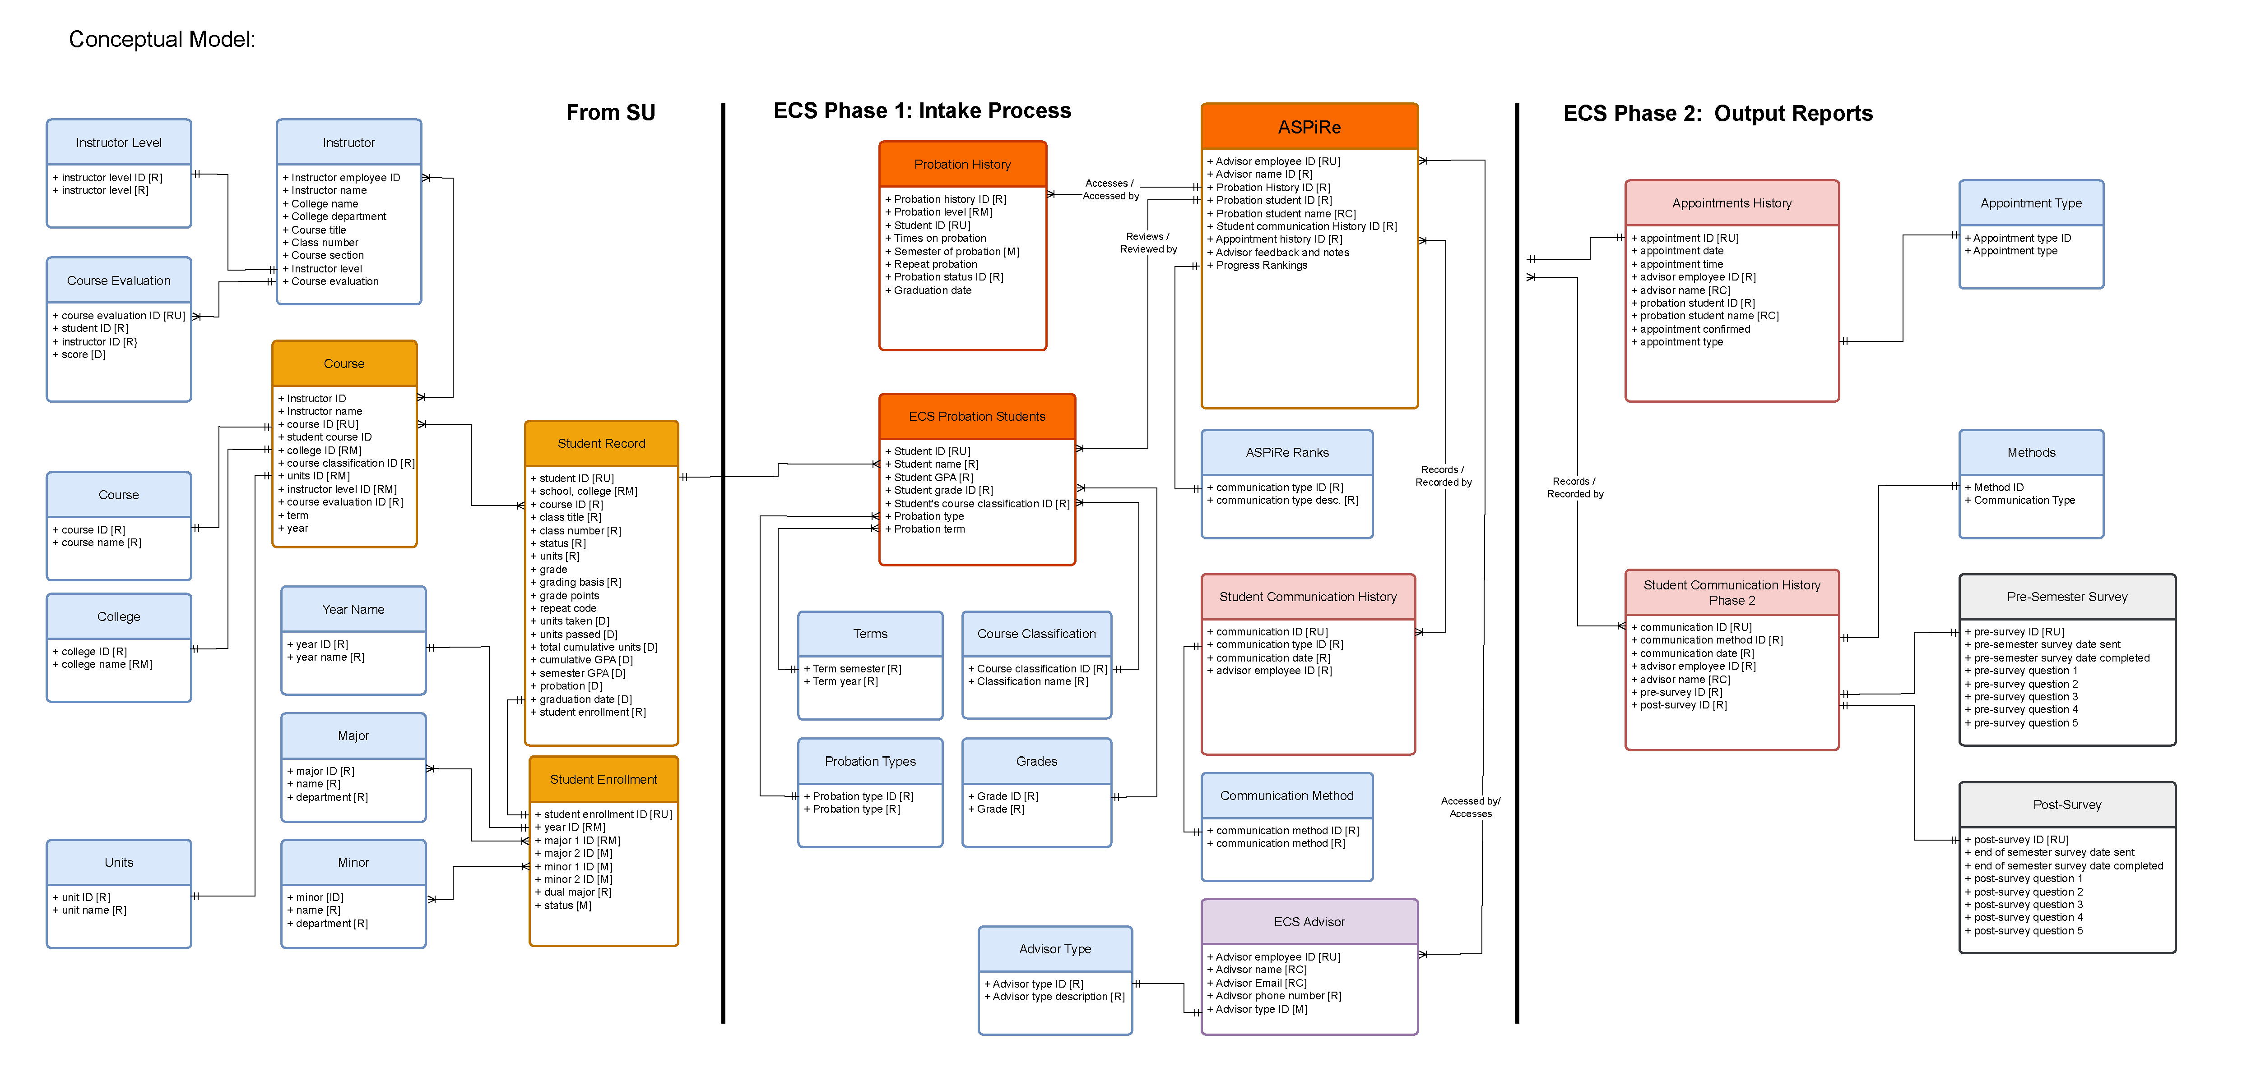
PROJECT SPOTLIGHT 01 · DATA ARCHITECTURE
ECS Student Probation Database
WHAT THIS SHOWS
This entity-relationship diagram maps the full architecture of the ECS probation database across three phases: institutional data intake from SU systems, the core ECS probation tracking layer, and the ASPiRe output reports used by advisors.
Key entities include Student Record, Probation History, Advising Appointments, and Pre/Post Survey data — all linked through FERPA-compliant student ID abstraction.
Learning Outcomes: Database Administration · ERD Design · FERPA-Compliant Architecture · IST 659 Spring 2024

Slide 7
PROJECT SPOTLIGHT 01 · SOLUTION & RESULTS
ECS Student Probation Database
IST 659 — Database Administration · Spring 2024 · Oracle DBMS, SQL, ERD Design
3
12
5 yrs
FERPA
Data Sources
Research Questions
Longitudinal Tracking
Compliant
Oracle · FAFSA · ASPiRe
Driving every design decision
Retention & graduation outcomes
Student ID abstraction architecture
What I built
Key insight
A multi-phase relational database tracking probation history, advising interactions, demographics, course-level risk factors, and intervention outcomes for ECS students — drawing from 3 institutional data sources.
Design decisions made early determine what questions can be asked later. Built around 12 specific institutional questions so every entity and relationship was purposeful — not assumed.
Learning outcome: Data Collection & Storage · Creates longitudinal infrastructure for Thriving in ECS to measure intervention effectiveness over time.

Slide 8
PROJECT SPOTLIGHT 02 · BUSINESS NEED
NLP Text Mining — Thriving in ECS Workshop
THE WORKSHOP
THE APPROACH
In Spring 2024, ECS piloted “Powering Through Academic Recovery” — a mandatory workshop for students on the highest level of probation whose suspension appeals were approved. Held January 26, 2024, it replaced the formal appeal process with a required intervention focused on early support and reflection.
Facilitated by ECS Career Services and Student Success Advising. Grounded in design thinking — key themes included mind mapping, problem framing, prototyping, and articulating NACE career competencies.
THE RESEARCH QUESTION
This project uses student survey responses from before and after the workshop to build and explore a text corpus — applying text mining to uncover patterns in student sentiment, reflection, and engagement, and preparing the data for potential future classification or clustering models.

Slide 9
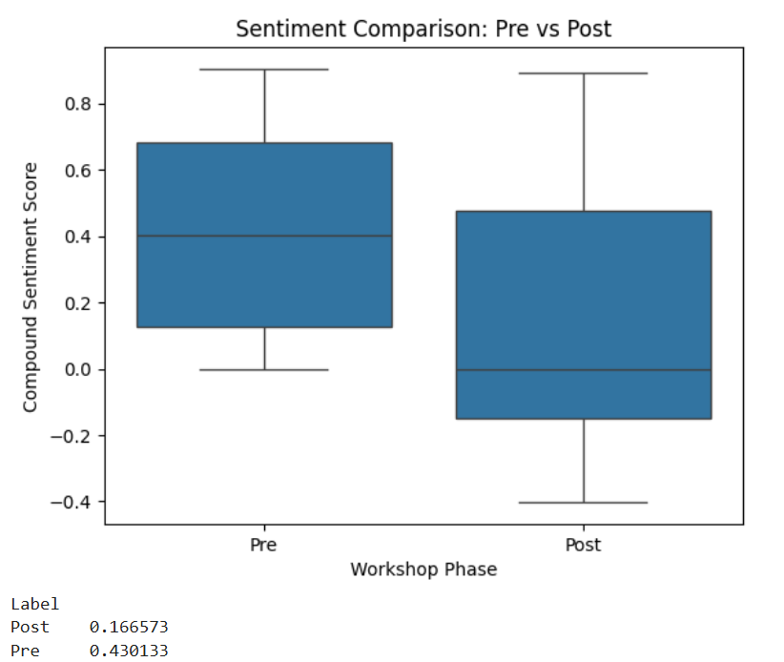
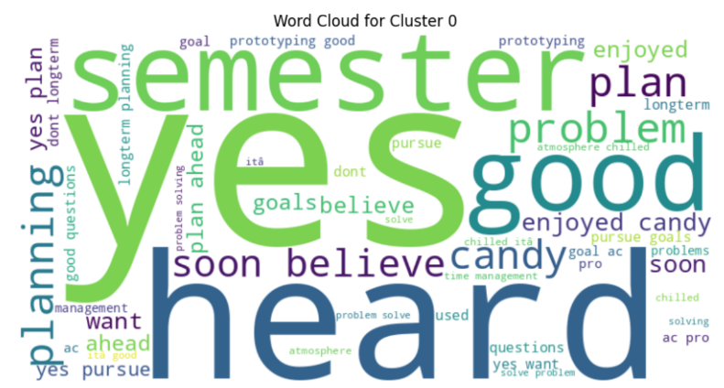
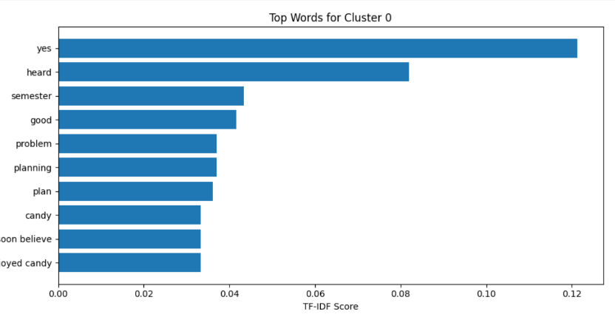
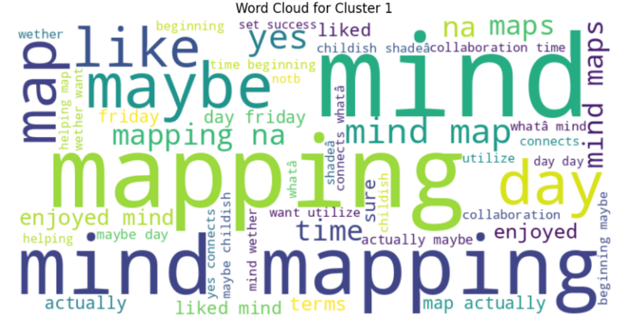
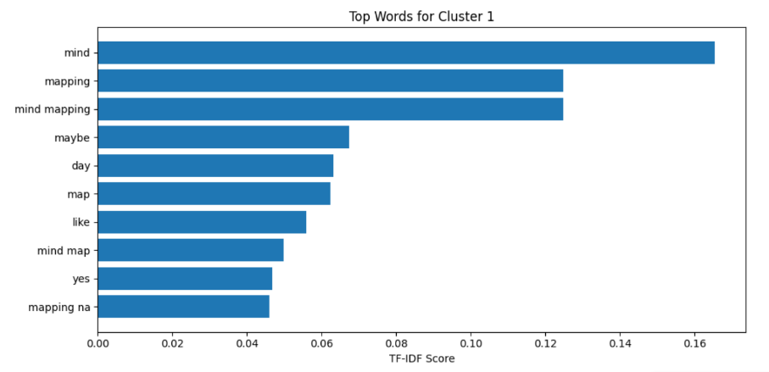
PROJECT SPOTLIGHT 02 · KEY VISUALIZATIONS
NLP Text Mining — Thriving in ECS Workshop
Sentiment Shifted Post-Workshop
Pre median 0.43 vs. post 0.17 — wider variance post reflects deeper critical reflection after the workshop.
Cluster 0: Goal-Oriented Language
“yes,” “heard,” “good” — affirming, future-focused language suggesting high engagement and sense of belonging.
TF-IDF: Top Terms, Cluster 0
“yes” and “heard” confirmed as the most distinctive terms — students in this cluster felt seen and motivated.
Cluster 1: Process & Reflection Language — “mind mapping,” “maybe,” “day” signal active processing, suggesting students were working through new frameworks.
TF-IDF: Top Terms, Cluster 1 — “mind,” “mapping,” and “mind mapping” dominate by a wide margin, confirming this cluster captured students most engaged with the mind-mapping exercise itself.
Learning Outcomes: NLP · Text Mining · VADER Sentiment · KMeans Clustering · IST 664 Spring 2024

Slide 10
PROJECT SPOTLIGHT 02
NLP Text Mining — Thriving in ECS Workshop
IST 736 — Text Mining · Spring 2024 · Python, NLTK, TF-IDF, KMeans, PCA, VADER
26
k=2
0.430
0.167
Documents
KMeans Clusters
Pre Sentiment
Post Sentiment
13 Pre · 13 Post workshop
Separated without labels
VADER compound score
Grounded, realistic shift
What I found
Why it matters
KMeans separated Pre and Post responses without ever using those labels — language shifted enough to be distinguishable purely by content.
Pre: 'problem,' 'help,' 'plan'
Post: 'mind map,' 'enjoy,' 'connections'
First quantitative analysis ever conducted on the Thriving in ECS workshop feedback. Provides data-grounded evidence that the program is shifting how students think — not just what they say.
Learning outcome: Analysis, Visualization, Communication · Connects directly to the mission of using data to improve programs serving students in academic crisis.

Slide 11
PROJECT SPOTLIGHT 04 · BUSINESS NEED
Predicting High School Student Academic Performance
THE CONTEXT
THE GAP
Student success is shaped by far more than GPA and attendance. Extracurricular activities, parental involvement, and study habits play a significant role in academic outcomes — yet traditional metrics provide only a partial picture. As Schreiner (2012) argues, student success encompasses academic achievement, engagement, satisfaction, and personal development.
Despite extensive research, there remains a need for deeper understanding of how different variables interact to impact academic outcomes. This study aims to go beyond traditional metrics — using classification, clustering, and association rule mining to identify patterns and associations that can predict student success.
PROBLEM STATEMENT
Analyze a comprehensive dataset of 2,392 high school students to identify key predictors of academic success — and offer actionable insights that enhance student engagement, satisfaction, and overall well-being beyond just improving grades.

Slide 12
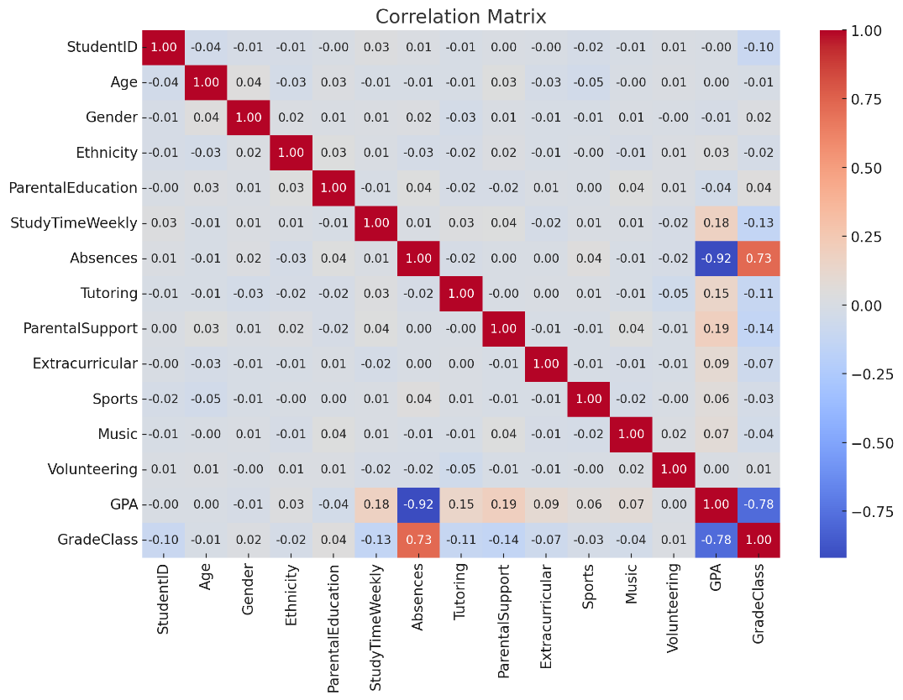
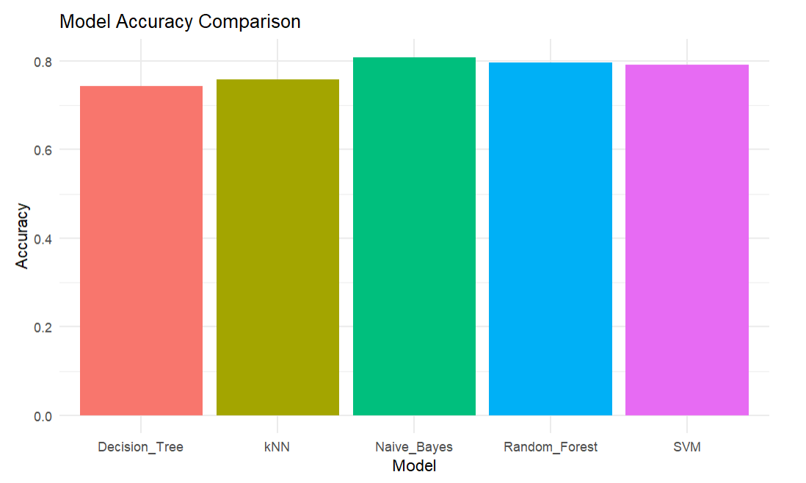
PROJECT SPOTLIGHT 04 · KEY FINDINGS
Predicting High School Student Academic Performance
CORRELATION MATRIX
MODEL ACCURACY COMPARISON
Naive Bayes & Random Forest achieved ~80% accuracy across 5 grade classes
Learning Outcomes: Predictive Modeling · Data Mining · Translates directly into advising practice

Slide 13
PROJECT SPOTLIGHT 04
Predicting High School Student Academic Performance
IST 707 — Data Analytics · Fall 2024 · R, caret, ggplot2, arules, e1071, randomForest
2,392
9
0.95
6.73
Students
Methods Applied
R² Regression
Top Rule Lift
With demographics & habits
From rules to Random Forest
95.42% variance explained
Directly actionable in advising
Key findings
What this means
Absence–GPA correlation: 0.92 — each additional absence = 0.92-point GPA drop. SVM and Random Forest achieved ~78–80% accuracy.
Highest-lift rule (6.73): high GPA + very low absences + tutoring → B outcome. Translates directly into advising practice.
The students most at risk are not hard to identify — if you have the right data. The challenge is not knowing what to do. It is having the systems to identify who needs help and the capacity to act before it's too late.
Learning outcome: Predictive Modeling, Analysis · Bridges statistical evidence with direct student-facing advising practice.

Slide 14
PROJECT SPOTLIGHT 07 · BUSINESS NEED
ECS Retention Model
THE PROBLEM
THE GAP
Advisors in ECS currently rely on reactive outreach — reaching students after they appear in crisis rather than before. By the time a student lands on probation, the semester is often already lost.
Five years of probation data sit in the database built in IST 659 — but no model yet exists to make it predictive.
Institutional data on probation patterns, course-level risk, advising touchpoints, and recovery outcomes exists — but has never been used to build a forward-looking model.
This project is the bridge: using the probation database I built in IST 659 as the foundation for a predictive retention model designed for direct use by ECS advisors.
PROJECT GOAL
Use five years of ECS probation history to build a predictive model that flags students at risk of academic probation before the semester ends — giving advisors a window to act.
Learning Outcomes: Predictive Modeling · Retention Analytics · Independent Project · In Progress

Slide 15
PROJECT SPOTLIGHT 07 · METHODOLOGY & APPROACH
ECS Retention Model
Independent Project · In Progress · Python, R, Oracle DBMS, SHAP, scikit-learn
DATA FOUNDATION
KEY FEATURES
MODELS UNDER EVALUATION
Five years of ECS probation records drawn from the Oracle DBMS built in IST 659 — including probation history, GPA trajectories, course-level risk, advising interactions, and recovery outcomes.
Cumulative GPA, semester GPA drop, prior probation count, high-risk course enrollment, absences, advising frequency, parental education, FAFSA status, and time-to-intervention.
Logistic Regression (baseline), Random Forest, Gradient Boosting (XGBoost), and SVM — evaluated on precision, recall, and F1 with a focus on minimizing false negatives.
WHAT MAKES THIS DIFFERENT
Built for advisors, not researchers. SHAP values will surface the top drivers for each flagged student — so advisors know not just who is at risk, but why, and what to address first.
Equity-centered from the start. Model performance will be evaluated across demographic subgroups to ensure it doesn’t systematically underserve first-gen, Pell-eligible, or underrepresented students.
Results pending · Model outputs, SHAP visualizations, and advising use-case documentation to be added upon completion

Slide 16
Thank You
Gabriela Bermudez · M.S. Applied Data Science · Syracuse University, May 2026
“The data shows the pattern.
The story shows the person.”
▶ Learn More About Me
[ Link coming soon — portfolio site in progress ]

