Slide 1
Widespread Amateur Trading
Implications for risk management

Slide 2
Roadmap
Motivations
Our Dataset
Stock-Level Analysis
Portfolio-Level Analysis
Implications for the Market
Conclusions
Appendix

Slide 3





Motivations
Explosion in amateur trading and gameR-traders

Slide 4
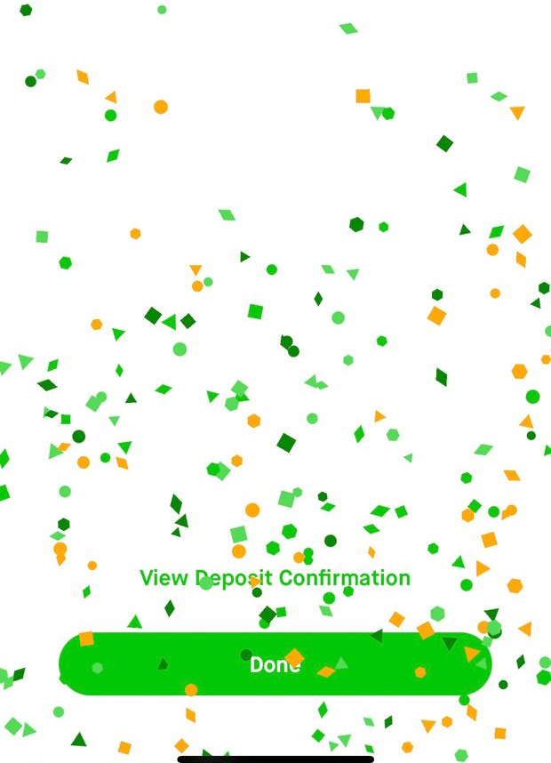
Behavioral Finance Approach: Robinhood Gamers
Wall-Street Journal: Does Robinhood Make It Too Easy to Trade? From Free Stocks to Confetti
“Nudging”: Button brightness, Difficult to cancel trades
Addictive behaviours: up to 5 hours of trading a day
Gaming: Confetti when deposit
User leaderboard
User suicide

Slide 5
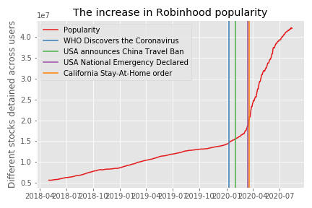
The Evolution in Robinhood Traders during the Covid Episode
Proxy for popularity: sum of the number of users owning at least a share, across the 8,500+ shares available in the Robinhood data
Did people trade out of boredom?

Slide 6
Our Questions
What are key behaviors of Robinhood users?
What are the implications of Robinhood trading for risk management?
For some individual stocks
For Robinhood users collectively
For the market

Slide 7

Our Dataset

Slide 8
Relating Robinhood Usage…
 | Robinhood Popularity
Data source | Robintrack.net
What We Have | How many users own each of the 8,597 stocks available on Robinhood?
Time Window | May 2, 2018 to August 13, 2020, daily
Caveats and Comments | Robinhood gives free shares Number of users who own a stock Size of the position? Rebalancing?

Slide 9
… to Patterns in Returns on the Market
Download daily price data for the 8,597 stocks on Robinhood through Yahoo Finance
Fama-French factors from http://mba.tuck.dartmouth.edu/pages/faculty/ken.french/data_library.html

Slide 10

Stock-Level Analysis
Relating Robinhood Trading and Stock-Level Volatility

Slide 11
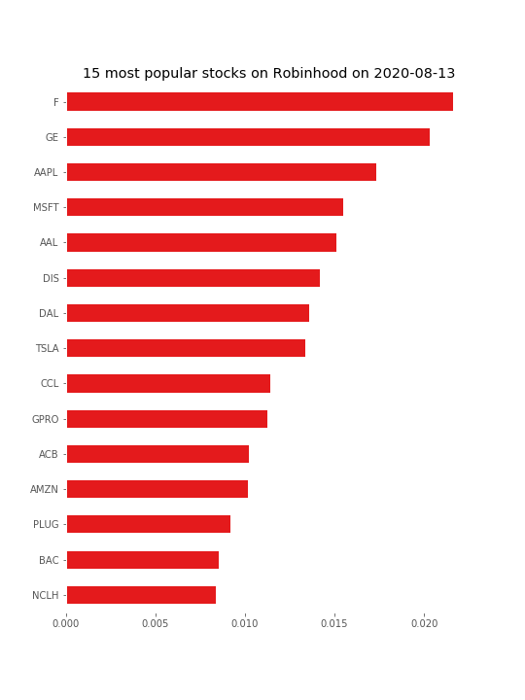
Most Popular Companies on Robinhood
Often mediatic and B2C companies
Sectorial bet: high technology

Slide 12

Measuring Stock-Level Volatility
Daily Realized Volatility
$$σ_{t}^{2}=r_{t}^{2}$$
Conditional Daily Volatility using a GJR-GARCH model
$$σ_{t}^{2}=ω+{β σ}_{t−1}^{2} +α{ ε}_{t −1}^{2}+γ{ ε}_{t −1}^{2} I(ε_{t −1}<0)$$

Slide 13
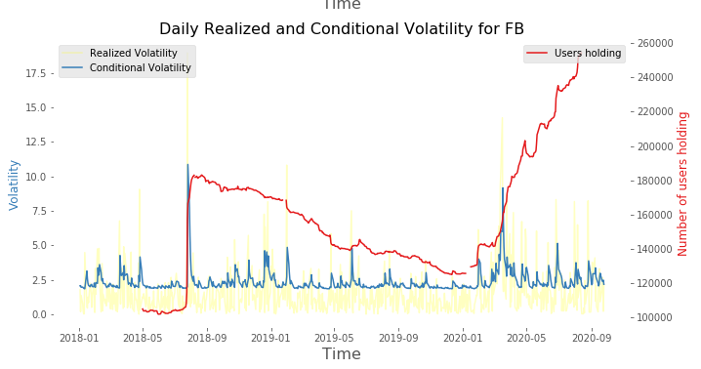
One notable example: Facebook
Users bought Facebook after the largest price drop (19%) in the history of Facebook, on July 25
They reduced positions over the following months as the price kept declining
Many more examples for popular and unpopular stocks available in Appendix (see the given Repository)

Slide 14
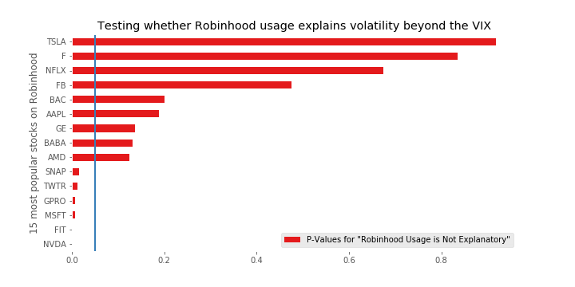

Does Robinhood bring more information than Market Volatility?
Run the regression
$$σ_{t}^{}=α+β_{VIX} . VIX_{t}+β_{Popularity} . Popularity_{t}$$
for each of the 15 most popular stocks available in the dataset
Test $β_{Popularity}=0$
Beyond the VIX and individual stock intercept, does Robinhood usage correlate with stock volatility?

Slide 15
Portfolio-Level Analysis
Analyzing the robinhood portfolio

Slide 16
Constructing the Robinhood Portfolio
Our dataset forces us to make assumptions to construct the cap-weighted portfolio
Assume that the number of shares of a company held by a user who owns at least some share of that company is independent of the company
The number of shares held for each company is proportional to the number of users who own that share
A strong assumption, because more expensive shares may be held in lesser quantity
Rebalance daily using the number of users holding and the price of that day

Slide 17
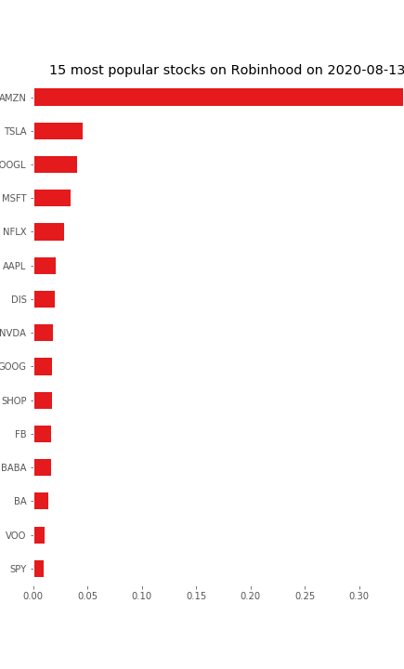
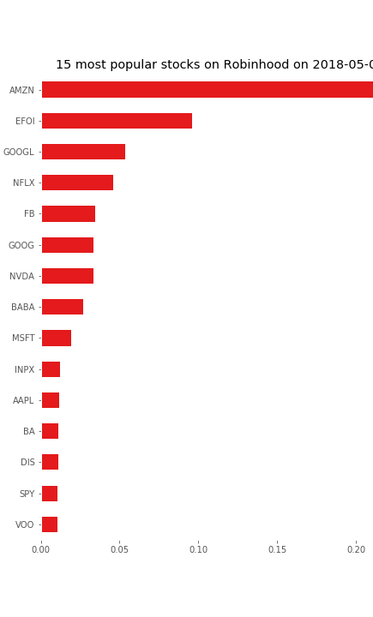
Largest weights in the Robinhood Portfolio
AMZN still most popular
TSLA gathering momentum

Slide 18
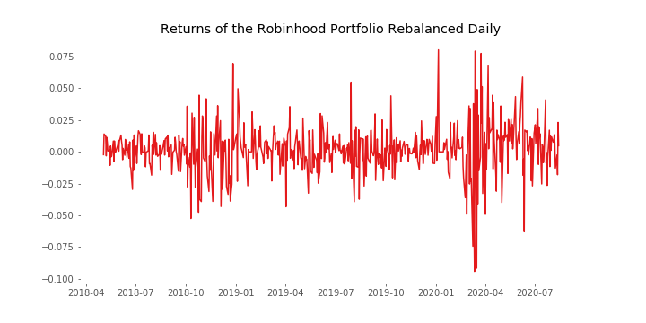
The Returns of the Robinhood Portfolio

Slide 19
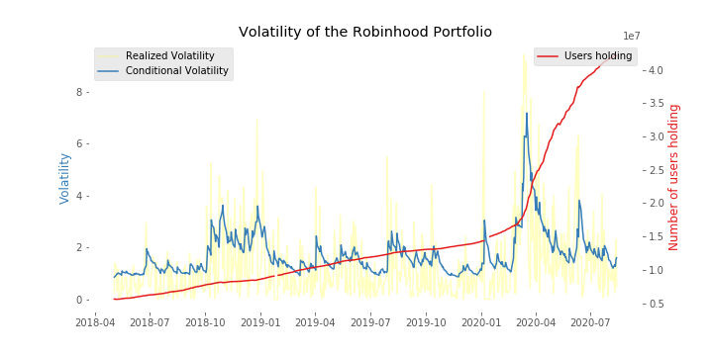
The Volatility of the Robinhood Portfolio
Important spikes (daily volatility up to 7%)

Slide 20

Fat Tails – The Hill Estimator
A lower value of the Hill Estimator indicates a fatter tail:
$$\hat{α_{H}}=\frac{1}{\hat{γ_{H}}}$$
Where
$$\hat{γ_{H}}= \frac{1}{τ} \sum_{t}{max⁡[0,\ln\left(v_{t}\right)−\ln\left(v_{0}\right)]}$$
$τ$ is the number of entries in the tail, $v_{t}$ are absolute returns, and $v_{0}$ is a given cut-off value beyond which we want to measure the fatness of the tail (here, taken to be the 95th percentile and 99th percentile of absolute returns).
 | S&P | Robinhood Portfolio
Hill Estimator (95%) | 0.4560 | 0.5751
Hill Estimator (99%) | 0.4025 | 1.0393

Slide 21


The Robinhood Portfolio in the CAPM framework
$$r_{t}^{e}=β \left(R_{m}−R_{f}\right)+ε_{t}$$
Daily alpha is economically and statistically insignificant
More than unit exposure to the market
Seemingly good Annualized Investment Ratio (0.729) over the market is completely insignificant (short time window)
 | Alpha | Beta | Residual Volatility | Estimated IR
Value (daily) | 0.0006 | 1.0074 | 0.0102 | 0.0608
Standard error | 95% Confidence Intervalle [-0.001, 0.001] | 0.04 | - | Scales as sqrt(Y)
Adjusted $R^{2}$: 0.706

Slide 22
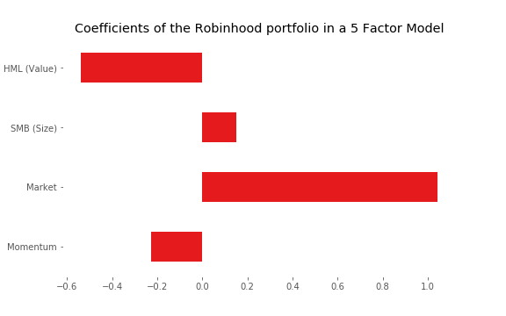

The Robinhood Portfolio Factor Model
4 Factors: Momentum, Market, SMB, HML
Unsignificant alpha (P-Value = 0.594)
All coefficients are very significant (highest P-value for coefficients is 0.016, for size)
Adjusted $R^{2}$: 0.743

Slide 23
Conclusions
Robinhood Traders exhibit some distinctive behaviours
Invest in companies they know through the media, or interect with as customers
React to volatility more than provoke it, “buying at a discount”
On the aggregated level, the Robinhood portfolio has:
Positive Investment Ratio against the S&P500
Trendy Robinhood Stocks could benefit vast public popularity. Is Robinhood popularity a leading indicator of good performance? Wisdom of Crowds?
Performance of the Robinhood portfolio well explained by risks taken in our Four-Factor model: Robinhood is not a new market factor (yet)
Individual traders probably have way worse results, because very limited diversification (“all-in” behaviour)

Slide 24
Appendix
Code Repository, data sources, references, report

Slide 25
Repository, Data Sources
All the code used to create the dataset and analyze it is available on the GitHub repository: https://github.com/GabCaz/robinhoodMarket
README.MD explains repository structure and how to run the code
Data sources

Slide 26
References
[https://fortune.com/2020/08/10/robinhood-popularity-data-robintrack-stock-market-trading-tracker/] About Robinhood’s decision to make its stock popularity API for data access unavailable
[https://www.wsj.com/articles/confetti-free-stocks-does-robinhoods-design-make-trading-too-easy-11597915801?st=3n7ahrfaahomesk&reflink=article_copyURL_share&fbclid=IwAR3EBqRjg8_Om_dnoJH8gWlUcHOVJM2y2qqorQBUPBnMVdzut37K8SxkF3w] A behavioural finance analysis of Robinhood’s mechanisms to encourage users to trade more and give a game-like experience to traders
[http://www.utstat.toronto.edu/keith/papers/robusthill.pdf] Presentation of the Hill Estimator

