Slide 1
Final Project of Python for data analysis
By Artémis Coussin and Gabriel Darcos

Slide 2
Summary
Ins and outs of the problem
Data exploratory
Modeling
Build the API

Slide 3
Ins and outs of the problem
Description of the problem
Why is it important to study this dataset ?

Slide 4
Description of the problem
We had to analyze the Seoul Bike Sharing Demand Data Set using data visualization to show the links between the variables. Most of the variables were given with the dataset but we also created some relevant variables.
We also needed to predict the Rented Bike count (Count of bikes rented at each hour) using the parameters we found relevant. We will build various models and keep the one giving us the best accuracy (MSE) on the predictions on the test set.

Slide 5
Why is it important to study this dataset ?
Currently rental bikes are introduced in many urban cities for the enhancement of mobility comfort. It is important to make the rental bike available and accessible to the public at the right time as it lessens the waiting time.
The crucial part is the prediction of bike count required at each hour for the stable supply of rental bikes.

Slide 6
Data exploratory
Source of the data
Structure analysis
Construction of a new variable
Distribution of the data
Relations between parameters
Relations between the parameters and the target

Slide 7

Source of the data
We found the data on the UC Irvine Machine Learning Repository.
We downloaded it as a csv file. (SeoulBikeData.csv)
To import the data in our Jupyter Notebook we had to write this line of code : df = pd.read_csv("SeoulBikeData.csv", encoding = 'unicode_escape', delimiter = ‘,’)
To use the pd.read_csv command we imported the library pandas as pd.
After that our dataset was in the dataframe df.

Slide 8
Structure analysis
Target variable: RentedBikeCount → continuous variable (integer)
We can see the number of rows and columns by printing the dataframe df : 8760 rows x 14 columns
We can obtain the variable types with df.dtypes : 4 parameters are integers, 6 are floats, 1 is datetime and 3 are objects (here they are strings)
We can count the missing values with the command df.isna().sum() : we can observe that there is no missing value.

Slide 9
Construction of the variable « Month »
To describe the evolution of rented bikes through the year we only had the date, but it’s difficult to observe the evolution of the data on the scale of a whole year with 365 different values.
Hence, we created the parameter « Month » with the line : df['Month']=df['Date’].dt.month
This parameter is really useful as we are going to see next.

Slide 10
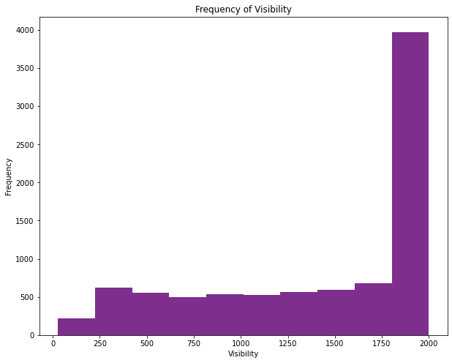
Distribution of the data
To see how each variable was distributed, we used the line df[‘NameOfVariable'].plot(kind='hist', color = '#7E2F8E’) for each variable (but we kept only one in the code for it to be cleaner)
It gave us a histogram as
in this example (for the
variable 'Visibility (10m)’) :

Slide 11
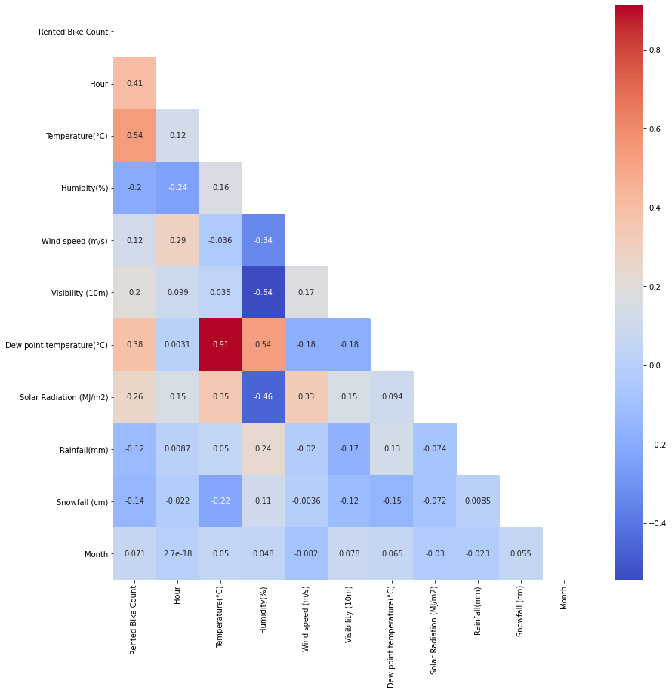
Relation between parameters
We used the code df.corr() to see the correlation between each variable.
We saw that there was one big correlation (0.91) between "Dew Point Temperature" and "Temperature" so we deleted Dew Point Temperature from the variables we wanted to use to build our model.

Slide 12
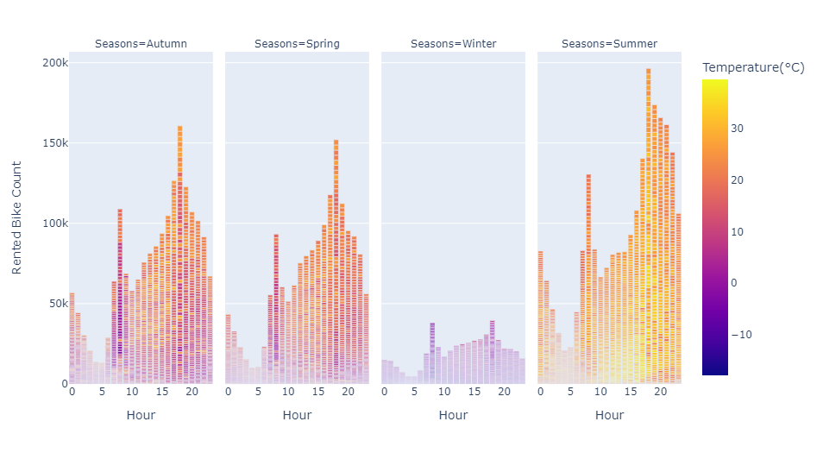
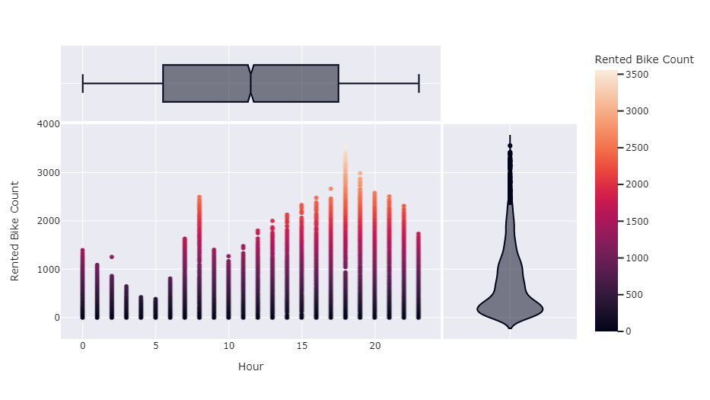
Relation parameters / target
We used mainly the library plotly (import plotly.express as px) to create graphics.
Here are two examples :

Slide 13
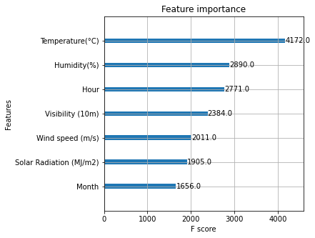
Relation parameters / target : conclusions
Whatever the season, the two hours of the day where the most bikes are rented are 8h and 18h (probably to go to work and to go back to work)
It doesn’t seem to be many differences in the number of rented bikes depending on if we’re in holiday or not.
Whatever the hour, more bikes are rented if the temperature is higher.
The number of rented bikes increases with the temperature. That’s why the season where the less bikes are rented is winter. We can see that with the graphic of the importance of each feature in the Xgboost model :

Slide 14
Modeling
The target
The parameters
Preprocessing
The models
The best model

Slide 15
The target
RentedBikeCount is a continuous variable.
Hence, we will use models which predict a value and not a label : linear regression, lasso, decision tree, random forest and XGboost.

Slide 16
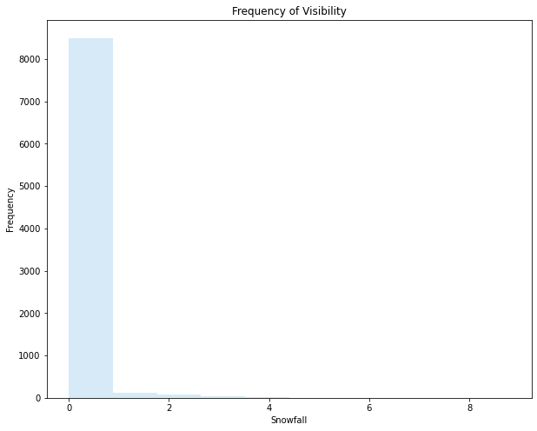
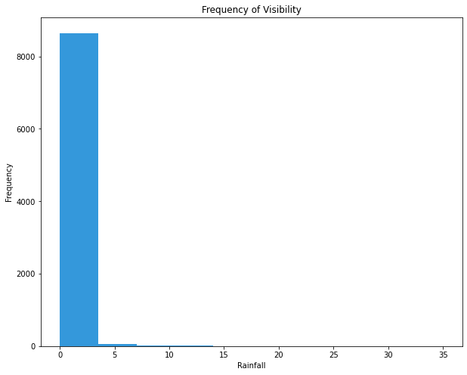
Variables chosen as parameters
We used the line df.skew() to see which are the most biased parameters. We saw that Snowfall and Rainfall are too biased to be used, as their histogram confirm.
We don’t have to use Dew Point Temperature neither because its correlation with temperature was really high and it would be redundant to use both of them.
In conclusion, we chose the following parameters : ‘Hour’, ‘Temperature(°C)’, ‘Humidity(%)’, ‘Wind speed (m/s)’, ‘Visibility (10m)’, ‘Solar Radiation (MJ/m2)’, ‘Month’.

Slide 17
Preprocessing
We created a list of the parameters we wanted. We called it Colonnes_Prediction.
We created a dataframe with the values of only the parameters we wanted, called x (x = df[Colonnes_Prediction]). We created another dataframe with only the values of our target, called y.
We created a train set and a test set for both x and y using the train_test_split function.

Slide 18
Method for each model
First, we do a grid search to determine which are the best values for each parameter of the model (except for the LR model which doesn’t have any parameters)
Then we create the model with the appropriate code and the values of parameters we found (see on the Jupyter notebook)
Then, we calculate the MSE (Mean Squared Error) to see the accuracy of the model. The lower the MSE is, the better the model.
Finally we represent the tendency of the predicted data with a graph (using plt.scatter), showing that it follows the tendency of the actual data.

Slide 19
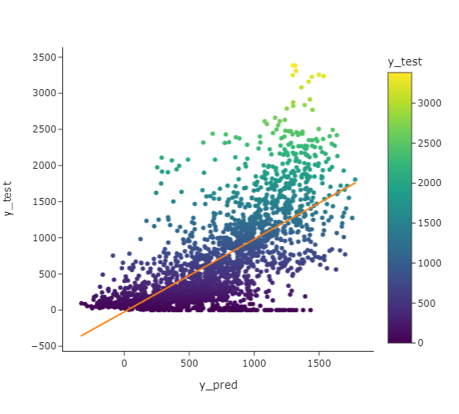
Model 1 : linear regression
The most basic model is the linear regression model.
We use the fit()and predict() functions on a LinearRegression() object.
We found a MSE of 104,77.
Here is the graph :

Slide 20

Model 2 : Lasso
The two parameters we need to test with a gridsearch are ‘alpha’ and ‘max_iter’. The best values for them appear to be respectively 7 and 100000.
We use the fit()and predict() functions on a linear_model.Lasso() object.
We found a MSE of 104,85.
Here is the graph :

Slide 21
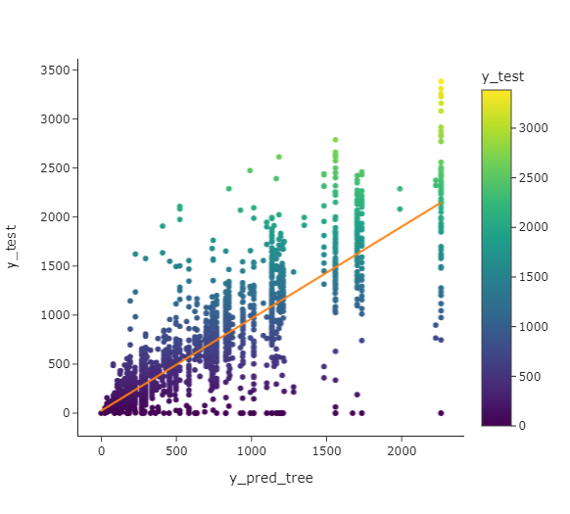
Model 3 : Decision Tree
The 3 parameters we need to test with a gridsearch are ‘criterion’, ‘max_depth’ and ‘splitter’. The best values for them appear to be respectively ‘friedman_mse’, 7 and ‘best’.
We use the fit()and predict() functions on a DecisionTreeRegressor() object.
We found a MSE of 63.737.
Here is the graph :

Slide 22
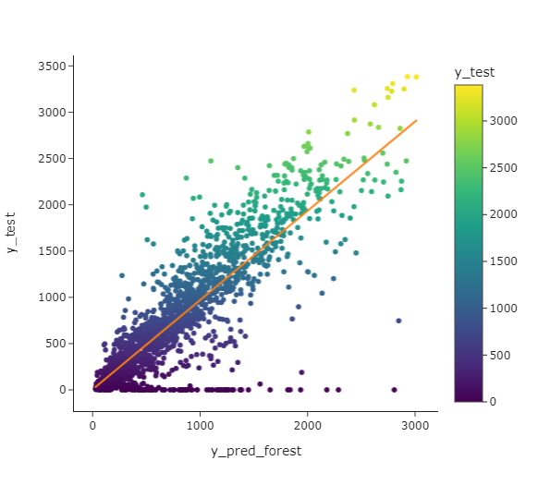
Model 4 : RandomForest
The 2 parameters we need to test with a gridsearch are ‘max_depth’ and ‘n_estimators’. The best values for them appear to be respectively 18 and 300. (we first did a gridsearch between 100 and 500 but then we put it between 300 and 301 because the exécution was really long).
We use the fit()and predict() functions on a RandomForestRegressor() object.
We found a MSE of 46.945.
Here is the graph :

Slide 23
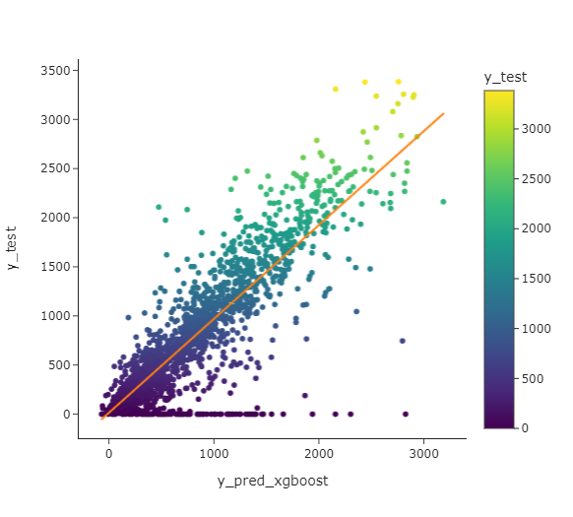
Model 5 : XGBoost
The 5 parameters we need to test with a gridsearch are 'max_depth’, 'learning_rate’, 'colsample_bytree’, 'alpha’, and 'n_estimators’.
The best values for them appear to be respectively 7, 0.1, 0.9, 12 and 200.
We use the fit()and predict() functions on a XGBRegressor() object.
We found a MSE of 45.044.
Here is the graph :

Slide 24
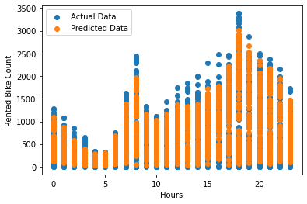
The best model
The model with the best MSE was XGBoost. However, we encountered some problems of conversion that forced us to put validate_features = false, which was risky. Plus, there was a difference of only 1 between the best and second best MSEs.
That’s why we chose the model with the second best : Random Forest with a MSE of only 46.945.
Here is a graph representing the tendency of our predicted values, we can see that it follows the tendency of the actual data :

Slide 25
Build the API
The pickle module
The HTML file
The code in Python
Final render

Slide 26
Pickle module
The pickle module (standard in Python) allows the serialization of memory objects into strings (and vice versa). It is useful for persistence and data transfer over a network.
Here we saved the random forest model (which was our best model) in a file called model.pkl. For that we used the command pickle.dump(rfr, open('model.pkl','wb’)).

Slide 27
The HTML file (index.html)
We coded the structure of our browser window in the html file and called it in our flask file.
In this file we put different textboxs in which the user can enter a value for each parameter taken by the model. We also put a button the user have to press to make a prediction of the value RentedBikeCount using the model and the parameters he entered.
Eventually we put the text that should appear with the value of the prediction after the button is pushed.

Slide 28
The code in Python (app.py)
Then, in our Flask code called app.py, we called this file and immediatly loaded the model. We load it with this code : model = pickle.load(open('model.pkl', 'rb’))
We can access the webpage at this link : http://127.0.0.1:5000
@app.route('/’) defines the webpage before the prediction
@app.route('/predict',methods=['POST’]) defines the webpage after pushing the button to predict a value
@app.route('/results',methods=['POST’]) allows us to try the model on the Jupyter file.

Slide 29
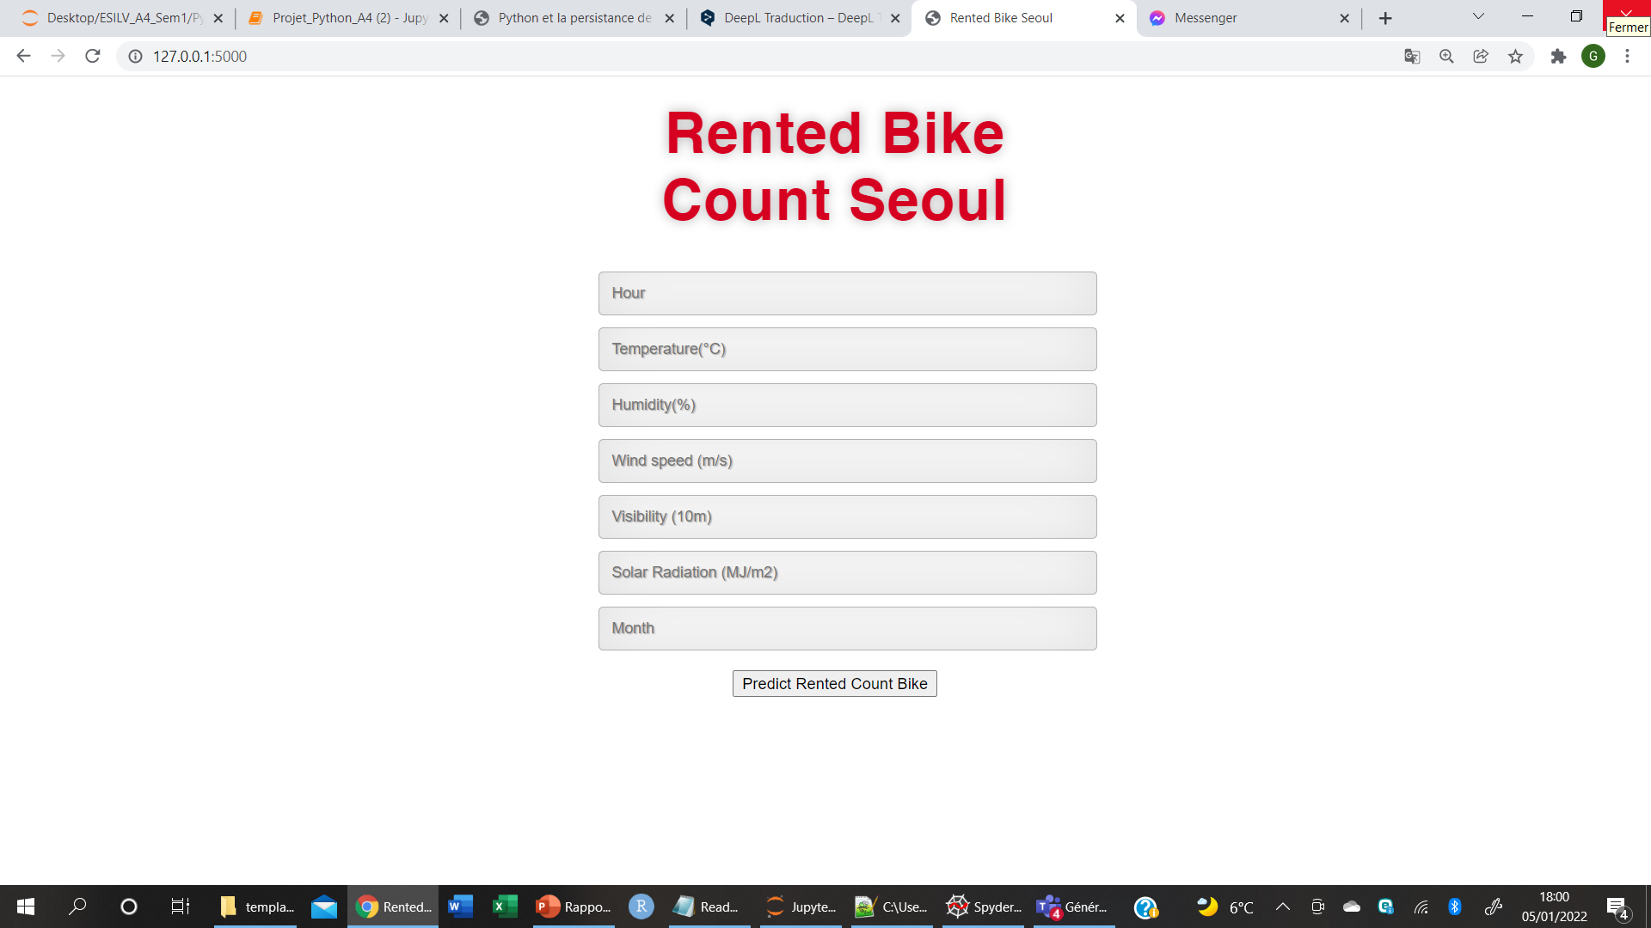
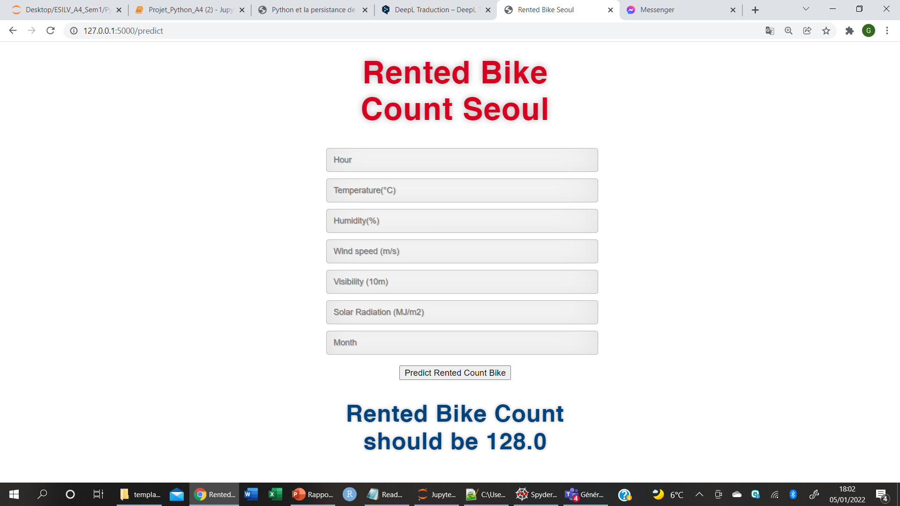
Final rendering

Slide 30
Thank you for your reading !
All the files will be on our Github at this link : https://github.com/GabDarkos/SeoulBikeData_Python_Coussin_Darcos

