Slide 1
Finding interactions among many molecules with a small fraction of exhaustive experiments
Gabriel Krouk and Dennis E. Shasha
Figures 1–5 (main text) and Figures S1–S3 (SI Appendix)

Slide 2
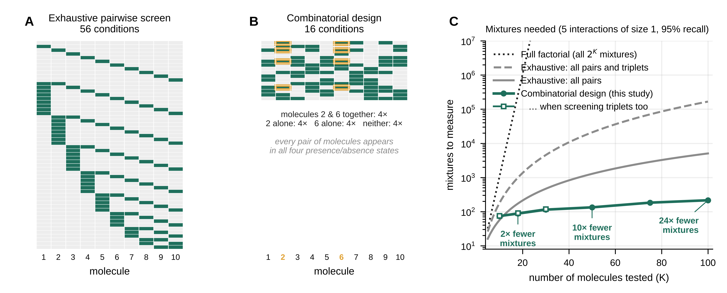
Fig. 1. Exhaustive versus combinatorial designs.
(A) An exhaustive pairwise screen of 10 molecules measures the control, each molecule alone, and each of the 45 pairs (56 conditions; rows, conditions; columns, molecules; green, present). (B) A combinatorial design of 16 mixtures for the same 10 molecules. Each molecule is present in half of the mixtures, and every pair of molecules occurs in all four presence/absence states; the cells outlined in orange show the mixtures in which molecules 2 and 6 are both present. Because every mixture informs every molecule and every pair, the design is both smaller and statistically more efficient. (C) Number of conditions needed as the number of molecules K grows: all 2^{K} mixtures (dotted), all pairs and triplets (dashed), all pairs (solid gray), and the combinatorial design needed to recover 95% of five pairwise interactions of size 1 with 3 replicates (green circles; open squares, three-way interactions, K ≤ 30). Numbers give the fold reduction relative to the exhaustive pairwise screen.
1
Notes:
Fig. 1. Exhaustive versus combinatorial designs.
(A) An exhaustive pairwise screen of 10 molecules measures the control, each molecule alone, and each of the 45 pairs (56 conditions; rows, conditions; columns, molecules; green, present). (B) A combinatorial design of 16 mixtures for the same 10 molecules. Each molecule is present in half of the mixtures, and every pair of molecules occurs in all four presence/absence states; the cells outlined in orange show the mixtures in which molecules 2 and 6 are both present. Because every mixture informs every molecule and every pair, the design is both smaller and statistically more efficient. (C) Number of conditions needed as the number of molecules K grows: all 2K mixtures (dotted), all pairs and triplets (dashed), all pairs (solid gray), and the combinatorial design needed to recover 95% of five pairwise interactions of size 1 with 3 replicates (green circles; open squares, three-way interactions, K ≤ 30). Numbers give the fold reduction relative to the exhaustive pairwise screen.

Slide 3
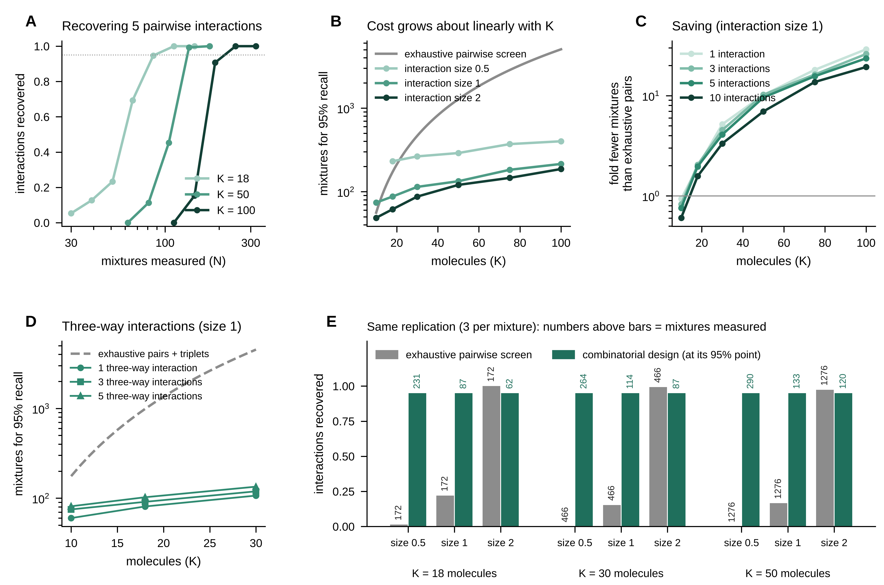
Fig. 2. Simulations with up to 100 molecules.
(A) Fraction of five planted pairwise interactions (size d = 1) recovered as a function of the number of mixtures measured, for 18, 50, and 100 molecules. The dotted line marks 95% recall. (B) Number of mixtures needed for 95% recall of five interactions of size 0.5, 1, or 2, compared with the size of the exhaustive pairwise screen (gray). (C) Fold reduction in the number of conditions relative to the exhaustive pairwise screen, for 1 to 10 interactions of size 1. Values below 1 (K = 10) indicate that the exhaustive screen is smaller. (D) Number of mixtures needed to recover 95% of one to five three-way interactions of size 1, compared with an exhaustive screen of all pairs and triplets (dashed). (E) With the same replication (3 per condition) and the same analysis, the exhaustive pairwise screen (gray) recovers few interactions of size 0.5 or 1, whereas the combinatorial design reaches 95% with far fewer mixtures. Numbers above bars give the number of conditions measured. In all panels, half of the molecules have an effect of their own, a diffuse background of very small interactions is present (total variance 0.1), and results are averages over 30 simulated outputs per point.
2
Notes:
Fig. 2. Simulations with up to 100 molecules.
(A) Fraction of five planted pairwise interactions (size d = 1) recovered as a function of the number of mixtures measured, for 18, 50, and 100 molecules. The dotted line marks 95% recall. (B) Number of mixtures needed for 95% recall of five interactions of size 0.5, 1, or 2, compared with the size of the exhaustive pairwise screen (gray). (C) Fold reduction in the number of conditions relative to the exhaustive pairwise screen, for 1 to 10 interactions of size 1. Values below 1 (K = 10) indicate that the exhaustive screen is smaller. (D) Number of mixtures needed to recover 95% of one to five three-way interactions of size 1, compared with an exhaustive screen of all pairs and triplets (dashed). (E) With the same replication (3 per condition) and the same analysis, the exhaustive pairwise screen (gray) recovers few interactions of size 0.5 or 1, whereas the combinatorial design reaches 95% with far fewer mixtures. Numbers above bars give the number of conditions measured. In all panels, half of the molecules have an effect of their own, a diffuse background of very small interactions is present (total variance 0.1), and results are averages over 30 simulated outputs per point.

Slide 4
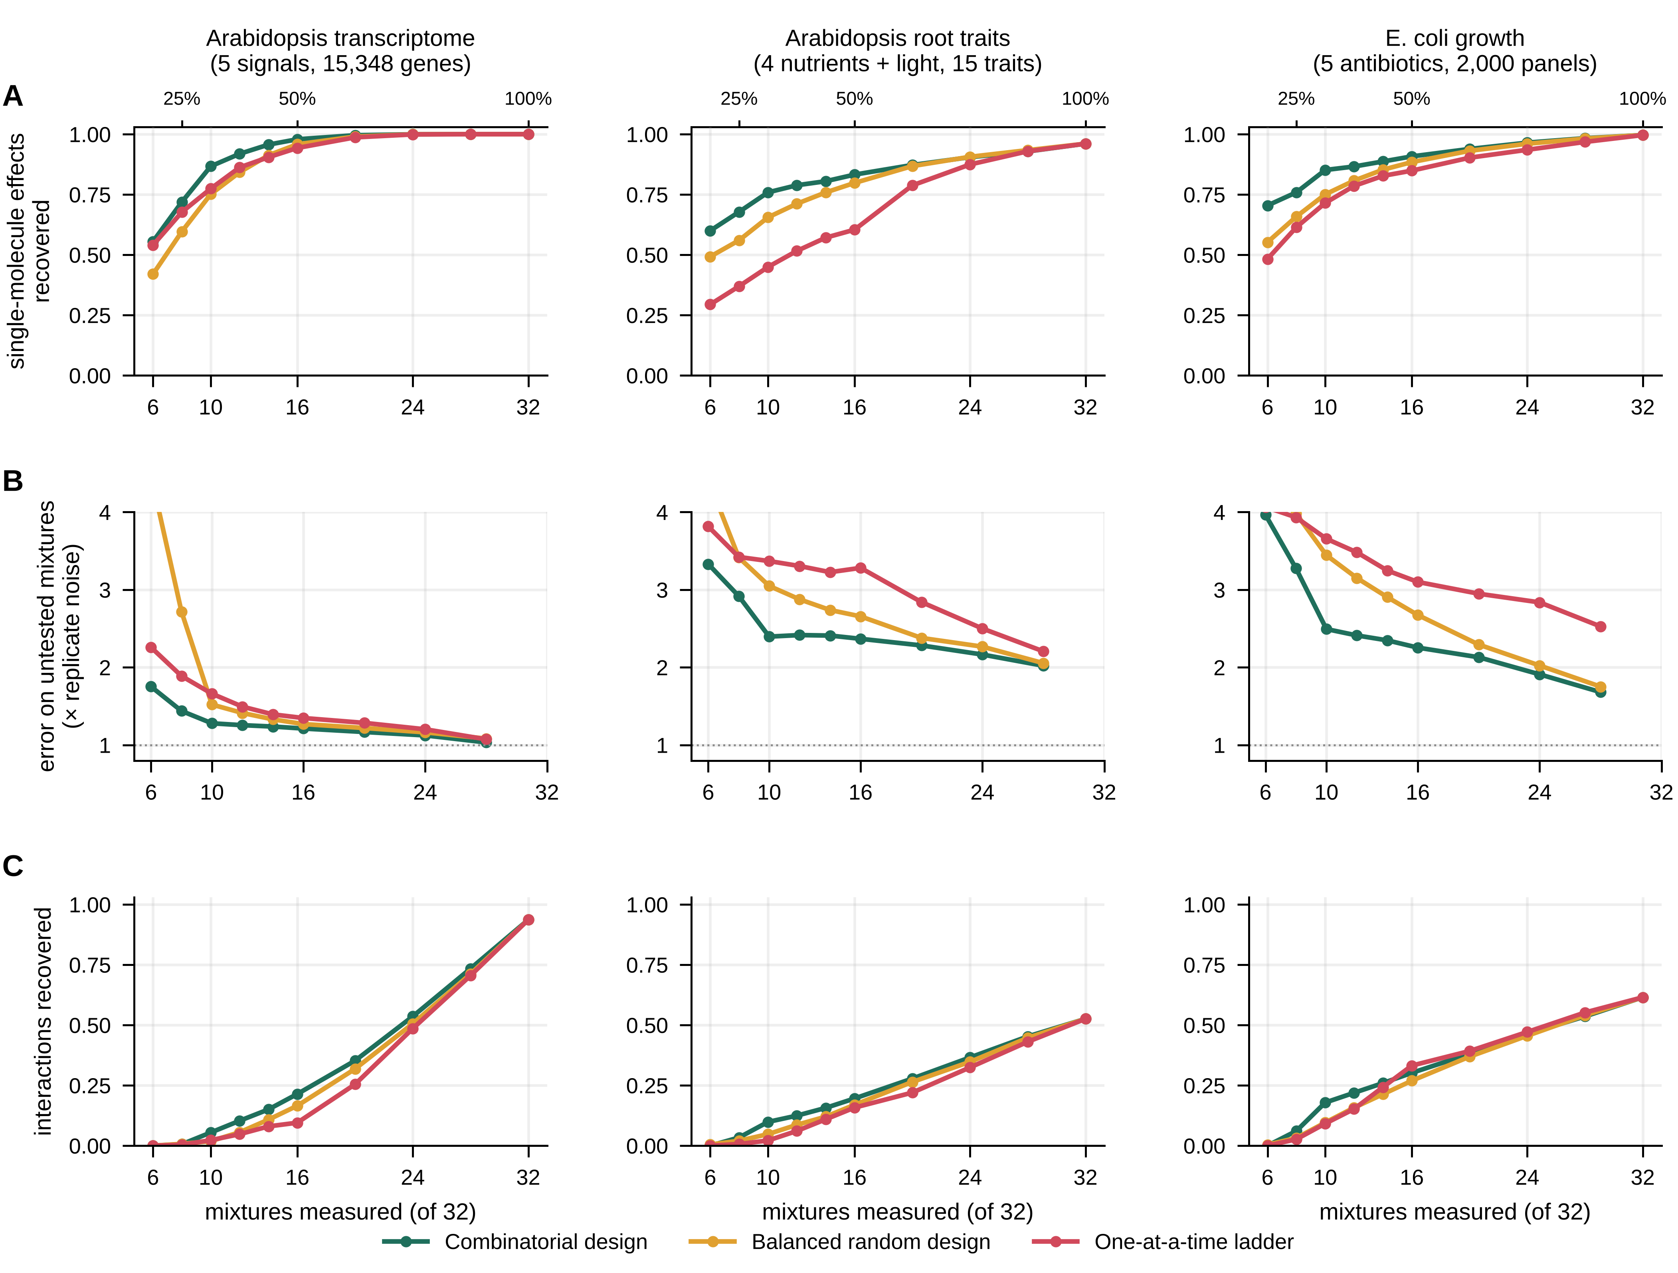
Fig. 3. Benchmark on three real complete factorial experiments.
For each dataset (columns), every one of the 32 mixtures of five factors had been measured, which defines the reference answer. Subsets of 6 to 32 mixtures were analyzed following a combinatorial design (green), a balanced random design (orange), or a one-at-a-time ladder (control, single factors, then pairs, and so on; red). The top axis gives the fraction of the complete design. (A) Fraction of the reference single-factor effects recovered. (B) Error in predicting the mixtures that were not measured, relative to the noise of a measured mixture mean (dotted line, 1). (C) Fraction of the reference interactions (pairs and triplets) recovered. Curves are averages over 30 random draws (transcriptome, bacterial growth) or 20 independent splits of the plants × 5 draws (root traits). Transcriptome, Arabidopsis roots under nitrate, ammonium, auxin, cytokinin, and abscisic acid (15,348 genes) (1); root traits, Arabidopsis under nitrogen, phosphorus, potassium, sulfur, and light (15 traits) (2); bacterial growth, E. coli under five-antibiotic panels (2,000 panels) (5).
3
Notes:
Fig. 3. Benchmark on three real complete factorial experiments.
For each dataset (columns), every one of the 32 mixtures of five factors had been measured, which defines the reference answer. Subsets of 6 to 32 mixtures were analyzed following a combinatorial design (green), a balanced random design (orange), or a one-at-a-time ladder (control, single factors, then pairs, and so on; red). The top axis gives the fraction of the complete design. (A) Fraction of the reference single-factor effects recovered. (B) Error in predicting the mixtures that were not measured, relative to the noise of a measured mixture mean (dotted line, 1). (C) Fraction of the reference interactions (pairs and triplets) recovered. Curves are averages over 30 random draws (transcriptome, bacterial growth) or 20 independent splits of the plants × 5 draws (root traits). Transcriptome, Arabidopsis roots under nitrate, ammonium, auxin, cytokinin, and abscisic acid (15,348 genes) (1); root traits, Arabidopsis under nitrogen, phosphorus, potassium, sulfur, and light (15 traits) (2); bacterial growth, E. coli under five-antibiotic panels (2,000 panels) (5).

Slide 5
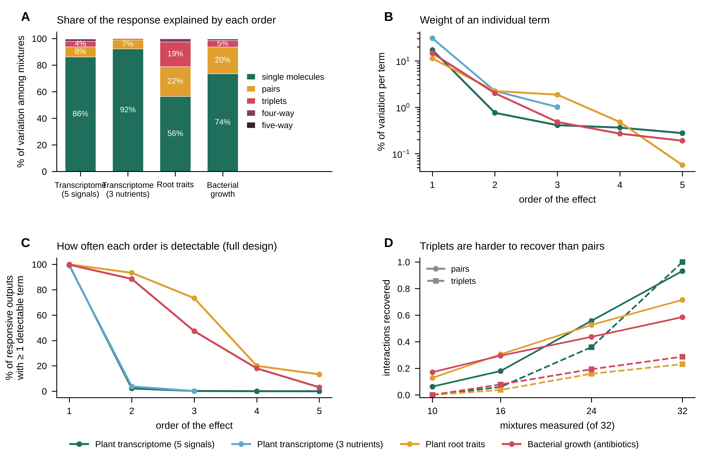
Fig. 4. Interactions among three or more molecules are rare or weak.
(A) Share of the variation among the true mixture means explained by single-factor effects and by interactions of each order, corrected for measurement noise and pooled over responsive outputs. (B) Same quantity divided by the number of possible terms of each order, which gives the average weight of an individual term (log scale). Values for high orders are upper bounds. (C) Percentage of responsive outputs with at least one detectable term of each order in the complete design (false discovery rate 1%). Transcriptome (5 signals), 2,612 responsive genes; transcriptome (3 nutrients), 4,996 genes; root traits, 15 traits; bacterial growth, 10,780 panels. (D) Recovery of pairwise (solid) and three-way (dashed) interactions by the combinatorial design in the benchmark of Fig. 3 (colors as in A–C). The transcriptome contains only five reference three-way interactions.
4
Notes:
Fig. 4. Interactions among three or more molecules are rare or weak.
(A) Share of the variation among the true mixture means explained by single-factor effects and by interactions of each order, corrected for measurement noise and pooled over responsive outputs. (B) Same quantity divided by the number of possible terms of each order, which gives the average weight of an individual term (log scale). Values for high orders are upper bounds. (C) Percentage of responsive outputs with at least one detectable term of each order in the complete design (false discovery rate 1%). Transcriptome (5 signals), 2,612 responsive genes; transcriptome (3 nutrients), 4,996 genes; root traits, 15 traits; bacterial growth, 10,780 panels. (D) Recovery of pairwise (solid) and three-way (dashed) interactions by the combinatorial design in the benchmark of Fig. 3 (colors as in A–C). The transcriptome contains only five reference three-way interactions.

Slide 6
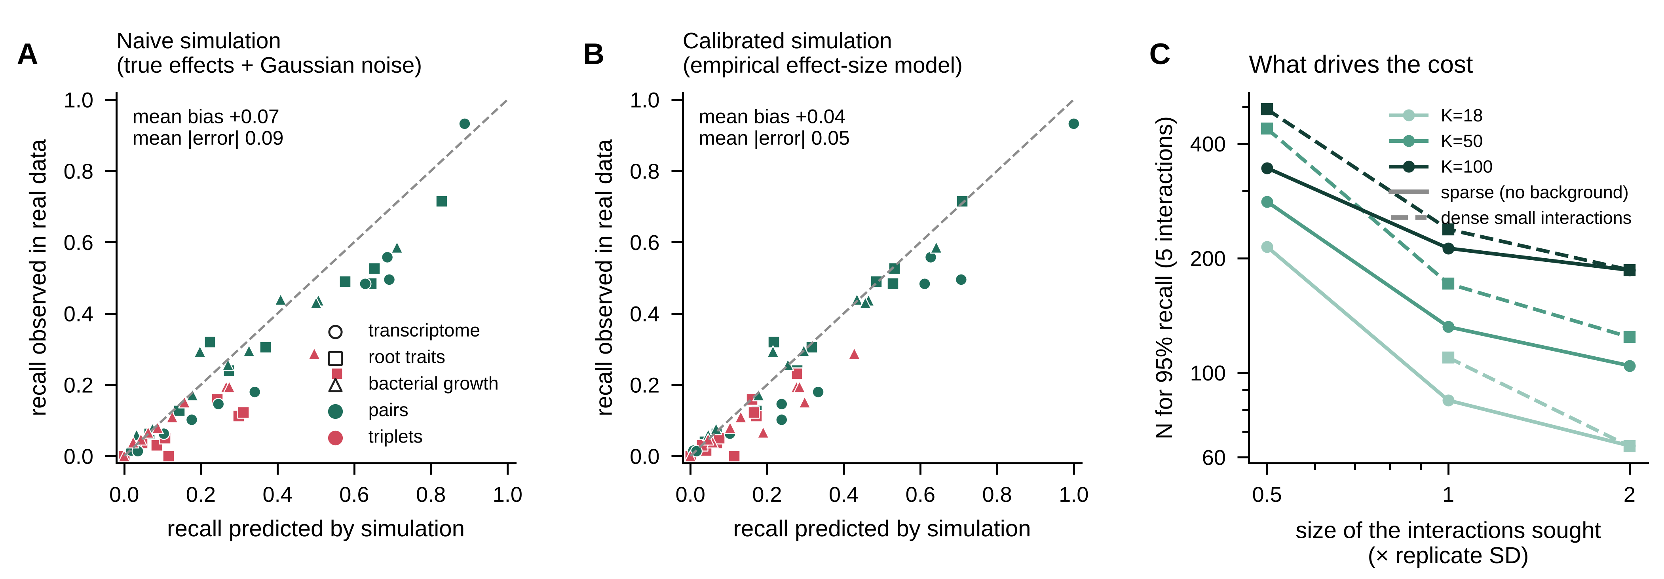
Fig. 5. Calibrating the planning simulations on real data.
(A) Interaction recovery predicted by a naive simulation (significant effects of the complete design plus Gaussian noise) versus recovery observed on real data, for each dataset, design strategy, number of mixtures, and order (green, pairs; red, triplets). Points below the diagonal indicate optimism. (B) Same comparison for the calibrated simulation, in which effects of every order are drawn from the empirical distribution (zero, small, or large) estimated from each dataset. (C) Number of mixtures needed to recover 95% of five interactions as a function of their size, without background (solid) or with a dense background of small interactions as in the phenotypic datasets (dashed), for 18, 50, and 100 molecules. Missing points did not reach 95% within the range simulated.
5
Notes:
Fig. 5. Calibrating the planning simulations on real data.
(A) Interaction recovery predicted by a naive simulation (significant effects of the complete design plus Gaussian noise) versus recovery observed on real data, for each dataset, design strategy, number of mixtures, and order (green, pairs; red, triplets). Points below the diagonal indicate optimism. (B) Same comparison for the calibrated simulation, in which effects of every order are drawn from the empirical distribution (zero, small, or large) estimated from each dataset. (C) Number of mixtures needed to recover 95% of five interactions as a function of their size, without background (solid) or with a dense background of small interactions as in the phenotypic datasets (dashed), for 18, 50, and 100 molecules. Missing points did not reach 95% within the range simulated.

Slide 7
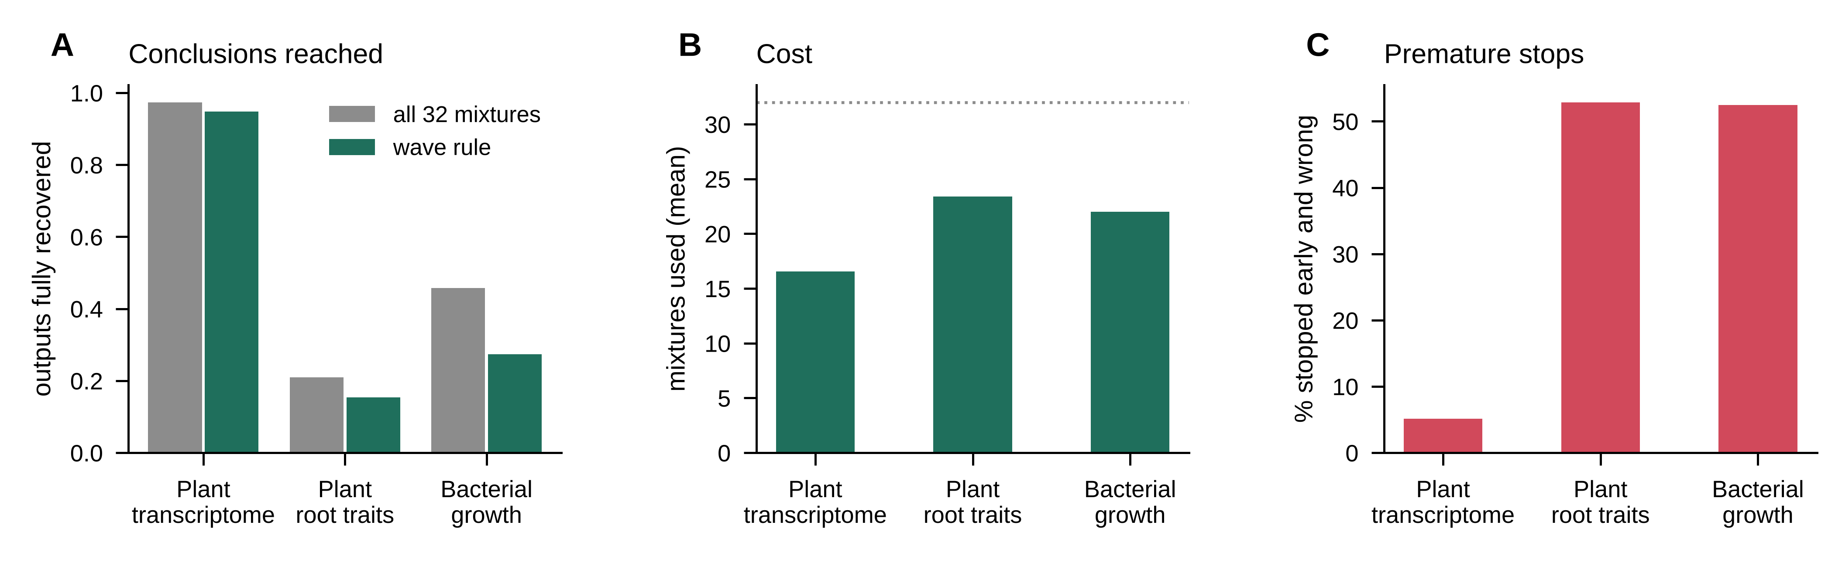
Fig. S1. Experiments in waves.
The combinatorial sequence was measured in waves of 10, 16, 24, and 32 mixtures; after each wave the model predicted the next wave, and the experiment stopped when the prediction error was within 1.5 times the noise. (A) Fraction of outputs for which the complete answer was recovered, with the wave rule (green) or with all 32 mixtures (gray). (B) Average number of mixtures used. (C) Percentage of outputs for which the rule stopped early with an incomplete answer.
S1
Notes:
Fig. S1. Experiments in waves.
The combinatorial sequence was measured in waves of 10, 16, 24, and 32 mixtures; after each wave the model predicted the next wave, and the experiment stopped when the prediction error was within 1.5 times the noise. (A) Fraction of outputs for which the complete answer was recovered, with the wave rule (green) or with all 32 mixtures (gray). (B) Average number of mixtures used. (C) Percentage of outputs for which the rule stopped early with an incomplete answer.

Slide 8
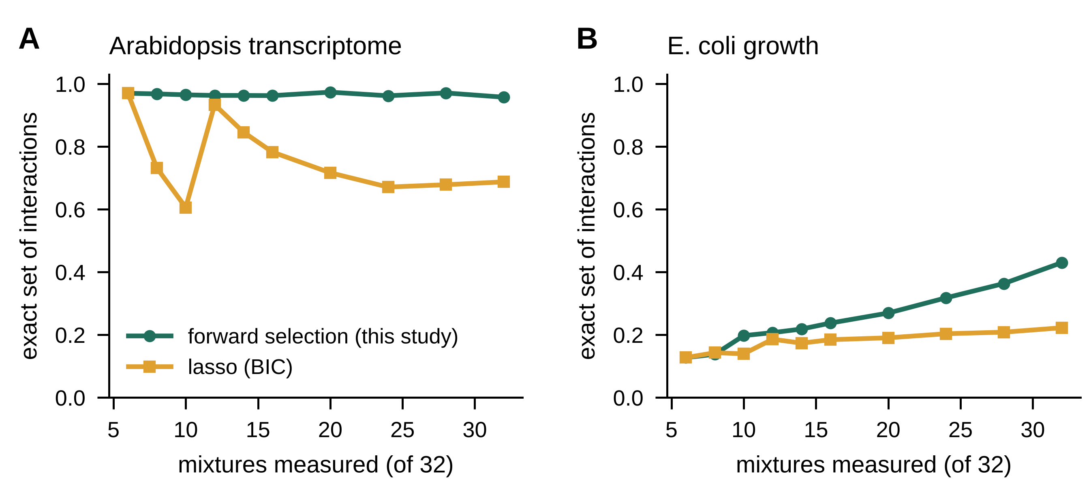
Fig. S2. Forward selection versus lasso.
Fraction of outputs for which the exact set of reference interactions was recovered by the forward-selection analysis used throughout (green) or by a lasso with all pairs and triplets as candidates and the penalty chosen by the Bayesian information criterion (orange), for the combinatorial design. (A) Plant transcriptome (400 outputs with effects). (B) Bacterial growth (400 panels).
S2
Notes:
Fig. S2. Forward selection versus lasso.
Fraction of outputs for which the exact set of reference interactions was recovered by the forward-selection analysis used throughout (green) or by a lasso with all pairs and triplets as candidates and the penalty chosen by the Bayesian information criterion (orange), for the combinatorial design. (A) Plant transcriptome (400 outputs with effects). (B) Bacterial growth (400 panels).

Slide 9
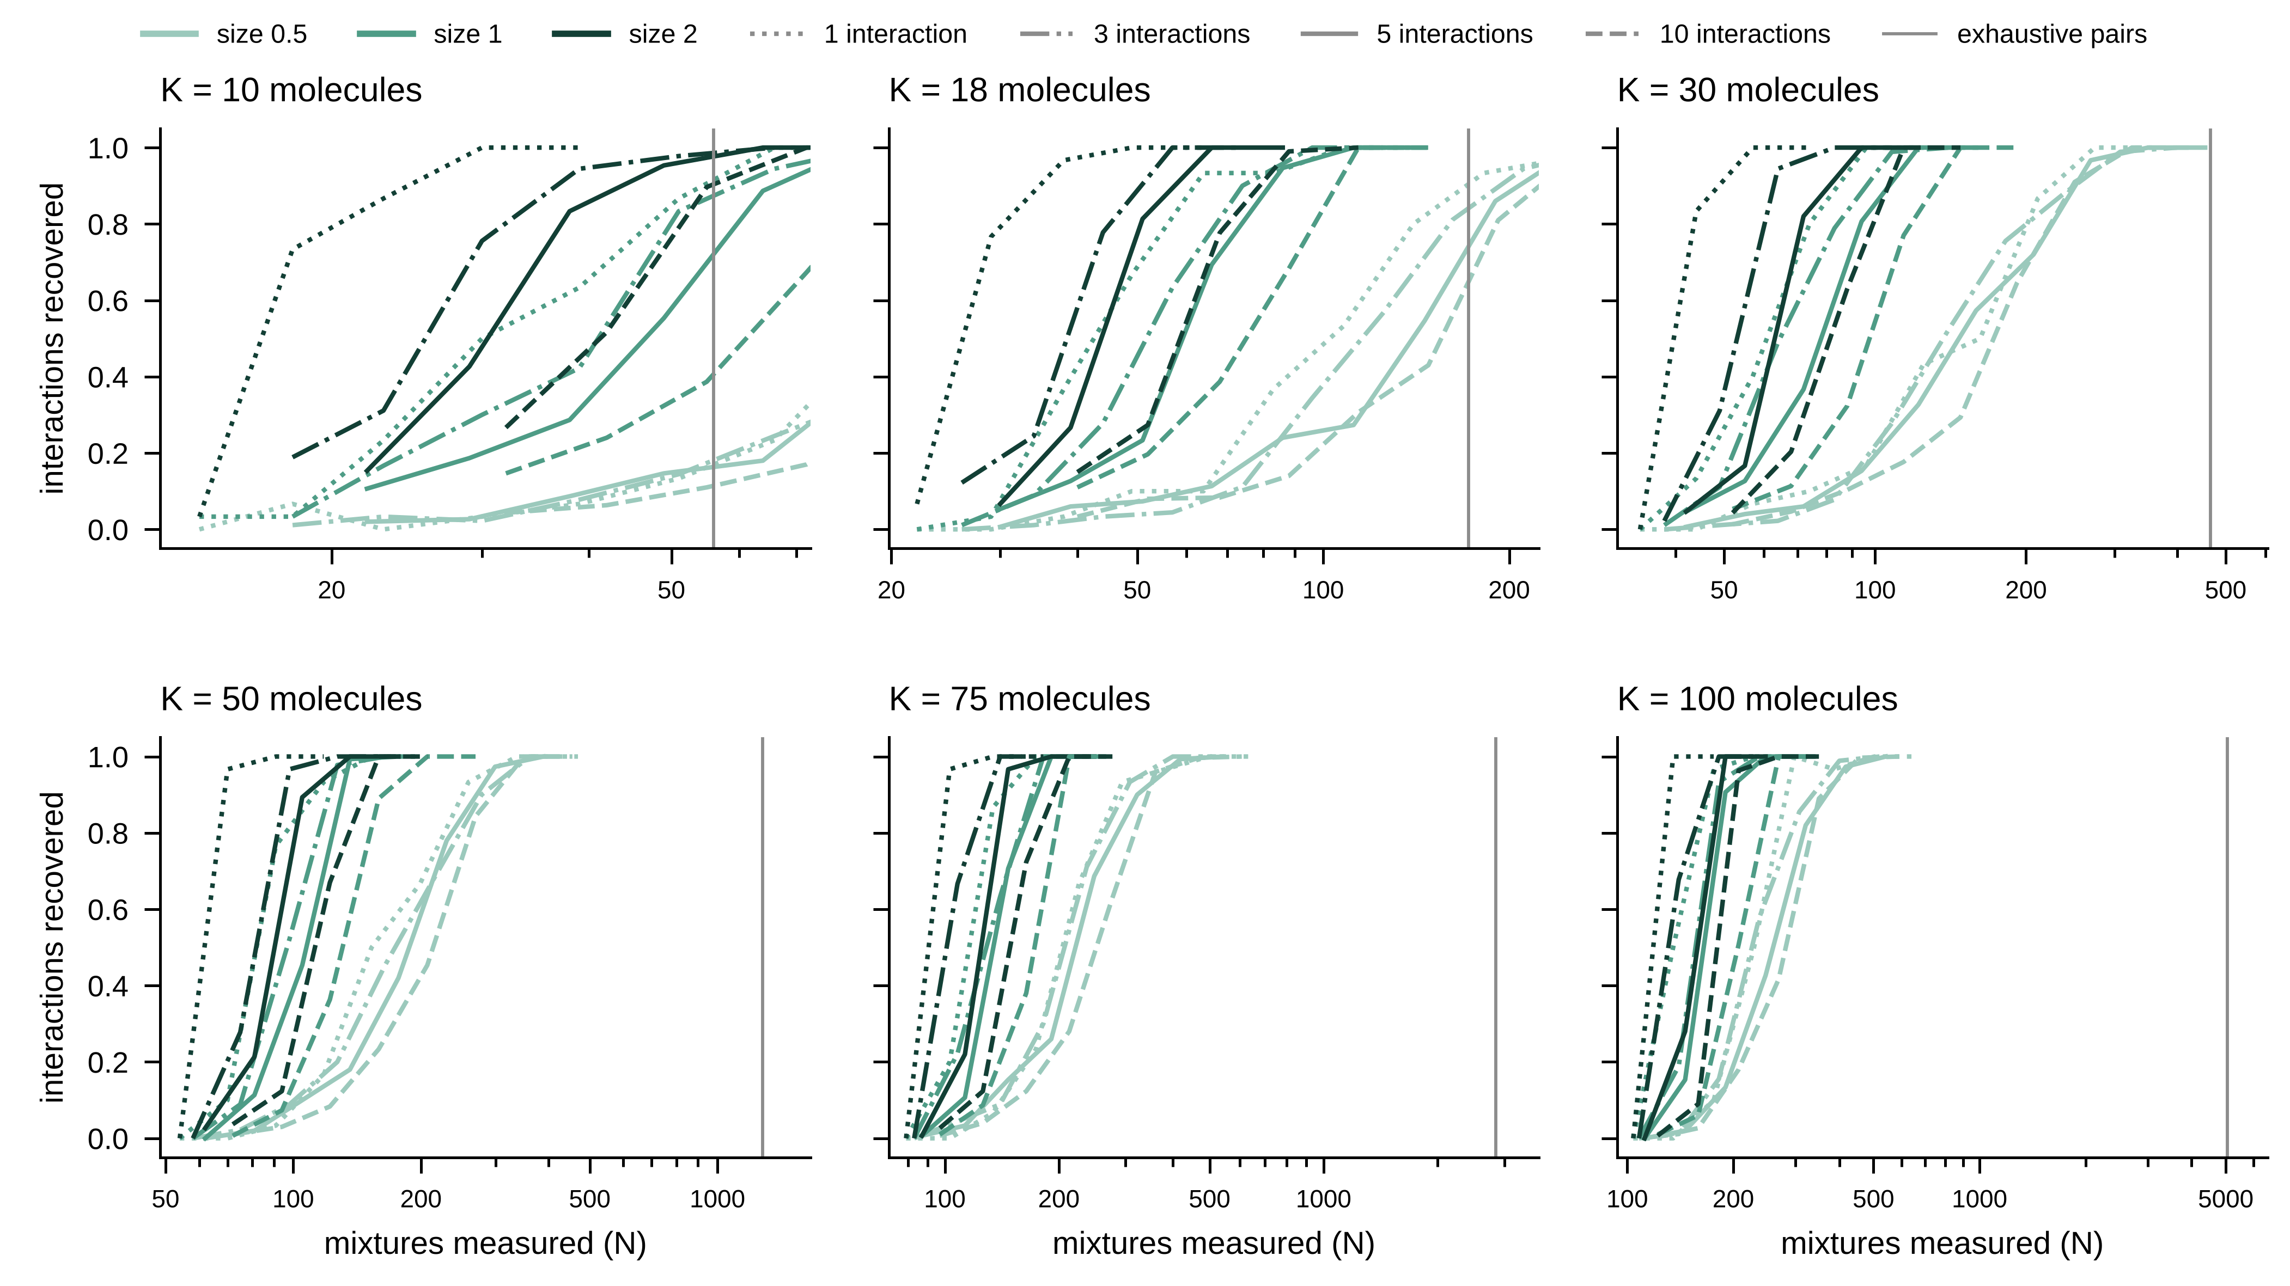
Fig. S3. Recovery curves for all simulated scenarios with pairwise interactions.
Each panel shows one number of molecules K; colors give the size of the interactions and line styles their number. The vertical line marks the size of the exhaustive pairwise screen.
S3
Notes:
Fig. S3. Recovery curves for all simulated scenarios with pairwise interactions.
Each panel shows one number of molecules K; colors give the size of the interactions and line styles their number. The vertical line marks the size of the exhaustive pairwise screen.

